Slide 1
DD 2431 Machine Learning Lab3 Presentation
Ahmed Assal
770715-T259

Slide 2
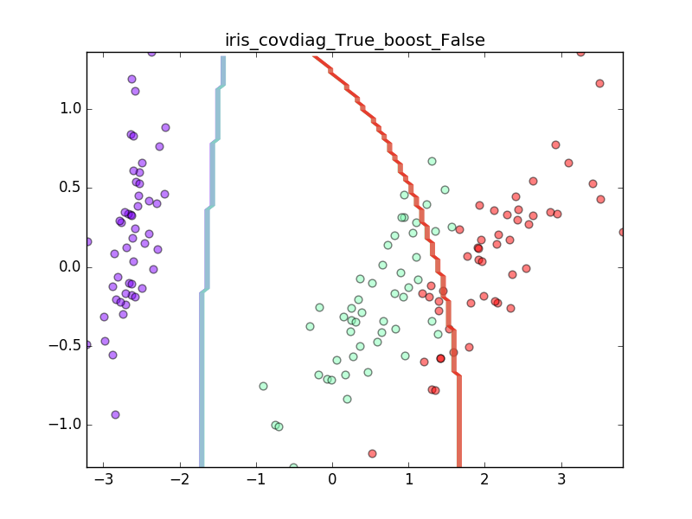
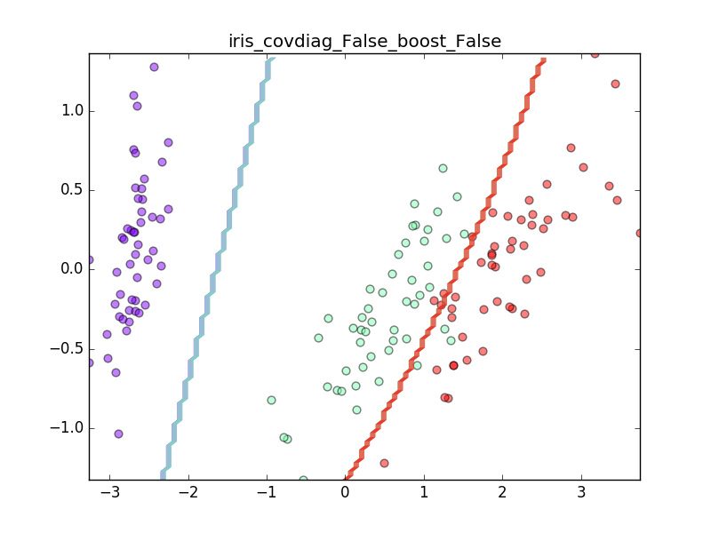
Iris dataset – classification w/o boosting
A1
Accuracy: 95.89
SD: 2.48
Accuracy: 97.13
SD: 2.02
A2

Slide 3
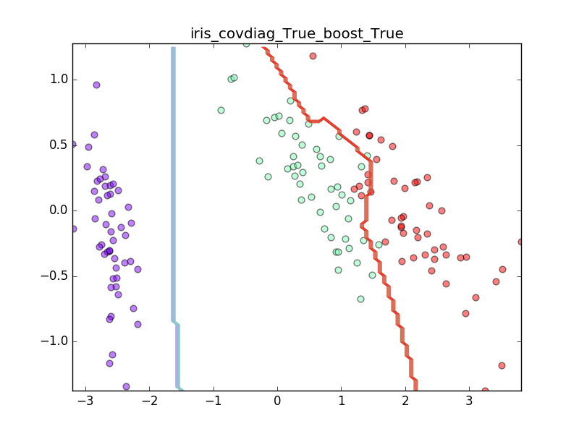
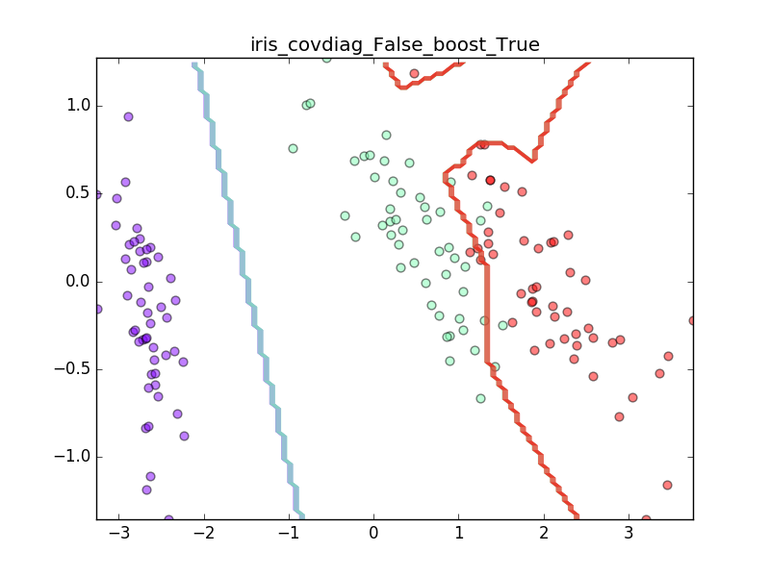
Iris dataset – classification with boosting
B1
Accuracy: 95.49
SD: 3.04
Accuracy: 95.69
SD: 2.63
B2

Slide 4
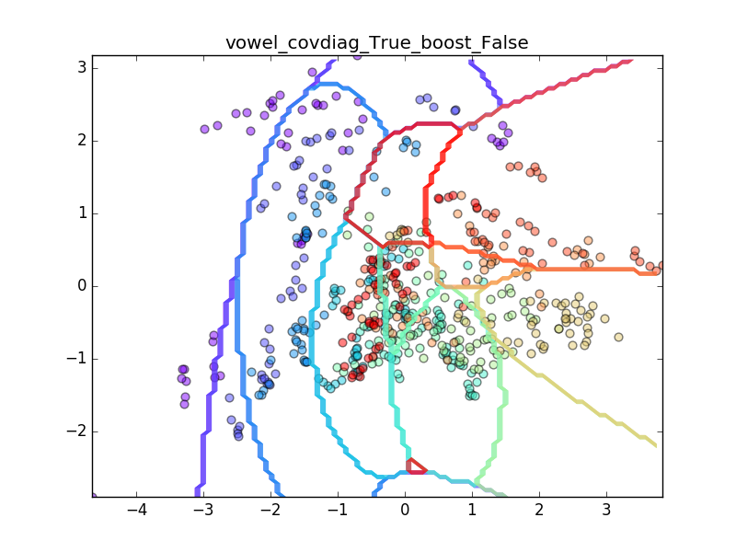
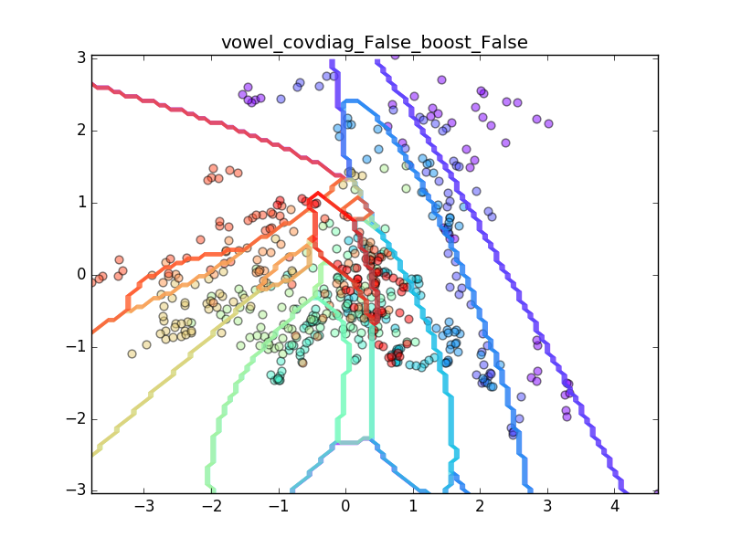
Vowels dataset – classification w/o boosting
C1
Accuracy: 59.13
SD: 4.06
Accuracy: 90.99
SD: 1.91
C2

Slide 5
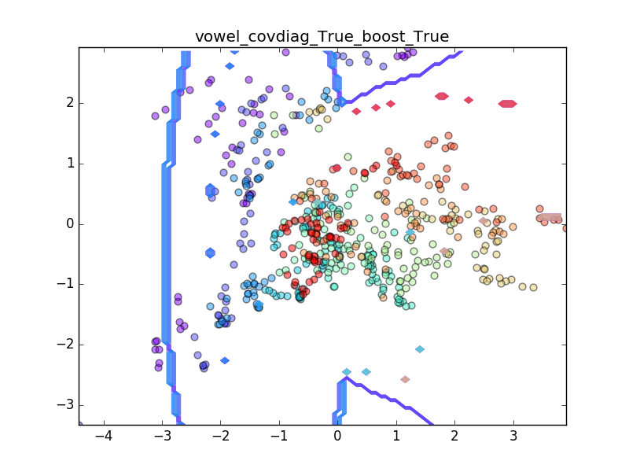
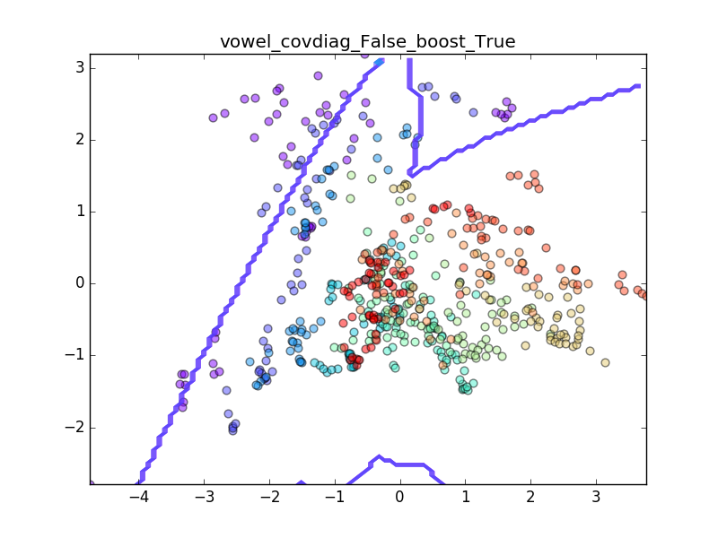
Vowels dataset – classification with boosting
D1
Accuracy: 67.55
SD: 3.95
Accuracy: 90.62
SD: 2.48
D2

Slide 6
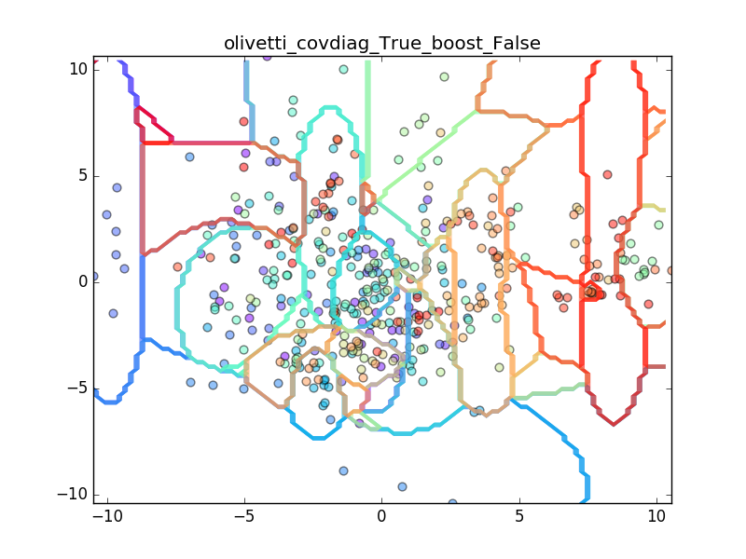
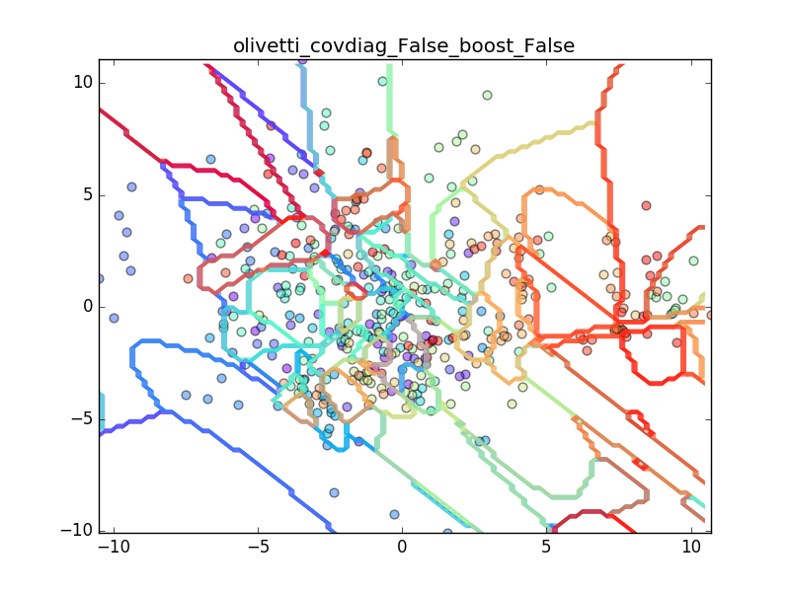
Olivetti dataset – classification w/o boosting
E1
Accuracy: 58.09
SD: 3.34
Accuracy: 54.3
SD: 3.71
E2

Slide 7
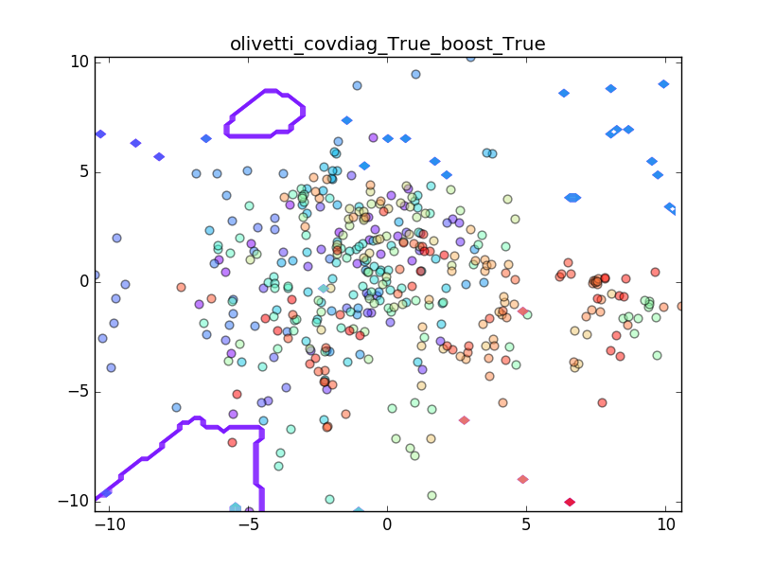
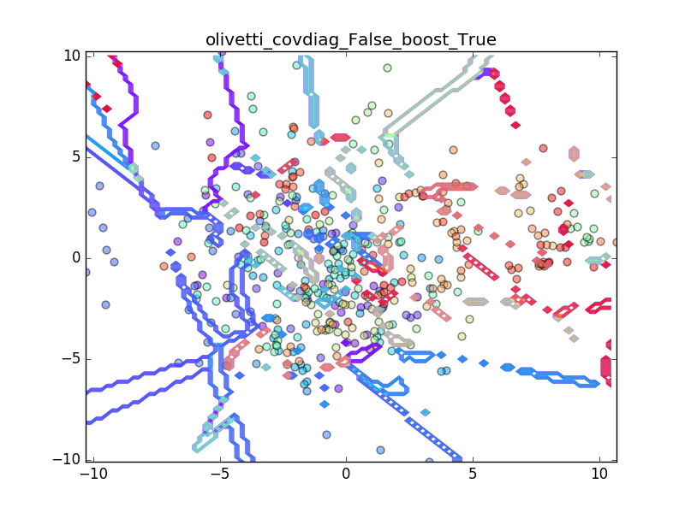
Olivetti dataset – classification with boosting
F1
Accuracy: 58.53
SD: 3.57
Accuracy: 54.96
SD: 4.35
F2

Slide 8
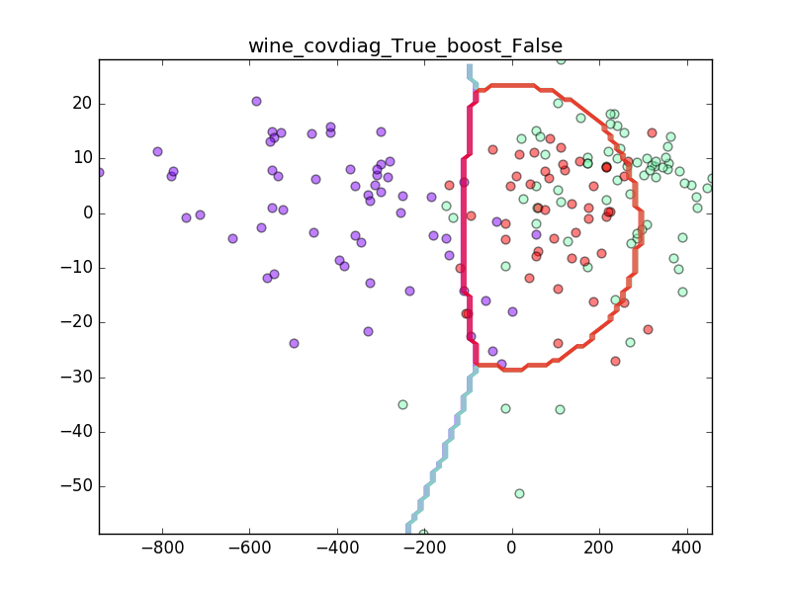
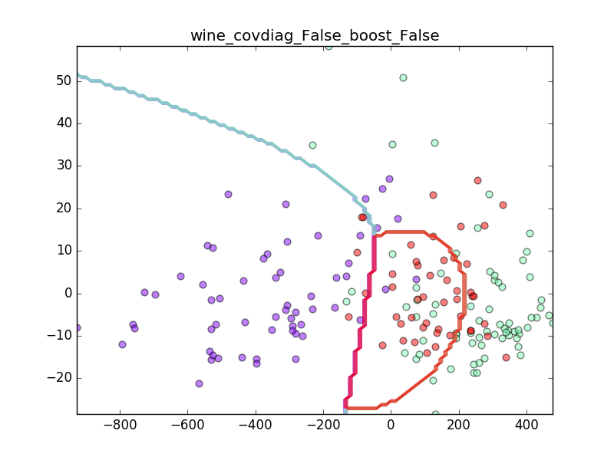
Wine dataset – classification w/o boosting
G1
Accuracy: 94.85
SD: 2.43
Accuracy: 98.47
SD: 1.53
G2

Slide 9
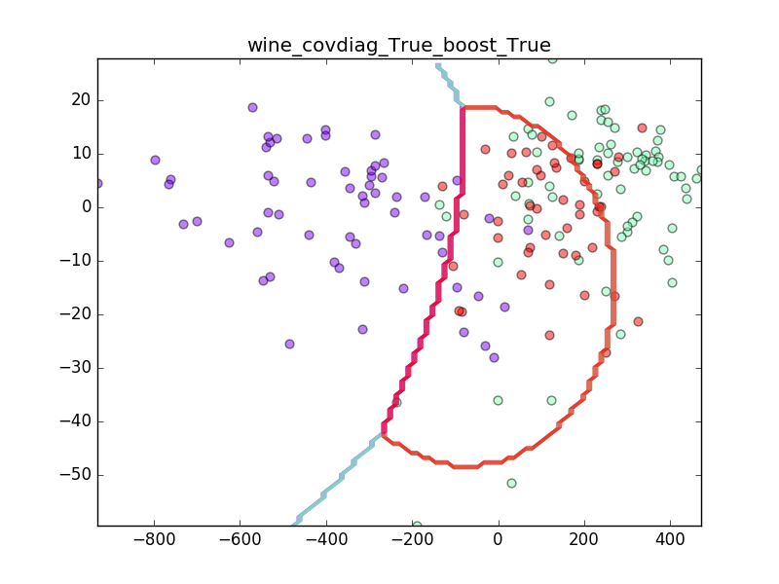
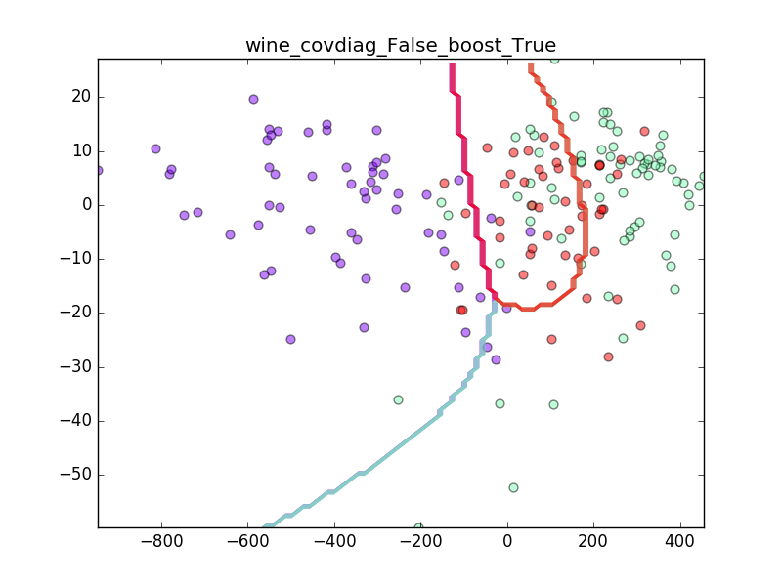
Wine dataset – classification with boosting
H1
Accuracy: 95.26
SD: 2.62
Accuracy: 88.57
SD: 10.04
H2

Slide 10
Questions set 1 part 1
Does the feature independence assumption have any effect on the classification accuracy for the different datasets?
If so why does some of the datasets have more difference than others?
Yes
Depending on the covariance matrix of the classes of the data, some data are less conditionally independent, matrices are not diagonal, so making this assumption will orient the decision surfaces more parallel to Cartesian axes and will consequently results in the decision surfaces overlapping some of the data in a class.
See A1 and A2

Slide 11
Questions set 1 part 2
When can an independence assumption be reasonable and when not?
How does the standard deviation differ for the two assumptions and what does that imply?
When the covariance matrix as least significance values or zeros off the diagonal we can safely assume conditional independence.
SD usually is less when we do not assume conditional independence and the data are spread in a way that is not parallel to the axes, elliptical in shape. This implies that the decision surface are more parallel to one of the main axes of the ellipse bounding/approximiating the data spread, i.e. it minimizes the SD. (the average is what minimizes SSE.

Slide 12
Questions set 2 part 1
Is there any improvement in classification accuracy? Why/why not?
Plot the decision boundary of the boosted classier and compare it with that of the basic. What differences do you notice? Is the boundary of the boosted version more complex?
Can we make up for not using a more advanced model in the basic classier (e.g. independent features) by using boosting?
Generally, no. It stays the same, gets improved a little bet or even gets worse.
As, plotted above, the boundary tries to better trace the separation between the data classes. It is less smooth and more jagged.
Sometimes we can.

Slide 13
If the covariance is shared between classes, The decision boundary is a linear function (a hyperplane in general).
If the covariance is not shared between classes, The decision boundary is a quadratic function. In 2-d case, it looks like an ellipse, or a parabola, or a hyperbola.

