Slide 1
Clustering Grocery Items
ML Project

Slide 2
Team members
Name | College | Roll number
Rithika Akula | MVSR Engineering College | 2451-18-733-025
Sai Sumanth Avara | MVSR Engineering College | 2451-18-733-026
Ahmed Ata-ul Kareem | Sri Indu College of Engineering and Technology | 17D41A0505
Bhimavarapu Indratej Reddy | Sphoorthy Engineering College | 17N81A0552

Slide 3
Abstract
Online shops often sell tons of different items and this can become very messy very quickly! Data science can be extremely useful to automatically organize the products in categories so that they can be easily found by the customers.
The goal of this project is to look at user purchase history and create categories of items that are likely to be bought together and, therefore, should belong to the same section.
Company XYZ is an online grocery store. In the current version of the website, they have manually grouped the items into a few categories based on their experience.
In this project we would like to answer the following questions:
The customer who bought the most items overall in her lifetime
For each item, the customer who bought that product the most
Cluster items based on user co-purchase history. That is, create clusters of products that have the highest probability of being bought together. We will replace the old/manually created categories with these new ones. Each item can belong to just one cluster.

Slide 4
Introduction
Existing System | Proposed System
The existing system does not provide a way of grouping customers and hence identifying natural clusters is difficult. Disadvantages of Existing System: The limitations of available systems are not sufficient to deal with the complex data. In this section, we present some of the limitations that are present in the existing system. The system uses DBMS and hence can return records based on the filters. The system also requires data extensive data preprocessing and Exploratory Data Analysis (EDA) in order to perform feature engineering. | We aim to implement K-Means, Hierarchical clustering and others and also fine tune the parameters of the model. These models would be trained on a data set which will be engineered carefully after performing the feature engineering. Advantages: Load and explore the dataset and generate ideas for data preparation and model selection. Perform Exploratory Data Analysis to find correlations. Visualize clusters produced by the algorithms

Slide 5
Procedure
The following are the steps used to solve the problem statements.
Importing Libraries
Importing the dataset files
Explore the data and pick the file relevant to the particular problem statement (since we have three of them)
Perform exploratory Data Analysis/Visualization and bring insights of the variables to detect:
The customer who bought the most items overall in their lifetime
For each item, the customer who bought that product the most
Prepare the data to perform Clustering efficiently
Use Elbow method and/or Hierarchical Clustering to find optimum number of clusters
Apply relevant Clustering algorithm to fit the clusters to the data
Visualize the data
Prepare the data to perform Classification efficiently
Apply Logistic Regression Classifier algorithm to test the clusters created
Measure the performance of the model using metrics like precision

Slide 6
Data Collection
The .csv files given as dataset are:
item_to_id.csv
purchase_history.csv
prepared_purchased_history.csv
item_to_id.csv file: contains two columns: Item_name, Item_id, that map the name of the grocery item to its assigned item id number.
purchase_history.csv file: contains two columns: user_id, id. The user_id column contains the id of the customer and its corresponding id column contains a list of item ids representing the items purchased by that customer. This file contains a raw representation of user purchase history.
prepared_purchased_history.csv file: contains 49 columns. The first column is the id of the customer. The following 48 columns (item_1, item_2 … item_48) each represent an item from the list and the value of the cell corresponds to the quantity of that item bought by that customer. This file contains a clean representation of the user purchase history.

Slide 7
Data Analysis
Our problem statement has three questions and we are using prepared_purchased_history.csv file for to solve them
In prepared_purchased_history.csv:
We have checked for categorical feature and found that there are none. So we have concluded that there are only numerical features
We have also checked for any Nan values or missing values and we have found none.

Slide 8
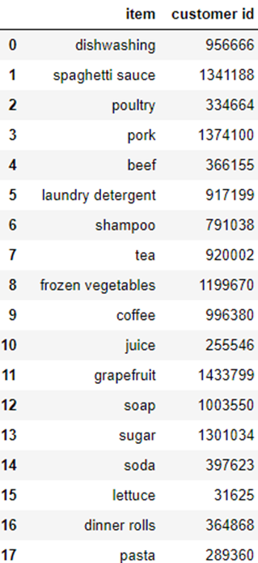
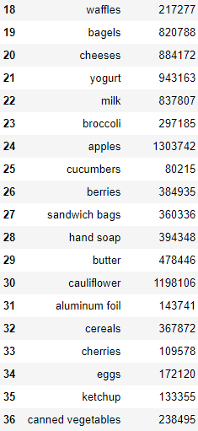
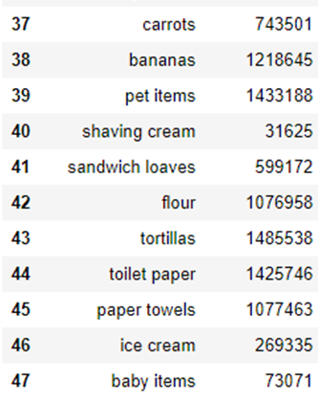
Answers for the first two questions are :
1. Detect the customer who bought the most items overall in their lifetime:
The user with user_id = 269335 has bought 72 items in their lifetime.
2. For each item, find the customer who bought that product the most

Slide 9
Data Preparation for Clustering Problem
Algorithms require features with some specific characteristic to work properly. Here, the need for Feature Engineering arises. Feature engineering efforts mainly have two goals:
Preparing the proper input dataset, compatible with the machine learning algorithm requirements.
Improving the performance of machine learning models.
In our dataset prepared_purchased_history.csv file:
We have the first column representing the customer id. For forming clusters of the grocery items, we do not need the id column and hence this column needs to be removed.
According to the problem statement, we need whether an item was bought by the customer or not. We do not need the quantity of the items bought. Hence we need a table representing value ‘1’ for item bought and ‘0’ for not bought.

Slide 10
Clustering
We have performed following methods in solving the clustering problem :
Elbow method
Hierarchical Clustering
K-means Clustering
Classification (used for Verification)

Slide 11
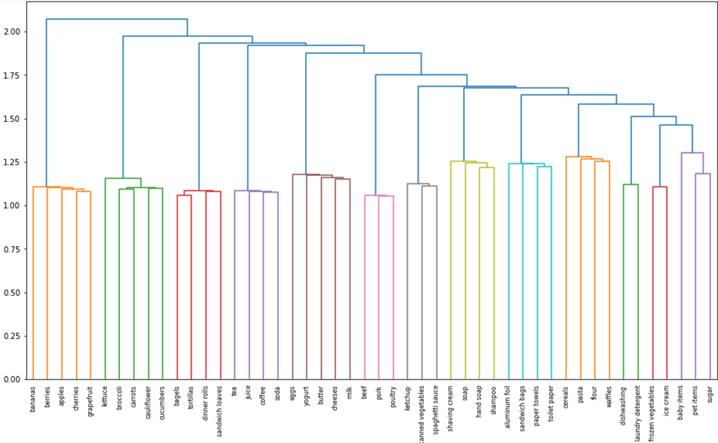
Dendogram obtained in herirachical clustering

Slide 12
Clusters of items likely to bought together
Cluster 1 | Apples, Bananas, Berries, Cherries, Grapefruit
Cluster 2 | Broccoli, Carrots, Cauliflower, Cucumber, Lettuce
Cluster 3 | Bagels, Dinner Rolls, Sandwich Loaves, Tortillas
Cluster 4 | Coffee, Juice, Soda, Tea
Cluster 5 | Butter, Cheeses, Eggs, Milk, Yoghurt
Cluster 6 | Beef, Pork, Poultry
Cluster 7 | Canned Vegetables, Ketchup, Spaghetti Sauce
Cluster 8 | Hand Soap, Shampoo, Shaving Cream, Soap
Cluster 9 | Aluminum Foil, Paper Towels, Sandwich Bags, Toilet Paper
Cluster 10 | Cereals, Flour, Pasta, Waffles
Cluster 11 | Dishwashing, Laundry Detergent
Cluster 12 | Frozen Vegetables, Ice Cream
Cluster 13 | Pet items, Sugar
Cluster 14 | Baby items

Slide 13
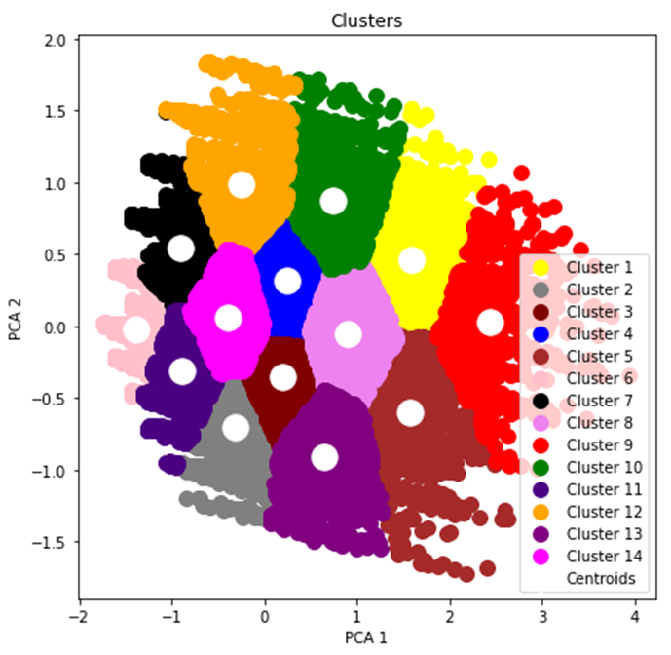
Scattered plots of formed clusters by K-means clustering

Slide 14
Verification using classification
We have created clusters using K-means clustering and given a label to our dataset rows representing the cluster that row belongs to. Now we need to check the accuracy of these formed clusters using classification algorithm.
Here we pick the Logistic Regression algorithm.
Logistic Regression:
Logistic regression is a classification algorithm used to assign observations to a discrete set of classes. Logistic regression transforms its output using the logistic sigmoid function to return a probability value.
The Final accuracy obtained by Logistic Regression algorithm is 96.28%

