Slide 1
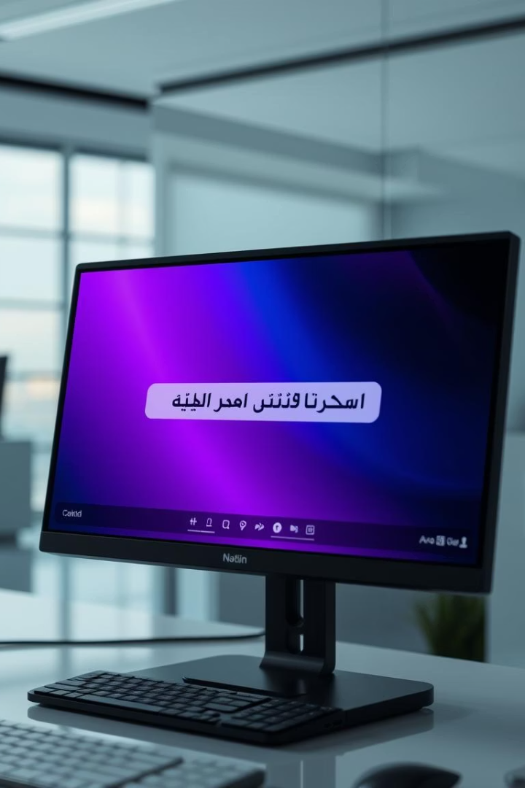

Arabic Autocorrection NLP Project
This project focuses on developing an autocorrection system for Arabic text by fine-tuning a pre-trained neural machine translation model. The base model used is Helsinki-NLP/opus-mt-ar-en, adapted specifically for correction tasks. Implementation is carried out using the Hugging Face Transformers library, leveraging its powerful tools for natural language processing.
by Ahmed Abobaker

Slide 2
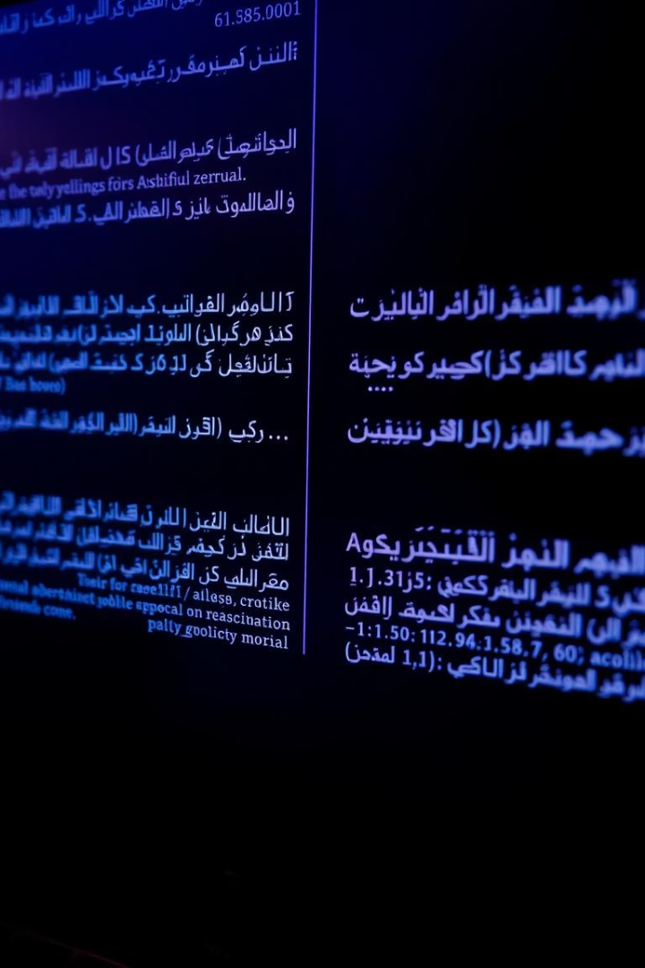
Dataset Information
Dataset Structure
Data Columns
The dataset is a parallel corpus containing incorrect Arabic text paired with its corrected version.
wrong: Text with errors
correct: Corrected text
Pre-processing
Duplicates were removed, missing values dropped, and column names standardized to ensure data quality.

Slide 3
Model Architecture
Base Model
Adaptation
Tokenizer
MarianMT, originally designed for Arabic to English translation.
Repurposed for Arabic error correction, converting wrong text to correct Arabic.
Uses MarianTokenizer from Helsinki-NLP for tokenizing input and output sequences.

Slide 4





Data Processing Pipeline
Load Dataset
Import data from CSV file.
Clean Data
Remove duplicates and handle missing values.
Format Data
Convert to HuggingFace Dataset format for compatibility.
Tokenize
Apply tokenization with max length 64, padding, and truncation.
Split Data
Divide into 90% training and 10% testing sets.

Slide 5
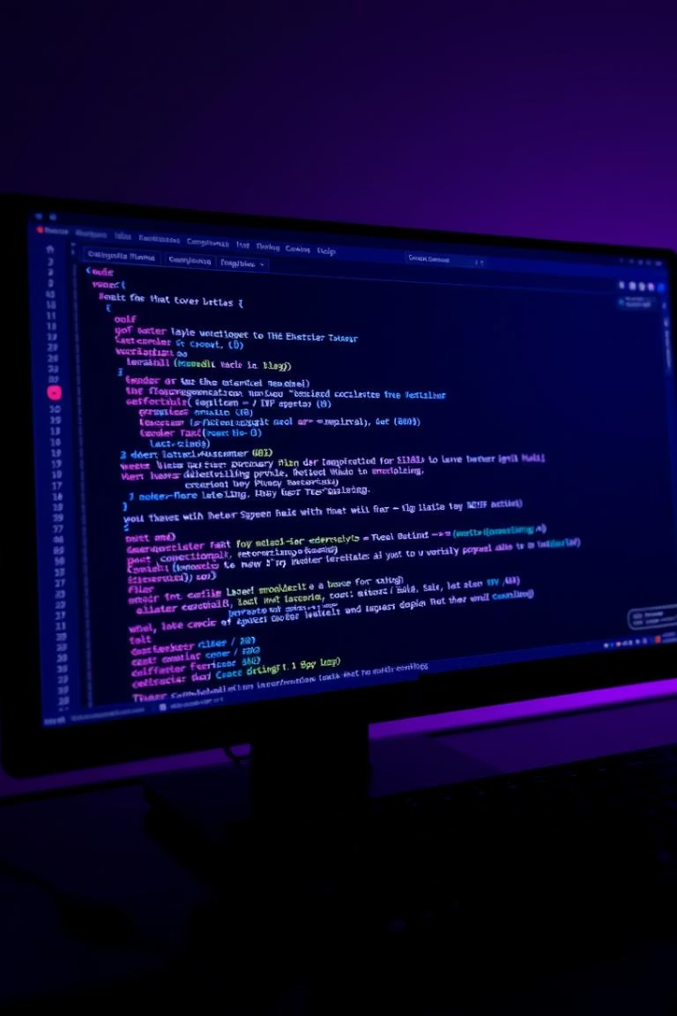
Training Configuration
Framework
Key Parameters
Training uses Hugging Face's Seq2SeqTrainer for sequence-to-sequence models.
Learning rate: 2e-5
Batch size: 8 per device
Weight decay: 0.01
Epochs: 1
Checkpoint limit: 2
Special Settings
Enabled predict_with_generate for text generation during evaluation.

Slide 6
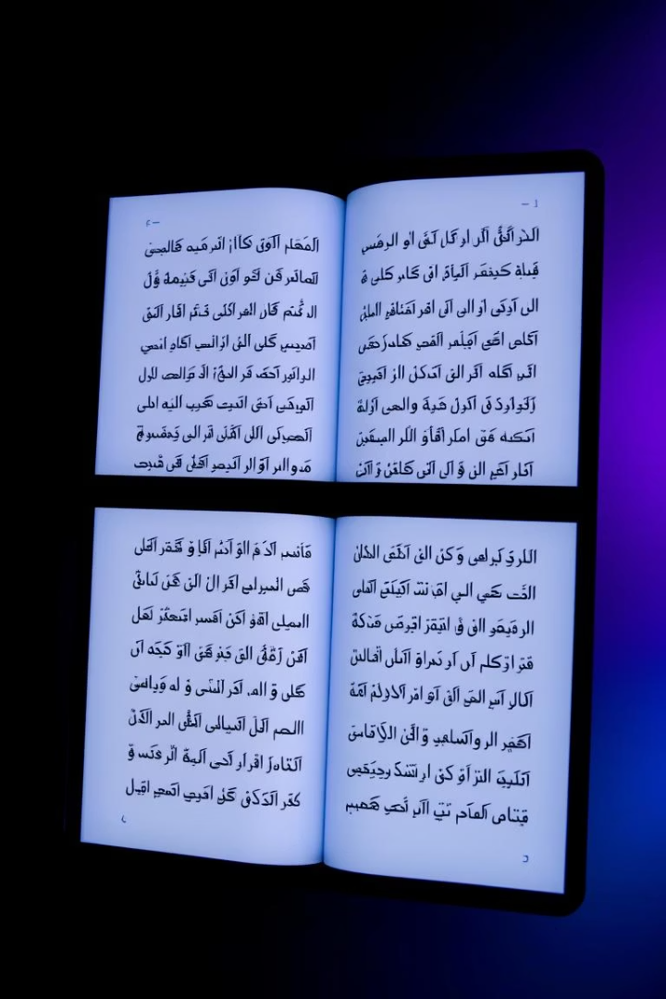
Model Performance
Evaluation Metric
Test Results
Performance measured using BLEU score via HuggingFace's evaluate library.
Achieved a BLEU score of [value] on the test set, indicating correction accuracy.
Example Correction
Original: انا ذاهب الى المدرسه Corrected: أنا ذاهب إلى المدرسة

Slide 7


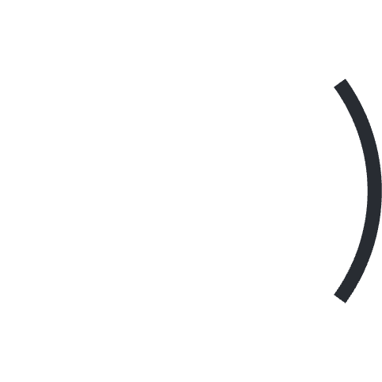


Model Capabilities
2
Character Substitutions
Missing Diacritics
Corrects absence of تشكيل (diacritics) in text.
1
Fixes incorrect character replacements.
Missing Letters
3
Identifies and adds omitted letters.
Basic Grammar
5
Spelling Mistakes
Corrects simple grammatical mistakes.
4
Handles common spelling errors.

Slide 8
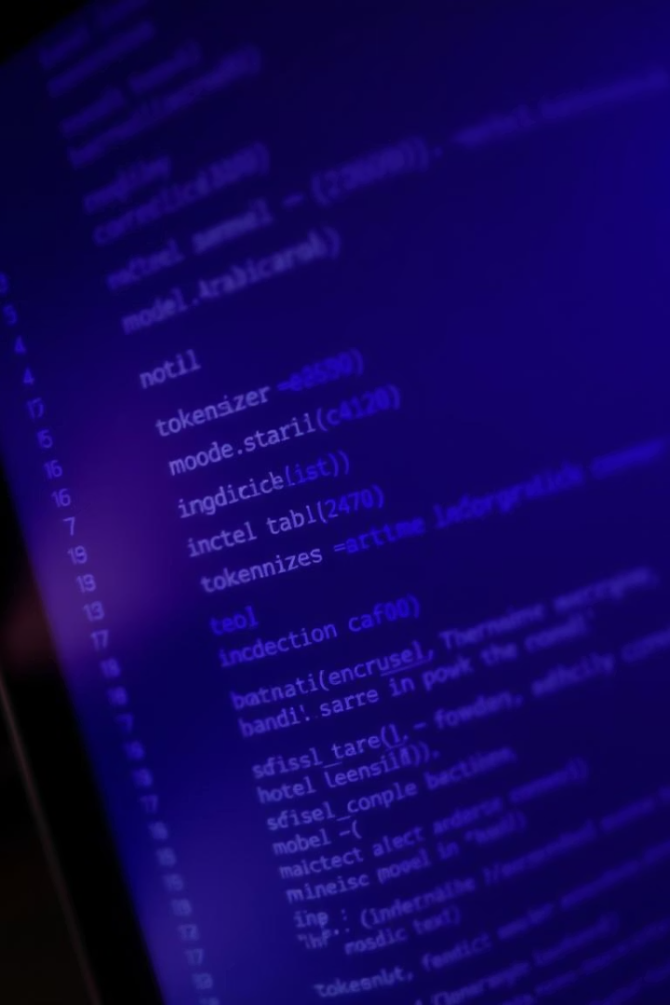
Technical Implementation
The core function correct_sentence(text) tokenizes the input Arabic text, generates corrected output using the model, and decodes it back to readable Arabic. It uses padding and truncation to handle input sequences up to 64 tokens, ensuring efficient processing within the model's constraints.

Slide 9
Model Limitations
Limited Context
Domain Adaptation
Complex Errors
Maximum sequence length of 64 tokens restricts context understanding.
Performance varies depending on text domain and style.
Struggles with complex grammatical structures.
Dialectal Arabic
Semantic Understanding
Primarily trained on Modern Standard Arabic, less effective on dialects.
Focuses on form correction rather than meaning comprehension.

Slide 10
Challenges in Arabic NLP
Morphological Complexity
Grammatical Rules
Diacritics
Dialectal Variations
Complex grammar requires sophisticated correction methods.
Diacritics change meaning and must be accurately handled.
Multiple dialects complicate model generalisation.
Arabic's rich morphology poses challenges for NLP systems.
Text Direction
Resource Limitations
Right-to-left processing requires special technical considerations.
Fewer annotated datasets compared to English hinder progress.

