Slide 1
Used Car Price Analysis
Data Analysis Project
Tools: Python, Pandas, Matplotlib, Seaborn
Dataset: Used Car Price (Kaggle)

Slide 2
PROBLEM
Understand the main factors affecting used car prices
Explore relationships between car features and price
Generate insights to support buying & selling decisions

Slide 3
Dataset Overview
Total records: 4000+ cars
Features include:
Brand, Model Year, Mileage
Fuel Type, Transmission
Accident History, Price
Data cleaned and standardized before analysis

Slide 4
Data Cleaning & Preparation
Converted price and mileage to numeric values
Standardized transmission types into main categories
Handled missing values in fuel type and accident and clean_title columns
Adding the kilometer column by converting from milage to kilometers and drop milage column
Removed unsupported and Unknown fuel types
Removed Other transmission isn’t (Automatic or Manual or Cvt)

Slide 5
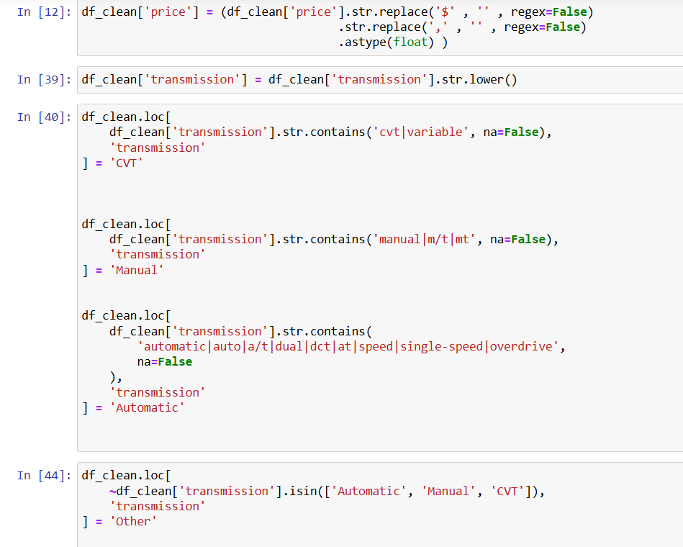
Converted price
Standardized transmission types into main categories

Slide 6

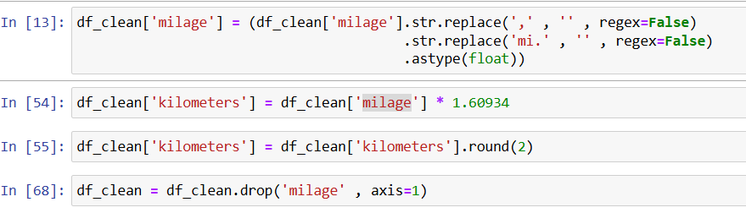
Handled missing values in fuel type and accident and clean_title columns
Adding the kilometer column by converting from milage to kilometers and drop milage column

Slide 7
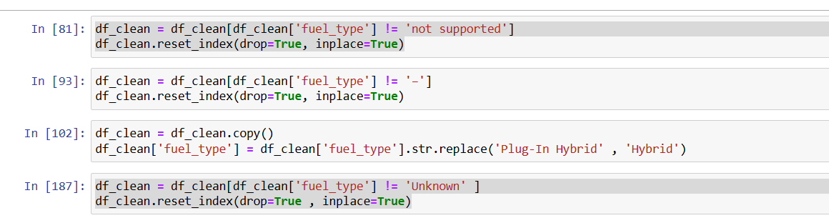
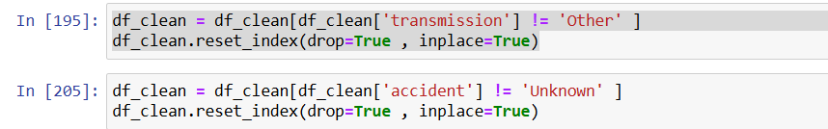
Removed unsupported and Unknown fuel types
Removed Other transmission isn’t (Automatic or Manual or Cvt) and Unknown Accident

Slide 8
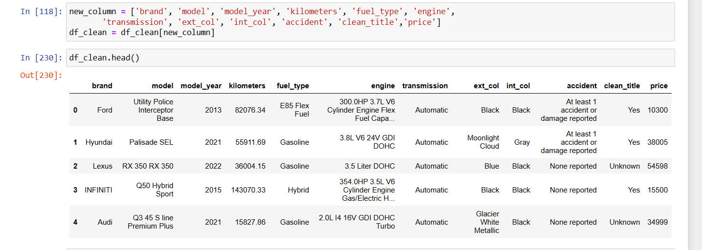
Data After Handling

Slide 9
Analysis Questions
1- What Is The Price Distribution ?
2- How Does Brand Affect Car Price ?
3- What Is The Relationship Between Model Year And Price ?
4-does Fuel Type Influence Price ?
5-how Does Transmission Type Affect Price ?
6-do Accident History Affect Pricing ?

Slide 10
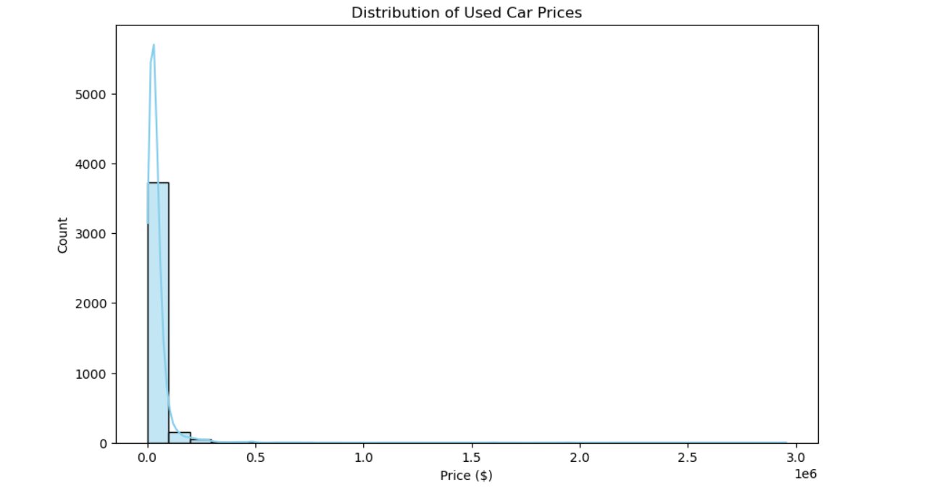
The Price Distribution

Slide 11
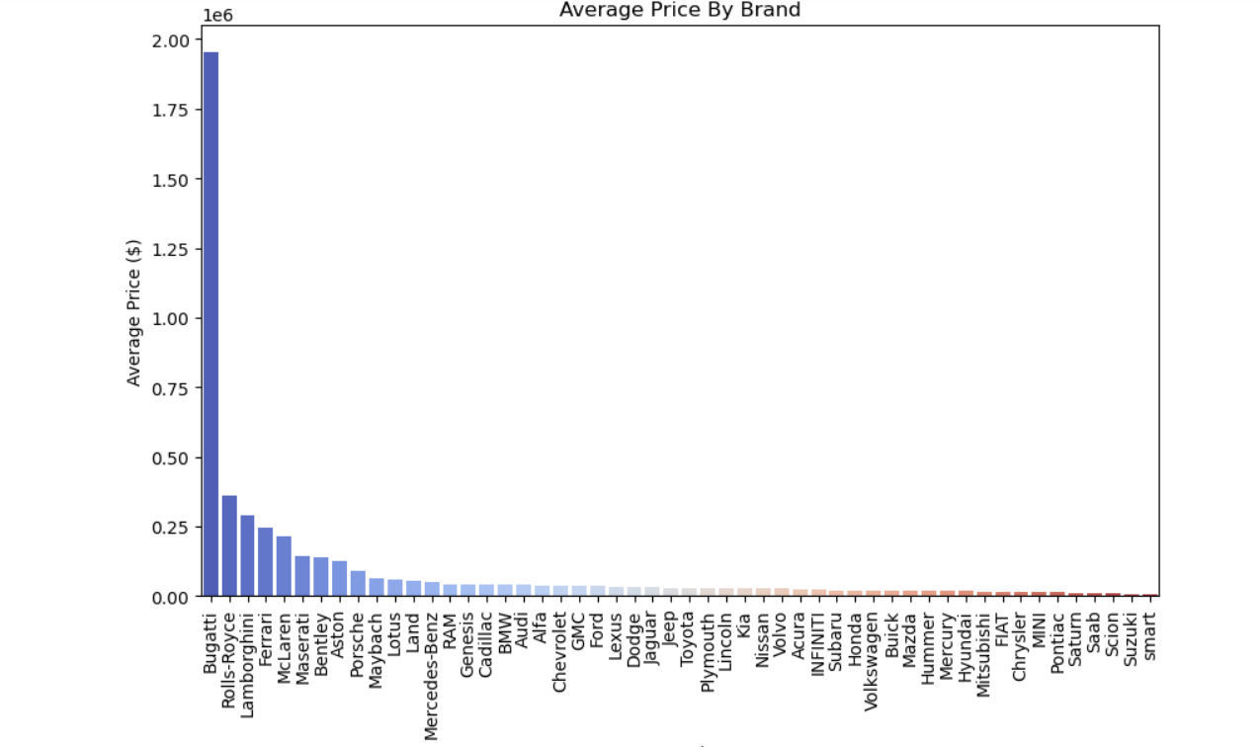
Brand Affect Car Price ?

Slide 12
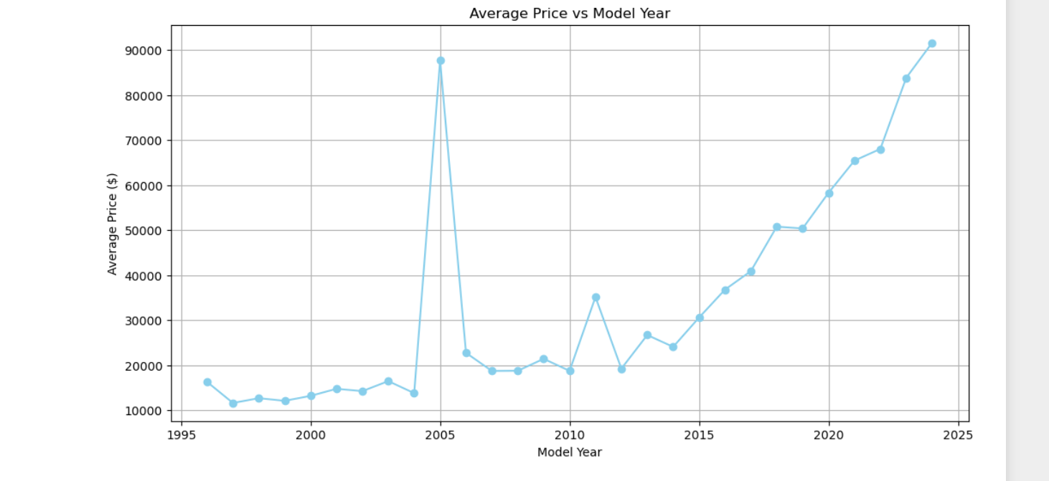
The Relationship Between Model Year And Price ?

Slide 13
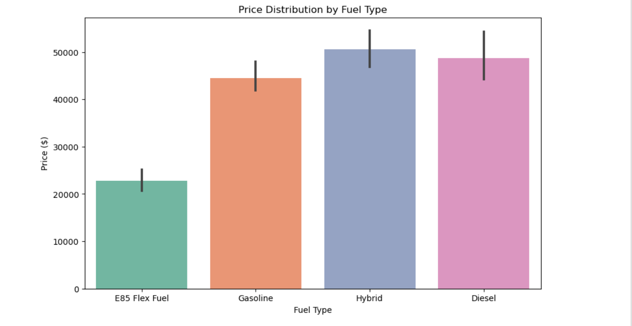
Fuel Type Influence Price

Slide 14
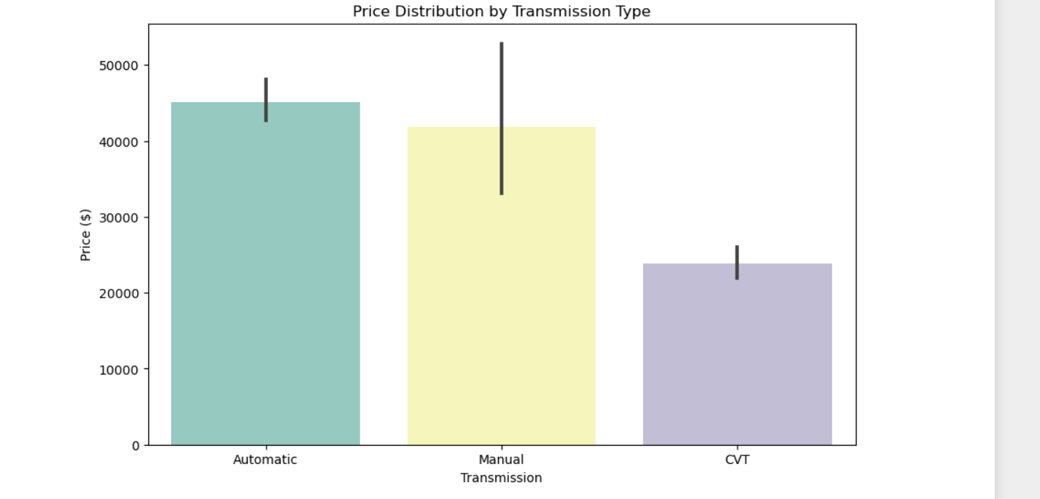
Transmission Type Affect Price

Slide 15
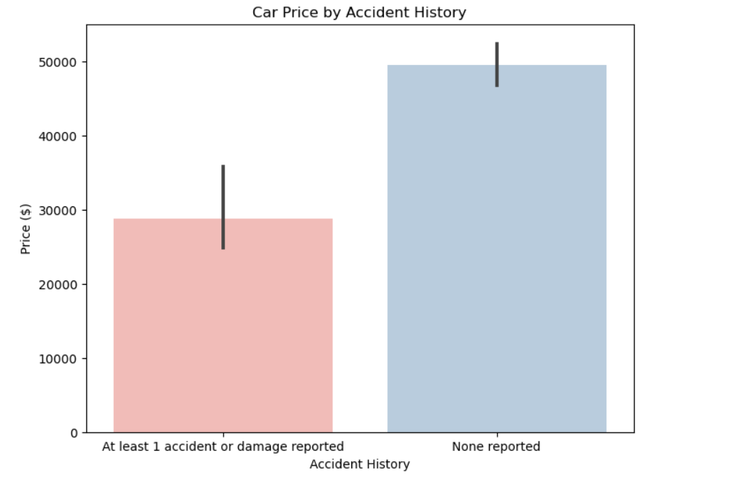
Accident History Affect Pricing

Slide 16
Key Insights
Brand plays a major role in pricing
Luxury brands consistently show higher average prices compared to economy brands.
Newer model years are priced higher
There is a clear upward trend in prices for newer cars, confirming that car age is a key value driver.
Fuel type affects car value
Plug-In Hybrid and Diesel vehicles generally have higher prices than Petrol cars.
Automatic transmission cars are more expensive
Automatic vehicles show higher mean prices compared to Manual and CVT cars.
Vehicle history matters
Cars with clean titles and no accident history maintain higher resale prices.

