Slide 1
ITI · DATABASE FUNDAMENTALS · LESSON 3
ERD Mapping to Tables
A 7-step algorithm from entities and relationships to relations, keys, and foreign keys.
Lecturer: Rana Salah
Based on original slides by
rsalah@mcit.gov.eg · Room 3005
Shahinaz S. Azab · edited by Mona Saleh · Rana Salah
Notes:
Welcome. This is Lesson 3 of the Database Fundamentals course. Today we turn ERDs into real tables using a 7-step algorithm. By the end, you'll never again stare at an ERD wondering where the foreign key goes.

Slide 2
02 · OBJECTIVES
You will be able to…
01
02
03
Read any ERD and name the 7 mapping rules that apply.
Decide where every foreign key goes — and why.
Map a full narrative — ERD → tables — end to end.
Notes:
Three concrete outcomes. By the end of this lesson students should be able to apply the 7 rules on any ERD, place every foreign key correctly, and justify where it goes.

Slide 3
03 · AGENDA
The 7-step Mapping
01
Regular entities
05
M:N relationships
02
Weak entities
06
Multi-valued attributes
03
1:1 relationships
07
N-ary relationships
04
1:N relationships
+
Case study · pitfalls · recap
Notes:
Here is the whole lesson on one slide. Seven rules, then one worked case study, then practice. Each rule gets exactly one slide in the same format: a tiny ERD on the left, the resulting tables on the right, and the FK highlighted.

Slide 4
04 · VOCABULARY
The relational model in one picture
STUDENT ← relation
4 tuples
RELATION
student_id
name
gpa
A relation is a set of tuples/rows.
42001
Mona Saleh
3.6
TUPLE
42002
Omar Hany
3.2
One row — one fact.
42003
Nour Adel
3.9
42004
Youssef Tarek
2.8
ATTRIBUTE
One column — one property.
↑ column = attribute
← row = tuple
DOMAIN
The set of values that column may hold.
Notes:
Before we map anything, agree on vocabulary. A relation is a table. A tuple is a row. An attribute is a column. A domain is the set of allowed values for that column. These are the four nouns we use for the next 20 minutes.

Slide 5
05 · VOCABULARY
Keys & constraints you will use today
PK
FK
UK
NN
CHK
Primary Key
Foreign Key
Unique Key
NOT NULL
CHECK
Unique, not null — identifies every row.
Points to the PK of another table.
Unique values, but not the chosen PK.
Value is required for every row.
A boolean rule the row must satisfy.
every FK is coloured teal and every PK is coloured red — in the diagrams and in the tables.
Notes:
These five constraints are the tools we spend on every mapping rule. PK uniquely identifies a row. FK points from one table to another. UK is also unique but not necessarily the PK. NOT NULL means a value is required. CHECK enforces a condition.

Slide 6
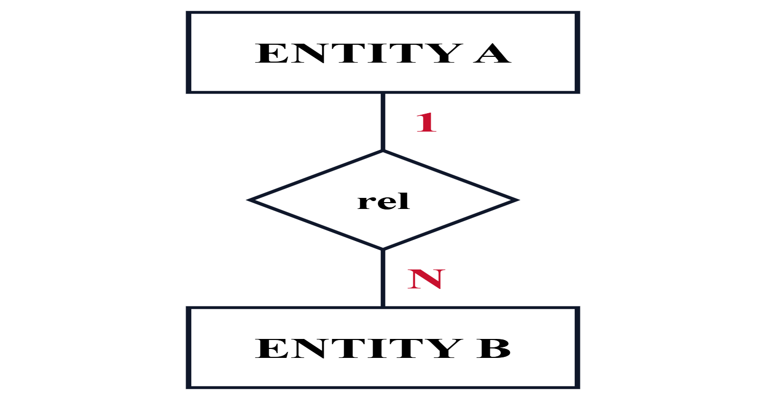
06 · MENTAL MODEL
How to read every mapping slide
ERD FRAGMENT
TABLES (WITH FK)
entity_a
→
a_id (PK), name
FK ↓
entity_b
b_id (PK), title, a_id (FK → entity_a)
Notes:
This is the pattern every one of the next seven slides follows. Left: a tiny ERD fragment. Right: the tables it becomes. The arrow is a foreign-key reference. If you can read this one slide, you can read all seven.

Slide 7
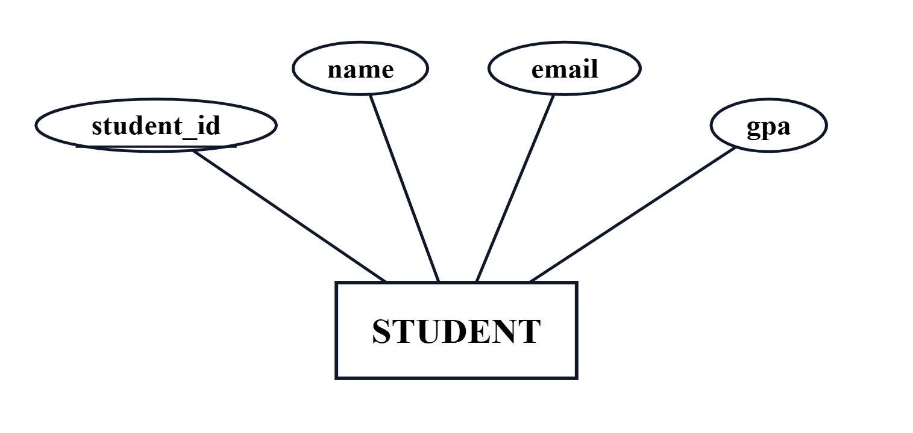
STEP 1 OF 7 · REGULAR ENTITIES
01/07
Every strong entity becomes a table.
TABLE
ERD
student
student_id PK
name
email UK
gpa
42001
Mona Saleh
mona@iti.gov.eg
3.6
42002
Omar Hany
omar@iti.gov.eg
3.2
Rule: one table per entity, one attribute per column, choose any key attribute as the PK.
Notes:
The simplest rule. Every regular (strong) entity type becomes its own table. Pick one key attribute as the primary key. Nothing to do with other entities yet.

Slide 8
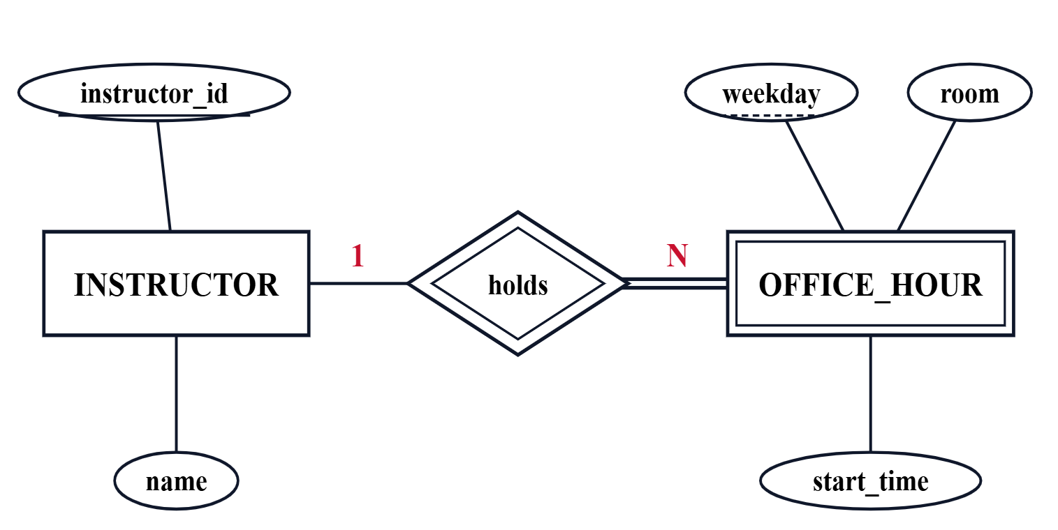
STEP 2 OF 7 · WEAK ENTITIES
02/07
Weak entity → table + FK; PK = owner FK + partial key.
TABLES
ERD
instructor
instructor_id (PK), name, email
office_hour
instructor_id (PK, FK → instructor), weekday (PK) , start_time, room
double rectangle = weak entity. double diamond = identifying relationship. dashed underline = partial key · double line = total participation.
Rule: composite PK = owner's PK (as FK) + the weak entity's partial key.
Notes:
A weak entity has no key of its own — it depends on an owner. Create a table for it, add the owner's PK as a FK, and the composite PK is (owner FK + the weak entity's partial key). Example: a dependent needs their employee's id plus their own name to be unique.

Slide 9
STEP 3 OF 7 · 1:1 RELATIONSHIPS
03/07
Binary 1:1 Relation depends on participation — pick one of three.
A · Both mandatory
B · One mandatory
C · Both optional
Every employee must have an office , every office must have an employee.
Every department must have a manager ; not every employee manages one.
An instructor may mentor a student ; both sides can exist alone.
employee_office
department
mentorship
emp_id (PK)
, name,
dept_id (PK)
, name,
instructor_id (FK, UK)
,
office_no, floor
manager_id (FK, NOT NULL)
student_id (FK, UK)
→ Merge into one table.
→ FK on the mandatory side.
→ Third link table.
Why FK on the mandatory side (case B): that row is required to have a partner — the FK can be NOT NULL . Putting it on the optional side would force NULLs for every unpaired row.
Notes:
This is the slide the old deck got wrong. Three cases. Both sides mandatory: merge into one table — no row of either side exists without the other. One mandatory: put the FK on the mandatory side pointing to the optional side — the mandatory row then always has a value, and optional rows have none to orphan. Both optional: a separate link table so neither side carries NULLs.

Slide 10
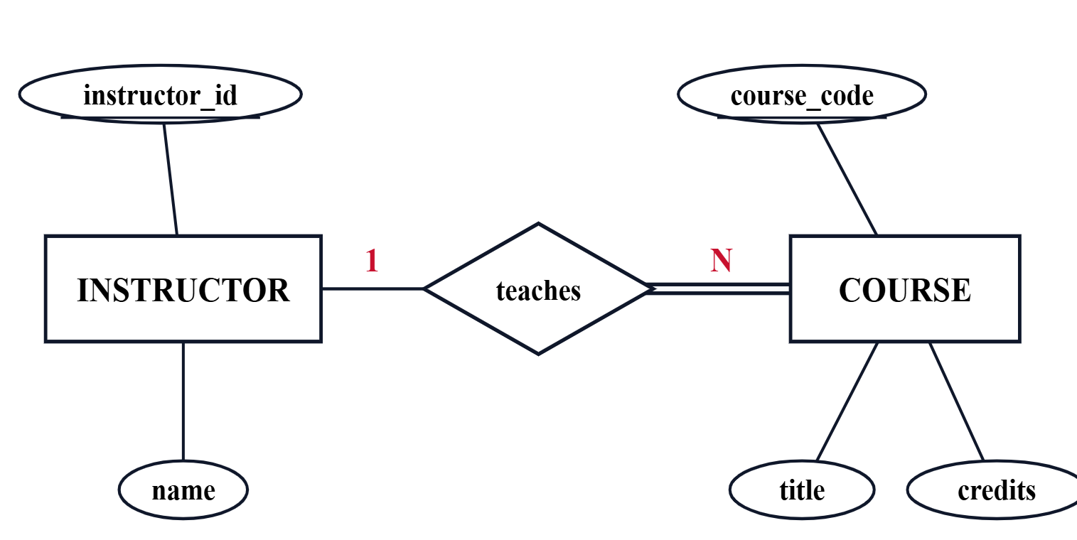
STEP 4 OF 7 · 1:N RELATIONSHIPS
04/07
Binary 1:N —Put the FK on the N (many) side.
TABLES
ERD
instructor
instructor_id (PK), name, email
course · the N side
course_code (PK), title, credits, instructor_id (FK → instructor)
Rule: FK on the N-side; add any simple relationship attributes there too.
double line = total participation: every course has an instructor → FK is NOT NULL
Notes:
One instructor teaches many courses, but a course has exactly one lead instructor. The FK sits on the many side — course.instructor_id. Any attributes of the relationship itself go on the many-side table too.

Slide 11
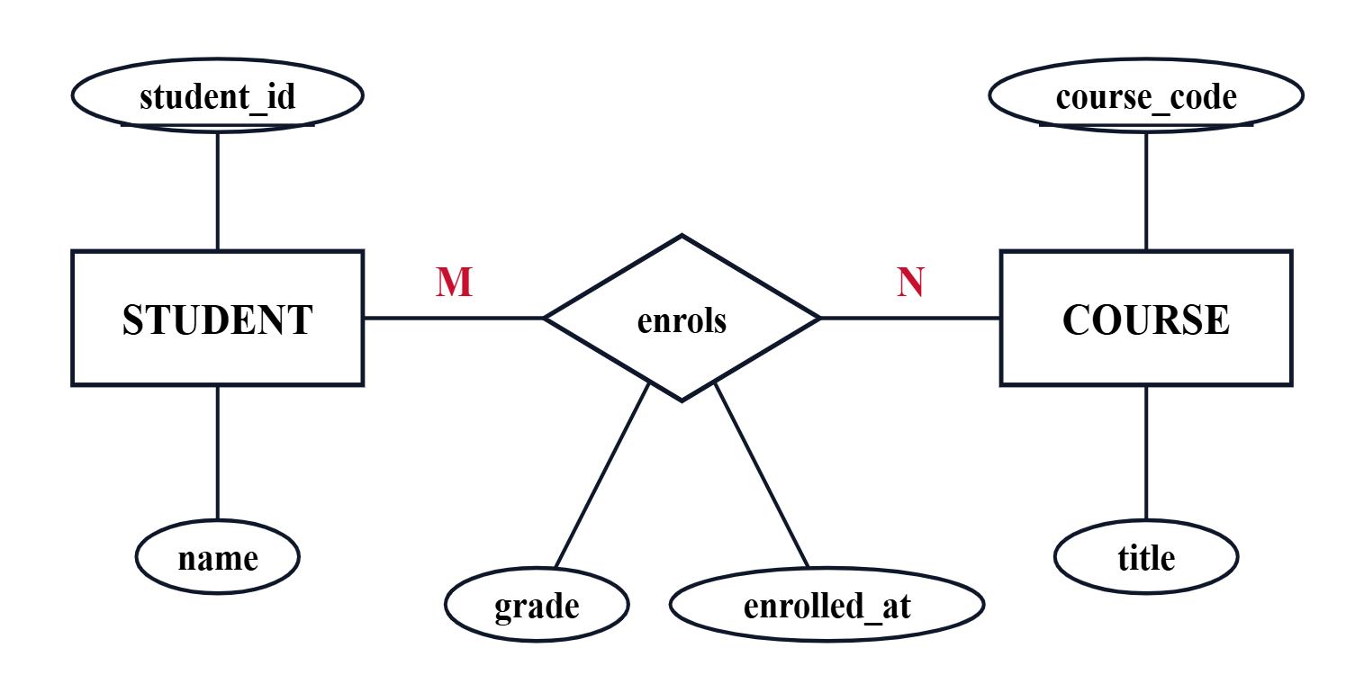
STEP 5 OF 7 · M:N RELATIONSHIPS
05/07
Binary M:N → a new junction table with both FKs.
TABLES
ERD
student
course
student_id (PK), name
course_code (PK), title
enrolment · junction table
student_id (PK, FK → student), course_code (PK, FK → course) , grade, enrolled_at
grade and enrolled_at belong to the relationship, not to either entity
Rule: composite PK of both FKs; relationship attributes live here.
Notes:
A student can enrol in many courses, and a course has many students. You cannot stuff that into either entity's table without duplicating rows. Make a third table — the junction — with both FKs. Relationship attributes like grade go here.

Slide 12
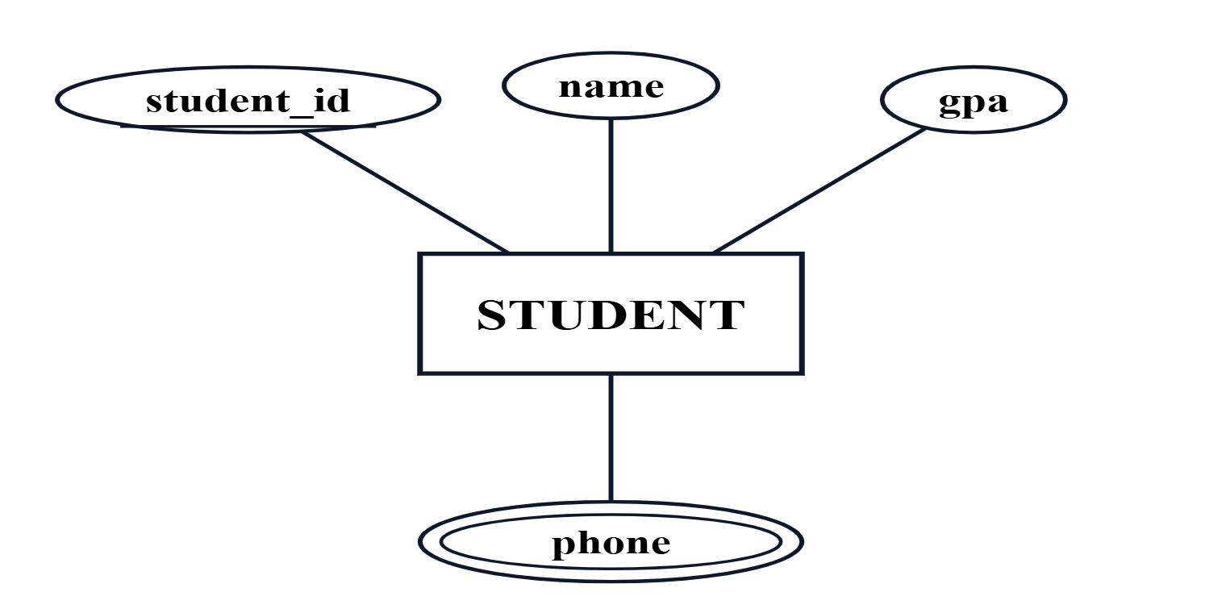
STEP 6 OF 7 · MULTI-VALUED ATTRIBUTES
06/07
One extra table — FK + value.
TABLES
ERD
student
student_id (PK), name, gpa
student_phone
student_id (PK, FK → student), phone (PK)
Rule: one row per value; composite PK of (FK, value).
double ellipse = multi-valued attribute
Notes:
A student can have several phone numbers. Never cram them into one column separated by commas — you cannot query that. Make a tiny table with two columns: the owner's FK, and the value. Together they form the PK.

Slide 13
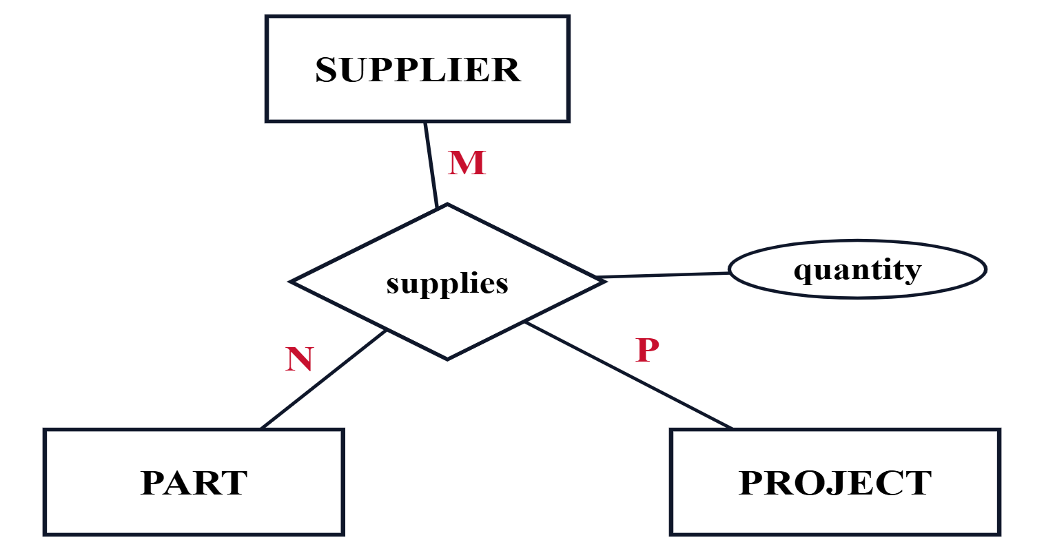
STEP 7 OF 7 · N-ARY RELATIONSHIPS
07/07
Three or more? One junction table, n FKs.
ONE JUNCTION TABLE
TERNARY ERD
supplies
supplier_id (PK, FK), part_id (PK, FK), project_id (PK, FK) , quantity, delivered_on
Not the same as three M:N tables. Three binary junctions would let you say "supplier A supplies part P" and "project J uses part P" — without knowing supplier A actually delivered P to project J. The ternary row captures all three at once.
Notes:
A ternary (or higher-arity) relationship cannot be broken into pairs of binary relationships without losing meaning. Example: a supplier delivers a part to a project — the three together are the fact. Make one junction table with three FKs; the PK is all three together.

Slide 14
14 · SUMMARY
Which rule, where the FK goes
#
ERD construct
What to create
Where the FK goes
1
Strong entity
One table
— none —
2
Weak entity
One table
On the weak table, part of composite PK
3
1:1
Merge · one FK · link table
On the mandatory side (or in the link table)
4
1:N
No new table
On the N (many) side
5
M:N
New junction table
Both FKs in the junction
6
Multi-valued attribute
New small table
FK + value as composite PK
7
N-ary (n ≥ 3)
New junction table
All n FKs as composite PK
Notes:
One slide, all seven rules. Print this if you print one slide from the lesson. It is the lookup table you reach for during any mapping exercise.

Slide 15
15 · PITFALLS
Three mistakes we see every term
#1 · 1:N on the wrong side
#2 · M:N without a junction
#3 · Multi-value in one cell
WRONG instructor: id, name, course_code (FK)
WRONG student: id, name, course_code (FK)
WRONG student.phones = '010…, 011…, 012…'
RIGHT course: code, title, instructor_id (FK)
RIGHT enrolment(student_id, course_code, grade)
RIGHT student_phone(student_id, phone)
A comma-separated column can't be indexed, joined, or constrained.
An instructor would need as many rows as courses he teach.
Can't record multiple courses per student without duplication.
Notes:
These are the three mistakes I see on nearly every first draft. For each: show the wrong version, show the right version, and say in one line why the wrong version breaks.

Slide 16
CASE STUDY · 1 OF 3 · NARRATIVE
A banking system
A bank operates many branches ; each branch has a unique name, a unique address and a phone.
THINK BEFORE THE NEXT SLIDE
Which words are entities?
The bank stores customer information: ID, name, address, and one or more phone numbers.
Which words are attributes?
Which relationship is 1:1?
Each customer owns exactly one account ; each account belongs to exactly one customer and has a number, balance, and the date of its last transaction.
Which is 1:N? Which is M:N?
Any multi-valued attributes?
A customer may make any number of transactions — withdrawal or deposit — at any branch. Each transaction records a number, type, date, time, amount, and the branch where it occurred.
Notes:
Read the narrative aloud. Then ask: how many entities do you see? How many relationships? Which are 1:1, 1:N, M:N? Students should list them before you move to the ERD slide.

Slide 17
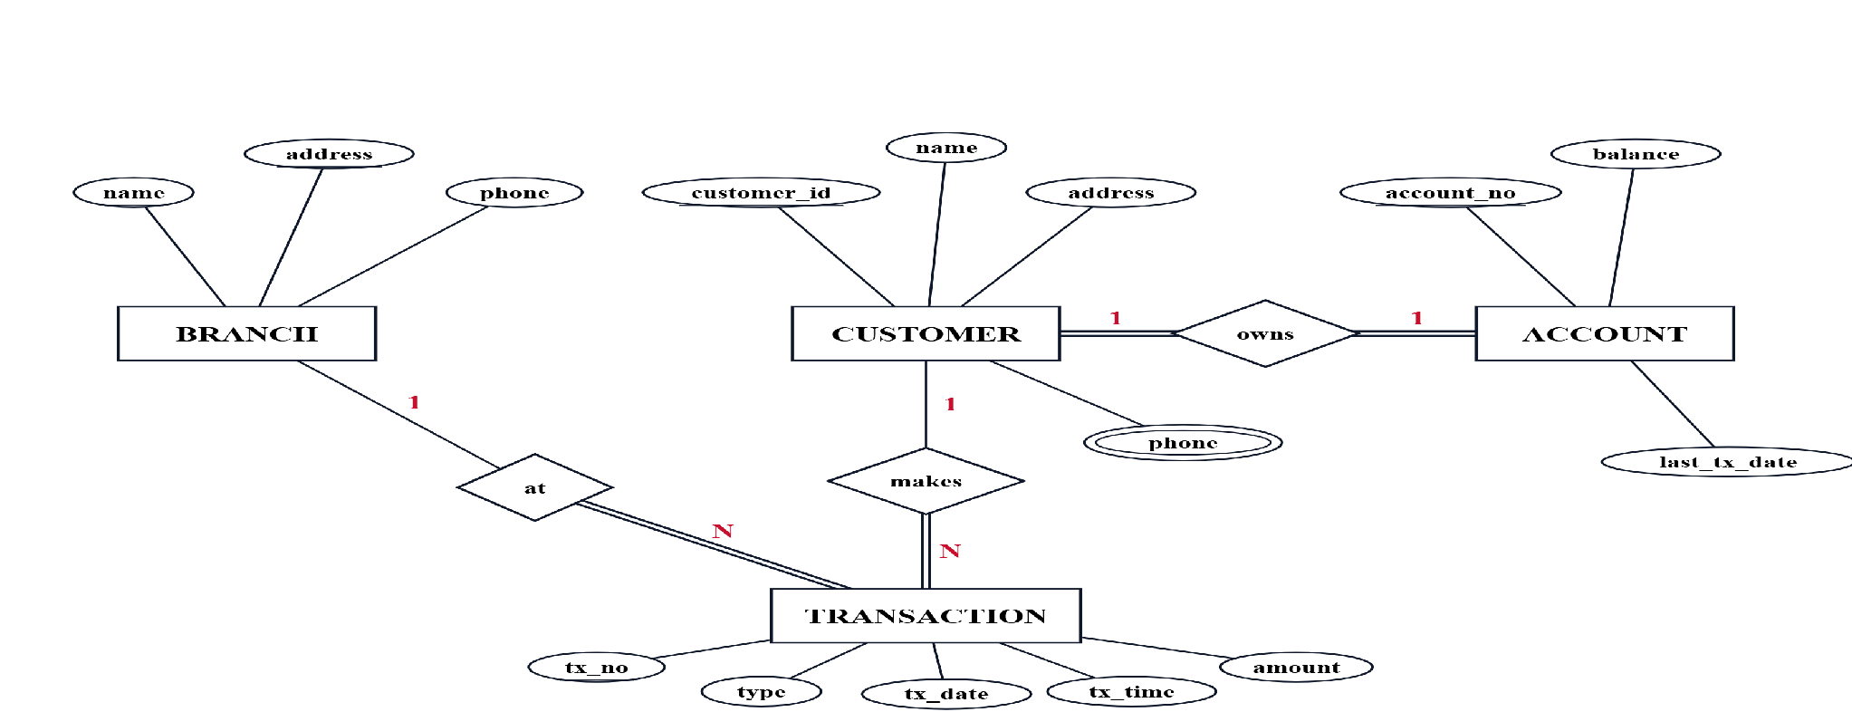
CASE STUDY · 2 OF 3 · ERD
The banking ERD
▣ entity
◆ relationship
⬭ multi-valued attribute
1 / N cardinality (Chen)
═ total participation
Notes:
Four entities, three relationships. Customer–Account 1:1, both sides total (double lines). Customer–Transaction 1:N and Branch–Transaction 1:N, transaction side total — every transaction has a customer and a branch. Branch has two candidate keys (name, address). Customer phone is multi-valued. Ask: is last_tx_date derivable from TRANSACTION? Yes — we store it for speed; mention that.

Slide 18
CASE STUDY · 3 OF 3 · TABLES
The banking schema, mapped step by step
branch
step 1
customer
step 1
account
step 3
customer_phone
step 6
transaction
step 1+4
name (PK) address UK phone
customer_id (PK) name address
account_no (PK) balance last_tx_date customer_id (FK, UK, NN)
customer_id (PK, FK) phone (PK)
tx_no (PK) type CHK tx_date, tx_time amount customer_id (FK, NN) branch_name (FK, NN)
Design note: customer–account is 1:1 with both sides total, so step 3 allows a merge. We keep two tables and put customer_id in account as UNIQUE + NOT NULL — that keeps it exactly 1:1. Branch has two candidate keys (name, address): name is the PK, address becomes UNIQUE.
Notes:
Branch and customer: step 1 (branch PK = name, address UNIQUE). Account: step 3 — 1:1 both total, so we may merge; we keep it split with customer_id UNIQUE + NOT NULL in account. Customer_phone: step 6. Transaction: step 1 plus two step-4 FKs (customer_id, branch_name), both NOT NULL because of total participation. Every FK is teal.

Slide 19
CAR CASE STUDY · 1 OF 3 · NARRATIVE
A car manufacturer
An organisation makes many models of cars — each with a unique name, a suffix (GL, XL…) and an engine size.
THINK BEFORE THE NEXT SLIDE
How many entities?
Each model is made of many parts (id, description, production year, and many images). A part may appear in many models.
Which attribute is multi-valued?
model ↔ part — what cardinality?
Each model is produced at exactly one factory . Five factories exist — London, Birmingham, Bristol, Wolverhampton, Manchester — each with a machine count, capacity, OS, DBMS, Internet.
model ↔ factory — what cardinality?
Why is the fact ternary, not three binaries?
Key constraint: the parts and the model are produced in the same factory. That ties the three entities together as one fact — a ternary relationship.
Notes:
Second worked case study. Three entities — model, part, factory. Highlight the last sentence: parts and models in the SAME factory. That is what forces a ternary relationship, not three independent binaries.

Slide 20
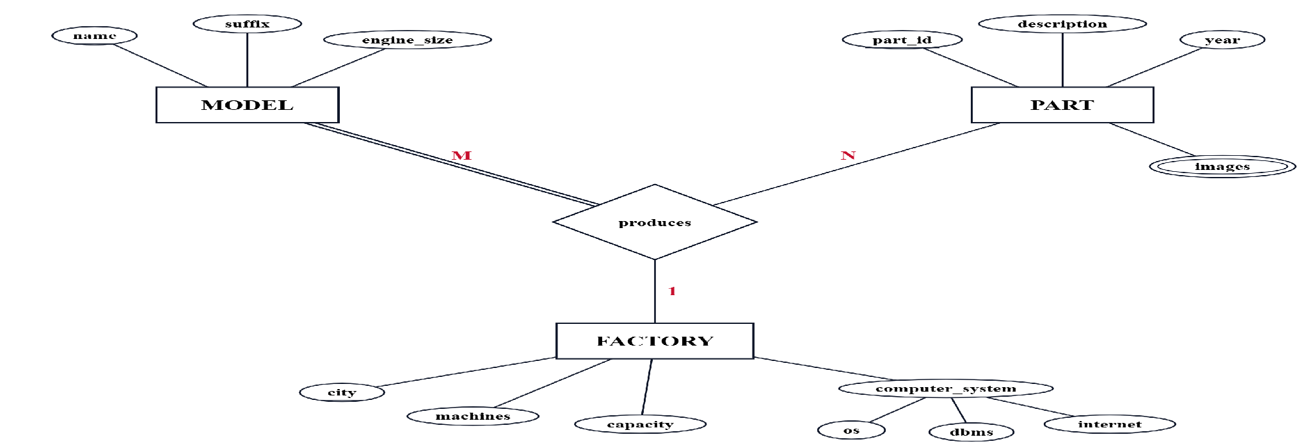
CAR CASE STUDY · 2 OF 3 · ERD
One ternary “produces” — model, part, factory
Why ternary? For a given (model, part) pair the factory is exactly one — the same one that makes both. Three separate binary M:N relationships would lose that link.
Notes:
Three entities around one ternary diamond 'produces'. Cardinality M-N-1 means: for a given (model, part) pair there is EXACTLY one factory that produces that pair. That constraint is what forces a ternary and cannot be captured with three binary M:N relationships.

Slide 21
CAR CASE STUDY · 3 OF 3 · TABLES
The car schema, mapped step by step
model
step 1
part
step 1
factory
step 1
part_image
step 6
produces
step 7
name (PK) suffix engine_size
part_id (PK) description year
city (PK) machines, capacity os, dbms, internet ← composite
part_id (PK, FK) image_url (PK)
model_name (PK, FK) part_id (PK, FK) factory_city (FK, NN)
Design note — the ternary: composite PK of produces is (model_name, part_id); factory_city is a non-key FK because the same (model, part) pair always lands at one factory — the “same factory” constraint from the narrative.
Notes:
Three entity tables (step 1), one multi-valued table part_image (step 6), and the ternary produces (step 7). Factory computer system is composite, so only its parts (os, dbms, internet) become columns. In produces, the factory leg has cardinality 1: for a given (model, part) there is exactly one factory, so the PK is (model_name, part_id) and factory_city is a NOT NULL FK outside the key.

Slide 22
BUS CASE STUDY · 1 OF 3 · NARRATIVE
A country bus company
The company owns many buses — number, no. of chairs, brand, and one or more options (AC, automatic, PS).
THINK BEFORE THE NEXT SLIDE
Which attribute is multi-valued?
Each bus is allocated to one route ; a route may have many buses. A route has km, start, end, duration.
bus ↔ route — what cardinality?
route ↔ town — what cardinality?
A route passes through many towns ; a town may be on many routes. Each town has a unique name and a station name.
How do you record allocation history?
Where does the last route per driver live?
Time-varying: one or more drivers are allocated to a route for a period . The system keeps every change and each driver's last route.
Notes:
Third worked case study. Four entities — bus, route, town, driver. Highlight two patterns: options is multi-valued, and driver-to-route allocation is time-varying (we must keep the history of changes AND know each driver's last route).

Slide 23
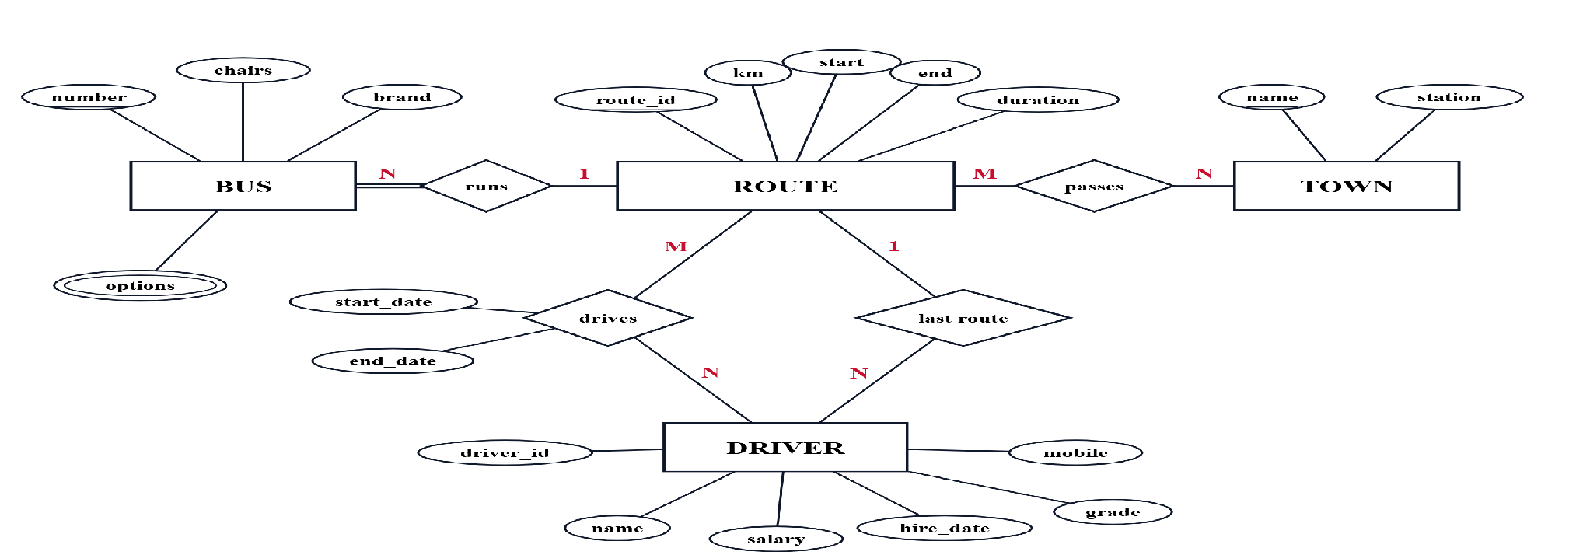
BUS CASE STUDY · 2 OF 3 · ERD
Bus · route · town · driver
Allocation history: drives is M:N with start_date and end_date — every reassignment is a new row. last route is a separate 1:N so each driver points to exactly one current route.
Notes:
Four entities, four relationships. runs: bus N to route 1, bus side total. passes: route M:N town. drives: route M:N driver with start_date and end_date, keeps the allocation history. last route: route 1 to driver N, the current assignment. Route and driver have no natural key, so we propose route_id and driver_id.

Slide 24
BUS CASE STUDY · 3 OF 3 · TABLES
The bus schema, mapped step by step
bus
step 1 + 4
route
step 1
town
step 1
number (PK) chairs, brand route_id (FK, NN)
route_id (PK) km, start, end duration
name (PK) station
bus_option
step 6
route_town
step 5
driver
step 1 + 4
bus_number (PK, FK) option (PK) CHK AC·Auto·PS
route_id (PK, FK) town_name (PK, FK)
driver_id (PK) name, mobile, hire_date salary, grade last_route_id (FK)
drives · time-stamped allocation history
step 5 + relationship attribute
driver_id (PK, FK), route_id (PK, FK), start_date (PK), end_date
History + last route: every reassignment inserts a new drives row; driver.last_route_id is a convenience FK updated on each change (otherwise derivable as the most recent row).
Notes:
Seven tables. bus: step 1 plus step-4 FK route_id (NOT NULL, total). route, town, driver: step 1. bus_option: step 6. route_town: step 5. drives: step 5 with relationship attributes, PK (driver_id, route_id, start_date). driver.last_route_id: step 4 FK from the last-route relationship.

Slide 25
20 · RECAP
What to walk out remembering
01
Every entity → one table. Weak entities carry the owner's FK inside their PK.
02
1:1 — merge, FK on the mandatory side, or a link table.
03
1:N — FK on the N side. Always.
04
M:N and N-ary — a new junction table whose PK is the combined FKs.
05
Multi-valued attributes get their own table — never a comma-separated cell.
Notes:
Five lines. If a student remembers nothing else, remember these.

Slide 26
21 · CHECK YOURSELF
Three questions · answers in notes
Q1
Q2
Q3
A student enrols in many courses; a course has many students. How many tables?
One instructor teaches many courses. Where does the FK go?
1:1 relationship, both sides mandatory. Best mapping?
A. instructor table
A. Link table
A. 2
B. a new junction table
B. Merge the two tables
B. 3
C. course table
C. FK on either side
C. 1
Notes:
Answers — Q1: B (M:N needs a junction, so a new table). Q2: C (FK on the N-side, so the course table). Q3: B (both mandatory means merge; or if you keep them split, FK goes on the mandatory side — not a link table).

Slide 27
UP NEXT · LESSON 4
LESSON 4 · SQL
We'll write SQL on these tables.
Same ITI example — CREATE TABLE, every constraint, INSERT, SELECT , joins and the rest. PostgreSQL dialect, from scratch.
ITI · Database Fundamentals
Thank you — questions?
Notes:
Lesson 4 picks up these exact tables and writes SQL on them — CREATE TABLE with every constraint, INSERT, SELECT, JOIN. Same ITI example throughout.

