Slide 1
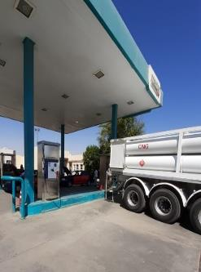
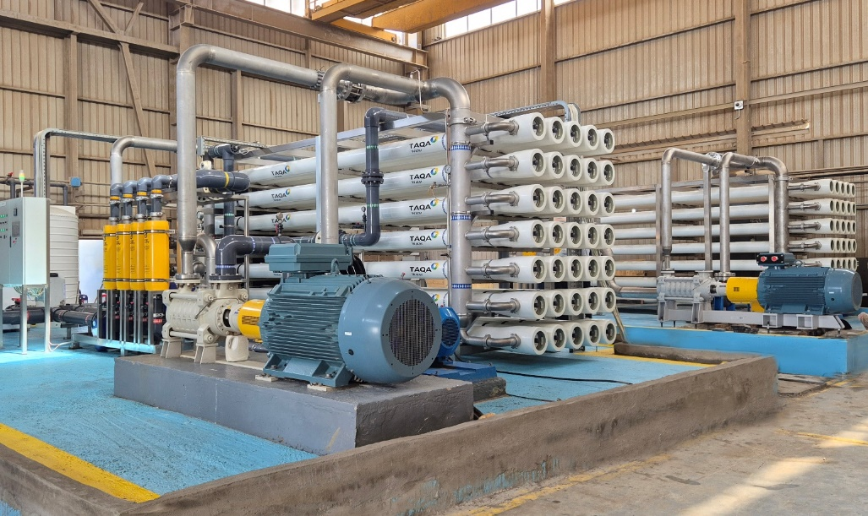
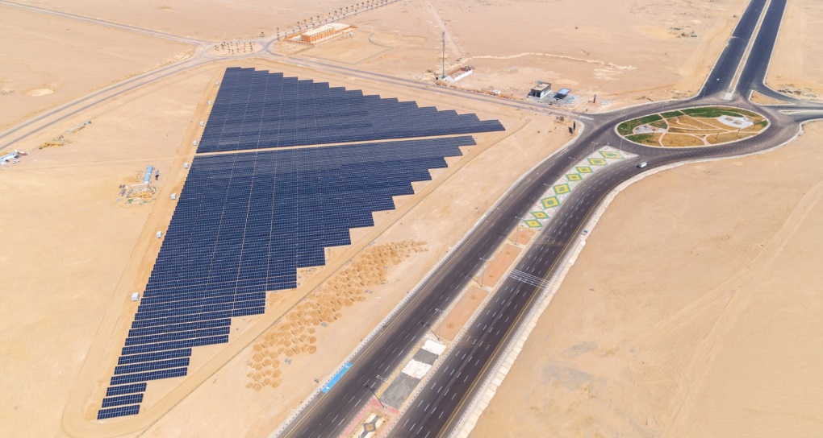
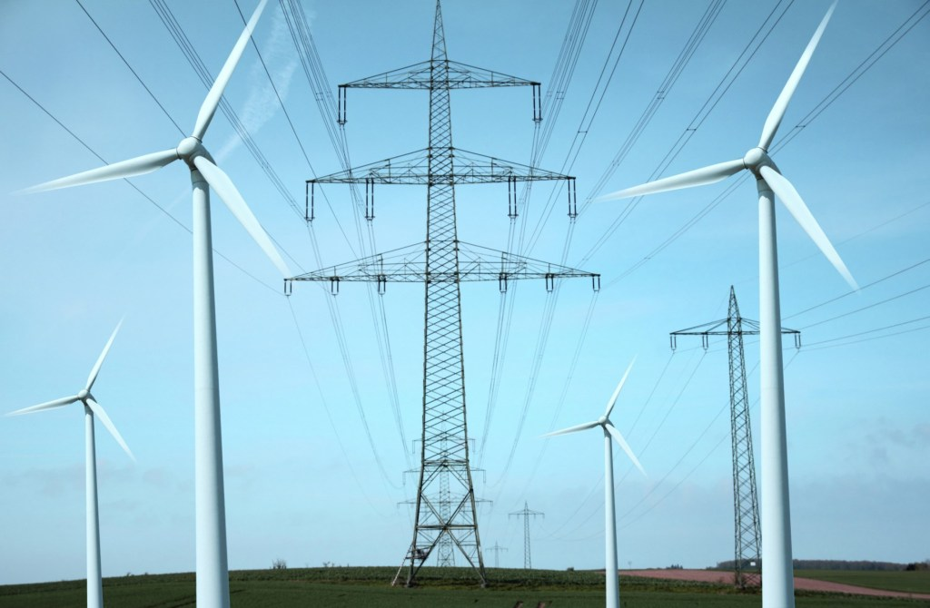
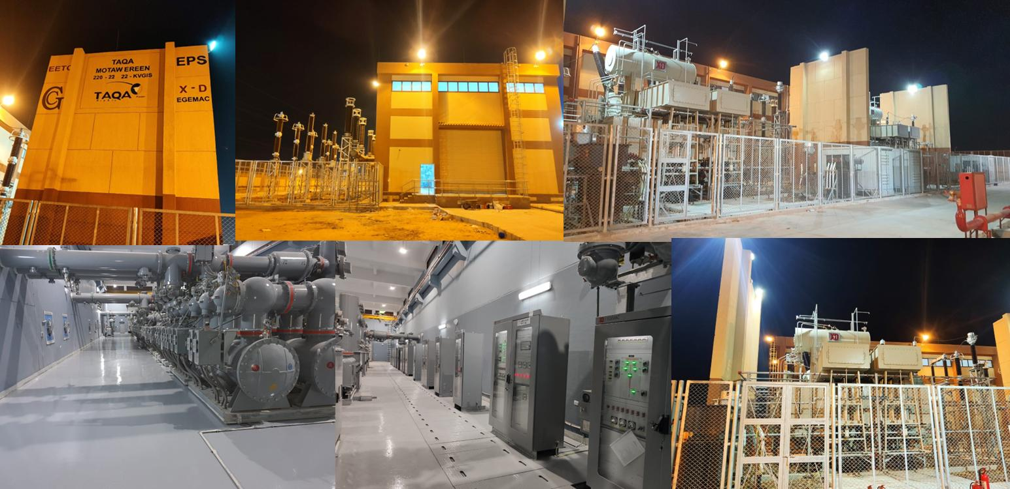
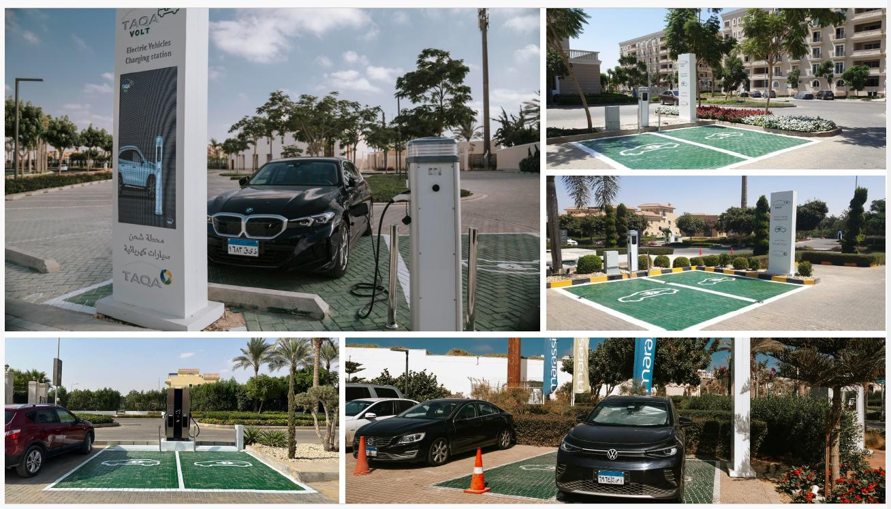



TAQA Arabia
Residential Customers
Integrated Energy & Utility Solutions · Jan 2026

Slide 2




TAQA Arabia · Who We Are
Egypt's leading integrated energy infrastructure developer — a true one-stop-shop for residential utilities
A World of Energy, Delivered End-to-End
Gas
Power
Founded in 2006 and listed on the EGX since 2023, TAQA Arabia is Egypt's largest private-sector energy and utility developer.
Across four divisions — Gas, Power, Petroleum and Water — TAQA finances, builds, owns and operates the utility backbone of residential communities, industrial zones and touristic destinations.
For a residential developer, that means one accredited partner can deliver gas, electricity, water, back-up power and EV charging under a single relationship.
Gas distribution & EPC networks
NGV stations & car conversion
Mobile CNG & LNG (virtual pipeline)
Generation & distribution (+1,600 MVA)
Renewable energy & solar PV
EV charging stations
Petroleum
Water
Oil-marketing stations & terminals
Lubricants retail & distribution
Bulk fuel storage & logistics
Reverse-osmosis desalination
Filtration & chemical treatment
Smart, solar-powered operations
Active member of the International Gas Union (IGU)
Accredited by the IGEM (Institution of Gas Engineers & Managers)

Slide 3
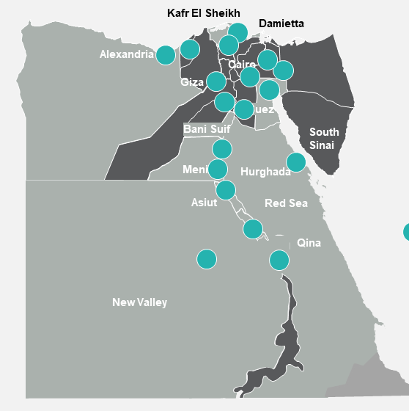




TAQA Arabia · Regional Presence
A growing platform across Egypt, the GCC, Africa and Greece
Geographic Footprint
Reach & Scale
8
4
Countries of presence
Operating divisions
Egypt, GCC, Africa & Greece
Gas · Power · Petroleum · Water
20+
3,400+
Governorates in Egypt
Employees
Industrial, residential & touristic
Across all divisions
International Expansion
GCC — Partnered and qualified with major players (Al Ghaneim, WETICO) for the Sovereign water-desalination program of up to 800,000 m³/day. Africa & Greece — Active development pipeline extending TAQA's integrated energy model beyond Egypt.
Governorates of operation across Egypt — concessions in 8 governorates renewed for 15 years.

Slide 4

TAQA Arabia · In Numbers
The scale behind a single residential utility partner — FY 2025
Operating Scale Across the Divisions
THE GROUP AT A GLANCE
GAS
POWER
EGP 13.4bn
+10,000
8
+1,600
+150
Revenue — FY 2025
km network
governorate concessions (15-yr)
MVA distribution
MW generation capacity
EGP 1.5bn
EBITDA — FY 2025
WATER
MOBILITY & CNG
~6.5M
+47,000
15
86
1st
Residential gas customers
m³/day desalination
operational locations
CNG stations
private EV-charging license
Founded 2006 · Listed on EGX 2023 · 3,400+ employees across all divisions

Slide 5

Residential Customers · Solutions Overview
The following slides detail every solution TAQA Arabia offers to residential developments
Six integrated solutions — each presented across three slides: Scope & Value Proposition → Client Value & Delivery Timeline → Proven Track Record.
Mobile CNG
01
Electricity Distribution
02
Water Desalination
03
Off-grid natural gas delivered via mobile virtual pipeline — zero infrastructure capex.
Turnkey MV/LV networks, smart metering and licensed lifetime O&M.
Reverse-osmosis plants and digitalized, solar-powered water operations.
Gas Distribution
04
Diesel Rental
05
EV Chargers
06
End-to-end gas network EPC — design, build, commission and operate.
Emergency & back-up power gensets on a flexible rental / OPEX model.
AC, DC and golf-car charging with full-investment green-mobility services.

Slide 6






1
Mobile CNG: Scope & Value Proposition
Portable natural-gas supply delivering cost savings, flexibility and energy security for off-grid residential communities
SCOPE
VALUE PROPOSITION
Mobile CNG Solution
1
Off-Grid Gas Supply
TAQA Arabia delivers portable CNG via MEGC trailers with an integrated pressure-reduction unit — connecting any compound, resort or remote community to natural gas without waiting for a pipeline, at zero infrastructure capex.
Reliable natural gas to communities without pipeline access — compounds, resorts and remote developments.
2
No-Capex Delivery Model
BOO / BOOT via Capacity-as-a-Service — no upfront infrastructure cost for the community developer.
3
Cost Savings vs. Diesel & LPG
What we deliver
≈40% lower fuel cost than diesel; replaces LPG and electric heating across the development.
MEGC trailers (5,700 Nm³ at 250 bar) with optional onboard PRU
Mother / Mobile / Daughter virtual-pipeline station chain
Capacity-as-a-Service billing (reserved Nm³/day)
SCADA real-time monitoring & automatic hot-swap dispatch
End-to-end: survey, permitting, deploy, operate & maintain
4
Cleaner Emissions
Cuts CO₂ by ~24% vs. diesel and lowers NOx & particulates — supports ESG and green-rating targets.
5
99.5% Uptime SLA
SCADA-monitored hot-swap replenishment guarantees uninterrupted supply to every home.
6
Scalable to Any Load
Starter (500 Nm³/day) to Heavy (5,000+ Nm³/day) — scales with occupancy, bridges to grid later.

Slide 7




1
Mobile CNG: Value to the Client & Delivery Timeline
What changes for the client after implementation — and how TAQA delivers it, phase by phase
VALUE ADDED TO THE CLIENT
Immediate Liveability
Lower Resident Bills
Zero Developer Capex
Bridge-to-Grid Security
Hot water, cooking gas and heating from day one — units become sellable and occupiable before the pipeline arrives.
Natural gas at ~13 EGP/m³ vs. ~20.5 EGP/L diesel translates directly into lower service charges for residents.
TAQA finances, owns and operates the asset; the developer preserves capital for the core build.
Covers the typical 2–5-year gap until the national grid reaches new cities and remote zones.
IMPLEMENTATION TIMELINE — START TO FINISH
1
2
3
4
5
6
7
Discovery
Initial Contact
Site Audit
Contract
Mobilization
On-Site Install
Live Gas
Day 0
Day 1–3
Day 4–7
Day 8–14
Day 15–30
Day 90–120
Day 120–200
Lead identification & commercial qualification.
NDA signed, requirement scoping.
Technical load profiling & demand curve.
Capacity tier, CaaS pricing & 99.5% SLA.
MEGC & PRU procured and prepared.
PRU adapter installed, SCADA activated.
Switchover from diesel to live CNG supply.

Slide 8
1
Mobile CNG: Proven Track Record
A show of muscle — what TAQA Arabia has already delivered
First company in Egypt to supply natural gas through a mobile virtual pipeline
TAQA Arabia pioneered mobile CNG in Egypt, using its network of 86 CNG stations to extend a virtual pipeline into four governorates with no fixed gas infrastructure. The same model now serves industrial, residential, touristic and agribusiness clients — proving off-grid communities can run on clean natural gas years before the physical pipeline arrives.
86
4
CNG stations feeding the virtual pipeline
Governorates served off-grid
+2,350
+10
Virtual Pipeline — 4 Governorates
mmscf CNG delivered per year
Active mobile-CNG clients

Slide 9





2
Electricity Distribution: Scope & Value Proposition
Turnkey distribution networks for residential developments — from power sourcing and design through licensed lifetime O&M
SCOPE
VALUE PROPOSITION
Turnkey Power Distribution
1
Largest Private Distributor
TAQA Arabia is the largest private electricity distributor in Egypt. For residential developments it sources power, builds the substation and medium/low-voltage network, installs smart metering, and operates the whole asset under a licensed long-term concession.
42% private-sector distribution market share and Egypt's first private distribution & generation licenses.
2
Full O&M Service Model
Developer owns the network; TAQA delivers licensed lifecycle operation under a long-term contract.
3
Profit-Share Model
What we deliver
Aligned commercials — developer and TAQA share upside from electricity sales and metering revenues.
Power sourcing, government relations & grid MV interconnection
Substation development & engineering / load-study approvals
MV / LV distribution network design, supply & installation
Solar PV & hybrid power integration options
Smart metering: supply, install & billing software platform
Licensed 24/7 distribution-network O&M & meter maintenance
4
Demand-Side Management
Smart-meter analytics drive load shifting and peak shaving — lower bills and reduced grid stress.
5
Reliability & Smart O&M
24/7 predictive maintenance and rapid-response teams with guaranteed SAIDI / SAIFI performance.
6
Smart Metering & App
Power & water smart metering with consumption analytics and real-time resident notifications.

Slide 10

2
Electricity Distribution: Value to the Client & Delivery Timeline
What changes for the client after implementation — and how TAQA delivers it, phase by phase
VALUE ADDED TO THE CLIENT
Guaranteed Power Quality
A New Revenue Stream
Single Accountable Operator
Lower Resident Bills
Stable, metered, billable electricity to every unit from handover — no reliance on stretched public utilities.
The profit-share model turns the distribution network from a cost centre into recurring income for the developer.
One licensed party owns sourcing, network, metering and O&M — no finger-pointing between contractors.
Demand-side management and tariff optimization reduce consumption and end-user charges.
IMPLEMENTATION TIMELINE — START TO FINISH
1
2
3
4
5
6
Power Sourcing
Engineering Approval
MEP Approval
Value Engineering
Smart Metering
Operation & Maintenance
Phase 1
Phase 2
Phase 3
Phase 4
Phase 5
Phase 6
Gov. relations, grid interim MV interconnection.
Load study & engineering drawings approval.
Shop drawings / BOM, FAT & supervision.
Demand planning & techno-commercial solution.
Power & water metering supply & platform.
Licensed lifetime network & meter O&M.

Slide 11
2
Electricity Distribution: Proven Track Record
A show of muscle — what TAQA Arabia has already delivered
Powering Egypt's leading residential and mixed-use developments
TAQA Power operates +1,600 MVA of distribution capacity, of which 950 MVA serves 26 mixed-use and residential concessions across 31 million m². Its NABQ (160 MVA) and 6th of October Developers (250 MVA) substations anchor a network serving developers such as Emaar, Ora, City Edge, Marakez and LMD — currently +12,000 customers, targeting 50,000.
+1,600
950
MVA distribution capacity
MVA serving residential / mixed-use
26
~35,000
Mixed-Use Compounds — 950 MVA
Mixed-use concessions
Power customers served

Slide 12


3
Water Desalination: Scope & Value Proposition
Reliable freshwater for residential developments — turnkey reverse-osmosis desalination, smart operations and lifecycle support
SCOPE
VALUE PROPOSITION
Turnkey Desalination & Smart Water
1
Reliable Freshwater Supply
TAQA Arabia delivers guaranteed freshwater security for residential and coastal developments via reverse-osmosis desalination plants and fully digitalized water operations — using technology that consumes up to 50% less power than its peers.
Guaranteed water security for new developments — independent of grid-utility constraints.
2
50% Lower Energy Use
Advanced energy-efficient desalination plus VSDs, peak-demand control and solar PV cut power use.
3
Cost & Risk Covered by TAQA
What we deliver
BOO / BOOT models with long-term water-purchase agreements — minimal upfront capex.
Reverse-osmosis (RO) desalination plant design & build
Pre-treatment, post-treatment & brine management
Energy-efficient pumping: VSDs & PID-controlled networks
Solar PV integration on rooftops, tanks & parking
IoT monitoring: water quality, smart dosing & tank levels
O&M, smart metering & predictive analytics
4
Sustainability & ESG Impact
Solar-powered desalination, brine management and a reduced freshwater-extraction footprint.
5
Smart Operations & Uptime
Real-time monitoring, leak & failure detection and predictive-maintenance dashboards.
6
Resident Experience
Dynamic billing, consumption analytics and real-time notifications via mobile app.

Slide 13


3
Water Desalination: Value to the Client & Delivery Timeline
What changes for the client after implementation — and how TAQA delivers it, phase by phase
VALUE ADDED TO THE CLIENT
Water Security on Day One
No Capex, Predictable OPEX
Green-Rating Enabler
Lifecycle Peace of Mind
Coastal and desert developments get reliable potable water independent of public-network capacity.
TAQA funds and owns the plant; the developer pays a transparent per-m³ rate under a water-purchase agreement.
Solar-powered RO and brine management support LEED / green-community certification and ESG goals.
Smart O&M, leak detection and predictive maintenance protect uptime for the life of the community.
IMPLEMENTATION TIMELINE — START TO FINISH
1
2
3
4
5
6
Water Demand Study
Plant Design
Commercial Model
Construction
Commissioning
Smart O&M
Phase 1
Phase 2
Phase 3
Phase 4
Phase 5
Phase 6
Consumption profiling & source-water survey.
RO sizing, pre/post-treatment & PV integration.
BOO/BOOT & water-purchase agreement.
Plant build, networks & smart metering.
Testing, water-quality validation & handover.
IoT monitoring & predictive maintenance.

Slide 14
3
Water Desalination: Proven Track Record
A show of muscle — what TAQA Arabia has already delivered
Egypt's first & largest eco solar-powered water-desalination plant
On the Red Sea, TAQA Water built Egypt's first green desalination facility powered entirely by renewable energy, using technology that consumes 50% less power than peers. It serves 50,000+ people in the Red Sea Governorate and cuts CO₂ by 8,560 tonnes a year — winning both Sustainable Project of the Year and Power & Water Project of the Year.
+47,000
15
m³/day contracted desalination capacity
Operational water locations
50,000+
8,560
Soma Bay — Eco Solar Desalination
People served at Soma Bay
Tonnes CO₂ avoided per year

Slide 15
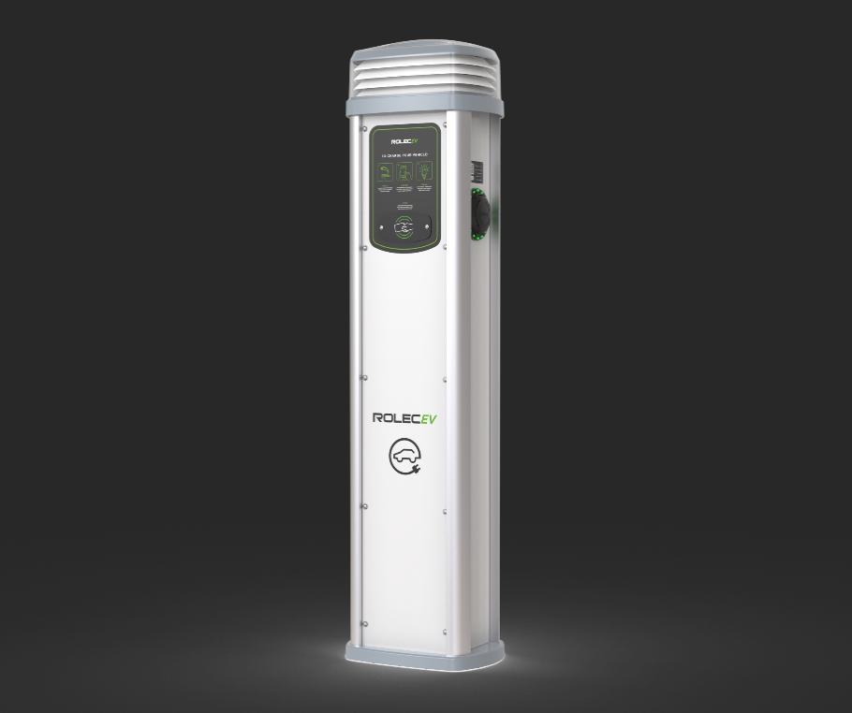

4
Gas Distribution: Scope & Value Proposition
End-to-end EPC for natural-gas distribution networks across residential communities and mixed-use developments
SCOPE
VALUE PROPOSITION
Turnkey Gas Network EPC
1
25+ Years EPC Experience
As Egypt's largest private gas distributor, TAQA Arabia delivers full-scope Engineering, Procurement and Construction for natural-gas distribution networks — from feasibility and route planning through testing, commissioning and lifetime operation of the community network.
Decades of project delivery across Egypt and the wider MENA region.
2
Largest Private Distributor
11.5% national LDC share and 66% of private gas concessions — serving ~6.5M residential customers.
3
In-House Engineering & PMO
Dedicated engineering and project-management teams under one roof.
What we deliver
4
Standards Compliance
Feasibility studies & network route planning
Detailed engineering & design
Procurement of pipes, valves, meters & SCADA
Construction & installation of distribution networks
Testing, commissioning & handover
Integration with power & utility infrastructure
Aligned with IGEM, EGAS and international gas-safety standards.
5
Single-Point Accountability
End-to-end EPC ownership — design through commissioning and handover.
6
Integrated Utility Backbone
Gas networks integrated with TAQA's broader power, water and EV offering.

Slide 16
4
Gas Distribution: Value to the Client & Delivery Timeline
What changes for the client after implementation — and how TAQA delivers it, phase by phase
VALUE ADDED TO THE CLIENT
Piped Gas to Every Home
Higher Property Value
One EPC Partner
Safe & Compliant
Residents get safe, metered, always-on natural gas for cooking, heating and hot water.
Connection to the national gas grid is a premium amenity that lifts unit sale and rental value.
A single accountable party from feasibility to handover removes interface risk for the developer.
IGEM / EGAS-compliant design and construction protect residents and de-risk approvals.
IMPLEMENTATION TIMELINE — START TO FINISH
1
2
3
4
5
6
Feasibility
Engineering
Procurement
Construction
Commissioning
Operation
Phase 1
Phase 2
Phase 3
Phase 4
Phase 5
Phase 6
Network feasibility & route planning.
Detailed engineering & design.
Pipes, valves, meters & SCADA sourcing.
Network installation across the community.
Testing, safety checks & handover.
Licensed distribution & metering O&M.

Slide 17
4
Gas Distribution: Proven Track Record
A show of muscle — what TAQA Arabia has already delivered
Egypt's largest private gas distributor, serving ~6.5 million residential customers
TAQA Gas operates a network exceeding 10,000 km across 8 governorate concessions, renewed for 15 years since 2019. With ~6.5 million residential customers connected and a 66% share of private gas concessions, it has the EPC and operating track record to build and run the gas backbone of any new residential community.
+10,000
~6.5M
km of gas network
Residential customers
8
66%
+10,000 km Network — 8 Governorates
Governorate concessions (15-yr)
Of private gas concessions

Slide 18

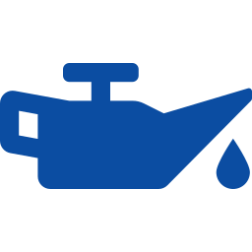

5
Diesel Rental: Scope & Value Proposition
Reliable emergency & back-up power for residential developments — turnkey diesel gensets on a rental / OPEX model with 24/7 O&M
SCOPE
VALUE PROPOSITION
Turnkey Diesel Power Solutions
1
Business / Community Continuity
TAQA Arabia supplies, installs, rents and operates diesel generator sets for emergency and back-up power across residential compounds, clubhouses and community infrastructure — on a flexible rental model with full 24/7 operation and maintenance.
Instant back-up power keeps lifts, pumps, lighting and amenities running through any outage.
2
Rapid Deployment
Standardized gensets and skid solutions installed and commissioned fast.
3
Flexible Capacity
Modular sizing from 500 kVA to 20 MVA — scale up or relocate as the development grows.
What we deliver
4
On-Site Fuel Storage
Diesel generator supply, sizing & commissioning
Synchronization, ATS & switchgear integration
Acoustic enclosures, exhaust & cooling systems
Fuel storage & bulk distribution
Remote monitoring & predictive maintenance
24/7 O&M, spares & rapid-response service
Bulk fuel tanks and managed distribution ensure extended autonomy during outages.
5
Compliant & Safe
Meets local emissions, noise and electrical-safety standards for residential zones.
6
Rental & OPEX Model
Rental and full-service options with guaranteed response SLAs — no capital outlay.

Slide 19


5
Diesel Rental: Value to the Client & Delivery Timeline
What changes for the client after implementation — and how TAQA delivers it, phase by phase
VALUE ADDED TO THE CLIENT
Uninterrupted Living
No Capital Lock-Up
Right-Sized & Relocatable
Hands-Off Reliability
Residents keep power to elevators, water pumps, security and common areas during grid failures.
Rental model means the developer avoids buying, owning and depreciating generator assets.
Capacity flexes with construction phases and occupancy, then redeploys where needed.
TAQA's 24/7 O&M, remote monitoring and rapid response remove the operating burden entirely.
IMPLEMENTATION TIMELINE — START TO FINISH
1
2
3
4
5
6
Load Assessment
Genset Sizing
Delivery
Integration
Commissioning
24/7 O&M
Phase 1
Phase 2
Phase 3
Phase 4
Phase 5
Phase 6
Back-up load survey & redundancy plan.
Capacity selection & rental structuring.
Gensets, enclosures & fuel tanks delivered.
Synchronization, ATS & switchgear tie-in.
Testing, safety checks & go-live.
Remote monitoring & rapid-response service.

Slide 20
5
Diesel Rental: Proven Track Record
A show of muscle — what TAQA Arabia has already delivered
Owning and operating captive generation across Egypt's toughest sites
TAQA Power owns and operates 6 captive power plants and +150 MW of contracted generation capacity through long-term agreements, including flare-to-power and combined-heat-and-power systems. The same engineering, fuel-logistics and 24/7 O&M discipline underpins TAQA's diesel back-up rental offering for residential communities.
6
+150
Captive power plants operated
MW contracted generation
500 kVA–20 MVA
24/7
Captive Power — 6 Plants
Genset sizing range
O&M and rapid response

Slide 21
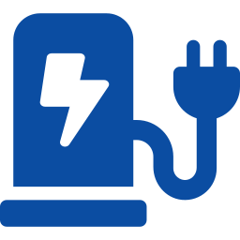
6
EV Chargers: Scope & Value Proposition
Green-mobility charging for residential communities — three charger lines and six end-to-end services on a full-investment model
SCOPE
VALUE PROPOSITION
EV Charging Infrastructure
1
First EV License in Egypt
TAQA Arabia holds Egypt's first EV-charging license and delivers complete green-mobility infrastructure for residential developments — engineering, supply, installation, operation and even full investment — backed by a 24/7 hotline and a user / operator mobile app.
TAQA holds the first private EV-charging license in the country — a genuine first-mover advantage.
2
Full Charger Range
AC, DC fast and golf-car chargers cover every residential and resort mobility need.
3
Full-Investment Option
What we deliver
TAQA can fund the entire network under a profit-share model — zero capex for the developer.
AC EV chargers — residential & commercial
DC fast chargers — highways & community gateways
Golf-car chargers — resorts, campuses & estates
Engineering: site assessment & charger network design
Supply, installation & lifecycle O&M (uptime support)
Full-investment profit-share model, hotline & mobile app
4
Turnkey Engineering
Site assessment, design, supply and installation delivered end-to-end by one partner.
5
Lifecycle O&M & Uptime
Ongoing operation and maintenance keep every charger available and revenue-generating.
6
Hotline & Mobile App
24/7 TAQA hotline plus a user and operator app for seamless charging and management.

Slide 22


6
EV Chargers: Value to the Client & Delivery Timeline
What changes for the client after implementation — and how TAQA delivers it, phase by phase
VALUE ADDED TO THE CLIENT
Future-Proof Amenity
New Recurring Revenue
Zero Capex Entry
Effortless Resident Experience
EV-ready parking is now a deciding factor for buyers — it differentiates and future-proofs the community.
The profit-share model turns charging into an income stream shared with the developer.
Full-investment option lets developers offer charging without funding the hardware or installation.
App-based charging, transparent billing and a 24/7 hotline make adoption simple for residents.
IMPLEMENTATION TIMELINE — START TO FINISH
1
2
3
4
5
6
Site Assessment
Commercial Model
Supply
Installation
Activation
O&M & Support
Phase 1
Phase 2
Phase 3
Phase 4
Phase 5
Phase 6
Engineering survey & charger-mix design.
Full-investment / profit-share structuring.
AC / DC / golf-car charger procurement.
Turnkey installation & grid tie-in.
App onboarding, testing & go-live.
Lifecycle uptime, hotline & app support.

Slide 23
6
EV Chargers: Proven Track Record
A show of muscle — what TAQA Arabia has already delivered
Pioneering Egypt's EV-charging rollout from the front
TAQA Power secured the first private EV-charging license in Egypt and is rolling out AC and DC charging across residential, commercial and highway locations, supported by its own operator and user mobile app and 24/7 hotline. As Egypt's largest private power player, TAQA pairs charging with on-site solar and distribution — a complete green-mobility package for any community.
1st
3
Private EV-charging license in Egypt
Charger lines: AC, DC & golf-car
6
24/7
First EV License — Green Mobility
End-to-end services offered
Hotline & app support

Slide 24


Why One Partner: The TAQA One-Stop-Shop
One SLA, one communication point, one accountable operator — across every utility in the community
From Fragmented Vendors to a Single Operator
One SLA
A single service-level agreement governs gas, power, water, back-up and EV — one uptime guarantee, one penalty regime, one renewal.
Mobile CNG
TAQA
Arabia
One Communication Point
A single account team and 24/7 hotline for every utility — no chasing five contractors when something needs attention.
EV Charging
Electricity
One Commercial Relationship
Consolidated billing, aligned contract terms and a single negotiation instead of six separate procurement cycles.
One Engineering Standard
Utilities designed to interoperate from day one — shared trenches, shared metering platform, shared monitoring.
Diesel Back-up
Water
One Accountable Owner
End-to-end responsibility removes interface risk and finger-pointing between specialised vendors.
Gas

Slide 25


The Power of the Bundle: Cross-Solution Benefits
How combining the solutions under one SLA creates value no single vendor can match
Solar + Desalination
Solar + EV Charging
Distribution + Smart Metering
On-site solar PV powers the RO plant — Egypt's first eco green desalination model, cutting both energy cost and CO₂.
Community solar feeds EV chargers, lowering charging cost and maximising the green-mobility story for residents.
One metering platform bills electricity and water together — shared infrastructure, single resident app.
Gas + Mobile CNG
Diesel + Distribution
Shared O&M & Monitoring
Mobile CNG bridges supply until the permanent gas network goes live — seamless handover, no diesel gap.
Back-up gensets integrate directly into the TAQA-built distribution network with automatic transfer — true redundancy.
One control room and field team monitor every utility — pooled spares, pooled response, lower unit O&M cost.
Sold as one SLA: lower combined cost · shared infrastructure & trenches · one billing & monitoring platform · stronger ESG / green-rating story · single accountable operator for the entire community utility backbone.

Slide 26
Success Story: Soma Bay
A single destination running on multiple TAQA solutions — the one-stop-shop, proven
Egypt's first & largest eco solar-powered desalination plant
At Soma Bay on the Red Sea, TAQA Arabia integrated solar generation, power distribution and reverse-osmosis desalination into a single, renewable-powered utility system — using technology that consumes 50% less power than its peers. It is the clearest proof of the bundled, one-SLA model serving a residential and touristic destination.
Solutions combined on one site:
Solar PV
Power Distribution
Water Desalination
Smart O&M
50,000+
8,560
People served (Red Sea Gov.)
Tonnes CO₂ avoided / year
50%
2
Less power than peer plants
Industry awards won
Recognised as Sustainable Project of the Year and Power & Water Project of the Year.

