Slide 1
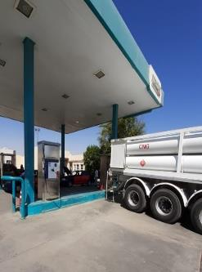
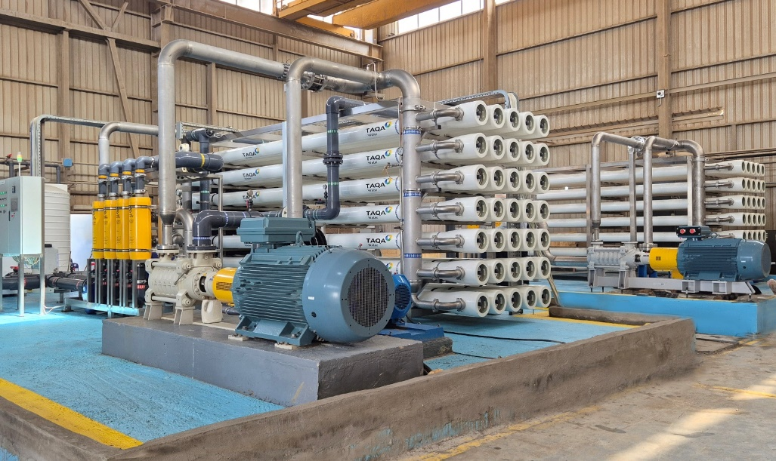
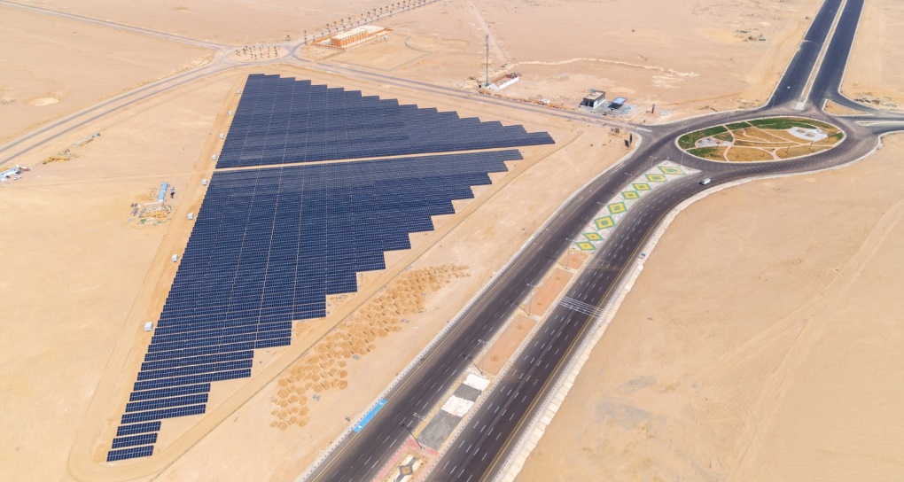
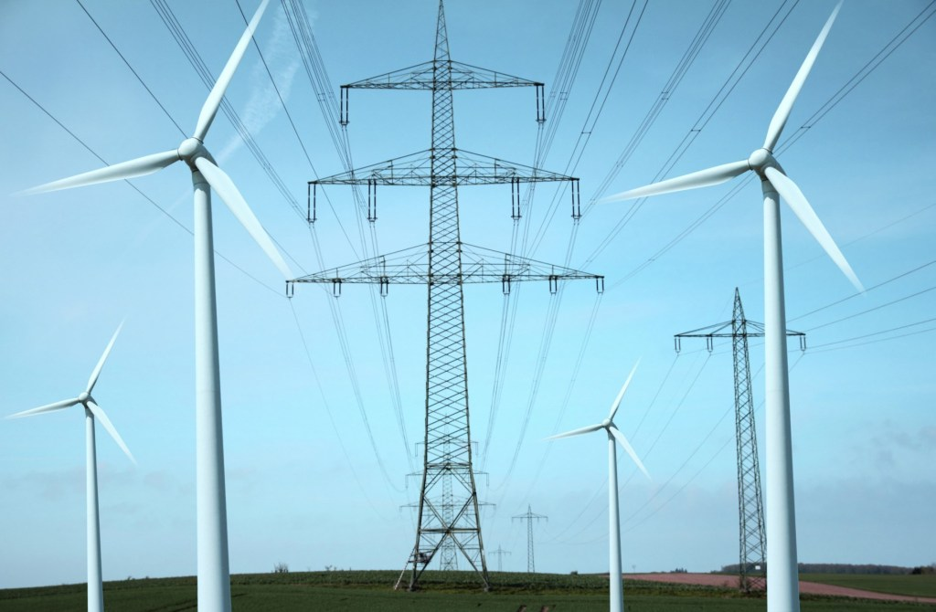
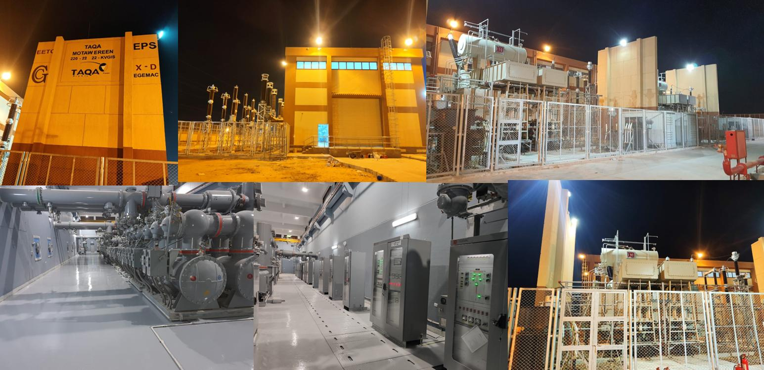
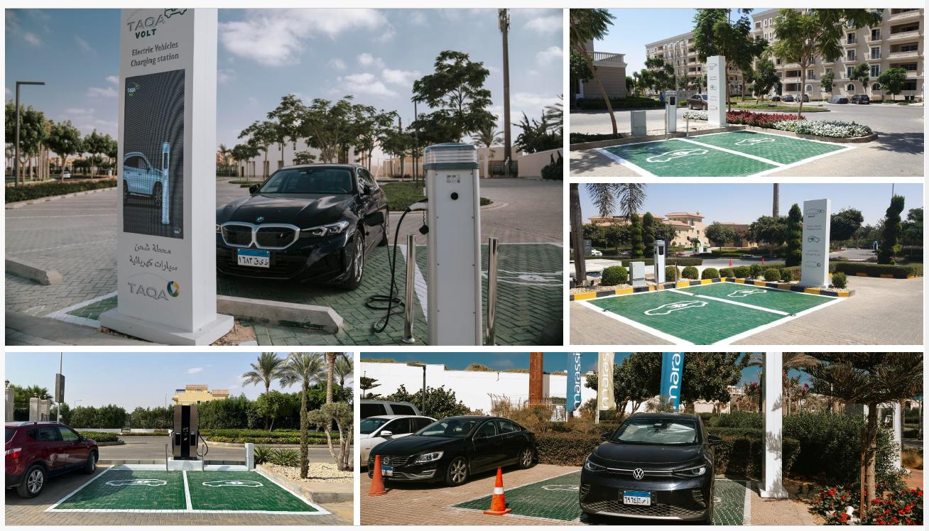



TAQA Arabia
Agriculture Clients
Integrated Energy & Utility Solutions · Jan 2026

Slide 2




TAQA Arabia · Who We Are
A World of Energy, Delivered End-to-End
Gas
Power
Founded in 2006 and listed on the EGX since 2023, TAQA Arabia is Egypt's largest private-sector energy and utility developer.
Across four divisions — Gas, Power, Petroleum and Water — TAQA finances, builds, owns and operates the utility backbone of residential communities, industrial zones and touristic destinations.
For a residential developer, that means one accredited partner can deliver gas, electricity, water, back-up power and EV charging under a single relationship.
Gas distribution & EPC networks
NGV stations & car conversion
Mobile CNG & LNG (virtual pipeline)
Generation & distribution (+1,600 MVA)
Renewable energy & solar PV
EV charging stations
Petroleum
Water
Oil-marketing stations & terminals
Lubricants retail & distribution
Bulk fuel storage & logistics
Reverse-osmosis desalination
Filtration & chemical treatment
Smart, solar-powered operations
Active member of the International Gas Union (IGU)
Accredited by the IGEM (Institution of Gas Engineers & Managers)

Slide 3
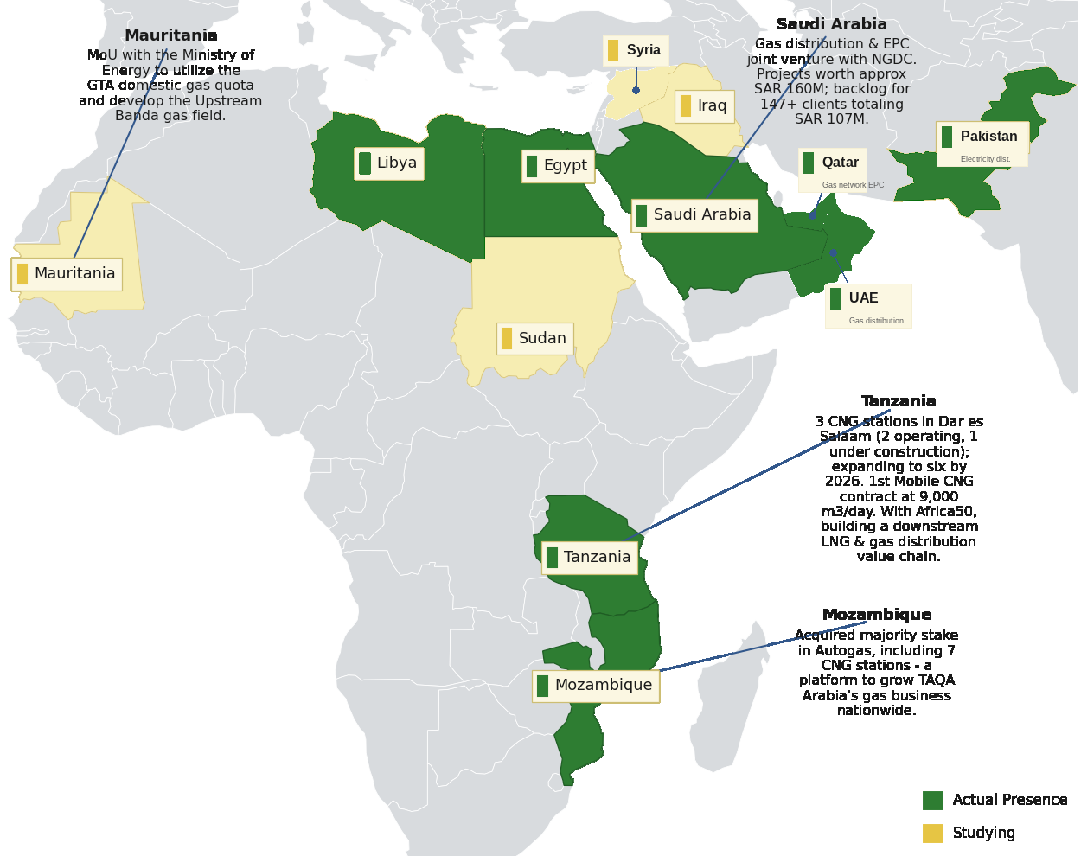




TAQA Arabia · Regional Presence
Presence Across Africa & the Middle East
Reach & Scale
10
Countries of presence
Egypt, GCC, Africa & South Asia
4
Operating divisions
Gas · Power · Petroleum · Water
20+
Governorates in Egypt
Industrial, residential & touristic
3,400+
Employees
Across all divisions
Actual presence and markets under study across Africa & the Middle East — extending TAQA’s integrated energy model well beyond Egypt.

Slide 4

TAQA Arabia · In Numbers
The scale behind a single residential utility partner — FY 2025
Operating Scale Across the Divisions
THE GROUP AT A GLANCE
GAS
POWER
EGP 13.4bn
+10,000
8
+1,600
+150
Revenue — FY 2025
km network
governorate concessions (15-yr)
MVA distribution
MW generation capacity
EGP 18bn+
Assets under Management
WATER
MOBILITY & CNG
~6.5M
+47,000
15
300
1st
Residential gas customers
m³/day desalination
operational locations
Total stations
private EV-charging license
Founded 2006 · Listed on EGX 2023 · 3,400+ employees across all divisions

Slide 5






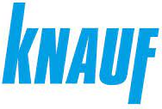




















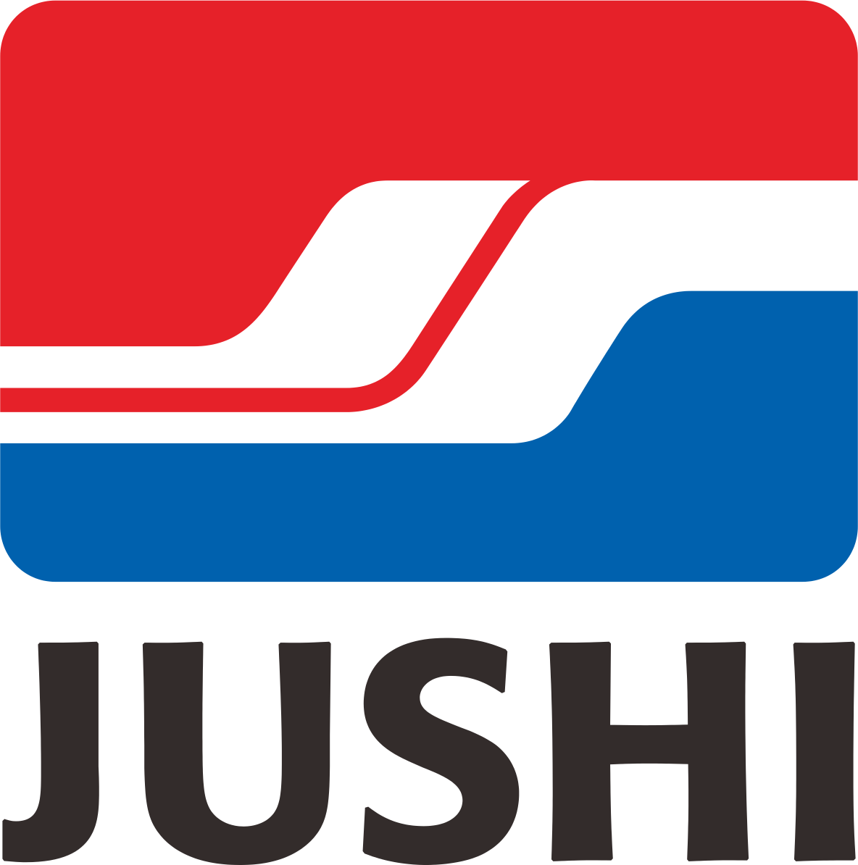












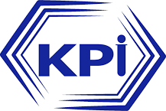



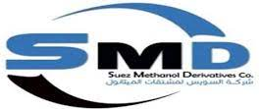





























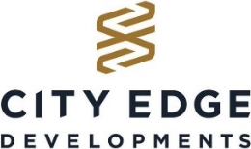



















TAQA Arabia · Trusted By
Clients and partners served across Multiple divisions

Slide 6
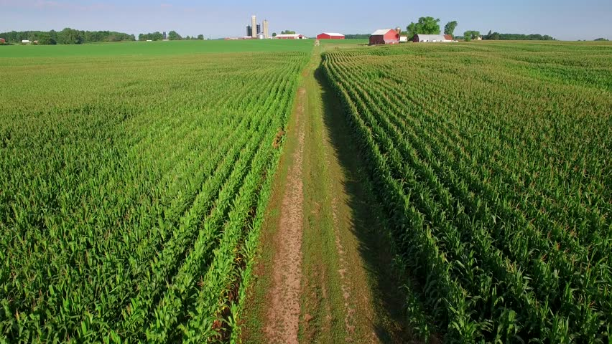




The Challenge Facing Egypt's Farms
Remote, off-grid agriculture is held back by costly fuel, fragile power and water insecurity
Expensive Diesel Dependence
Pivots and pumps run on diesel gensets — the single largest and most volatile cost on the farm, exposed to every fuel-price spike.
No Pipeline, No Grid
Remote reclamation land sits far from the gas pipeline and the electricity grid, with no easy connection in sight.
Water Insecurity
Over-abstracted groundwater and unreliable supply put crop yield — and the whole investment — at risk.
Egypt is reclaiming millions of feddans of desert farmland — almost all of it off-grid.
Fragile, Unmanaged Power
Stand-alone gensets fail, waste fuel at part-load and offer no backup — an interruption can cost an entire irrigation cycle.

Slide 7




The TAQA Integrated Farm Solution
One partner connects water and a smart, multi-source power stack to keep every pivot turning
TAQA delivers the whole farm energy-and-water backbone as one system — we secure the water, then power the pivots with the cheapest, cleanest energy, around the clock.
ENERGY SOURCES
SMART INTEGRATION
THE FARM
Solar
Cheapest day power
Battery Storage
Solar after sunset
Water Solutions
Desalination · wells · pumping
Mobile CNG Gensets
Clean gas firming
TAQA Smart
Energy Management
One control system
Powered Pivots
24/7 irrigation, lower cost
Diesel Gensets
Backup / peaks

Slide 8
The Smart Energy Mix: Power Around the Clock
Solar by day, batteries after sunset, gas and diesel for firming — least-cost, lowest-carbon, always on
Farm power demand (pivots + pumps)
How the stack is dispatched
1
Solar first
Cheapest, cleanest power runs the pivots all day.
2
Then batteries
Stored daytime solar carries irrigation into the evening and early morning.
3
Gas gensets firm
Mobile-CNG gensets fill gaps at ~40% less than diesel.
4
Diesel last
Runs only for peaks and backup — minimised, not relied on.
00:00
06:00
12:00
18:00
24:00
Solar
Battery (stored solar)
Mobile CNG gas gensets
Diesel (backup/peaks)
One TAQA energy-management system optimises the mix every minute — least cost, lowest carbon, always on.

Slide 9
Agriculture · Solutions Overview
The following slides detail every solution TAQA Arabia offers to farms and agribusiness
Water Solutions
01
Solar
02
Desalination, groundwater treatment and smart, solar-powered irrigation pumping.
Tailored solar PV via PPA to power pivots and pumps by day — no farm capex.
Mobile CNG
04
Battery Storage
03
Portable natural gas to fuel farm gensets — ~40% cheaper than diesel.
Shifts solar into the night and firms the stack so pivots never stop.

Slide 10
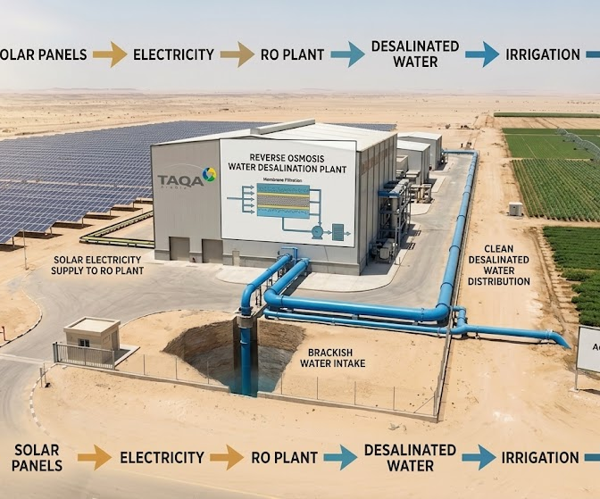
1
Water Solutions: Scope & How It Works
Reliable, cost-effective water for the farm — desalination, groundwater treatment and smart irrigation pumping
SCOPE
1
TAQA INVESTS THE CAPEX
Brackish / seawater RO desalination units · Pre-treatment & filtration system · Storage reservoirs & pumping · Irrigation distribution & smart meters · BOO / BOOT plant financing
2
THE PROCESS — STEP BY STEP
1
TAQA studies the farm's water source, salinity and demand.
2
Brackish or seawater is drawn in and pre-treated.
3
Reverse-osmosis units desalinate water to irrigation quality.
4
Treated water is stored, pumped and distributed to fields.
5
TAQA operates the plant and guarantees volume and quality.
3
WHAT YOU RECEIVE
TAQA can provide an integrated solution, including funding, construction, ownership and operation of the asset subject to project requirements
Reliable irrigation-grade water on demand
Water for
every acre
Independence from strained groundwater
Guaranteed volume, quality and uptime

Slide 11
1
Water Solutions: Value Proposition
Why TAQA Arabia is the right partner for this solution
VALUE PROPOSITION
WHAT YOU GAIN
THE TAQA ARABIA EDGE
Guaranteed Water Security
Flexible Delivery Approach
Reliable freshwater for irrigation, independent of grid-utility and groundwater constraints.
BOO / BOOT or EPC via Capacity-as-a-Service — no upfront infrastructure cost for the community developer.
Lower Energy & Water Cost
Smart Operations & Uptime
VSDs, peak-demand control and solar-powered pumping cut energy use and non-revenue water losses.
Real-time monitoring, leak & failure detection and predictive-maintenance dashboards.
Frees Up Groundwater
Tailored to the Farm
Desalination and treatment reduce over-abstraction, protecting the aquifer for the long term.
Solutions sized to crop type, hectares and irrigation schedule — not one-size-fits-all.
Sustainability & ESG Impact
Performance Guarantees
Solar-powered desalination, brine management and a reduced freshwater-extraction footprint.
Volume and quality backed by contractual SLAs.

Slide 12
1
Water Solutions: Implementation Timeline
IMPLEMENTATION TIMELINE — START TO FINISH
Day 0–20
Day 20–60
Day 45–75
Day 75–210
Day 210–260
Day 260+
1
2
3
4
5
6
Water Demand Study
Plant Design
Commercial Model
Construction
Commissioning
Smart O&M
Crop water need & source-water survey.
RO sizing, pumping & solar integration.
BOO/BOOT & water-purchase agreement.
Plant, wells, networks & smart metering.
Testing, water-quality validation & handover.
IoT monitoring & predictive maintenance.
STUDY & DESIGN Day 0–60
FINANCE & BUILD Day 45–260
SMART OPERATE Day 260+
Crop water-demand profiling, source-water survey, RO and pumping sizing, and solar-integration planning for the farm.
BOO/BOOT structuring and water-purchase agreement, plant and well construction, irrigation networks, smart metering and water-quality validation.
IoT monitoring of water quality and flow, leak detection, predictive maintenance and energy-optimised pumping.

Slide 13
1
Water Solutions: Proven Track Record
A show of muscle — what TAQA Arabia has already delivered
Egypt's first & largest eco solar-powered desalination plant
On the Red Sea, TAQA Water built Egypt's first green desalination facility powered entirely by renewable energy, using technology that consumes 50% less power than peers. The same solar-powered, smart-operated water model — proven at scale — secures irrigation supply for large farms and agribusiness.
+47,000
15
m³/day contracted desalination
Operational water locations
50%
8,560
Eco Solar Desalination — Soma Bay
Less power than peer plants
Tonnes CO₂ avoided / year

Slide 14
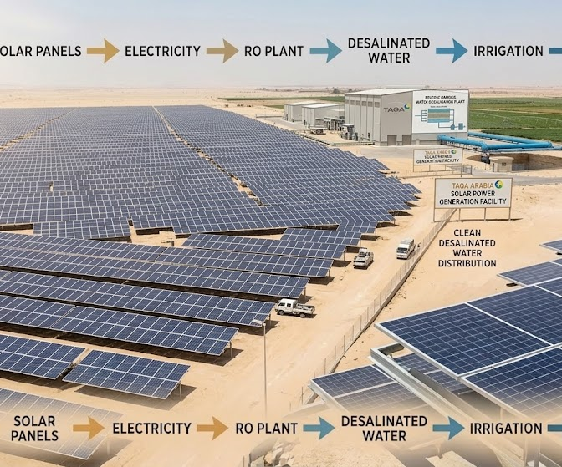
2
Solar: Scope & How It Works
Tailored solar PV to power pivots and pumps by day — integrated with storage and diesel for round-the-clock supply
SCOPE
1
TAQA INVESTS THE CAPEX
Ground-mount & pump-side PV arrays · Solar inverters & mounting · Pump controllers & soft starters · Monitoring & connection works · BOO / BOOT solar financing
2
THE PROCESS — STEP BY STEP
1
TAQA assesses land, sun hours and the farm's pumping load.
2
PV arrays and inverters are installed near pumps and facilities.
3
Panels generate clean power through daylight irrigation hours.
4
Solar drives pumps, cold rooms and farm loads directly.
5
TAQA monitors yield and maintains the system.
3
WHAT YOU RECEIVE
TAQA can provide an integrated solution, including funding, construction, ownership and operation of the asset subject to project requirements
Daytime power matched to irrigation needs
Free fuel
from the sun
Sharp cut in diesel and grid costs
Monitored, maintained PV assets

Slide 15
2
Solar: Value Proposition
Why TAQA Arabia is the right partner for this solution
VALUE PROPOSITION
WHAT YOU GAIN
THE TAQA ARABIA EDGE
Lower Energy Bills
Flexible Financing Solutions
Clean solar energy at lower cost than diesel-only pivot power, through long-term PPAs.
CAPEX, BOOT/BOO or PPA — own it, transfer it over time, or buy cheaper solar under a zero-capex PPA.
Energy Security
Single Energy Partner
On-site generation reduces exposure to fuel-price spikes and supply disruption.
One single utility Provider for electricity and water and providing Both solar and Batteries for Maximum Savings and utilization
Sustainability & Carbon Cut
Lifecycle O&M & Guarantee
Each 1 MWp avoids ~1,000 tons of CO₂ a year — strong ESG and export credentials.
Remote monitoring, maintenance and performance guarantees keep output high for 25+ years.
Uses Idle Land
Egypt’s Solar Pioneer
Marginal and unused farmland becomes a productive, cost-saving energy asset.
Operating Multiple solar Farms and water desalination projects across Egypt

Slide 16
2
Solar: Implementation Timeline
How TAQA delivers the solution from start to finish — phase by phase, with indicative timing
IMPLEMENTATION TIMELINE — START TO FINISH
Day 0–21
Day 21–55
Day 40–75
Day 75–130
Day 130–210
Day 210+
1
2
3
4
5
6
Site & Energy Study
System Design
PPA Structuring
Procurement
Install & Commission
O&M
Irradiation, pivot load & land survey.
Array sizing & genset/battery-tie design.
BOO / BOOT & tariff agreement.
Panels, inverters & mounting sourcing.
Build, tie-in, testing & go-live.
Monitoring & performance maintenance.
STUDY & DESIGN Day 0–55
FINANCE & BUILD Day 40–210
OPERATE Day 210+
Solar-irradiation and pivot-load study, land survey, array sizing and integration design with battery and genset systems.
BOO/BOOT structuring and PPA tariff, procurement of panels, inverters and mounting, installation, tie-in and commissioning.
Monitoring, cleaning and performance maintenance over the life of the PPA.

Slide 17
2
Solar: Case Study “Dina Farms”
A show of muscle — what TAQA Arabia has already delivered
Powering one of Egypt's largest farms (Dina Farms) with 7 Mwp Solar Plant.
farms use diesel generators as part of the operations that costs Currently around 10 EGP per kwh, and it grows over time. TAQA Arabia operates 7 Mwp Solar plant for Dina Farms with a tariff of 0.054 USD per Kwh which saves around 6 EGP per kwh and results Currently in 89 million for the first year.
Dina Farms
Total Savings Over 25 Years
Live agricultural solar project
9.3 Billion EGP
BOO / BOOT
~1,000
Dina Farms — Solar in Action
PPA models, no farm capex
t CO₂ avoided / MWp / yr

Slide 18
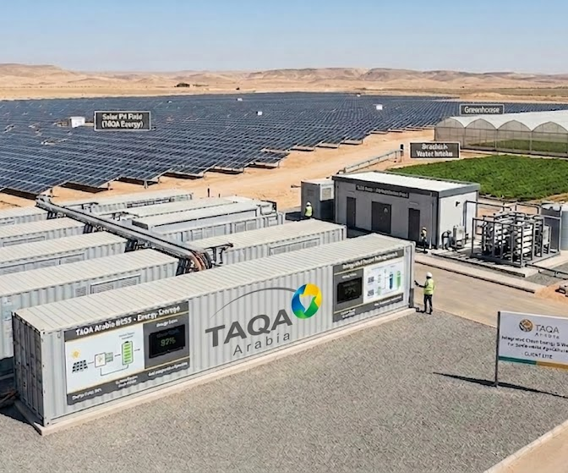
3
Battery Storage (BESS): Scope & How It Works
Battery storage that shifts solar into the night and firms the power stack — so irrigation never stops
SCOPE
1
TAQA INVESTS THE CAPEX
Battery energy-storage units · Power-conversion system & inverters · Switchgear & grid / solar interface · EMS & SCADA controls · BOO / BOOT financing
2
THE PROCESS — STEP BY STEP
1
TAQA sizes storage to the farm's load and solar profile.
2
Battery units and conversion systems are installed.
3
Storage charges from surplus daytime solar.
4
It discharges to run pumps and cold storage after dark.
5
An energy-management system optimizes every cycle.
3
WHAT YOU RECEIVE
TAQA can provide an integrated solution, including funding, construction, ownership and operation of the asset subject to project requirements
Round-the-clock power from daytime solar
Solar
after dark
Backup through grid and supply gaps
Stable energy for cold-chain and pumps

Slide 19
3
Battery Storage (BESS): Value Proposition
Why TAQA Arabia is the right partner for this solution
VALUE PROPOSITION
WHAT YOU GAIN
THE TAQA ARABIA EDGE
Solar After Sunset
Flexible Financing Solutions
Stores daytime solar surplus and dispatches it to run pivots into the evening and early morning.
CAPEX, BOOT/BOO or PPA — own it, transfer it over time, or buy cheaper solar under a zero-capex PPA.
Less Diesel, Lower Cost
Single Energy Partner
Battery dispatch displaces costly diesel-genset hours, cutting fuel spend and engine wear.
One single utility Provider for electricity and water and providing Both solar and Batteries for Maximum Savings and utilization
Greener Every Year
Lifecycle O&M & Guarantee
More stored solar dispatched means less diesel and a steadily smaller carbon footprint.
Remote monitoring, maintenance and performance guarantees keep output high for 25+ years.
A Stacked Asset
Smart Energy Management
One system delivers solar-shifting, peak support and backup — value across multiple uses.
TAQA Arabia EMS automatically optimizes charge/discharge against loads, solar and fuel cost to deliver the lowest Cost per Kwh or M3

Slide 20
3
Battery Storage (BESS): Implementation Timeline
How TAQA delivers the solution from start to finish — phase by phase, with indicative timing
IMPLEMENTATION TIMELINE — START TO FINISH
Day 0–21
Day 21–55
Day 40–75
Day 75–140
Day 140–220
Day 220+
1
2
3
4
5
6
Load & Solar Study
System Design
Commercial Model
Procurement
Install & Commission
Smart O&M
Pivot profile & solar-surplus analysis.
BESS sizing & hybrid configuration.
BOO / BOOT & savings agreement.
Batteries, PCS & EMS sourcing.
Build, integration, testing & go-live.
EMS optimisation & maintenance.
STUDY & DESIGN Day 0–55
FINANCE & BUILD Day 40–220
SMART OPERATE Day 220+
Pivot-load and solar-surplus analysis, BESS sizing and hybrid configuration with solar and gensets for 24-hour supply.
BOO/BOOT structuring and savings agreement, procurement of batteries, PCS and EMS, installation, integration and commissioning.
EMS-driven charge/discharge optimisation against loads, solar and fuel cost, plus monitoring and maintenance.

Slide 21
3
Battery Storage (BESS): Case Study
A show of muscle — what TAQA Arabia has already delivered
Turning intermittent solar into round-the-clock farm power
TAQA Arabia also provides agriculture clients with Solar plus battery so the client could maximize their savings throughout the year instead of using diesel that costs them 10 Egp per kwh. We operates to one of our agriculture client 1.1 Mw PV + 4Mw Batteries that supports the client with 4 hours with a tariff of 4 EGP per kwh with 10% annual increase and this saves for the client 6 EGP per kwh and 14 M EGP in the first year.
Solar shifting
Peak support
Day energy used at night
Firms the power stack
BOO / BOOT
1.3B EGP
Solar-Plus-Storage Integration
No farm capex
Savings over 25 years

Slide 22
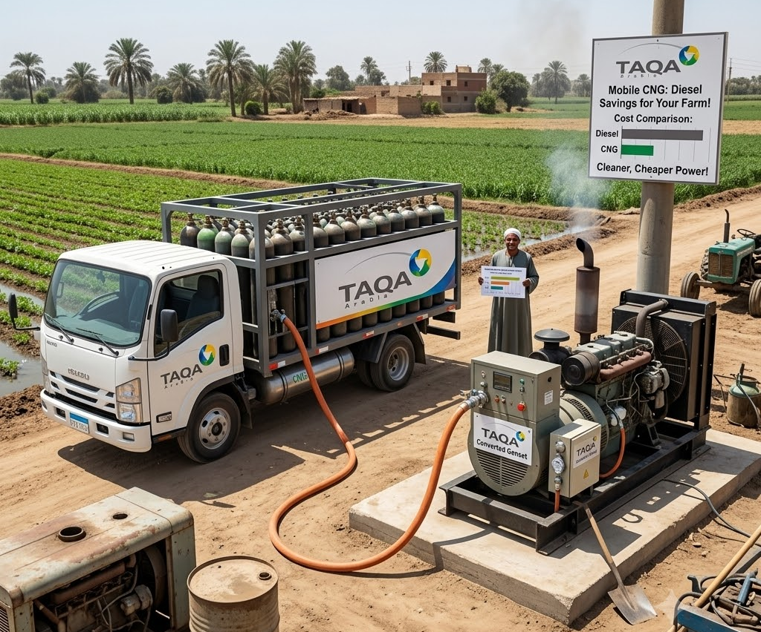
4
Mobile CNG: Scope & How It Works
Portable natural gas to fuel farm gas-gensets — a cleaner, cheaper alternative to diesel where there is no pipeline
SCOPE
1
TAQA INVESTS THE CAPEX
Mother station & compression · CNG / virtual-pipeline trailers · On-site decompression & PRMS skid · Metering & safety controls · BOO / BOOT financing
2
THE PROCESS — STEP BY STEP
1
Gas is compressed at a TAQA mother station to ~250 bar.
2
Trailers deliver it to the farm as a virtual pipeline.
3
On-site skids decompress and regulate to process pressure.
4
Gas fuels dryers, greenhouses and processing.
5
TAQA tracks usage and refills ahead of demand.
3
WHAT YOU RECEIVE
TAQA can provide an integrated solution, including funding, construction, ownership and operation of the asset subject to project requirements
Pipeline-grade gas without a pipeline
Gas,
off-grid
Lower-cost fuel for drying & processing
Managed supply and refills

Slide 23
4
Mobile CNG: Value Proposition
Why TAQA Arabia is the right partner for this solution
VALUE PROPOSITION
WHAT YOU GAIN
THE TAQA ARABIA EDGE
Off-Grid Gas Supply
Master Gas Scale and Network
Reliable natural gas to remote farms with no pipeline access, by mobile virtual pipeline.
TAQA's Master Gas runs Egypt's leading CNG virtual pipeline and has CNG stations scattered Across Egypt
Cost Savings vs. Diesel
Flexible Financing Solutions
Lower fuel cost than diesel — a major cut to the farm's biggest running expense.
CAPEX, BOOT/BOO or PPA — own it, transfer it over time, or buy cheaper solar under a zero-capex PPA.
Cleaner Operations
Scalable to Any Load
~24% lower CO₂ than diesel helps the farm meet tightening emissions and export requirements.
Starter (550 litres/day of diesel) to Heavy (5,500+ litres/day of diesel) — scales with the farm's gas demand.
Offset Diesel Quota
Presence Across Many Governorates
Reduce reliance on diesel quotas by providing cleaner and more cost-effective fuel alternatives.
Operates a nationwide portfolio of Mobile CNG projects across Egypt, extending natural gas access, reducing fuel costs, and enhancing energy reliability for clients

Slide 24
4
Mobile CNG: Implementation Timeline
How TAQA delivers the solution from start to finish — phase by phase, with indicative timing
IMPLEMENTATION TIMELINE — START TO FINISH
Day 0
Day 1–3
Day 4–7
Day 8–14
Day 15–30
Day 90–120
Day 120–200
1
2
3
4
5
6
7
Discovery
Initial Contact
Site Audit
Contract
Mobilization
On-Site Install
Live Gas
Lead identification & qualification.
NDA signed, requirement scoping.
Gas load profiling & demand curve.
Capacity tier, CaaS pricing
MEGC & PRU procured and prepared.
PRU adapter installed, SCADA activated.
Switchover from diesel to live CNG supply.
DISCOVERY & AUDIT Day 0–14
CONTRACTING Day 8–14
DEPLOYMENT & GO-LIVE Day 90–200
Lead qualification, NDA, site visit and full gas-load profiling — output is a precise demand curve and connection plan.
Capacity tier selection (Starter / Industrial / Heavy), CaaS pricing model, 99.5% uptime SLA and payment terms.
MEGC mobilized, PRU adapter installed, SCADA activated, safety tests and switchover from diesel to live CNG supply.

Slide 25
4
Mobile CNG: Proven Track Record
First company in Egypt to supply natural gas through a mobile virtual pipeline
TAQA Arabia pioneered mobile CNG in Egypt, using its network of 86 CNG stations to extend a virtual pipeline into four governorates with no fixed gas infrastructure. The model now serves ceramics, glass, food-processing and other industrial clients — proving off-grid factories can run on clean natural gas years before the pipeline arrives.
Guaranteed Savings
Wide Network
Saving in Comparison to the Current Diesel price
86 Stations Across 20 Governorates
10
Big Success Story
Existing Projects
Supply Natural Gas to a Whole Governorate “Kharge”
Notes:
Build a case study and the benefits from the case study for “El Kharga”

Slide 26



Why One Partner: The TAQA One-Stop-Shop
One SLA, one communication point, one accountable operator — for the farm's water and power
From Five Vendors to One Operator
One SLA
A single agreement covers water, solar, storage, gas and diesel — one uptime guarantee for the whole farm.
Water
TAQA
Arabia
One Communication Point
A single account team and 24/7 hotline — no chasing separate water and power contractors.
Smart EMS
Solar
One Commercial Relationship
Consolidated billing and aligned BOO/BOOT terms instead of separate procurement cycles.
One Smart System
Water and the full power stack run on one TAQA energy-management platform — optimised together.
Diesel
Storage
One Accountable Owner
End-to-end responsibility removes interface risk — TAQA owns the farm's water-and-energy uptime.
Mobile CNG

Slide 27


The Integrated Economics: Diesel-Only vs. TAQA
What changes when one partner runs an optimised water-and-power stack — illustrative
TODAY — DIESEL-ONLY FARM
WITH TAQA — INTEGRATED STACK
High, volatile fuel bill
Up to ~40% lower energy cost
Diesel is the biggest farm cost — exposed to every price spike.
Solar + storage + CNG displace most diesel hours — predictable PPA tariffs.
Pivots stop on failure
24/7 irrigation uptime
Stand-alone gensets fail with no backup — lost irrigation cycles.
Batteries and multi-source firming keep pivots turning through any gap.
High carbon footprint
Sharply lower CO₂
100% diesel means maximum CO₂ and emissions per feddan.
Each 1 MWp of solar avoids ~1,000 t CO₂/yr; CNG cuts a further ~24% vs diesel.
Multiple vendors
One accountable partner
Separate water, fuel and genset suppliers — no accountability.
Single SLA for water + power, zero capex under BOO/BOOT, one smart system.
The result: lower and more predictable energy cost, secured water, round-the-clock irrigation and a stronger ESG story — from one partner, with no capex.
Figures are illustrative / market-based and depend on farm size, crop, irrigation schedule and fuel prices.

Slide 28
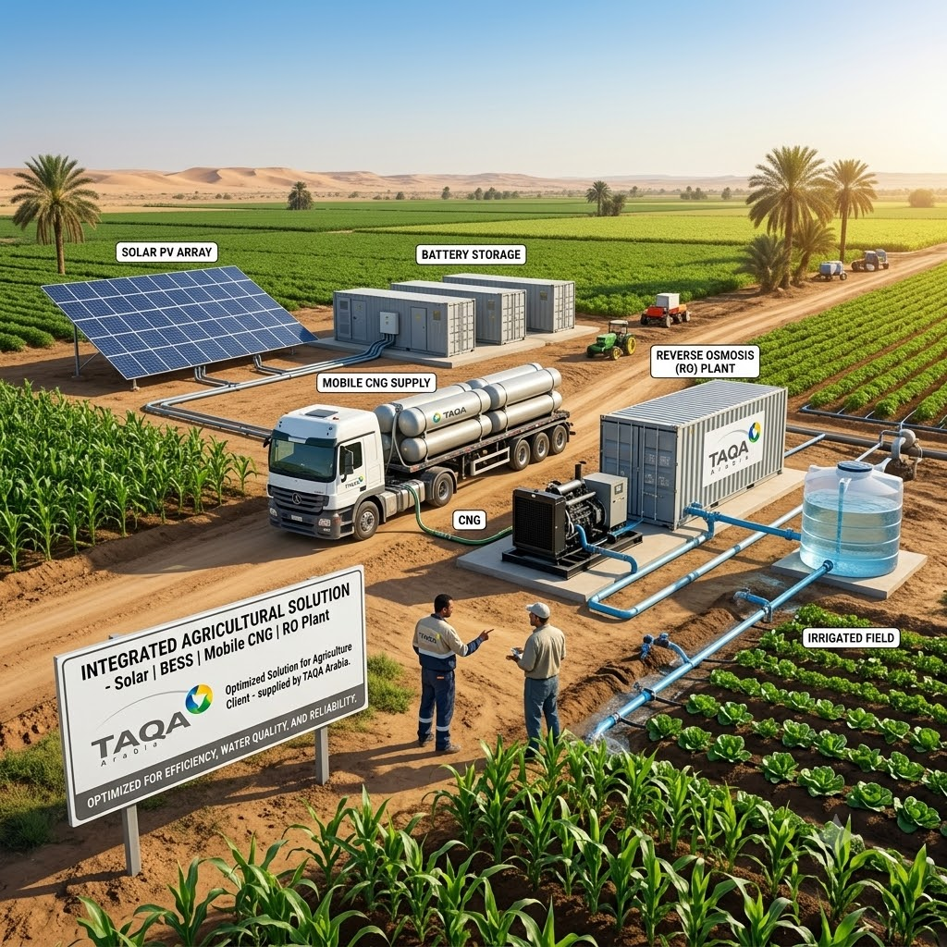
Proven on the Ground: Dina Farms & Beyond
Real agricultural renewable projects — the foundation for the fully integrated farm
Renewable energy at one of Egypt's largest farms
TAQA Arabia operates renewable-energy projects at Dina Farms — one of Egypt's largest integrated agricultural operations — alongside its landmark Benban solar developments. These projects prove TAQA can deploy and run clean energy at true agricultural scale. The next step is the fully integrated stack: pairing that solar with storage, gas and water under one operator.
What we bring to your farm:
Water Solutions
Solar
Battery Storage
Mobile CNG
Dina Farms
Benban
Live agricultural solar
Landmark solar project
~1,000
Zero
t CO₂ / MWp / yr avoided
Capex under BOO/BOOT

