Slide 1
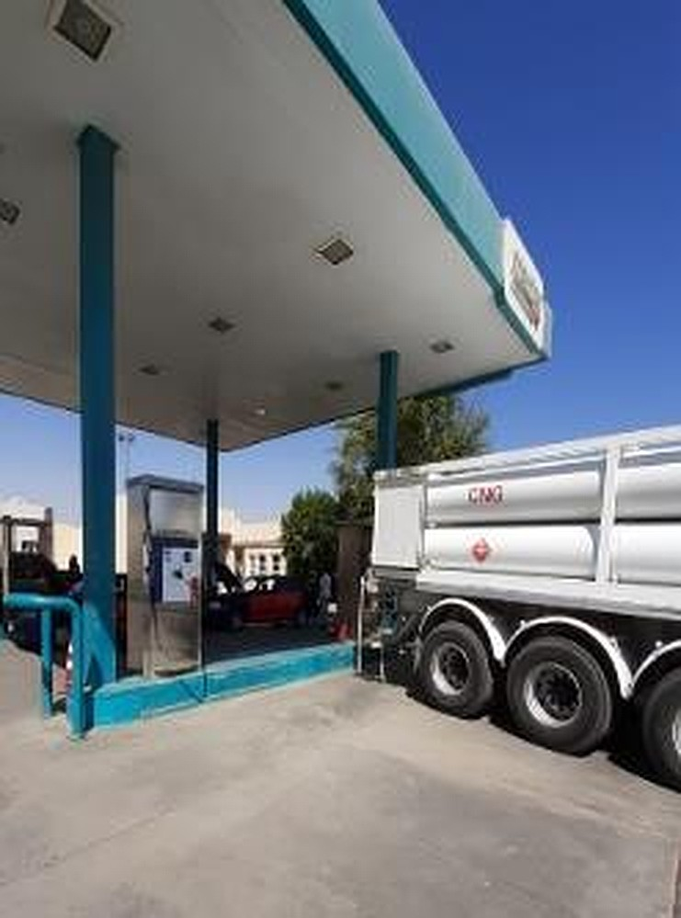
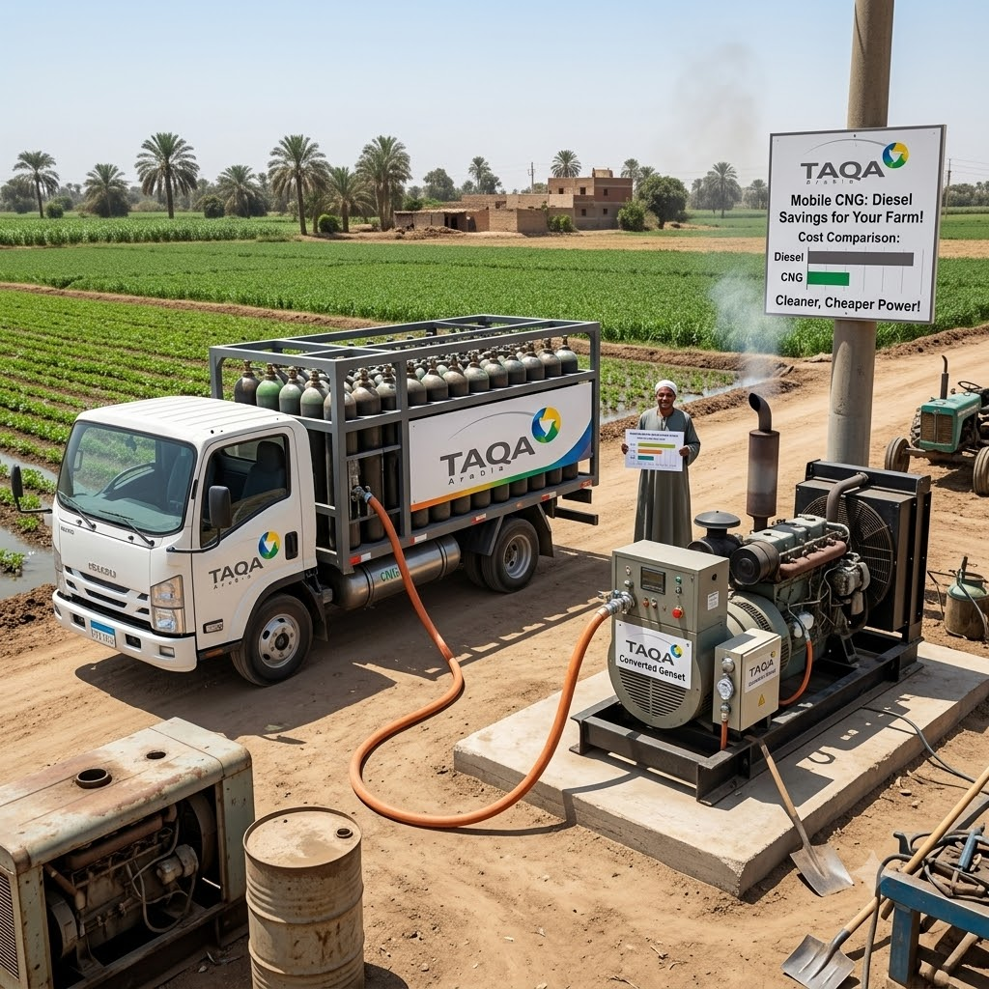
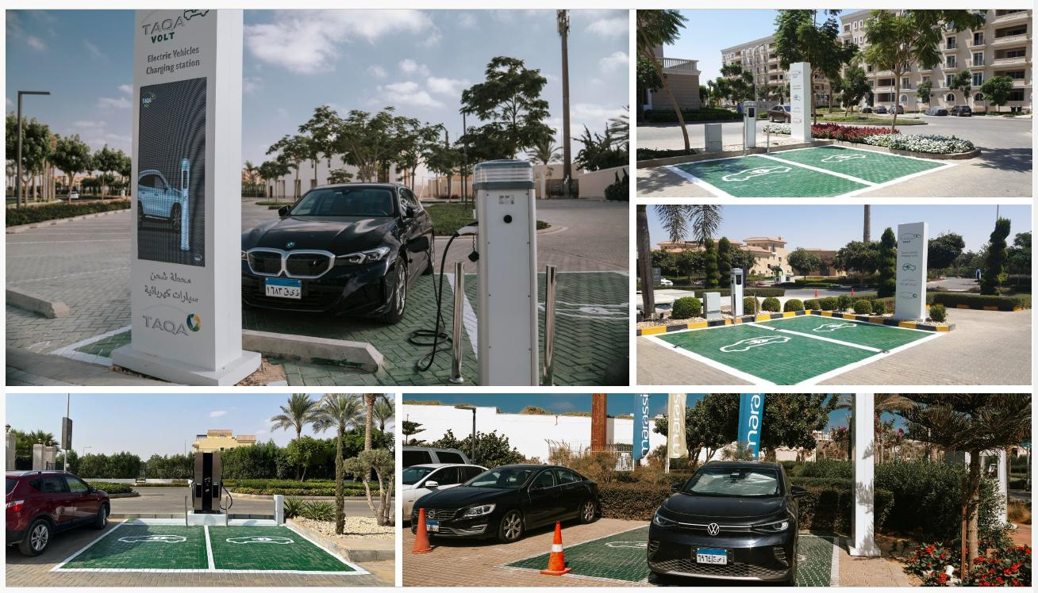
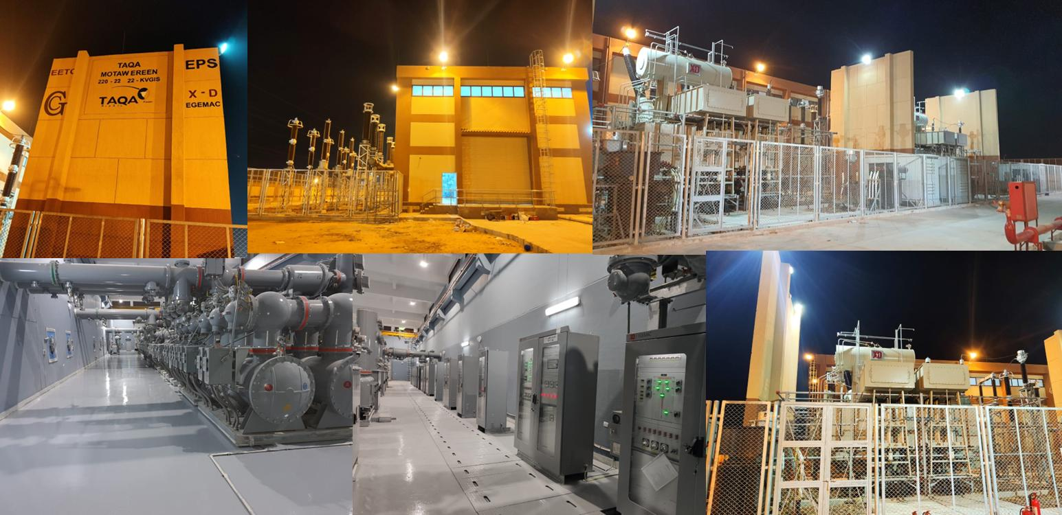
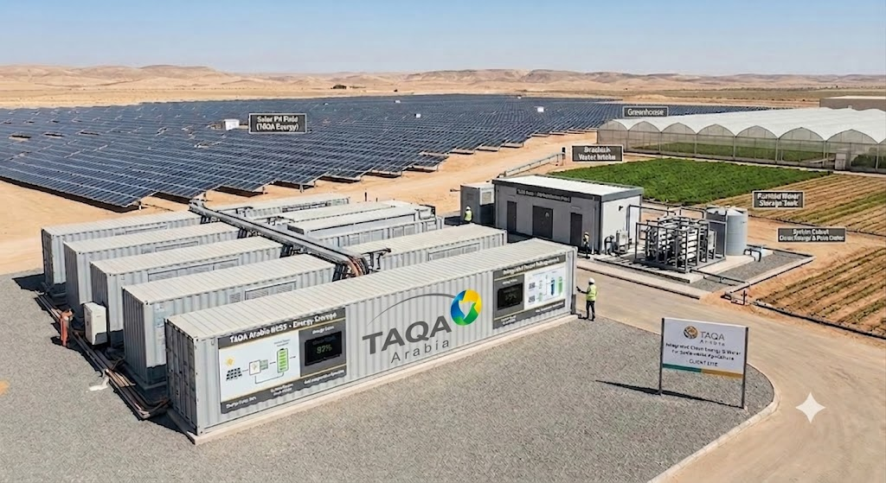
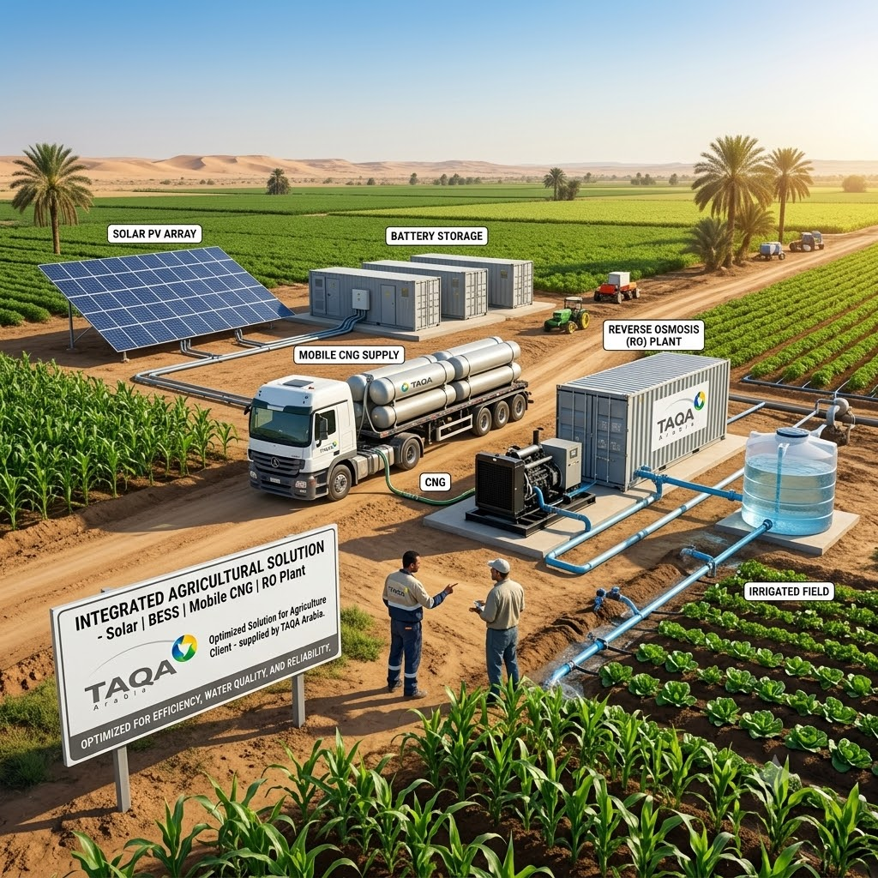


TAQA Arabia
Fleet & Mobility Sector
Integrated Energy & Mobility Solutions · Jun 2026
A World OF ENERGY

Slide 2





TAQA Arabia · Who We Are
Egypt's leading integrated energy infrastructure developer — a true one-stop-shop for residential utilities
A World of Energy, Delivered End-to-End
Gas
Power
Founded in 2006 and listed on the EGX since 2023, TAQA Arabia is Egypt's largest private-sector energy and utility developer.
Across four divisions — Gas, Power, Petroleum and Water — TAQA finances, builds, owns and operates the utility backbone of residential communities, industrial zones and touristic destinations.
TAQA is uniquely positioned to support different mobility solutions to fuel vehicles with different energy sources such as petroleum products, lubes, electricity for EVs and natural gas for NGVs
Gas distribution & EPC networks
NGV stations & car conversion
Mobile CNG & LNG (virtual pipeline)
Generation & distribution (+1,600 MVA)
Renewable energy & solar PV
EV charging stations
Petroleum
Water
Oil-marketing stations & terminals
Lubricants retail & distribution
Bulk fuel storage & logistics
Reverse-osmosis desalination
Filtration & chemical treatment
Smart, solar-powered operations
Active member of the International Gas Union (IGU)
Accredited by the IGEM (Institution of Gas Engineers & Managers)

Slide 3
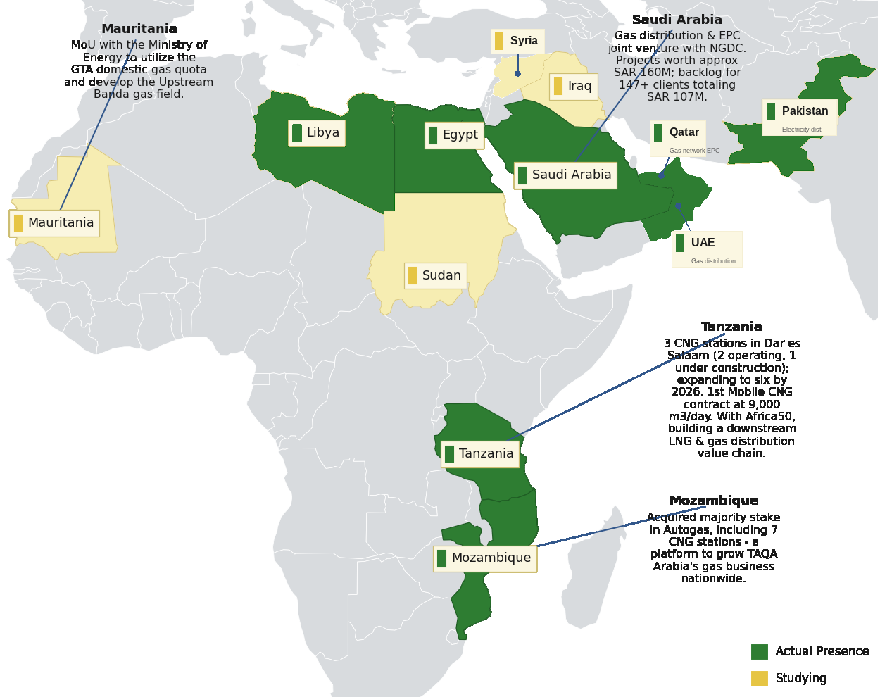




TAQA Arabia · Regional Presence
A growing platform across Egypt, the GCC, Africa and Greece
Presence Across Africa & the Middle East
Reach & Scale
10
Countries of presence
Egypt, GCC, Africa, Greece & South Asia
4
Operating divisions
Gas · Power · Petroleum · Water
20+
Governorates in Egypt
Industrial, residential & touristic
3,400+
Employees
Across all divisions
Actual presence and markets under study across Africa & the Middle East — extending TAQA’s integrated energy model well beyond Egypt.

Slide 4

TAQA Arabia · In Numbers
The scale behind a single residential utility partner — FY 2025
Operating Scale Across the Divisions
THE GROUP AT A GLANCE
GAS
POWER
EGP 13.4bn
86
18
+130
1st
Revenue — FY 2025
CNG stations
Conversion Centers with Capacity to convert up to 12 K Cars per year
Charging stations
private EV-charging license
EGP 1.5bn
EBITDA — FY 2025
Waqood
MOBILITY
~6.5M
Enertech
xx
230+
2
Residential gas customers
xxxxxxxxxxxxx
Station Managed
fuel stations (TAQA + Wataniya 172)
Fuel Terminals in Suez and Alexandria
Founded 2006 · Listed on EGX 2023 · 3,400+ employees across all divisions

Slide 5






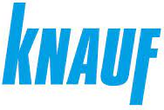




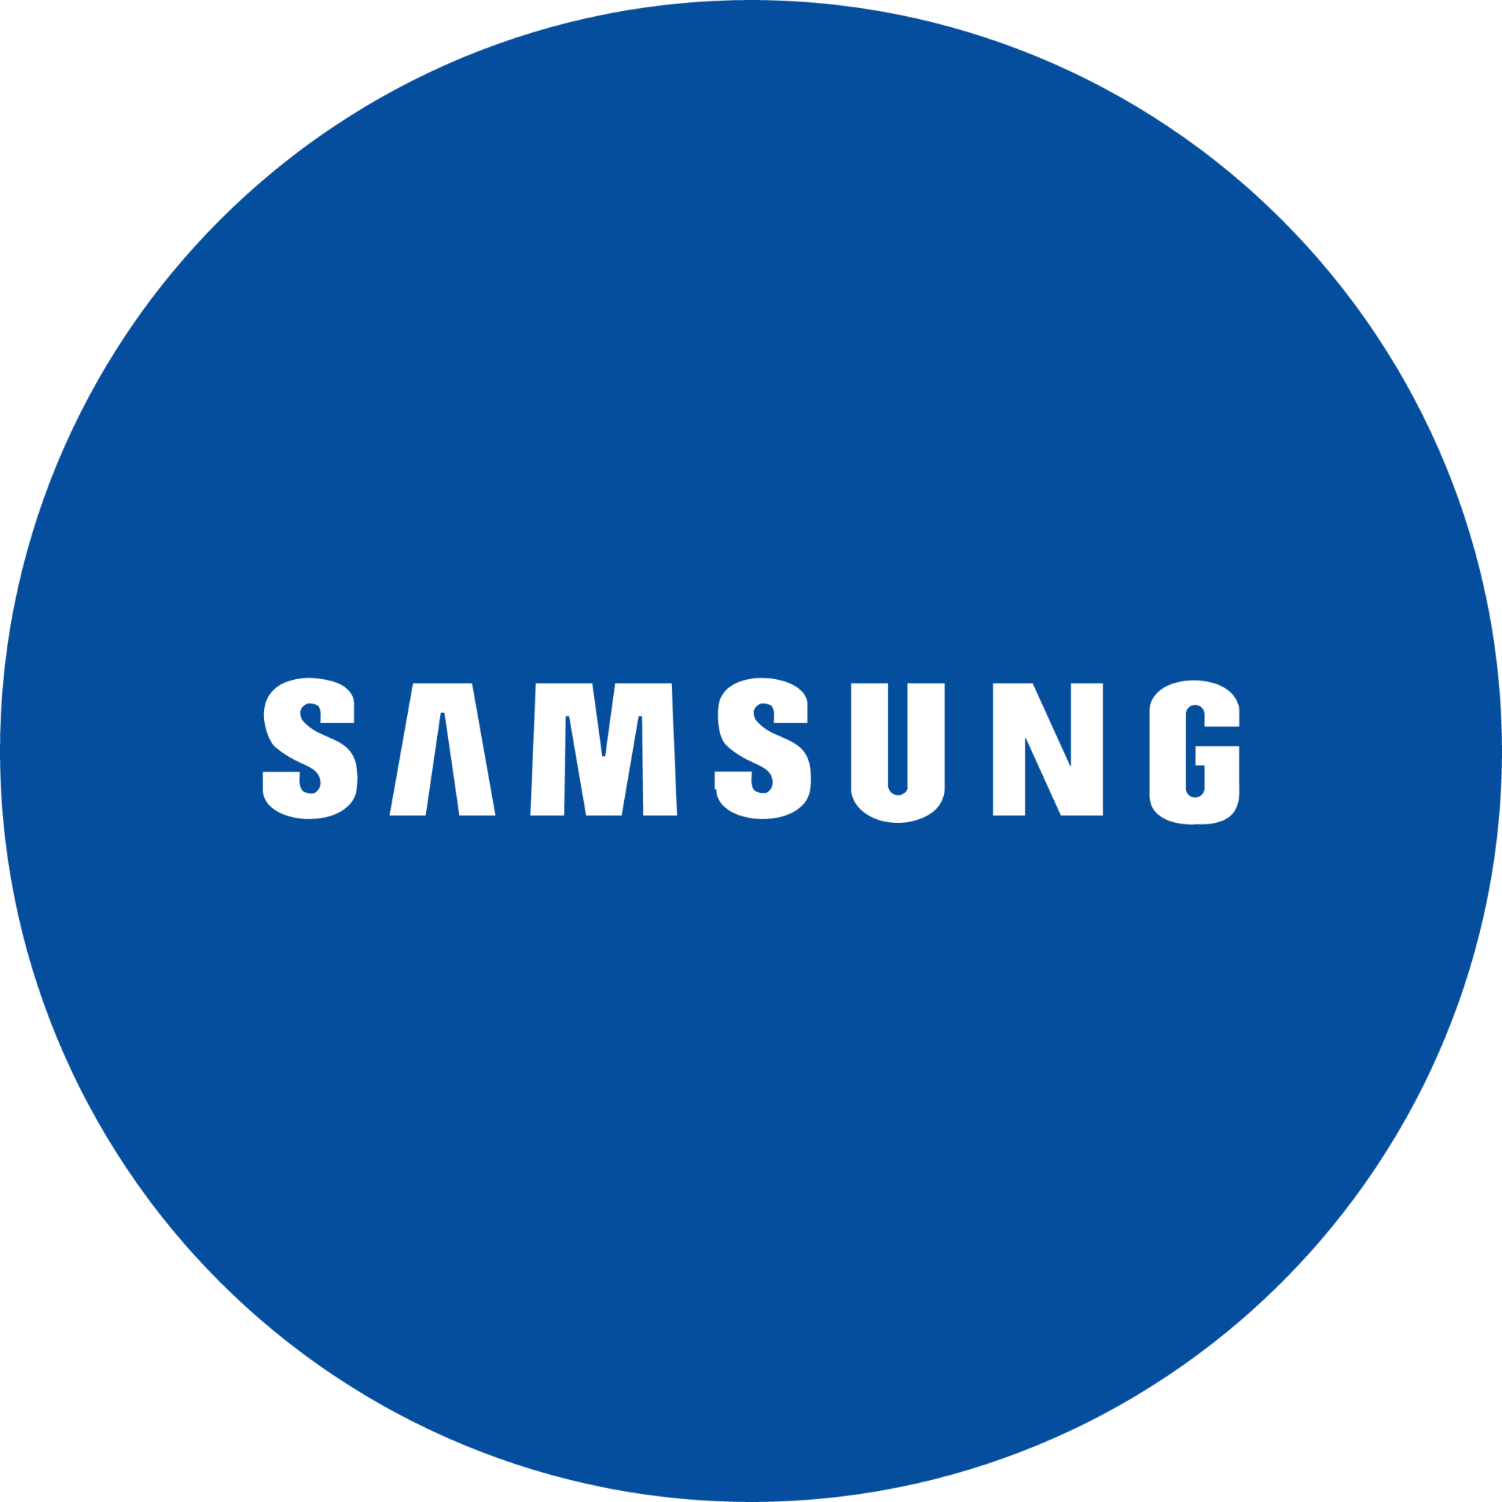















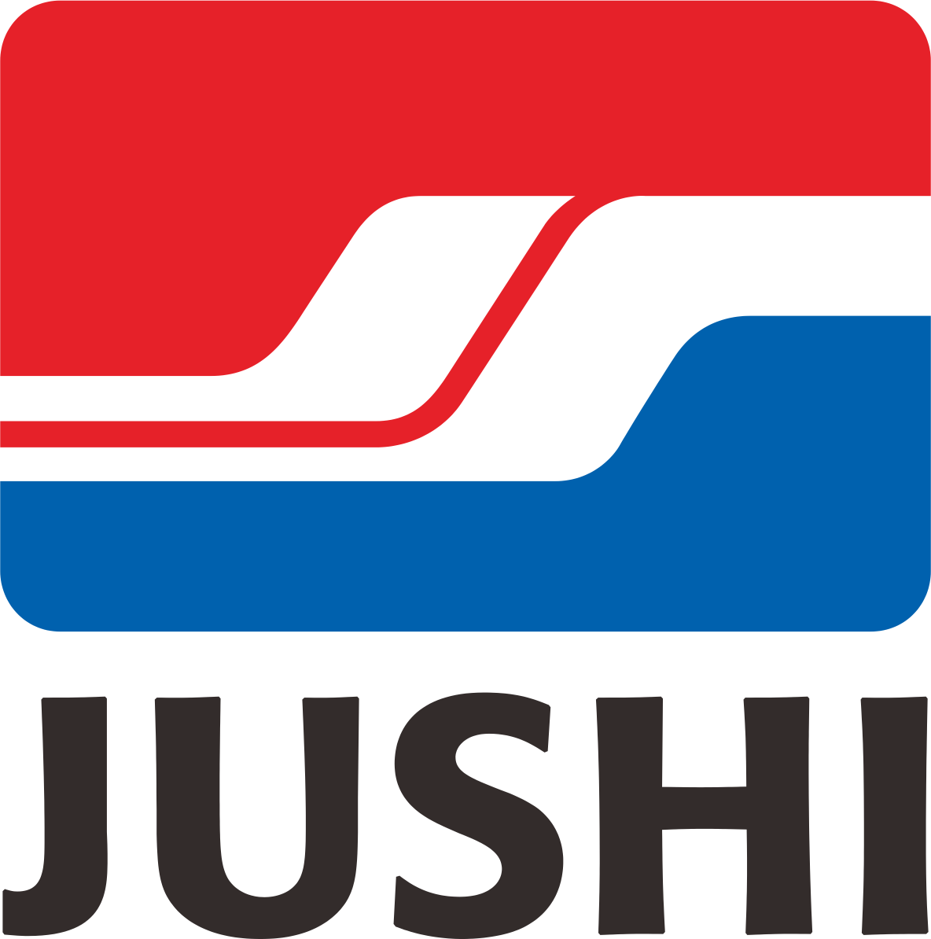

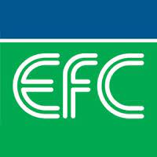














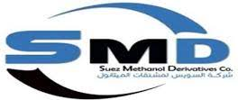





























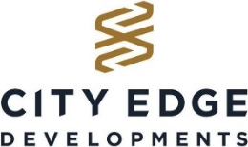



















TAQA Arabia · Trusted By
Clients and partners served across Multiple divisions

Slide 6
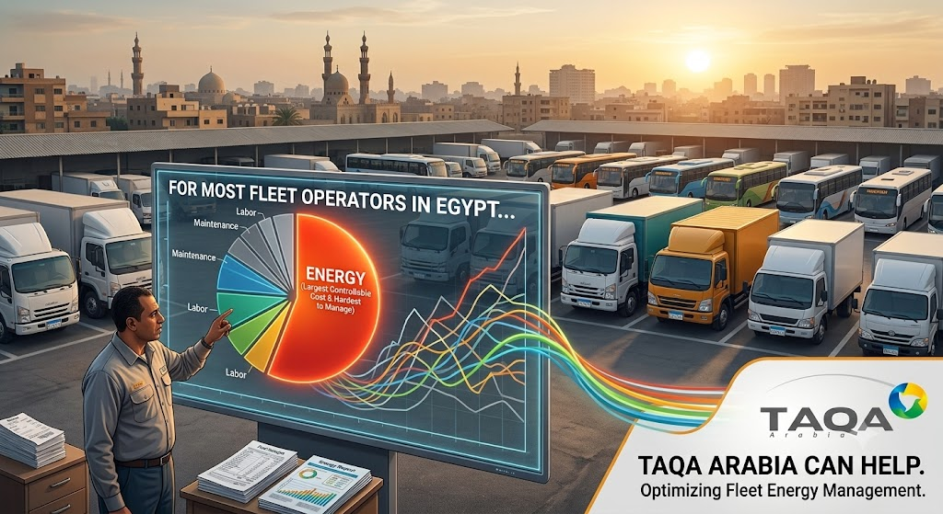
The Fleet Operator's Challenge
Why fleet energy is the biggest cost — and the hardest one to control
Fuel Is the Biggest Lever
Fuel is typically 30–50% of fleet operating cost — small per-litre moves swing the entire P&L.
Volatile, Unpredictable Prices
Diesel and petrol track global oil and policy — budgeting fuel becomes guesswork year to year.
Tightening Emissions Pressure
ESG targets, low-emission city zones and customer mandates are closing in on combustion fleets.
Fragmented Suppliers
Fuel, gas, chargers and telematics from separate vendors means many contracts and no single view.
A World OF ENERGY

Slide 7
The Mobility Energy Pathway
Diesel today, natural gas as the bridge, electric as the destination — at your pace
TAQA finances and manages each step, so the fleet moves down the cost-and-carbon curve at its own pace — never stranded, never forced.
NOW
BRIDGE
FUTURE
Optimise the Combustion Fleet
Convert to Natural Gas
Electrify the Fleet
Consolidate diesel and petrol under one Waqood account with depot fuelling — squeeze cost and visibility out of the fleet you run today.
Convert suitable vehicles to CNG and fuel them via the station network or the Master Gas mobile virtual pipeline — the fastest payback in the transition, up to ~40% lower fuel cost.
Roll out depot and en-route charging — backed by Egypt's first EV licence, +1,600 MVA of grid, solar and storage — for the lowest cost per km and zero tailpipe emissions.
Down the cost-and-carbon curve: each step lowers cost per kilometre and tailpipe emissions — financed and staged by TAQA, at your pace.
A World OF ENERGY

Slide 8
Mobility · Solutions Overview
The following slides detail every service TAQA Arabia's mobility sector offers to fleets
Fuel Stations
01
Natural Gas (CNG)
02
Keep today's fleet moving — diesel and gasoline from a nationwide TAQA-operated station network and two terminals
Convert the fleet you own to gas — and fuel it: licensed NGV conversion plus TAQA's CNG network and the Master Gas mobile virtual pipeline
EV Charging
03
Waqood Smart System
04
Electrify with the holder of Egypt's first private EV-charging licence — depot, destination and en-route AC/DC charging, end-to-end
See and control the whole fleet from one screen — TAQA's EnerTech platform that digitalizes fueling, spend and control
A World OF ENERGY

Slide 9
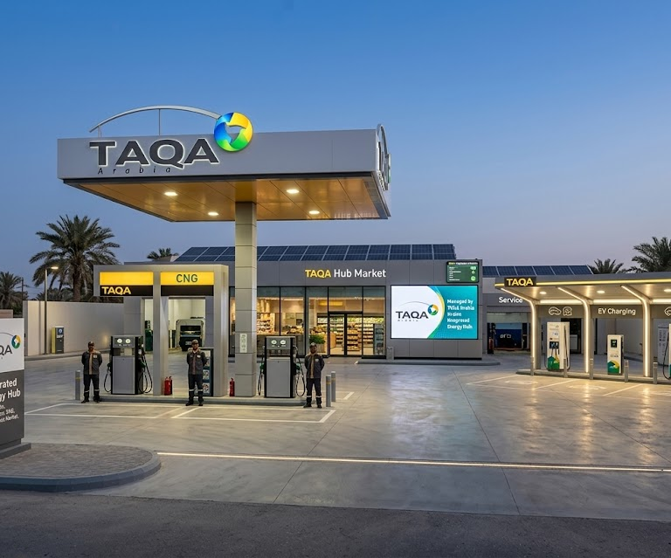
1
Fuel Stations: Scope & How It Works
Keep today's fleet moving — diesel and gasoline from a nationwide TAQA-operated station network and two terminals
SCOPE
1
TAQA INVESTS THE CAPEX
Forecourt, tanks & dispensers · Canopy, shop & safety systems · Automation, POS & fuel-management · Fleet cards & telemetry · Station financing & licensing
2
THE PROCESS — STEP BY STEP
1
TAQA secures the licence and builds the station to spec.
2
Tanks, dispensers and automation are installed and certified.
3
Fleet vehicles fuel using cards linked to each driver and vehicle.
4
Every litre is captured digitally against limits and rules.
5
TAQA supplies fuel, runs the site and reports consumption.
3
WHAT YOU RECEIVE
TAQA funds, builds, owns & operates the asset.
You pay only for the fuel you draw — little to no upfront CapEx.
Reliable fuel supply for your fleet
172 stations
added
Controlled, card-based fuelling
Full station operation and reporting
Notes:
To Elaborate on the solution by inserting the flow

Slide 10
1
Fuel Stations: Value Proposition
Why TAQA Arabia is the right partner for this solution
VALUE PROPOSITION
WHAT YOU GAIN
THE TAQA ARABIA EDGE
Depot & On-Site Fueling
Assured Fuel Quality
Bulk and on-site delivery keep heavy fleets fueled at base — no detours, no queueing at the pump.
Two owned terminals and a controlled logistics chain mean traceable, spec-compliant fuel that protects engines.
Spec-Compliant Supply
Nationwide Fueling Reach
Quality-assured fuel from owned terminals protects engines, warranties and resale value.
TAQA's own stations plus 172 newly managed Wataniya sites mean drivers refuel wherever the route goes.
Predictable Fuel Spend
A Ready Transition Partner
Consolidated billing and consumption reporting turn fuel from a blind cost into a managed, forecastable line.
The partner fueling you today is the one that converts you to CNG and electrifies you tomorrow.
A Single Point of Contact
One Cashless Account
One TAQA account team handles fuel, delivery and logistics — no juggling multiple suppliers.
A single fuel account replaces cash and scattered receipts — every liter logged to the right vehicle.
A World OF ENERGY

Slide 11
1
Fuel Stations: Implementation Timeline
How TAQA delivers the solution from start to finish — phase by phase, with indicative timing
IMPLEMENTATION TIMELINE — START TO FINISH
Day 0–7
Day 7–14
Day 14–30
Day 30+
Monthly
Ongoing
1
2
3
4
5
6
Account Setup
Network Activation
Depot Fuelling
Live Fuelling
Reporting
Optimisation
Fleet profiling, fuel account & credit terms.
Station access & depot survey.
On-site tank / bowser install where needed.
Cashless refuelling across the network.
Consolidated billing & consumption analytics.
Route, supply & spend reviews.
SET UP Day 0–14
DEPLOY Day 14–30
MANAGE Ongoing
Fleet profiling, account and credit terms, station-access activation and a depot fuelling survey.
On-site and bulk fuelling installed where required; cashless refuelling across the national network goes live.
Consolidated monthly billing, consumption analytics and periodic route and spend optimisation reviews.
A World OF ENERGY

Slide 12
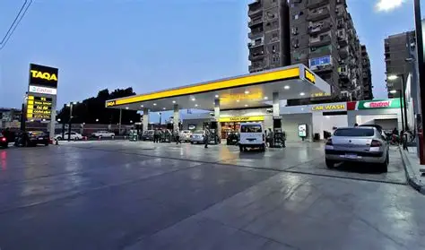
1
Fuel Stations: Proven Track Record
A show of muscle — what TAQA Arabia already delivers
A fuel-marketing network built over two decades — and growing fast
TAQA Petroleum was the first privately owned Egyptian company licensed to supply fuel, operating its own retail stations and two storage terminals in Suez and Alexandria. In 2026 it took over management of 172 Wataniya stations through Quick Fuel — a major step-change in reach. It is the dependable foundation that keeps commercial fleets fuelled today, and the same accredited partner behind the gas and EV infrastructure of tomorrow.
230
1st
Wataniya stations now managed + Own Stations
private fuel licence in Egypt
TAQA Petroleum — National Fuelling Backbone
2
43+
owned storage terminals
Terminal Capacities in Liters
A World OF ENERGY

Slide 13
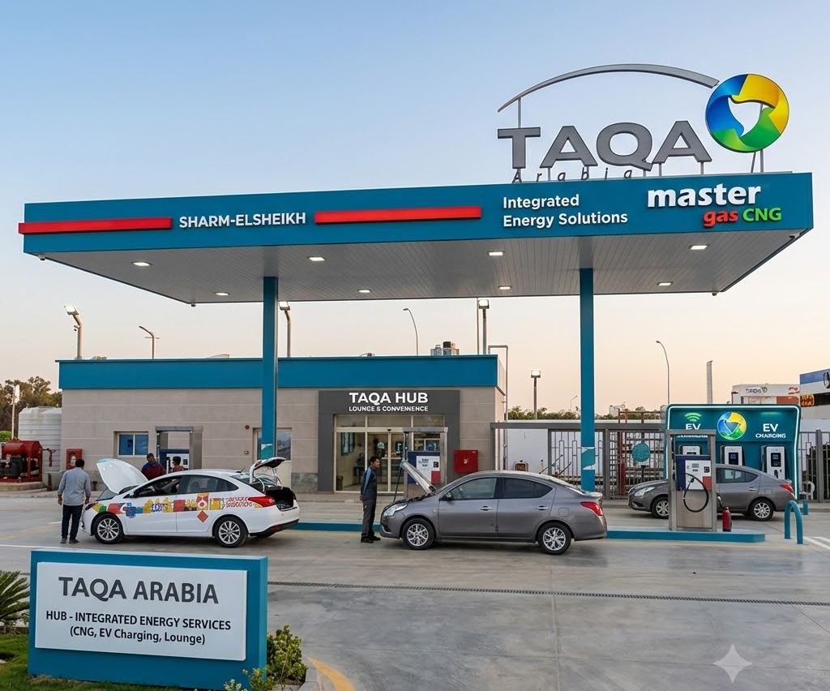
2
Natural Gas (CNG): Scope & How It Works
Convert the fleet you own to gas — and fuel it: licensed NGV conversion plus TAQA's CNG network and the Master Gas mobile virtual pipeline
SCOPE
1
TAQA INVESTS THE CAPEX
CNG mother & daughter stations · Compression & dispensing skids · Vehicle conversion workshops · Virtual-pipeline trailers · Station financing
2
THE PROCESS — STEP BY STEP
1
TAQA converts fleet vehicles to run on compressed natural gas.
2
Gas is compressed and dispensed at TAQA CNG stations.
3
Where no pipeline exists, trailers supply gas as a virtual pipeline.
4
Drivers fuel with cards that log every fill.
5
TAQA maintains stations, skids and converted vehicles.
3
WHAT YOU RECEIVE
TAQA funds, builds, owns & operates the asset.
You pay only for the gas you fuel with — little to no upfront CapEx.
Lower-cost CNG fuel for the fleet
Cheaper
per km
Conversion and refuelling network
Managed supply, even off-pipeline
Notes:
To Elaborate on the solution by inserting the flow

Slide 14
2
Natural Gas (CNG): Value Proposition
Why TAQA Arabia is the right partner for this solution
VALUE PROPOSITION
WHAT YOU GAIN
THE TAQA ARABIA EDGE
~40% Lower Fuel Cost
Convert + Fuel, One Partner
CNG is structurally cheaper than petrol and diesel — the single fastest lever on operating cost.
TAQA both converts the vehicle and fuels it — one accountable provider across the whole gas switch.
Bi-Fuel & Fully Certified
Conversion Workshops
Bi-fuel keeps petrol as a fallback; conversions, cylinders and stations are licensed and periodically re-tested.
In-house facilities convert and certify fleet vehicles 20 Conversion Centers Located Across Egypt
Fastest Payback
Master Gas CNG
Conversion cost is typically recovered within months from fuel savings — then it is pure margin.
A real, operating CNG network plus a mobile virtual pipeline that fuels depots with no fixed connection.
Cleaner, Quieter Engines
No Pipeline, No Problem
Natural gas cuts particulates, NOx and engine noise — better for cities, drivers and ESG.
Master Gas brings natural gas to remote depots in days — no waiting years for a fixed connection.
A World OF ENERGY

Slide 15
2
Natural Gas (CNG): Implementation Timeline
How TAQA delivers the solution from start to finish — phase by phase, with indicative timing
IMPLEMENTATION TIMELINE — START TO FINISH
Day 0–10
Day 10–20
Day 20–45
Day 45–55
Day 55–65
Ongoing
1
2
3
4
5
6
Assessment
Conversion Plan
Conversion
Inspection
Go-Live
Re-test & O&M
Suitable vehicles, routes & payback.
Dedicated vs. bi-fuel; fuel via network, Master Gas or a dedicated NGV station.
Licensed conversion or dedicated NGV station build.
Certification & safety sign-off.
CNG fuelling begins across the fleet.
SCADA dispatch & cylinder re-testing.
ASSESS Day 0–20
CONVERT & SUPPLY Day 20–65
OPERATE Ongoing
Profile routes and gas demand, identify which vehicles to convert, and choose dedicated-CNG or bi-fuel plus the fuelling mix.
Licensed conversion, cylinder fitting and safety sign-off, then switch the fleet onto live CNG via stations or Master Gas.
SCADA-monitored dispatch, uptime assurance, cylinder certification and periodic re-testing.
A World OF ENERGY

Slide 16
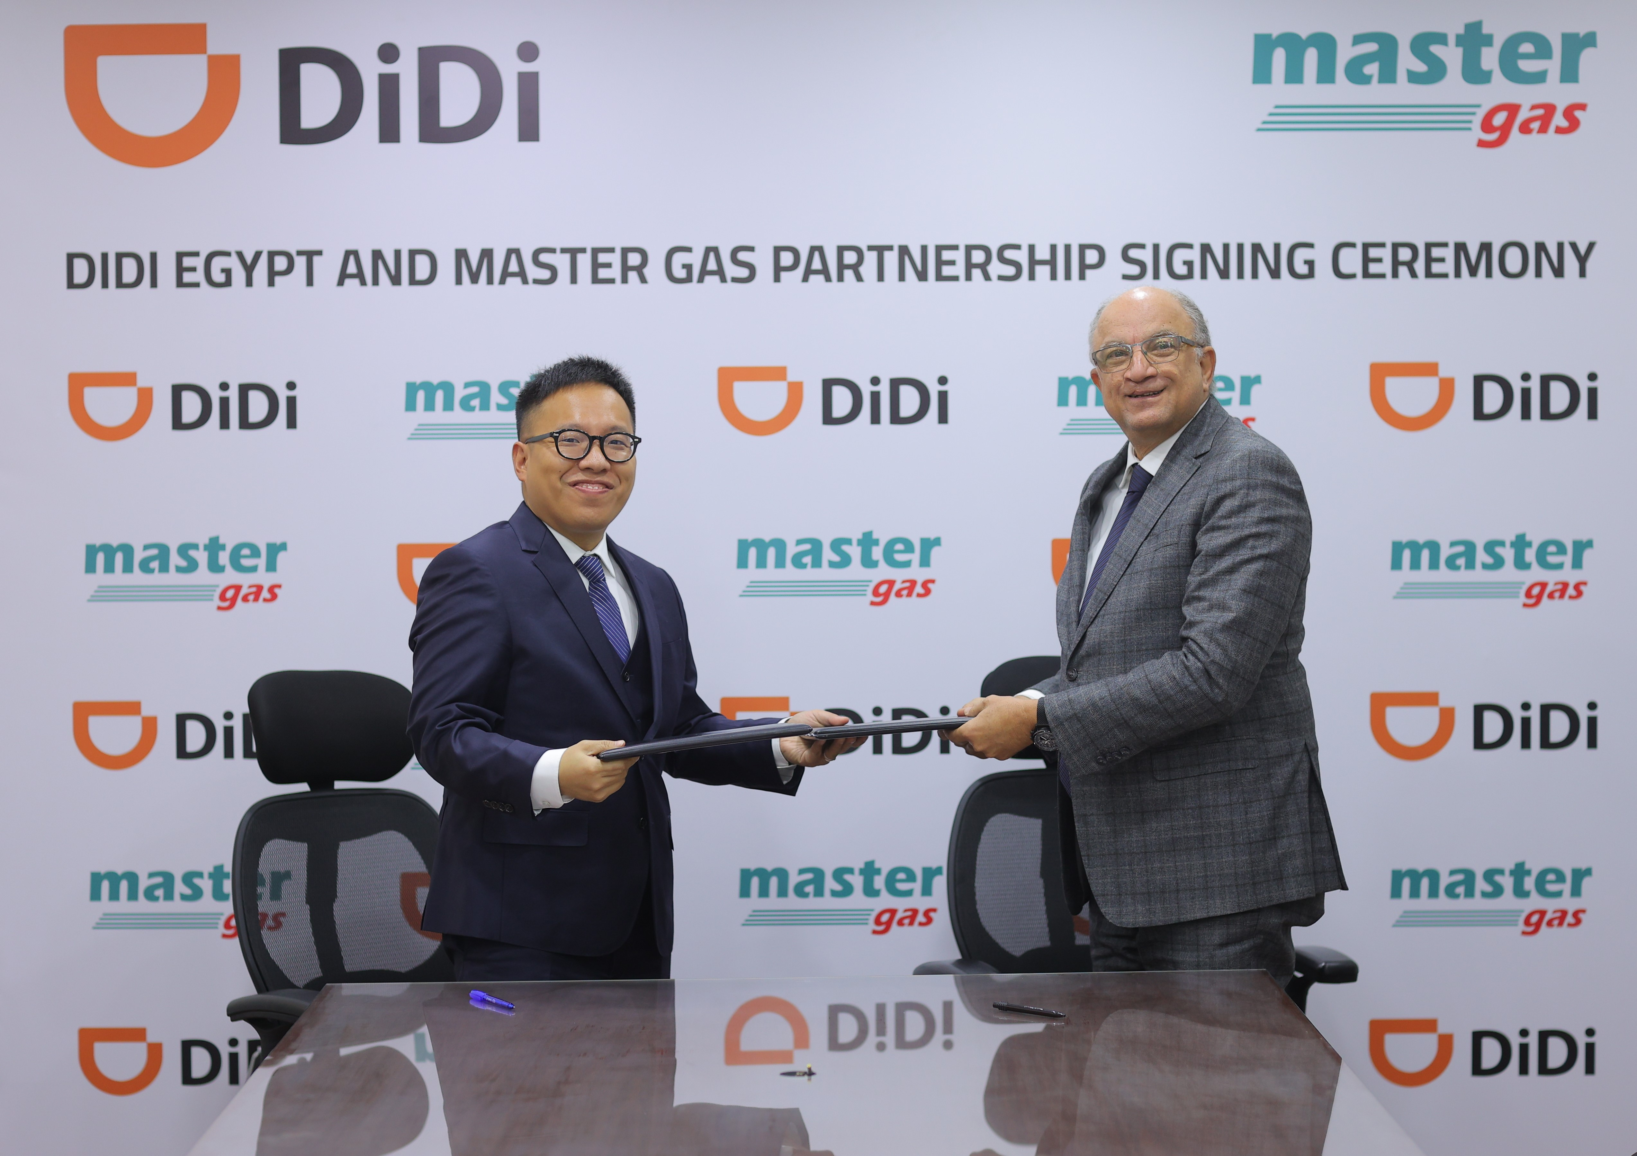
2
Natural Gas (CNG): Proven Track Record
A show of muscle — what TAQA Arabia already delivers
Convert and fuel — run by the operator of the gas network
Through its Gas division, TAQA Arabia operates 86 CNG stations, runs licensed vehicle-conversion centres, and pioneered mobile CNG in Egypt under the Master Gas brand — a virtual pipeline to sites with no fixed gas infrastructure. Because one partner both converts vehicles and fuels them, natural gas becomes the lowest-cost, lowest-disruption fuel switch a fleet can make.
86
Licensed
CNG stations operated
vehicle conversion centres
Master Gas — Virtual Pipeline & Conversion
Master Gas
~40%
mobile virtual pipeline
lower fuel cost (illustrative)
A World OF ENERGY

Slide 17
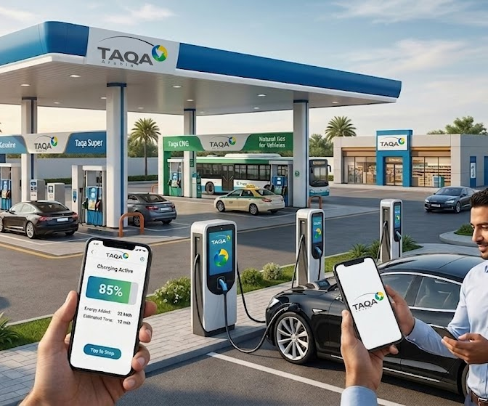
3
EV Charging: Scope & How It Works
Electrify with the holder of Egypt's first private EV-charging license — depot, destination and en-route AC/DC charging, end-to-end
SCOPE
1
TAQA INVESTS THE CAPEX
Depot AC / DC fast chargers · Grid connection & transformer upgrades · Smart charge-management system · Driver app, RFID & billing · Charger financing
2
THE PROCESS — STEP BY STEP
1
TAQA sizes depot and route charging to fleet duty cycles.
2
Chargers and grid upgrades are installed at depots and hubs.
3
Smart scheduling charges vehicles overnight at lowest cost.
4
Drivers authenticate; every kWh is logged per vehicle.
5
TAQA operates, maintains and reports on the network.
3
WHAT YOU RECEIVE
TAQA funds, builds, owns & operates the asset.
You pay only for the energy you charge — little to no upfront CapEx.
Depot and en-route charging ready to use
Depot
to road
Optimized, low-cost charging windows
Maintained uptime with full reporting
Notes:
To Elaborate on the solution by inserting the flow

Slide 18
3
EV Charging: Value Proposition
Why TAQA Arabia is the right partner for this solution
VALUE PROPOSITION
WHAT YOU GAIN
THE TAQA ARABIA EDGE
Lowest Energy Cost / Km
Flexible Financing Options
Electricity per kilometer undercuts both diesel and petrol — the end-state of the cost curve.
TAQA can fund the whole charging network under a profit-share model — zero charging capex for you.
Future-Proofed Fleet
Depot-to-Highway Coverage
Charging positions the fleet ahead of regulation, fuel bans and customer demand.
Overnight depot AC plus en-route DC fast charging — both the base and the road are covered.
Zero Tailpipe Emissions
Grid Capacity Secured
A genuinely zero-emission fleet — the strongest possible ESG and city-access position.
The power-distribution arm de-risks the hardest part of EV adoption — getting power to site.
Managed Uptime & App
One Energy Partner
Lifecycle O&M, an operator/user app and a 24/7 hotline keep every charger available and billing.
Charging integrates with TAQA's fuel and CNG offering — one partner across the whole transition.
A World OF ENERGY

Slide 19
3
EV Charging: Implementation Timeline
How TAQA delivers the solution from start to finish — phase by phase, with indicative timing
IMPLEMENTATION TIMELINE — START TO FINISH
Day 0–14
Day 14–30
Day 30–60
Day 60–95
Day 95–110
Day 110+
1
2
3
4
5
6
Site Assessment
Commercial Model
Supply
Installation
Activation
O&M & Uptime
Grid survey, duty-cycle & site mix — depot, residential, forecourt & en-route.
Full-investment / profit-share structuring.
AC / DC charger & grid-equipment procurement.
Install across depot, residential, forecourt & en-route; grid tie-in.
App onboarding, testing & go-live.
Lifecycle uptime, hotline & app.
DESIGN Day 0–30
BUILD Day 30–110
OPERATE Day 110+
Grid survey, fleet duty-cycle analysis and charger-mix design, plus commercial structuring under the full-investment model.
Procure AC/DC chargers and grid equipment, install at depot and en-route, tie into grid, onboard the app and go live.
Lifecycle O&M and guaranteed uptime, backed by the operator/user app and the 24/7 TAQA hotline.
A World OF ENERGY

Slide 20
3
EV Charging: Proven Track Record
A show of muscle — what TAQA Arabia already delivers
Pioneering Egypt's EV-charging rollout from the front
TAQA Power secured Egypt's first private EV-charging license and is rolling out AC and DC charging across depot, commercial and highway locations, supported by an operator/user app and a 24/7 hotline. As Egypt's largest private power distributor with 130 chargers capacity, TAQA pairs charging with the grid, solar and storage — the complete electrification package for any fleet.
1st
AC · DC
private EV licence in Egypt
depot & en-route charging
130
24/7
Chargers stationed Across Egypt
app & hotline support
A World OF ENERGY

Slide 21
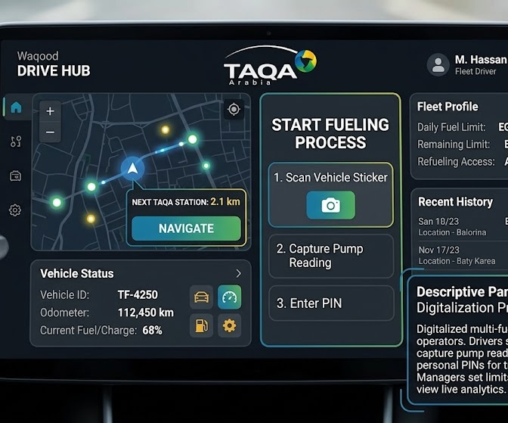
4
Waqood Smart System: Scope & How It Works
See and control the whole fleet from one screen — TAQA's EnerTech platform that digitalizes fueling, spend and control
SCOPE
1
TAQA INVESTS THE CAPEX
Vehicle RFID tags & stickers · Driver PIN & access devices · Station-side reader integration · Waqood platform & dashboards · Onboarding & configuration
2
THE PROCESS — STEP BY STEP
1
Vehicles, drivers and rules are configured in the Waqood platform.
2
RFID stickers and driver PINs are issued and linked.
3
At the pump, the system verifies vehicle, driver and limit.
4
Only authorized fuelling within set limits is allowed.
5
Every transaction streams to live dashboards and reports.
3
WHAT YOU RECEIVE
TAQA funds, builds, owns & operates the asset.
You pay only for the fuel you authorize — little to no upfront CapEx.
Total control over fleet fuelling
Every litre
tracked
Real-time consumption dashboards
Leakage and fraud designed out
Notes:
To Elaborate on the solution by inserting the flow

Slide 22
4
Waqood Smart System: Value Proposition
Why TAQA Arabia is the right partner for this solution
VALUE PROPOSITION
WHAT YOU GAIN
THE TAQA ARABIA EDGE
One Dashboard
Waqood by EnerTech
Liters, m³ of gas and kWh charged appear in a single dashboard — true total-energy visibility.
Waqood is TAQA Arabia's own energy-technology company — the platform is owned, not rented.
Fraud Designed Out
TAQA Arabia Diverse Network
Per-driver PINs, daily limits and pump-reading capture make unauthorized or phantom fueling almost impossible.
Utilize TAQA Arabia Diverse network of CNG and fuel and EV stations scattered Across Egypt
Decisions From Data
One platform for all energy types
Live consumption and behavior analytics show exactly where cost and waste sit across the fleet.
supports a client's transition from diesel today → CNG tomorrow → EV in the future under a single provider
Higher Asset Utilisation
Premium Customer Support
Consumption and behavior data surface idle, thirsty and inefficient vehicles to fix.
Dedicated account management and a single communication channel ensure fast issue resolution, proactive support, and a seamless experience
A World OF ENERGY

Slide 23
4
Waqood Smart System: Implementation Timeline
How TAQA delivers the solution from start to finish — phase by phase, with indicative timing
IMPLEMENTATION TIMELINE — START TO FINISH
Day 0–7
Day 7–14
Day 14–21
Day 21–30
Day 30–45
Ongoing
1
2
3
4
5
6
Discovery
Onboarding
Integration
Dashboard Live
Tuning
Optimise
Vehicles, drivers & rules scoping.
Stickers, PINs & limits configured.
Fuel, CNG & EV data connected.
Single-pane dashboard & billing live.
Limits, alerts & reports refined.
Analytics, ESG & savings reviews.
ONBOARD Day 0–14
ACTIVATE Day 14–30
OPTIMISE Ongoing
Scope vehicles, drivers and rules, then configure stickers, per-driver PINs and per-vehicle daily limits.
Connect fuel, CNG and EV-charging data and bring the single-pane dashboard and consolidated billing live.
Refine limits and alerts, and run continuous consumption, fraud, ESG and savings analytics.
A World OF ENERGY

Slide 24
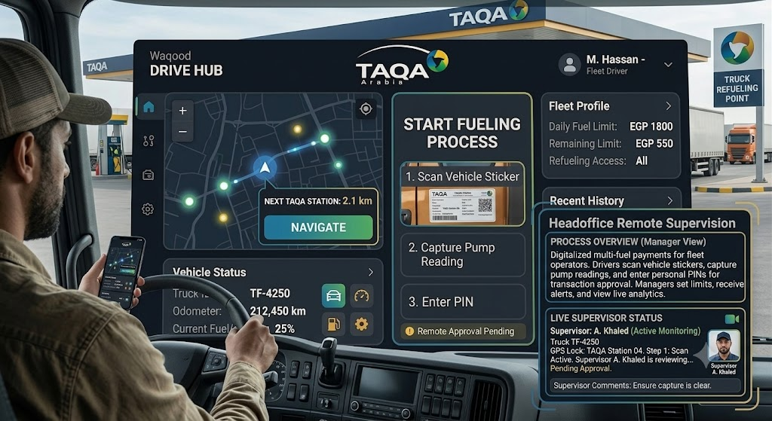
4
Waqood Smart System: Proven Track Record
A show of muscle — what TAQA Arabia already delivers
Egypt's smart fuel platform, built inside TAQA Arabia
Waqood · Fleet Dashboard
Waqood is TAQA Arabia's own EnerTech company, built to digitalise fuel payments for fleet operators. A driver scans a vehicle sticker, captures the pump reading and enters a personal PIN before the transaction is approved and invoiced — while managers set daily limits, receive fraud alerts and watch live analytics on a single dashboard. Extended across fuel, CNG and EV, Waqood turns a complex multi-fuel operation into one optimised, fully reported system.
Diesel / Petrol
CNG
EV
●
●
●
litres
m³ gas
kWh
EnerTech
Per-driver
✓ One account · per-driver PINs · real-time fraud alerts
a TAQA Arabia company
PINs, limits & alerts
1
Real-time
dashboard, every fuel
analytics & fraud control
A World OF ENERGY

Slide 25






Why One Partner: The TAQA One-Stop-Shop
One SLA, one communication point, one accountable operator — across every utility in the community
From Fragmented Vendors to a Single Operator
One SLA
A single service-level agreement governs gas, power, water, back-up and EV — one uptime guarantee, one penalty regime, one renewal.
Fuel
TAQA
Arabia
One Communication Point
A single account team and 24/7 hotline for every utility — no chasing five contractors when something needs attention.
One Commercial Relationship
EV Charging
Consolidated billing, aligned contract terms and a single negotiation instead of six separate procurement cycles.
CNG
One Engineering Standard
Utilities designed to interoperate from day one — shared trenches, shared metering platform, shared monitoring.
One Accountable Owner
End-to-end responsibility removes interface risk and finger-pointing between specialised vendors.
Waqood

Slide 26
The Integrated Economics: Diesel-Only vs. TAQA
Why a managed energy mix beats a diesel-only fleet — and widens the gap every year
TODAY — DIESEL-ONLY FLEET
WITH TAQA — INTEGRATED MIX
High, volatile fuel bill
Up to ~40% lower fuel cost
Diesel and petrol are the biggest cost — exposed to every oil-price spike.
CNG and EV displace the most expensive litres — predictable, managed pricing (illustrative).
Fragmented suppliers
One partner, one account
Fuel, gas, chargers and software from separate vendors — no single view.
Fuel, gas, conversion, charging and Waqood under a single SLA.
Fuel leakage & fraud
Leakage designed out
Cash, paper receipts and no per-vehicle control quietly inflate the bill.
Waqood PINs, limits and verified readings stop unauthorized and phantom fueling.
Rising carbon & city risk
Falling carbon, every year
100% combustion means maximum emissions and exposure to low-emission zones.
Each step down the pathway cuts CO₂ — near-zero once the fleet reaches EV.
The result: a lower and more predictable cost per kilometre, fewer suppliers, controlled fuel spend and a steadily stronger ESG story — from one partner, financed and staged at your pace.
A World OF ENERGY

Slide 27
From Pump to Plug: Your Fleet's Energy Partner
One partner for every kilometre — today's diesel to tomorrow's electric
From pump to plug, TAQA fuels every kilometre your fleet will ever drive.
Egypt's largest private energy developer is the single partner that can move your fleet from diesel today to electric tomorrow — fuel, CNG, conversion, charging and the Waqood platform that ties them together, financed and measured at every step.
What TAQA brings to your fleet:
Fuel Stations
Natural Gas (CNG)
Conversion
EV Charging
Waqood
230+
86
1st
130+
From diesel today to electric tomorrow
fuel stations under management
CNG stations operating
EV-charging licence in Egypt
EV charge points live
THE NEXT STEP: Let TAQA build your fleet's transition map — a complimentary baseline of your current fuel cost, emissions and the savings available at each stage of the journey.
A World OF ENERGY

