Slide 1
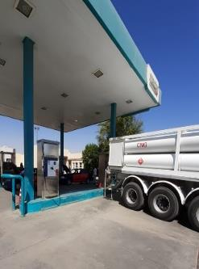
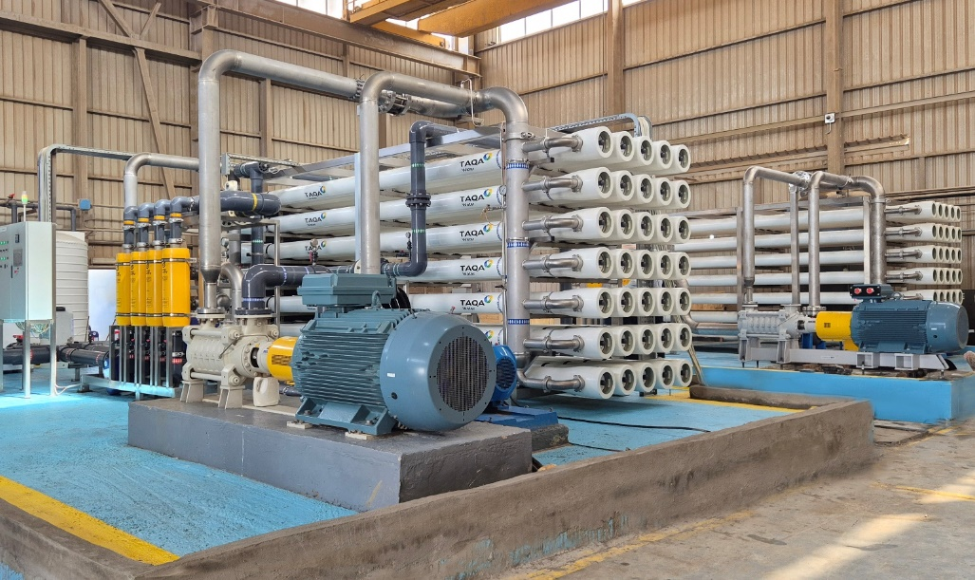
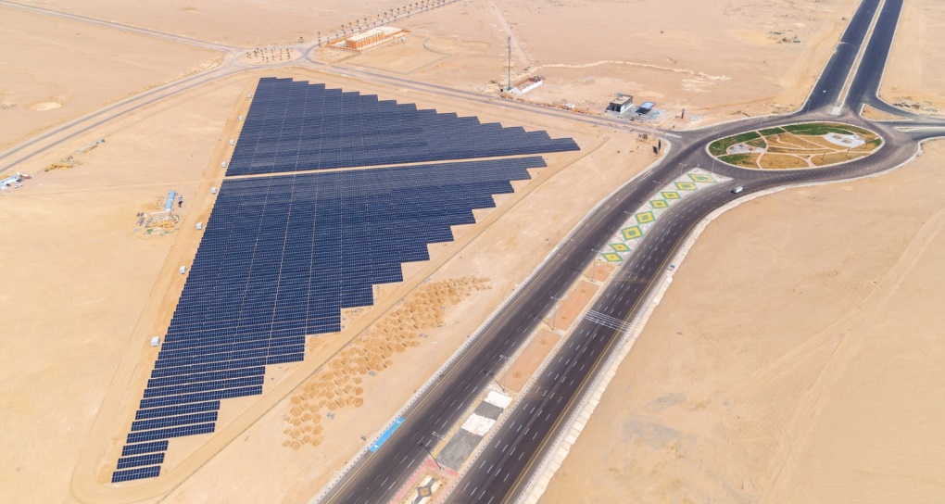
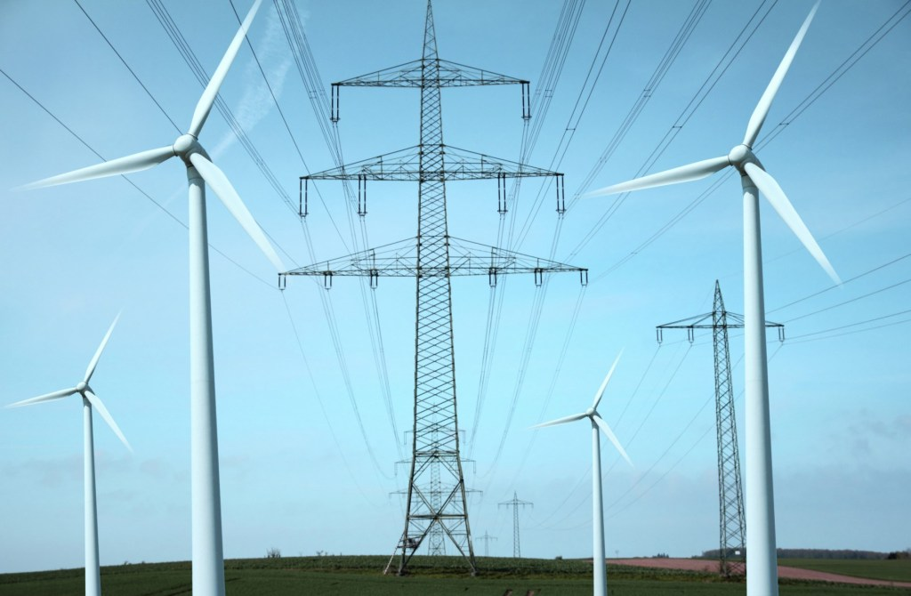
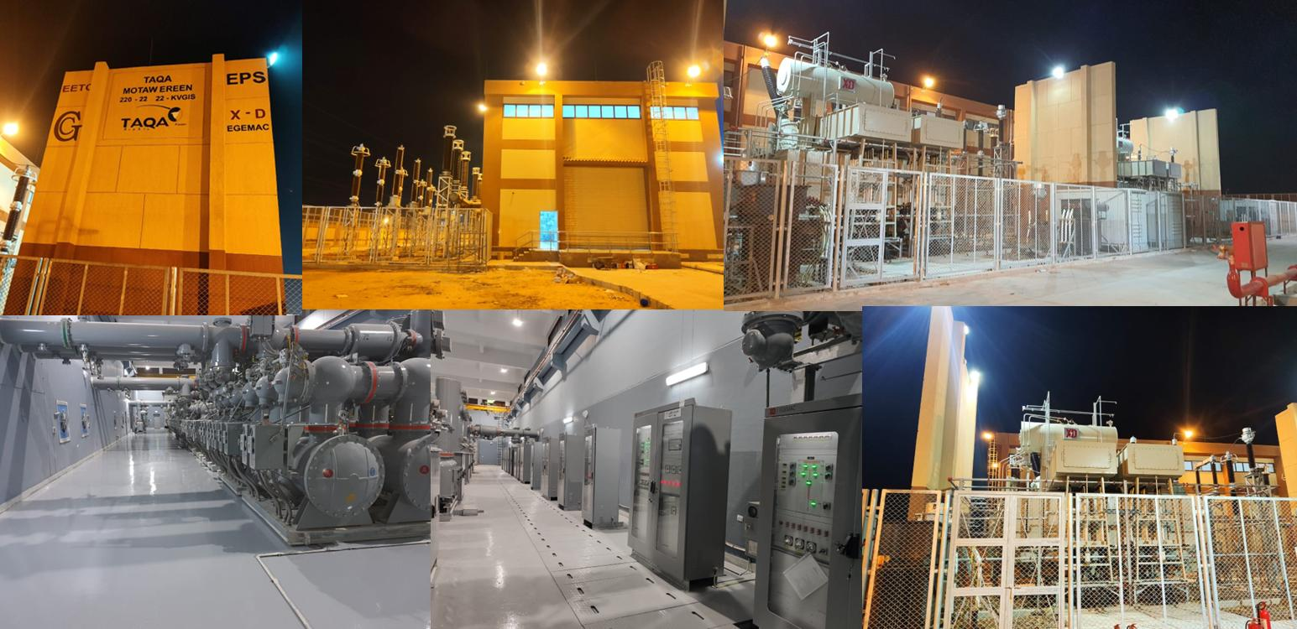
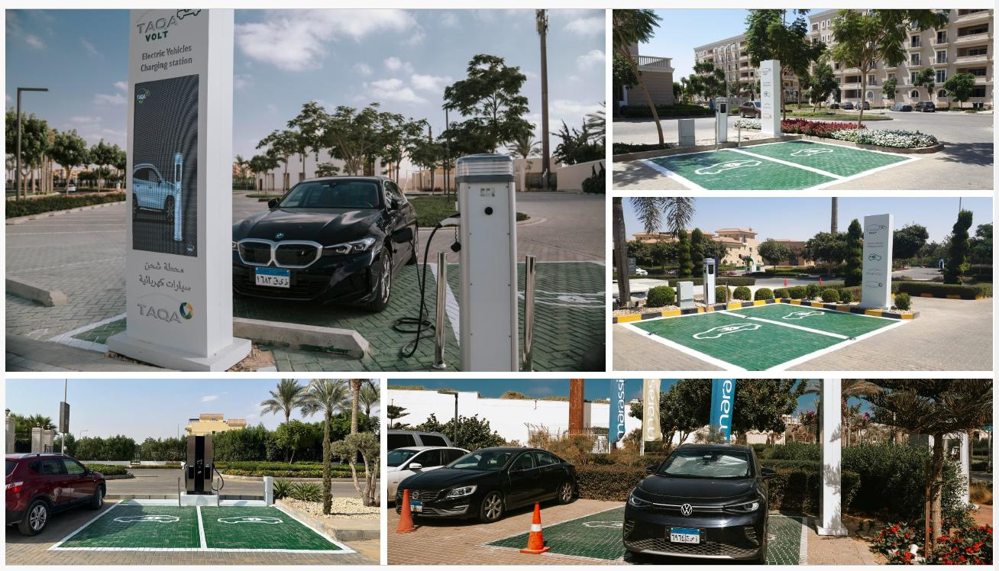



TAQA Arabia
Industrial Clients
Integrated Energy & Utility Solutions · Jan 2026

Slide 2




TAQA Arabia · Who We Are
Egypt's leading integrated energy infrastructure developer — a true one-stop-shop for residential utilities
A World of Energy, Delivered End-to-End
Gas
Power
Founded in 2006 and listed on the EGX since 2023, TAQA Arabia is Egypt's largest private-sector energy and utility developer.
Across four divisions — Gas, Power, Petroleum and Water — TAQA finances, builds, owns and operates the utility backbone of residential communities, industrial zones and touristic destinations.
For an industrial developer, that means one accredited partner with a proven delivery record can supply gas, power, water, Steam under a single relationship
Gas distribution & EPC networks
NGV stations & car conversion
Mobile CNG & LNG (virtual pipeline)
Generation & distribution (+1,600 MVA)
Renewable energy & solar PV
EV charging stations
Petroleum
Water
Oil-marketing stations & terminals
Lubricants retail & distribution
Bulk fuel storage & logistics
Reverse-osmosis desalination
Filtration & chemical treatment
Smart, solar-powered operations
Active member of the International Gas Union (IGU)
Accredited by the IGEM (Institution of Gas Engineers & Managers)

Slide 3
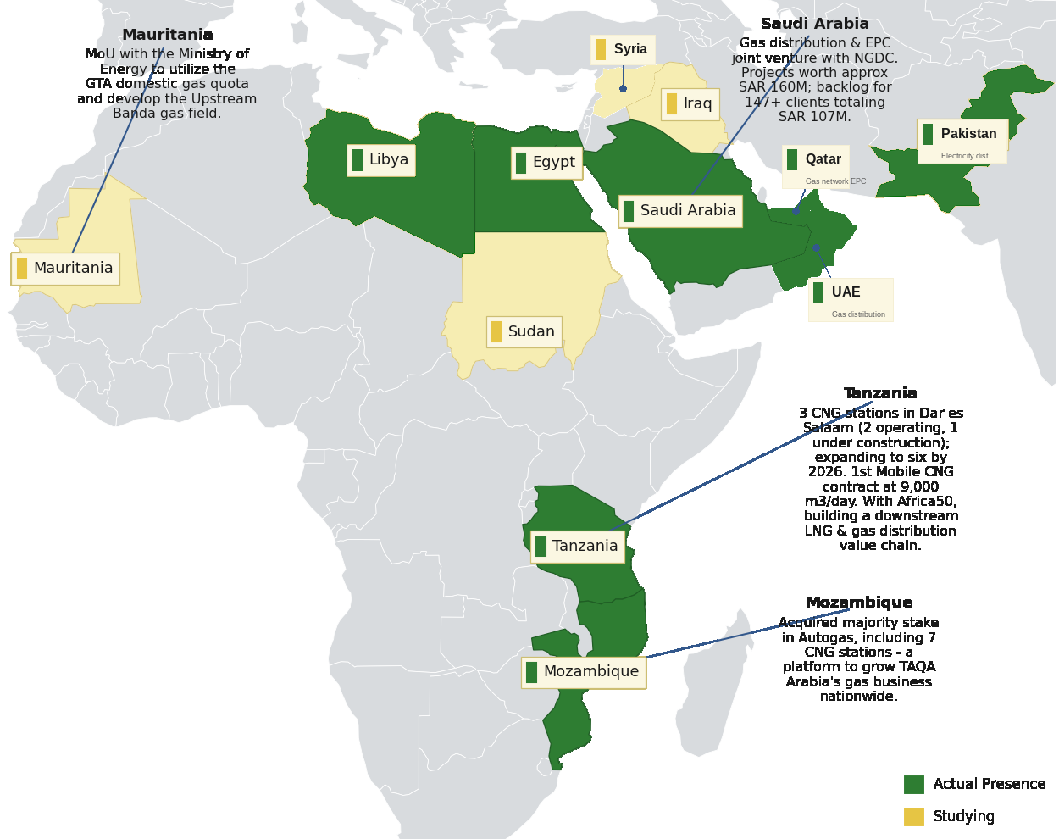




TAQA Arabia · Regional Presence
A growing platform across Egypt, the GCC, Africa and Greece
Presence Across Africa & the Middle East
Reach & Scale
10
Countries of presence
Egypt, GCC, Africa, Greece & South Asia
4
Operating divisions
Gas · Power · Petroleum · Water
20+
Governorates in Egypt
Industrial, residential & touristic
3,400+
Employees
Across all divisions
Actual presence and markets under study across Africa & the Middle East — extending TAQA’s integrated energy model well beyond Egypt.

Slide 4

TAQA Arabia · In Numbers
The scale behind a single integrated energy partner — FY 2025
Operating Scale Across the Divisions
THE GROUP AT A GLANCE
GAS
POWER
EGP 13.4bn
+10,000
8
+1,600
+150
Revenue — FY 2025
km network
governorate concessions (15-yr)
MVA distribution
MW generation capacity
EGP 18bn+
Assets under Management
WATER
MOBILITY & CNG
~6.5M
+47,000
15
300
1st
Gas customers nationwide
m³/day desalination
operational locations
Total stations
private EV-charging license
Founded 2006 · Listed on EGX 2023 · 3,400+ employees across all divisions

Slide 5






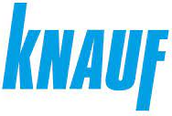




















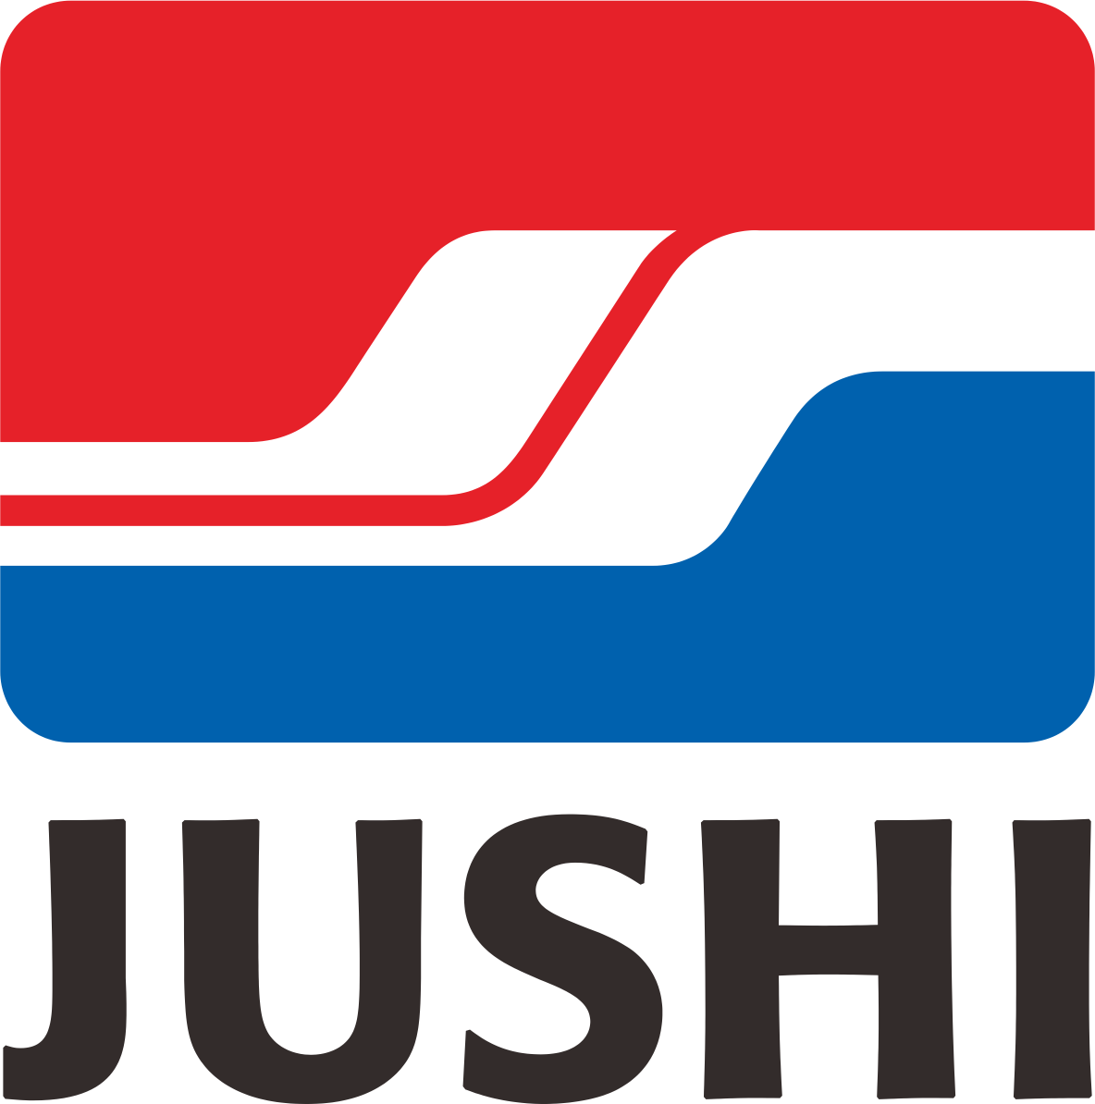


































































TAQA Arabia · Trusted By
Clients and partners served across Multiple divisions

Slide 6


Industrial Clients · Solutions Overview
The following slides detail every solution TAQA Arabia offers to industrial sites, factories and parks
Mobile CNG
01
Electricity Distribution
02
Gas Distribution
03
Off-grid natural gas via mobile virtual pipeline — zero infrastructure capex.
Turnkey MV/LV networks, smart metering and licensed lifetime O&M.
End-to-end gas network EPC — design, build, commission and operate.
CHP
04
Solar
05
Energy Storage (BESS)
06
Combined Heat & Power — up to ~85% efficiency from a single fuel input.
Tailored solar PV via PPA — clean power below grid tariffs, no capex.
Battery storage for peak shaving, solar firming and backup power.

Slide 7
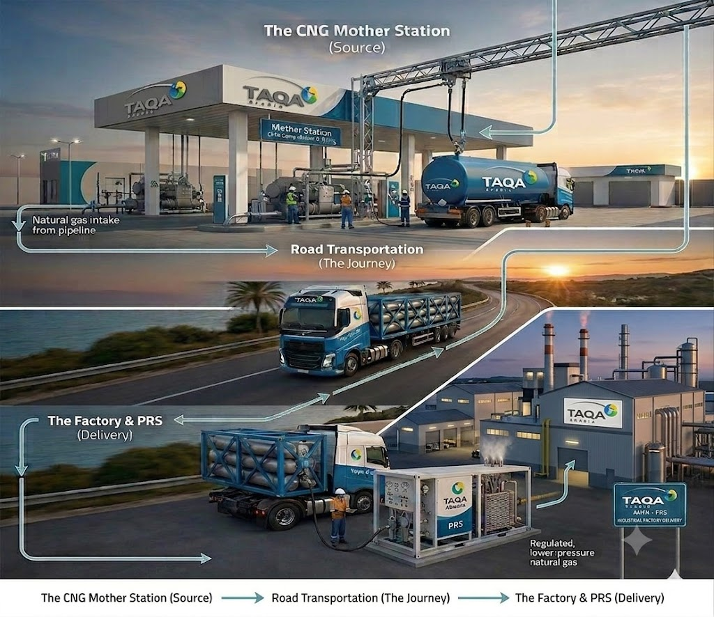
1
Mobile CNG: Scope & How It Works
Portable natural-gas supply delivering cost savings, flexibility and energy security for off-grid industrial sites
SCOPE
1
TAQA INVESTS THE CAPEX
Mother station & compression · CNG / virtual-pipeline trailers · On-site decompression & PRMS skid · Industrial metering & controls · BOO / BOOT financing
2
THE PROCESS — STEP BY STEP
1
Gas is compressed at a TAQA mother station to ~250 bar.
2
Trailers deliver it to your plant as a virtual pipeline.
3
On-site skids decompress and regulate to process pressure.
4
Gas feeds boilers, furnaces and process lines.
5
TAQA tracks usage and refills ahead of demand.
3
WHAT YOU RECEIVE
TAQA can provide an integrated solution, including funding, construction, ownership and operation of the asset subject to project requirements
Pipeline-grade gas without a pipeline
Gas,
off-grid
Continuous feed for industrial processes
Managed supply and refills

Slide 8
1
Mobile CNG: Value Proposition
VALUE PROPOSITION
WHAT YOU GAIN
TAQA ARABIA EDGE
Off-Grid Gas Supply
Flexible Delivery Approach
Reliable natural gas to The Factory without pipeline access.
BOO / BOOT or EPC via Capacity-as-a-Service — no upfront infrastructure cost for the Factory developer.
Cost Savings vs. Diesel & LPG
Nationwide Logistics Via Master Gas Stations
Lower fuel cost than diesel; replaces LPG and electric heating across the development.
A dedicated trailer fleet keeps refills on schedule across governorates based on Master Gas segregated stations across Egypt
Cleaner Emissions
Scalable to Any Load
Cuts CO₂ by ~24% vs. diesel and lowers NOx & particulates — supports ESG and green-rating targets.
Starter (550 litres/day of diesel) to Heavy (5,500+ litres/day of diesel) — scales with occupancy, bridges to grid later.
Offset Diesel Quota
Presence Across Many Governorates
Reduce reliance on diesel quotas by providing cleaner and more cost-effective fuel alternatives.
Operates a nationwide portfolio of Mobile CNG projects across Egypt, extending natural gas access, reducing fuel costs, and enhancing energy reliability for clients

Slide 9
1
Mobile CNG: Implementation Timeline
How TAQA delivers the solution from start to finish — phase by phase, with indicative timing
IMPLEMENTATION TIMELINE — START TO FINISH
Day 0
Day 1–3
Day 4–7
Day 8–14
Day 15–30
Day 90–120
Day 120–200
1
2
3
4
5
6
7
Discovery
Initial Contact
Site Audit
Contract
Mobilization
On-Site Install
Live Gas
Lead identification & commercial qualification.
NDA signed, requirement scoping.
Technical load profiling & demand curve.
Capacity tier, CaaS pricing
MEGC & PRU procured and prepared.
PRU adapter installed, SCADA activated.
Switchover from diesel to live CNG supply.
DISCOVERY & AUDIT Day 0–14
CONTRACTING Day 8–14
DEPLOYMENT & GO-LIVE Day 90–200
Lead qualification, NDA, site visit and full technical load profiling — output is a precise demand curve and connection plan.
Capacity tier selection (Starter / Industrial / Heavy), CaaS pricing model, 99.5% uptime SLA and payment terms — output is a signed agreement.
MEGC mobilized, PRU adapter installed, SCADA activated, safety tests and switchover from diesel to live CNG supply.

Slide 10
1
Mobile CNG: Proven Track Record
First company in Egypt to supply natural gas through a mobile virtual pipeline
TAQA Arabia pioneered mobile CNG in Egypt, using its network of 86 CNG stations to extend a virtual pipeline into four governorates with no fixed gas infrastructure. The model now serves ceramics, glass, food-processing and other industrial clients — proving off-grid factories can run on clean natural gas years before the pipeline arrives.
Guaranteed Savings
Wide Network
Saving in Comparison to the Current Diesel price
86 Stations Across 20 Governorates
10
Big Success Story
Existing Projects
Supply Natural Gas to a Whole Governorate “Kharge”
Notes:
Build a case study and the benefits from the case study for “El Kharga”

Slide 11
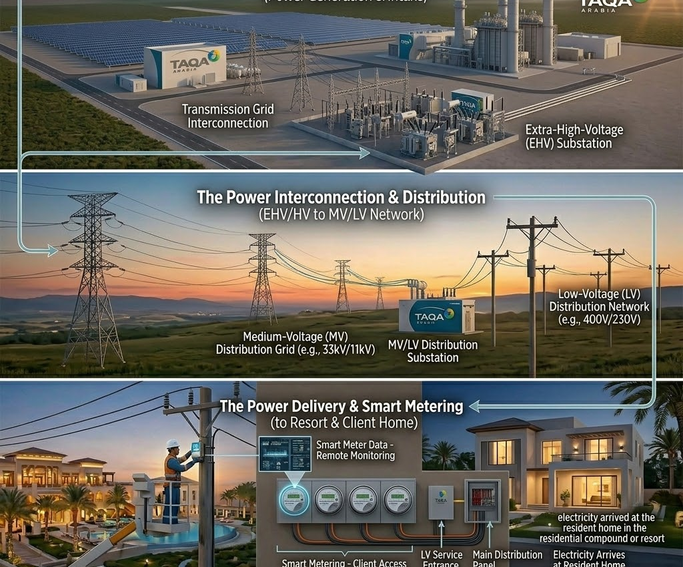
2
Electricity Distribution: Scope & How It Works
Turnkey distribution networks for industrial sites and parks — from power sourcing and design through licensed lifetime O&M
SCOPE
1
TAQA INVESTS THE CAPEX
HV / MV substations & switchgear · Distribution transformers · Cabling, protection & metering · SCADA & control room · BOO / BOOT financing
2
THE PROCESS — STEP BY STEP
1
TAQA designs the zone network to factory load demands.
2
Substations, transformers and feeders are built and energized.
3
Power is distributed to every plot at the right voltage.
4
Smart meters bill each factory for its consumption.
5
A 24/7 control room keeps the zone powered and balanced.
3
WHAT YOU RECEIVE
TAQA can provide an integrated solution, including funding, construction, ownership and operation of the asset subject to project requirements
A licensed industrial power network
450 MVA
in zones
Reliable supply to every factory
Operation, metering and billing handled

Slide 12
2
Electricity Distribution: Value Proposition
VALUE PROPOSITION
WHAT YOU GAIN
THE TAQA ARABIA EDGE
Potential New Revenue Stream
Flexible Delivery Approach
The profit-share model turns the distribution network from a cost center into recurring income for the Factory.
Take it as EPC build, licensed O&M, or a profit-share — TAQA flexes from substation to metering.
Lower Factory Bills
Faster Time-to-Handover
Demand-side management and tariff optimization reduce consumption and end-user charges.
TAQA's licensing relationships and in-house engineering compress approvals, so units energize on schedule.
Guaranteed Power Quality
Single Accountable Operator
Stable, metered, billable electricity to every unit from handover — no reliance on stretched public utilities.
One licensed party owns sourcing, network, metering and O&M — no finger-pointing between contractors.
Future-Ready Network
Reliability & Smart O&M
Designed for solar, storage and EV loads from day one — the Fcatory scales without re-builds.
24/7 predictive maintenance and rapid-response teams with guaranteed SAIDI / SAIFI performance.

Slide 13
2
Electricity Distribution: Implementation Timeline
How TAQA delivers the solution from start to finish — phase by phase, with indicative timing
IMPLEMENTATION TIMELINE — START TO FINISH
Day 0–30
Day 30–75
Day 75–120
Day 120–240
Day 240–300
Day 300+
1
2
3
4
5
6
Power Sourcing
Engineering Approval
MEP Approval
Network Build
Smart Metering
Energise & O&M
Gov. relations & grid MV interconnection.
Load study & engineering drawings approval.
Shop drawings / BOM, FAT & supervision.
MV/LV network construction & substation.
Power & water metering supply & platform.
Go-live & licensed network O&M.
SOURCE & DESIGN Day 0–75
BUILD & METER Day 75–300
OPERATE Day 300+
Power sourcing and government relations, substation development, grid interconnection, load studies and engineering-drawing approvals.
MEP approvals, value engineering, network construction, and supply/installation of the smart power & water metering platform.
Licensed long-term O&M of the distribution network and meters with 24/7 predictive maintenance and guaranteed reliability.

Slide 14
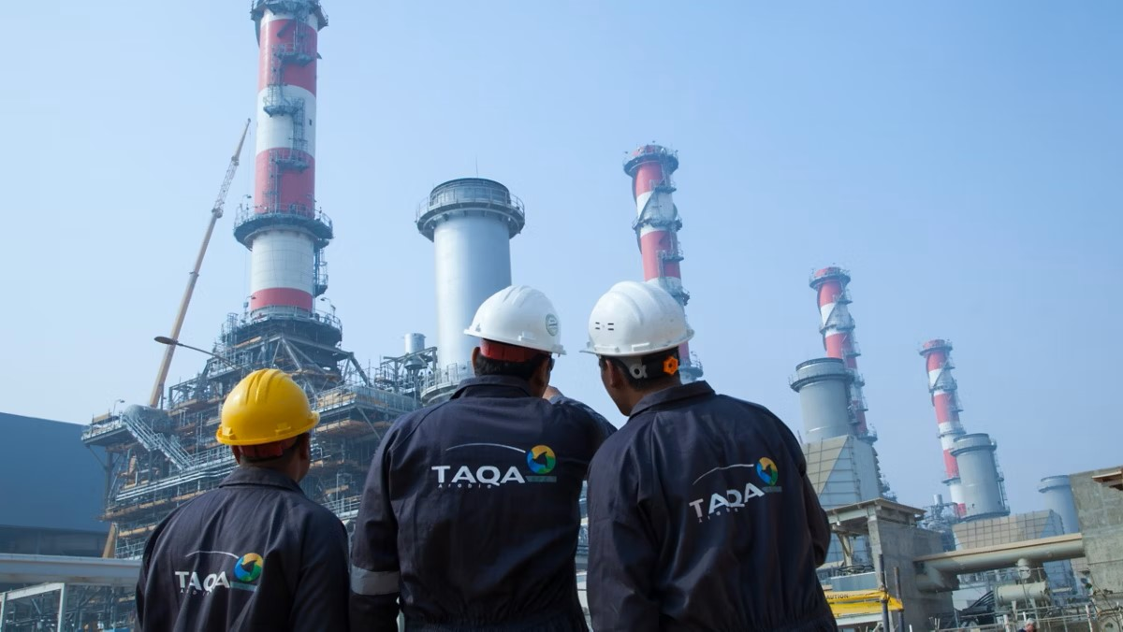





2
Power: Scale, Efficiency & Yield
TAQA POWER: SCALE, EFFICIENCY & YIELD
Unrivaled Power Infrastructure
One of Egypt's first private utilities licensed for power generation and distribution, anchored by major substations like 6th of October (250 MVA) and Nabq (160 MVA).
End-to-End Infrastructure
Engineering, EPC, substations, grid connections and distribution networks — delivered end to end.
Smart Energy Management
Network operation, preventive maintenance, advanced metering and digital energy management for uninterrupted supply.
Long-Term Partnership
Supporting integrated utility management and renewable energy integration to maximize asset value long-term.
1,600+
31M m²
12k+
Powering Industrial, Commercial & Residential Sites
Total MVA Distributed Across Egypt
Area Covered Across Different Concessions
End Users Connected to electricity
TRUSTED BY TIER-1 DEVELOPERS

Slide 15
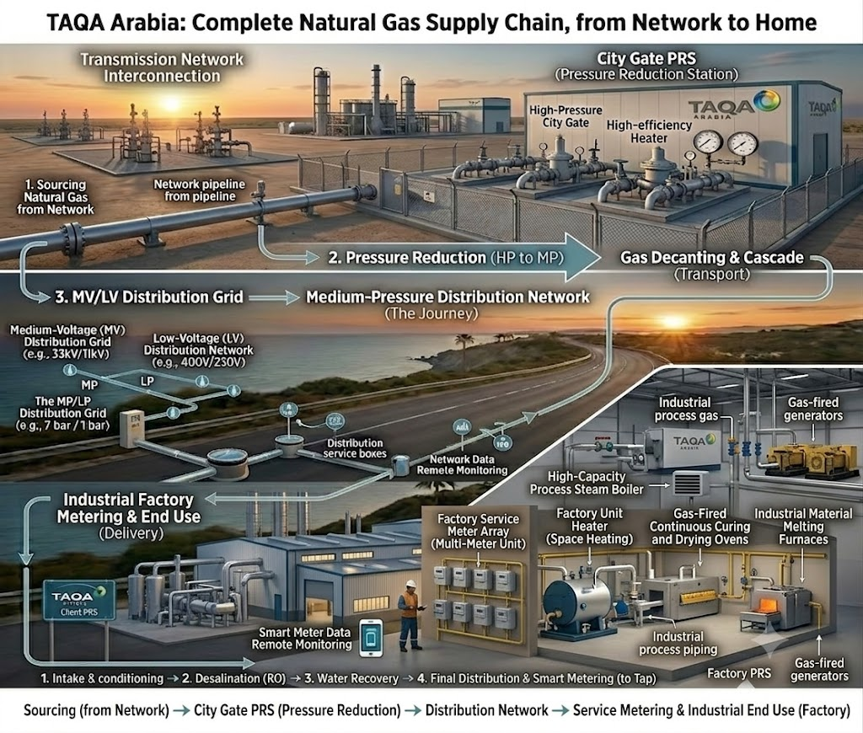
3
Gas Distribution: Scope & How It Works
End-to-end EPC for natural-gas distribution networks across industrial sites, parks and free zones
SCOPE
1
TAQA INVESTS THE CAPEX
City-gate & PRMS stations · Steel distribution mains · Factory service lines · Industrial meters & regulators · BOO / BOOT financing
2
THE PROCESS — STEP BY STEP
1
TAQA secures the concession and designs the gas grid.
2
Mains and service lines are laid across the zone.
3
Pressure is regulated to each factory's process needs.
4
Connections are metered, tested and commissioned.
5
TAQA operates, inspects and bills for gas delivered.
3
WHAT YOU RECEIVE
TAQA can provide an integrated solution, including funding, construction, ownership and operation of the asset subject to project requirements
A licensed industrial gas network
6.4 BCM
per year
Process-grade gas to every factory
Lifetime O&M and emergency response

Slide 16
3
Gas Distribution: Value Proposition
Why TAQA Arabia is the right partner for this solution
VALUE PROPOSITION
WHAT YOU GAIN
THE TAQA ARABIA EDGE
Diesel & LPG Fuel-Switching
Flexible Commercial Models
Manage the full transition from diesel and LPG to cleaner, cheaper natural gas.
Delivered as EPC, long-term O&M or BOO — choose the structure that fits your balance sheet.
Flexible Gas Sourcing — M-CNG or SNG
External & Internal Networks
Where no fixed pipeline exists yet, gas is supplied via M-CNG (mobile CNG) or SNG — no Factory waits.
TAQA builds the external distribution backbone and the internal Factory network.
Lower Factory Bills
One Partner Across all Phases
Subsidized piped natural gas is far cheaper than LPG cylinders or electric heating for residents.
A single accountable party from feasibility to handover removes interface risk for the developer, In-house engineering arm EGUSCO builds the network to spec.
Higher Asset Value
Standards Compliance
Connection to the national gas grid is a core industrial utility that lifts site value and tenancy.
Aligned with IGEM, EGAS and international gas-safety standards, protect residents and de-risk approvals.

Slide 17
3
Gas Distribution: Implementation Timeline
How TAQA delivers the solution from start to finish — phase by phase, with indicative timing
IMPLEMENTATION TIMELINE — START TO FINISH
Day 0–25
Day 25–70
Day 70–120
Day 120–240
Day 240–280
Day 280+
1
2
3
4
5
6
Feasibility
Engineering
Procurement
Construction
Commissioning
Operation
Network feasibility & route planning.
Detailed engineering & design.
Pipes, valves, meters & SCADA sourcing.
Network installation across the site.
Testing, safety checks & handover.
Licensed distribution & metering O&M.
PLAN & DESIGN Day 0–70
PROCURE & BUILD Day 70–240
COMMISSION & OPERATE Day 240+
Feasibility study, network route planning across the site and full detailed engineering and design.
Procurement of pipes, valves, meters and SCADA, then construction and installation of the distribution network.
Testing, commissioning and handover followed by licensed long-term distribution and metering operation.

Slide 18

3
Natural Gas Distribution: Proven Track Record
WHY TAQA IS YOUR STRATEGIC PARTNER
Unmatched Market Leadership
Egypt's first private natural gas distributor, licensed by EGAS — built on state-of-the-art networks under stable, long-term concessions.
End-to-End Capabilities
Surveys through engineering, construction, O&M, billing and 24/7 emergency response — fully in-house.
Dominant Private Network
Egypt's largest private gas pipeline network, by a wide margin.
+25
1.9M
Exclusive governorate concessions ensuring absolute long-term stability.
powering complex residential, commercial, and heavy-industry sites.
10k+
66%
Egypt's Private Natural Gas Distribution Network
Over 10,000 kilometers of robust, high-pressure Pipelines.
Dominant market share of all private gas distribution concessions in Egypt.
SAFETY & OPERATIONAL EXCELLENCE
ISO 9001:2015 Quality Management · ISO 14001:2015 Environmental Management · ISO 45001:2018 Occupational Health & Safety

Slide 19
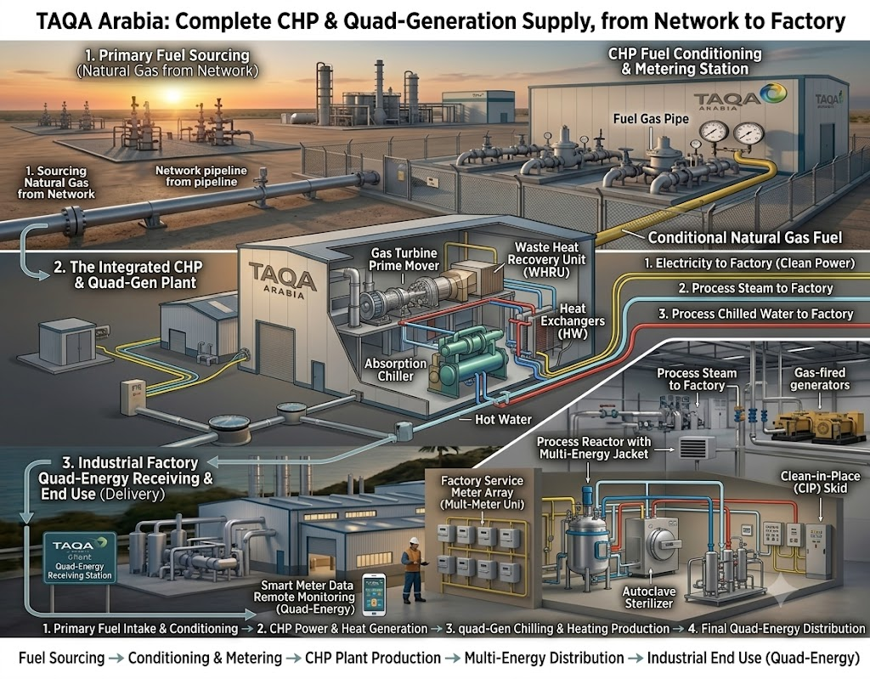
4
CHP: Scope & How It Works
Combined Heat & Power — capturing waste heat to deliver electricity plus thermal energy from a single fuel input
SCOPE
1
TAQA INVESTS THE CAPEX
Gas engine / turbine genset · Waste-heat recovery unit · Absorption chiller (tri-gen) · Grid sync, controls & SCADA · BOO / BOOT plant financing
2
THE PROCESS — STEP BY STEP
1
Natural gas feeds the on-site engine or turbine.
2
The genset generates electricity for your plant.
3
Exhaust and jacket heat are captured, not wasted.
4
Recovered heat becomes steam, hot water — and cooling via chiller.
5
Controls sync to the grid and match output to your load.
3
WHAT YOU RECEIVE
TAQA can provide an integrated solution, including funding, construction, ownership and operation of the asset subject to project requirements
On-site power plus steam, hot water & cooling
~85%
efficiency
Up to ~85% total fuel efficiency
One fuel input, three energy outputs

Slide 20
4
CHP: Value Proposition
Why TAQA Arabia is the right partner for this solution
VALUE PROPOSITION
WHAT YOU GAIN
THE TAQA ARABIA EDGE
Lower Energy Costs
Flexible Commercial Models
A single fuel input delivers both electricity and thermal energy, cutting unit costs.
Delivered as EPC, long-term O&M or BOO — choose the structure that fits your balance sheet.
High Overall Efficiency
Integrated Gas + CHP Solution
Up to ~85% efficiency by capturing waste heat that would otherwise be lost.
TAQA can supply both the natural gas and the CHP plant, creating a single accountable provider for both fuel and energy production
Flexible Thermal Outputs
Guaranteed Performance
Steam, hot water, chilled water or direct heat — matched to process needs.
TAQA's O&M and performance guarantees keep the system running at peak efficiency.
Reduced CO₂ Emissions
Reliability & Smart O&M
Higher fuel utilization translates into a smaller carbon footprint per unit of output.
24/7 predictive maintenance and rapid-response teams with guaranteed SAIDI / SAIFI performance.

Slide 21
4
CHP: Implementation Timeline
How TAQA delivers the solution from start to finish — phase by phase, with indicative timing
IMPLEMENTATION TIMELINE — START TO FINISH
Day 0–21
Day 21–60
Day 45–80
Day 80–160
Day 160–270
Day 270+
1
2
3
4
5
6
Energy Audit
System Design
Commercial Model
Procurement
Install & Commission
O&M
Power & thermal load profiling.
CHP sizing & tri-gen configuration.
BOO / BOOT & performance guarantee.
Gensets, HRSG & chillers sourcing.
Build, grid sync, testing & handover.
Performance-guaranteed operation.
AUDIT & DESIGN Day 0–60
FINANCE & BUILD Day 45–270
OPERATE Day 270+
Power and thermal load profiling, CHP sizing and tri-generation configuration matched to the plant's process needs.
BOO/BOOT structuring with performance guarantee, procurement of gensets, heat-recovery and chillers, installation, grid sync and commissioning.
Performance-guaranteed long-term operation and maintenance keeping efficiency at peak.

Slide 22
4
CHP: Case Study “MAFI”
A show of muscle — what TAQA Arabia has already delivered
Owning and operating high-efficiency captive generation
TAQA Power owns and operates a CHP station with the capacity of 9 Mw generators, 5.55 ton of steam, 810 RT and 1.6 Mw thermal of boiled water. This station supplies to the client 65 Gwh electricity, 43,762 ton of steam, 6 million RT and 12 Gw thermal of boiled water with tariffs that offer the clients savings of 6 Billion EGP over the project life and gas efficiency over 65%.
4 Products
6 Billion
Electricity, Steam, Chilled water and boiled water
Savings over 20 years
~85%
24/7
Captive Power & Cogeneration
CHP fuel efficiency
Performance-guaranteed O&M

Slide 23
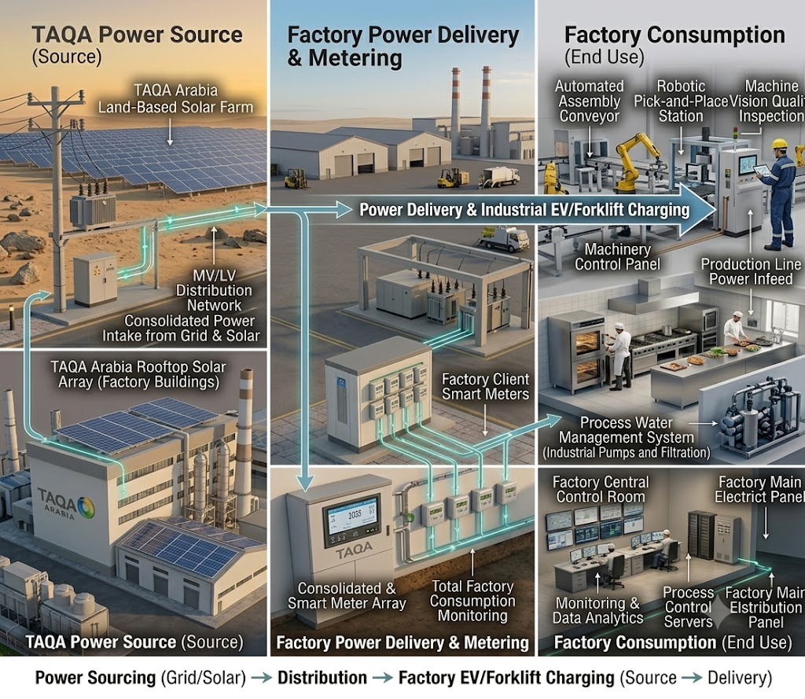
5
Solar: Scope & How It Works
Tailored solar PV solutions delivering measurable value across financing, sustainability and operations
SCOPE
1
TAQA INVESTS THE CAPEX
Rooftop & ground-mount PV · Inverters & transformers · Connection & net-metering works · Monitoring & SCADA · BOO / BOOT financing
2
THE PROCESS — STEP BY STEP
1
TAQA assesses roof, land and the plant's load curve.
2
PV arrays and inverters are installed and grid-tied.
3
Panels generate clean power across the working day.
4
Solar offsets daytime process and facility loads.
5
TAQA monitors yield and maintains the system.
3
WHAT YOU RECEIVE
TAQA can provide an integrated solution, including funding, construction, ownership and operation of the asset subject to project requirements
On-site solar cutting daytime grid draw
Daytime
savings
Lower, hedged energy cost
Monitored, maintained PV assets

Slide 24
5
Solar PV: Value Proposition
VALUE PROPOSITION
WHAT YOU GAIN
THE TAQA ARABIA EDGE
Lower Energy Bills
Egypt’s Solar Pioneer
Solar’s cost per kWh sits well below the grid tariff — Factory save from day one.
TAQA was the first national company to commercially operate a plot at the Benban solar park.
Tariff-Hike Hedge
Flexible Models
Lock in clean-energy cost for decades and insulate the Factory from grid-price escalation.
CAPEX, BOOT/BOO or PPA — own it, transfer it over time, or buy cheaper solar under a zero-capex PPA.
Higher Property Value
Turnkey Engineering
Solar-equipped, lower-running-cost homes command a premium and sell faster.
Survey, design, supply, installation and grid tie-in delivered end-to-end by one partner.
Green Living Credentials
Lifecycle O&M & Guarantee
Visible clean energy strengthens the community’s ESG and sustainability story.
Remote monitoring, maintenance and performance guarantees keep output high for 25+ years.

Slide 25
5
Solar: Implementation Timeline
How TAQA delivers the solution from start to finish — phase by phase, with indicative timing
IMPLEMENTATION TIMELINE — START TO FINISH
Day 0–21
Day 21–55
Day 40–75
Day 75–130
Day 130–210
Day 210+
1
2
3
4
5
6
Site & Energy Study
System Design
PPA Structuring
Procurement
Install & Commission
O&M
Irradiation, load & roof/land survey.
Array sizing, layout & grid-tie design.
BOO / BOOT & tariff agreement.
Panels, inverters & mounting sourcing.
Build, grid-tie, testing & go-live.
Monitoring & performance maintenance.
STUDY & DESIGN Day 0–55
FINANCE & BUILD Day 40–210
OPERATE Day 210+
Solar-irradiation and load study, roof/land survey, array sizing, layout and grid-tie design tailored to the site.
BOO/BOOT structuring and PPA tariff agreement, procurement of panels, inverters and mounting, installation, grid-tie and commissioning.
Monitoring, cleaning and performance maintenance over the life of the PPA.

Slide 26
5
Solar: Case Study “ASCOM”
A show of muscle — what TAQA Arabia has already delivered
Developing and investing in tailored solar across Egypt
TAQA Arabia operates solar PV to ASCOM with a capacity of 7 Mw with a discount of 15% on the grid tariff on the MV and supplies around 12.6 Gwh annually. the solar station provided 5M EGP in first year to the client and a savings of 340 million over the 25 years lifetime. Also, TAQA Arabia operates Solar stations in 6th of October industrial zones and our clients in the Cement industry.
BOO / BOOT
~1,000
PPA models, no client capex
t CO₂ avoided / MWp / yr
340 Million
24/7
Solar Development & Investment
Total savings over 25 years
Monitoring & O&M

Slide 27
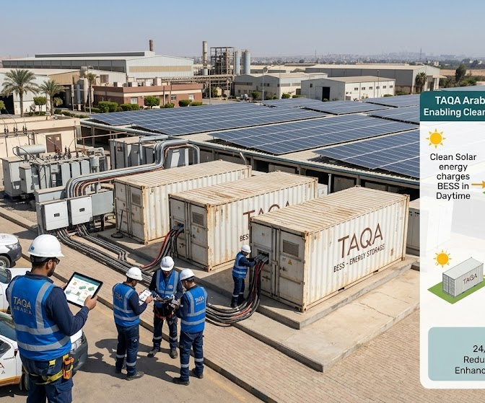
6
Energy Storage (BESS): Scope & How It Works
Battery Energy Storage Systems — storing clean power to cut peak charges, firm up solar and secure supply
SCOPE
1
TAQA INVESTS THE CAPEX
Battery energy-storage units · Power-conversion system & inverters · Switchgear & grid interface · EMS & SCADA controls · BOO / BOOT financing
2
THE PROCESS — STEP BY STEP
1
TAQA sizes storage to the plant's load and tariff profile.
2
Battery units and conversion systems are installed.
3
Storage charges when power is cheap or solar is surplus.
4
It discharges to shave peaks and bridge outages.
5
An energy-management system optimizes every cycle.
3
WHAT YOU RECEIVE
TAQA can provide an integrated solution, including funding, construction, ownership and operation of the asset subject to project requirements
Peak shaving and lower demand charges
Peak-shave
power
Backup through grid disturbances
Stored surplus from solar or off-peak

Slide 28
6
Energy Storage (BESS): Value Proposition
Why TAQA Arabia is the right partner for this solution
VALUE PROPOSITION
WHAT YOU GAIN
THE TAQA ARABIA EDGE
Peak-Demand Savings
Flexible Models
Discharge stored energy during peak hours to slash demand charges and tariff exposure.
CAPEX, BOOT/BOO or PPA — own it, transfer it over time, or buy cheaper solar under a zero-capex PPA.
Uninterrupted Production
Smart Energy Management
Instant-response backup protects critical lines and avoids costly downtime during outages.
EMS analytics optimize charge/discharge automatically against tariffs and loads.
Grid Services Revenue
Lifecycle O&M & Guarantee
Frequency regulation and load balancing can create new value streams.
Remote monitoring, maintenance and performance guarantees keep output high for 25+ years.
Future-Proof & Green
One Energy Stack
Enables deeper renewable integration and supports the plant's decarbonization roadmap.
Storage, solar, power and gas from a single provider.

Slide 29
6
Energy Storage (BESS): Implementation Timeline
How TAQA delivers the solution from start to finish — phase by phase, with indicative timing
IMPLEMENTATION TIMELINE — START TO FINISH
Day 0–21
Day 21–55
Day 40–75
Day 75–140
Day 140–220
Day 220+
1
2
3
4
5
6
Load & Tariff Study
System Design
Commercial Model
Procurement
Install & Commission
Smart O&M
Peak profile & tariff analysis.
BESS sizing & use-case configuration.
BOO / BOOT & savings agreement.
Batteries, PCS & EMS sourcing.
Build, integration, testing & go-live.
EMS optimisation & maintenance.
STUDY & DESIGN Day 0–55
FINANCE & BUILD Day 40–220
SMART OPERATE Day 220+
Peak-load and tariff analysis, BESS sizing and use-case configuration (peak shaving, solar firming, backup, grid services).
BOO/BOOT structuring and savings agreement, procurement of batteries, PCS and EMS, installation, integration and commissioning.
EMS-driven charge/discharge optimisation, monitoring and maintenance over the asset life.

Slide 30
6
Battery Storage (BESS): Backup Power & Grid Relief
A show of muscle — what TAQA Arabia has already delivered
Replacing diesel backup with BESS, paired with solar for a smarter grid
TAQA Arabia is Currently deploying (BESS) as a direct alternative to diesel generators for backup power — cutting fuel logistics, maintenance, and emissions from standby operations. Paired with solar PV , the same BESS asset shifts stored daytime generation into peak-demand hours, easing the load carried by client transformers and helping defer costly infrastructure upgrades.
Diesel Displacement
Peak Shifting
backup runtime shifted from diesel to BESS
Solar stored by day, discharged at peak demand
BOO / BOOT
Transformer Relief
BESS: From Diesel Backup to Smart Grid Support
No client capex
reduction in peak transformer loading

Slide 31





Why One Partner: The TAQA One-Stop-Shop
One SLA, one communication point, one accountable operator — across every utility on the site
From Fragmented Vendors to a Single Operator
One SLA
A single service-level agreement governs gas, power, CHP, solar and storage — one uptime guarantee, one renewal.
Mobile CNG
TAQA
Arabia
One Communication Point
A single account team and 24/7 hotline for every utility — no chasing multiple contractors.
Storage
Electricity
One Commercial Relationship
Consolidated billing, aligned contract terms and a single negotiation instead of separate procurement cycles.
One Engineering Standard
Utilities designed to interoperate from day one — shared infrastructure, metering and monitoring.
Solar
Gas
One Accountable Owner
End-to-end responsibility removes interface risk and finger-pointing between specialised vendors.
CHP

Slide 32
The Power of the Bundle: Cross-Solution Benefits
How combining the solutions under one SLA creates value no single vendor can match
Solar + Storage
Solar + Distribution
CHP + Gas
BESS stores daytime solar and dispatches it after sunset — pushing self-consumption and PPA savings far higher.
On-site solar feeds the TAQA-built network directly, lowering the plant's blended power cost.
TAQA's gas network fuels the CHP plant — one partner supplies the fuel and the cogeneration asset.
Storage + Distribution
Gas + Mobile CNG
Shared O&M & Monitoring
BESS shaves peak demand on the distribution network, cutting the most expensive part of the bill.
Mobile CNG bridges supply until the permanent gas network goes live — no production gap.
One control room and field team monitor every utility — pooled spares, pooled response, lower unit cost.
Sold as one SLA: lower combined energy cost · shared infrastructure · one billing & monitoring platform · stronger ESG / decarbonisation story · single accountable operator for the entire site's energy backbone.

Slide 33
Success Story: Integrated Industrial Energy
A single industrial client running on multiple TAQA solutions — the one-stop-shop, proven
One site, multiple TAQA solutions, one accountable operator
Across Egypt's industrial parks, TAQA Arabia combines gas distribution, private power distribution and on-site generation into a single, integrated energy system for factories — supplying the fuel, building the network and running the assets under one relationship. It is the clearest proof of the bundled, one-SLA model for industry.
Solutions combined on one site:
Gas Distribution
Power Distribution
CHP / Solar
Storage
450
+500
MVA serving industrial parks
Factories served
6.4 BCM
+150
Gas distributed / year
MW captive generation
TAQA Power operates 450 MVA across 9 industrial-park concessions serving +500 factories.

