Slide 1
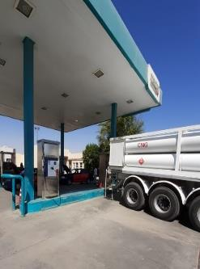
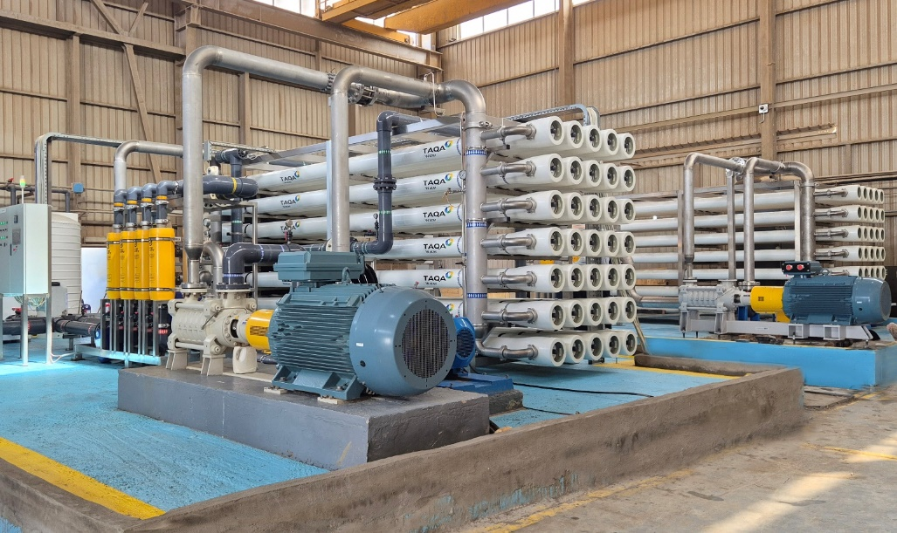
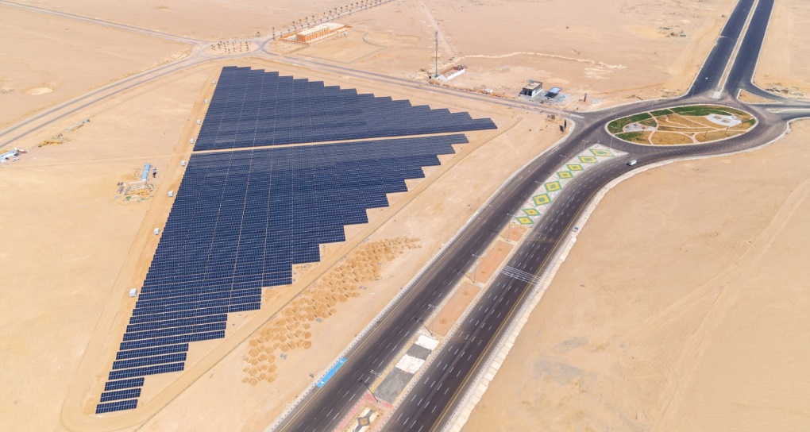
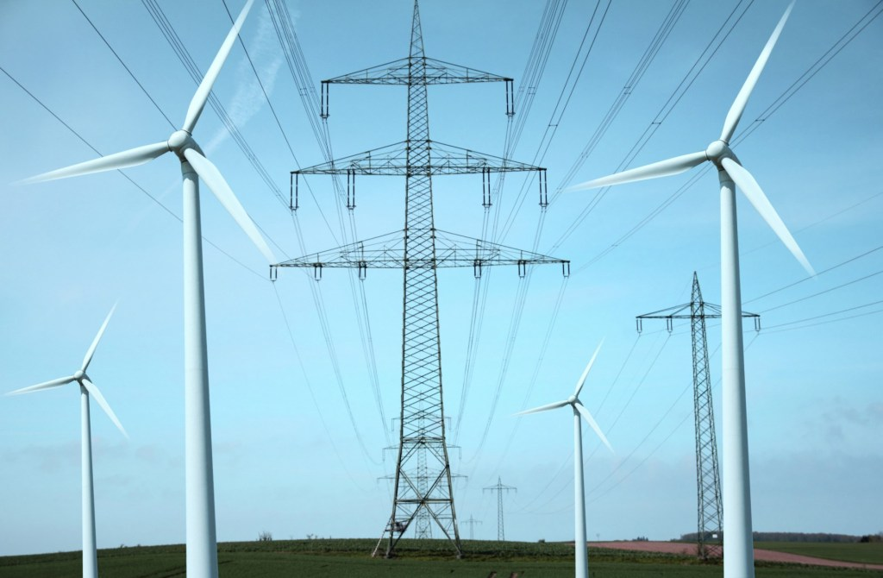
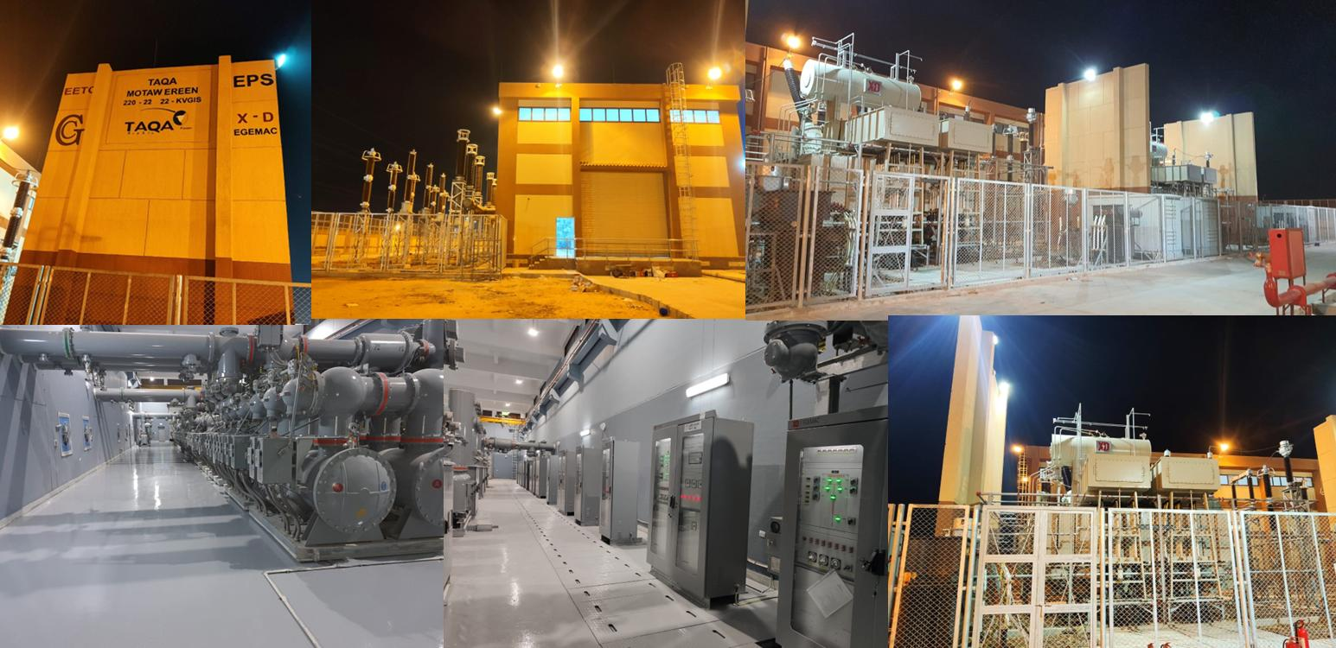
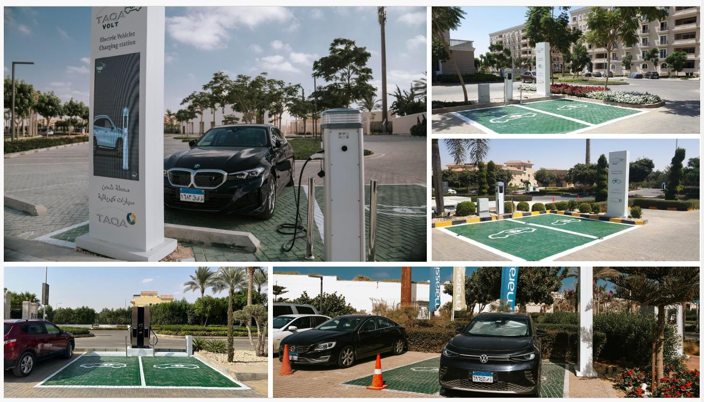



TAQA Arabia
Residential Customers
Integrated Energy & Utility Solutions · Jan 2026

Slide 2




TAQA Arabia · Who We Are
A World of Energy, Delivered End-to-End
Gas
Power
Founded in 2006 and listed on the EGX since 2023, TAQA Arabia is Egypt's largest private-sector energy and utility developer.
Across four divisions — Gas, Power, Petroleum and Water — TAQA finances, builds, owns and operates the utility backbone of residential communities, industrial zones and touristic destinations.
For a residential developer, that means one accredited partner can deliver gas, electricity, water, back-up power and EV charging under a single relationship.
Gas distribution & EPC networks
NGV stations & car conversion
Mobile CNG & LNG (virtual pipeline)
Generation & distribution (+1,600 MVA)
Renewable energy & solar PV
EV charging stations
Petroleum
Water
Oil-marketing stations & terminals
Lubricants retail & distribution
Bulk fuel storage & logistics
Reverse-osmosis desalination
Filtration & chemical treatment
Smart, solar-powered operations
Active member of the International Gas Union (IGU)
Accredited by the IGEM (Institution of Gas Engineers & Managers)

Slide 3
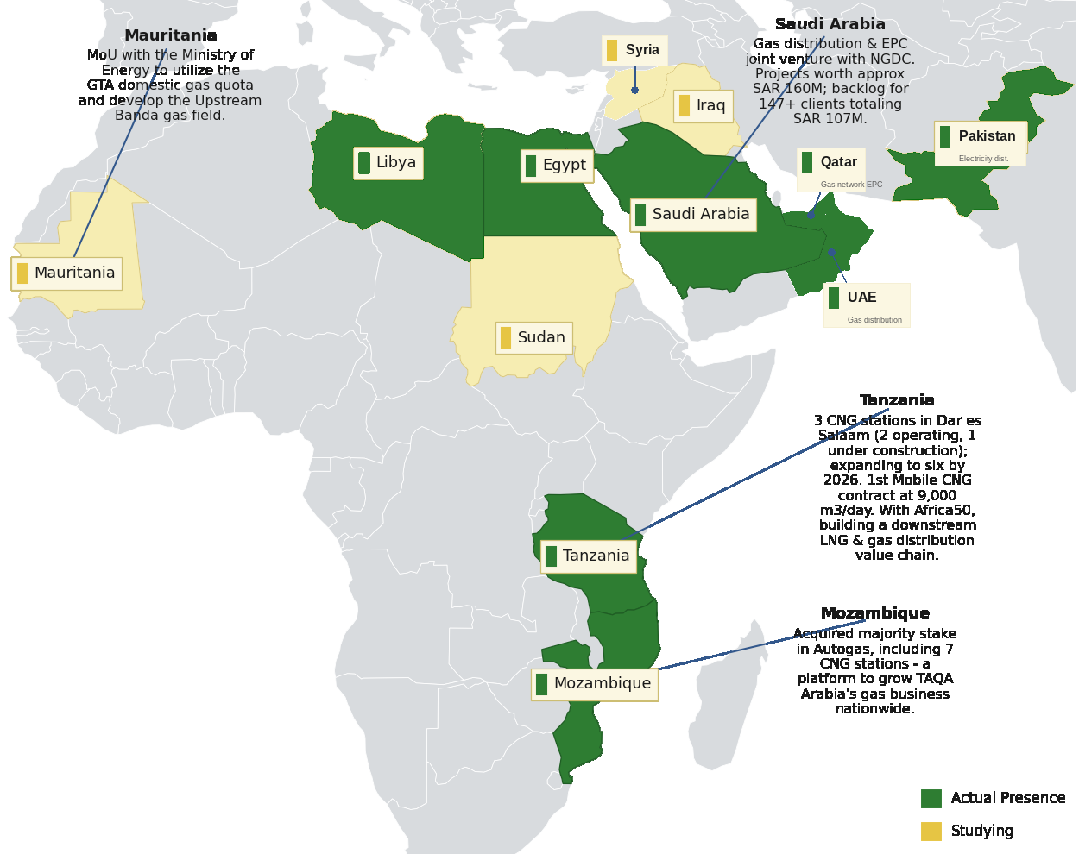




TAQA Arabia · Regional Presence
Presence Across Africa & the Middle East
Reach & Scale
10
Countries of presence
Egypt, GCC, Africa & South Asia
4
Operating divisions
Gas · Power · Petroleum · Water
20+
Governorates in Egypt
Industrial, residential & touristic
3,400+
Employees
Across all divisions
Actual presence and markets under study across Africa & the Middle East — extending TAQA’s integrated energy model well beyond Egypt.

Slide 4

TAQA Arabia · In Numbers
The scale behind a single residential utility partner — FY 2025
Operating Scale Across the Divisions
THE GROUP AT A GLANCE
GAS
POWER
EGP 13.4bn
+10,000
8
+1,600
+150
Revenue — FY 2025
km network
governorate concessions (15-yr)
MVA distribution
MW generation capacity
EGP 18bn+
Assets under Management
WATER
MOBILITY & CNG
~6.5M
+47,000
15
300
1st
Residential gas customers
m³/day desalination
operational locations
Total stations
private EV-charging license
Founded 2006 · Listed on EGX 2023 · 3,400+ employees across all divisions

Slide 5






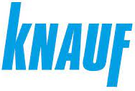



















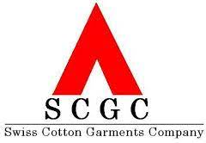
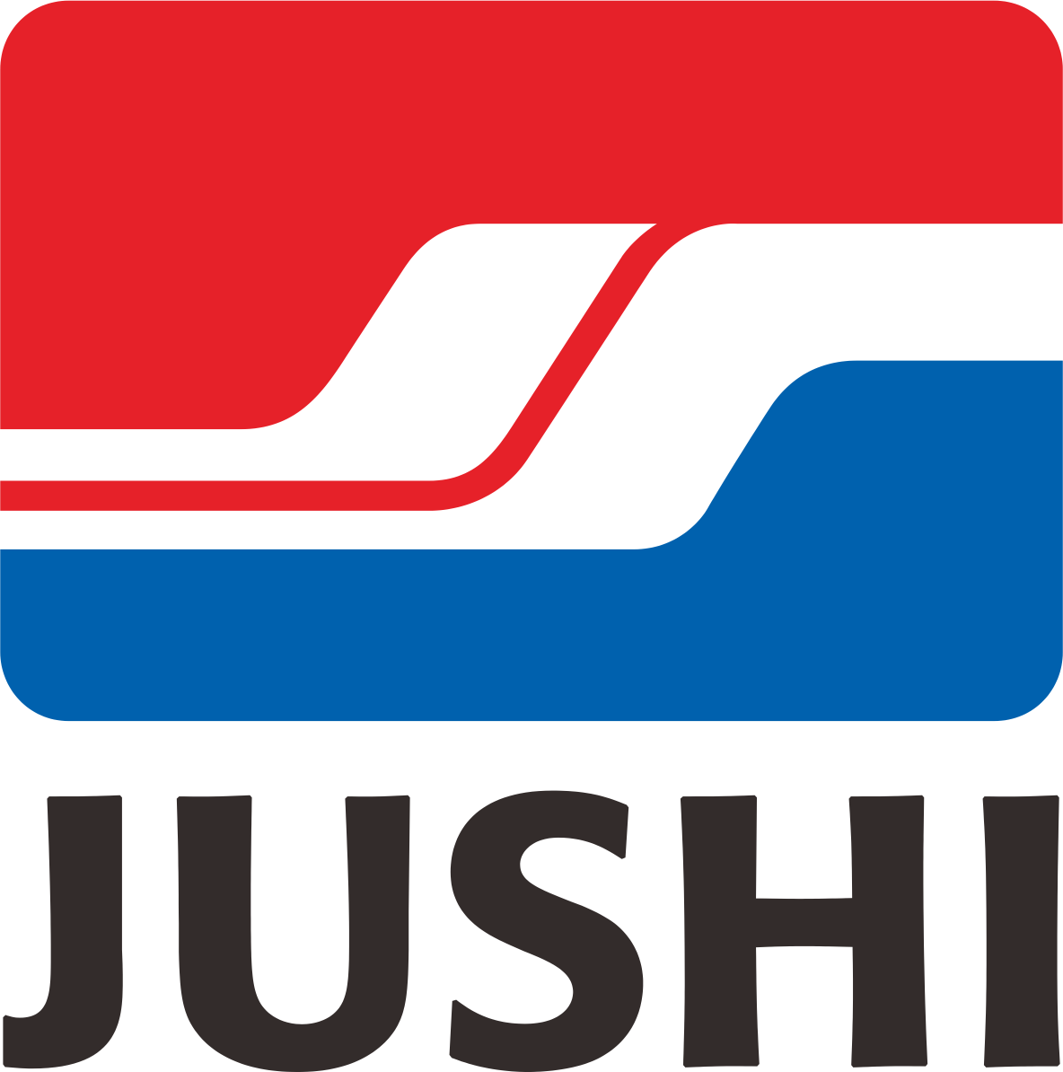

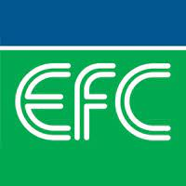










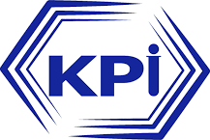



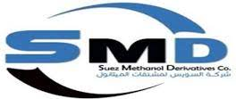





























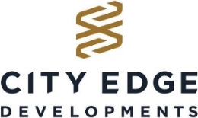



















TAQA Arabia · Trusted By
Clients and partners served across the Multiple divisions

Slide 6


Residential Customers · Solutions Overview
Electricity Distribution
02
Mobile CNG
01
Turnkey MV/LV networks, smart metering and licensed lifetime O&M.
Water Desalination
03
Off-grid natural gas delivered via mobile virtual pipeline — zero infrastructure capex.
Reverse-osmosis plants and digitalized, solar-powered water operations.
Diesel Rental
05
Emergency & back-up power gensets on a flexible rental / OPEX model.
Gas Distribution
04
EV Chargers
06
End-to-end gas network EPC — design, build, commission and operate.
Solar PV
07
AC, DC and golf-car charging with full-investment green-mobility services.
Rooftop and common-area solar PV — cutting bills, with flexible ownership.

Slide 7
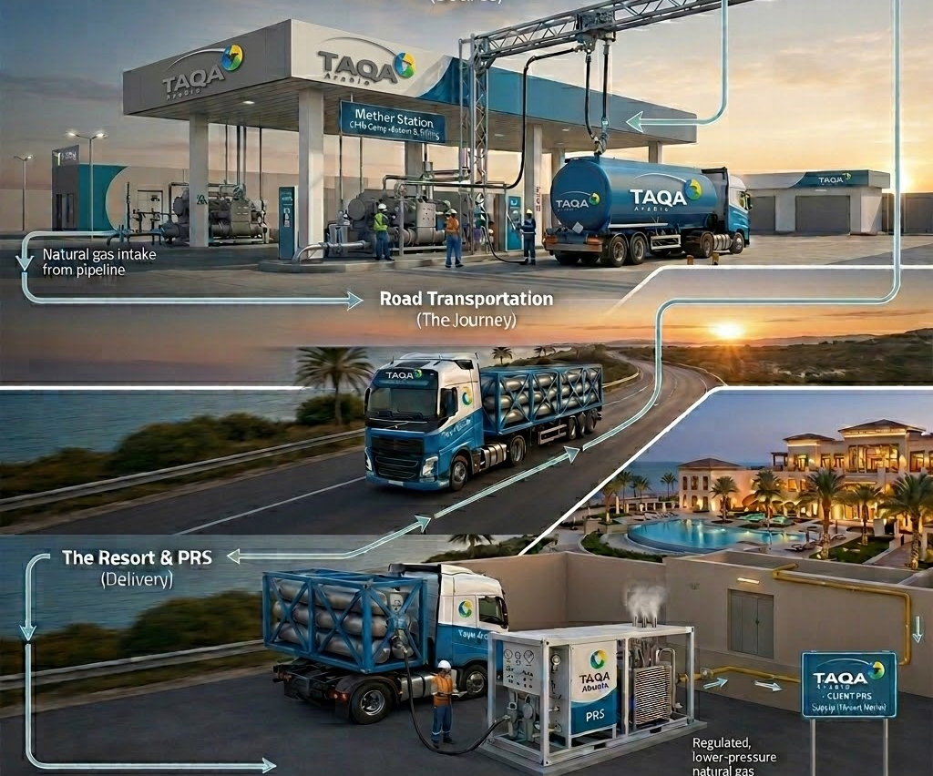
1
Mobile CNG: Scope & How It Works
SCOPE
1
TAQA INVESTS THE CAPEX
Mother station & compression skids · CNG / virtual-pipeline trailers · On-site decompression & PRMS skid · Metering, odorization & safety controls · BOO / BOOT asset financing
2
THE PROCESS — STEP BY STEP
1
Gas is compressed at a TAQA mother station to ~250 bar.
2
CNG trailers haul it to your community as a virtual pipeline.
3
On-site skids decompress and regulate gas to delivery pressure.
4
gas flows to homes and amenities.
5
TAQA monitors volumes and refills before you run low.
3
WHAT YOU RECEIVE
TAQA can provide an integrated solution, including funding, construction, ownership and operation of the asset subject to project requirements
Piped-quality gas with no physical pipeline
Grid gas,
no grid
Reliable supply to off-grid compounds
Seamless switch-over once the grid arrives

Slide 8
1
Mobile CNG: Value Proposition
VALUE PROPOSITION
WHAT YOU GAIN
TAQA ARABIA EDGE
Off-Grid Gas Supply
Flexible Delivery Approach
Reliable natural gas to communities without pipeline access — compounds, resorts and remote developments.
BOO / BOOT or EPC via Capacity-as-a-Service — no upfront infrastructure cost for the community developer.
Cost Savings vs. Diesel & LPG
Nationwide Logistics Via Master Gas Stations
lower fuel cost than diesel; replaces LPG and electric heating across the development.
A dedicated trailer fleet keeps refills on schedule across governorates based on Master Gas segregated stations across Egypt
Cleaner Emissions
Scalable to Any Load
Cuts CO₂ by ~24% vs. diesel and lowers NOx & particulates — supports ESG and green-rating targets.
Starter (550 litres/day of diesel) to Heavy (5,500+ litres/day of diesel) — scales with occupancy, bridges to grid later.
Offset Diesel Quota
Presence Across Many Governorates
Reduce reliance on diesel quotas by providing cleaner and more cost-effective fuel alternatives.
Operates a nationwide portfolio of Mobile CNG projects across Egypt, extending natural gas access, reducing fuel costs, and enhancing energy reliability for clients

Slide 9
1
Mobile CNG: Implementation Timeline
IMPLEMENTATION TIMELINE — START TO FINISH
Day 0
Day 1–3
Day 4–7
Day 8–14
Day 15–30
Day 90–120
Day 120–200
1
2
3
4
5
6
7
Discovery
Initial Contact
Site Audit
Contract
Mobilization
On-Site Install
Live Gas
Lead identification & commercial qualification.
NDA signed, requirement scoping.
Technical load profiling & demand curve.
Capacity tier, CaaS pricing
MEGC & PRU procured and prepared.
PRU adapter installed, SCADA activated.
Switchover from diesel to live CNG supply.
DISCOVERY & AUDIT Day 0–14
CONTRACTING Day 8–14
DEPLOYMENT & GO-LIVE Day 90–200
Lead qualification, NDA, site visit and full technical load profiling — output is a precise demand curve and connection plan.
Capacity tier selection (Starter / Industrial / Heavy), CaaS pricing model, 99.5% uptime SLA and payment terms — output is a signed agreement.
MEGC mobilized, PRU adapter installed, SCADA activated, safety tests and switchover from diesel to live CNG supply.

Slide 10
1
Mobile CNG: Proven Track Record
First company in Egypt to supply natural gas through a mobile virtual pipeline
TAQA Arabia pioneered mobile CNG in Egypt, using its network of 86 CNG stations to extend a virtual pipeline into four governorates with no fixed gas infrastructure. The model now serves ceramics, glass, food-processing and other industrial clients — proving off-grid factories can run on clean natural gas years before the pipeline arrives.
Guaranteed Savings
Wide Network
Saving in Comparison to the Current Diesel price
86 Stations Across 20 Governorates
10
Big Success Story
Existing Projects
Supply Natural Gas to a Whole Governorate “Kharge”
Notes:
Build a case study and the benefits from the case study for “El Kharga”

Slide 11
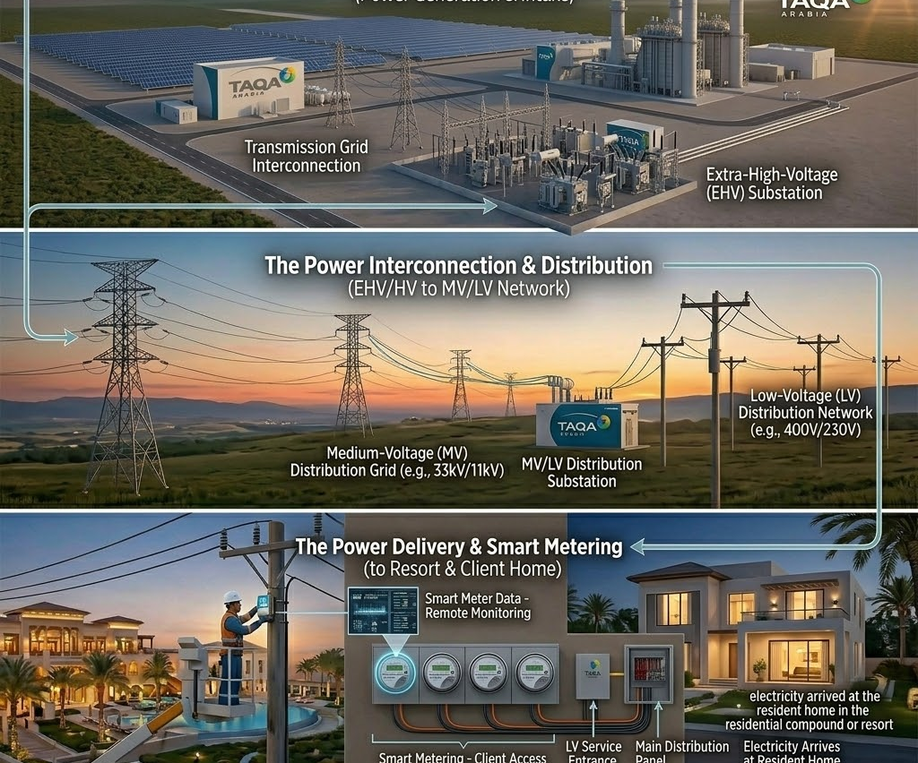
2
Electricity Distribution: Scope & How It Works
Turnkey distribution networks for residential developments — from power sourcing and design through licensed lifetime O&M
SCOPE
1
TAQA INVESTS THE CAPEX
MV / LV substations & ring-main units · Distribution transformers · Cabling, switchgear & protection · Smart meters & SCADA · BOO / BOOT network financing
2
THE PROCESS — STEP BY STEP
1
TAQA designs the network to the community's load and master plan.
2
Substations, transformers and cabling are built and energized.
3
Power is stepped down and distributed to every plot and amenity.
4
Smart meters record each unit consumed per household.
5
SCADA and a 24/7 team keep the network balanced and online.
3
WHAT YOU RECEIVE
TAQA can provide an integrated solution, including funding, construction, ownership and operation of the asset subject to project requirements
A fully built, licensed power network
Plug-and-play
grid
Metered electricity to every home
24/7 operation, faults and billing handled

Slide 12
2
Electricity Distribution: Value Proposition
VALUE PROPOSITION
WHAT YOU GAIN
THE TAQA ARABIA EDGE
Potential New Revenue Stream
Flexible Delivery Approach
The profit-share model turns the distribution network from a cost center into recurring income for the developer.
Take it as EPC build, licensed O&M, or a profit-share — TAQA flexes from substation to metering.
Lower Resident Bills
Faster Time-to-Handover
Demand-side management and tariff optimization reduce consumption and end-user charges.
TAQA's licensing relationships and in-house engineering compress approvals, so units energize on schedule.
Guaranteed Power Quality
Single Accountable Operator
Stable, metered, billable electricity to every unit from handover — no reliance on stretched public utilities.
One licensed party owns sourcing, network, metering and O&M — no finger-pointing between contractors.
Future-Ready Network
Reliability & Smart O&M
Designed for solar, storage and EV loads from day one — the community scales without re-builds.
24/7 predictive maintenance and rapid-response teams with guaranteed SAIDI / SAIFI performance.

Slide 13
2
Electricity Distribution: Implementation Timeline
IMPLEMENTATION TIMELINE — START TO FINISH
Day 0–30
Day 30–75
Day 75–120
Day 120–240
Day 240–300
Day 300+
1
2
3
4
5
6
Power Sourcing
Engineering Approval
MEP Approval
Network Build
Smart Metering
Energise & O&M
Gov. relations & grid MV interconnection.
Load study & engineering drawings approval.
Shop drawings / BOM, FAT & supervision.
MV/LV network construction & substation.
Power & water metering supply & platform.
Go-live & licensed network O&M.
SOURCE & DESIGN Day 0–75
BUILD & METER Day 75–300
OPERATE Day 300+
Power sourcing and government relations, substation development, grid interconnection, load studies and engineering-drawing approvals.
MEP approvals, value engineering, network construction, and supply/installation of the smart power & water metering platform.
Licensed long-term O&M of the distribution network and meters with 24/7 predictive maintenance and guaranteed reliability.

Slide 14
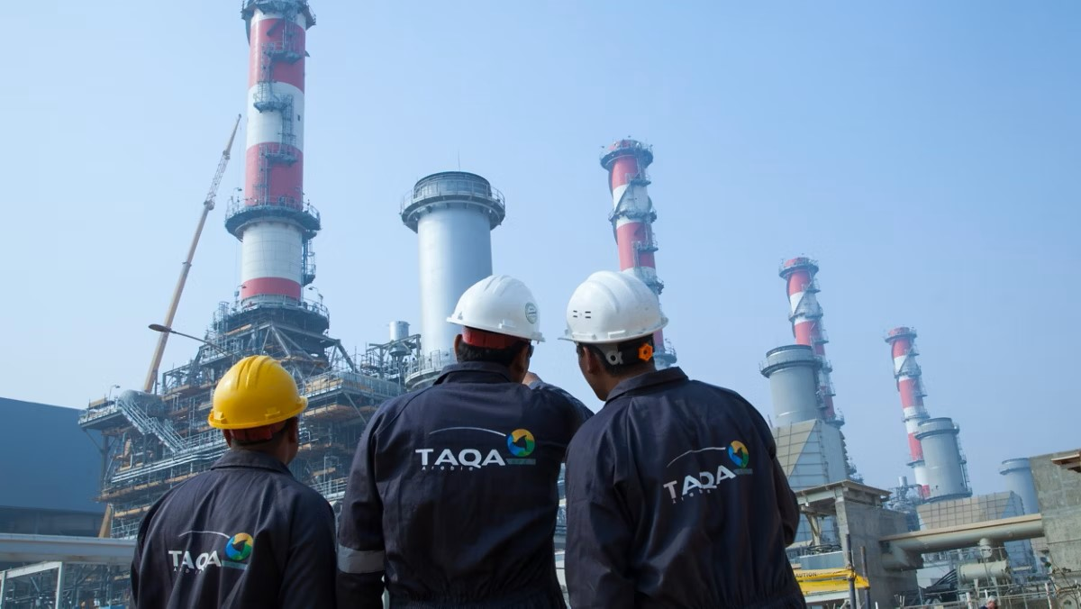


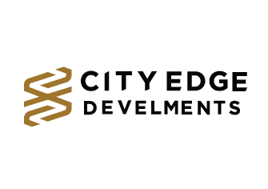


2
Power: Scale, Efficiency & Yield
TAQA POWER: SCALE, EFFICIENCY & YIELD
Unrivaled Power Infrastructure
One of Egypt's first private utilities licensed for power generation and distribution, anchored by major substations like 6th of October (250 MVA) and Nabq (160 MVA).
End-to-End Infrastructure
Engineering, EPC, substations, grid connections and distribution networks — delivered end to end.
Smart Energy Management
Network operation, preventive maintenance, advanced metering and digital energy management for uninterrupted supply.
Long-Term Partnership
Supporting integrated utility management and renewable energy integration to maximize asset value long-term.
1,600+
31M m²
12k+
Powering Industrial, Commercial & Residential Sites
Total MVA Distributed Across Egypt
Area Covered Across Different Concessions
End Users Connected to electricity
TRUSTED BY TIER-1 DEVELOPERS

Slide 15
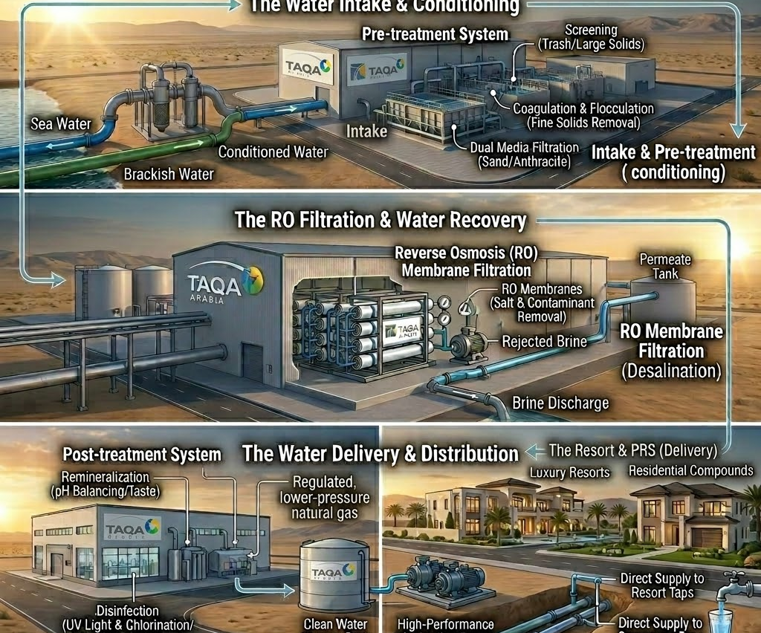
3
Water Desalination: Scope & How It Works
SCOPE
1
TAQA INVESTS THE CAPEX
Intake & pre-treatment system · Reverse-osmosis desalination trains · Post-treatment & storage tanks · Pumping, distribution & smart meters · BOO / BOOT plant financing
2
THE PROCESS — STEP BY STEP
1
Seawater or brackish water is drawn in and pre-treated.
2
Reverse-osmosis membranes remove salt and impurities.
3
Clean water is remineralized to potable standard.
4
Treated water is stored, pumped and distributed to the community.
5
TAQA operates the plant and guarantees output quality.
3
WHAT YOU RECEIVE
TAQA can provide an integrated solution, including funding, construction, ownership and operation of the asset subject to project requirements
Potable water independent of the public network
Your own
water source
Guaranteed volume and quality
Full plant operation and maintenance

Slide 16
3
Water Desalination: Value Proposition
VALUE PROPOSITION
WHAT YOU GAIN
THE TAQA ARABIA EDGE
50% Lower Energy Use
Flexible Commercial Models
Advanced energy-efficient desalination plus VSDs, peak-demand control and solar PV cut power use.
Delivered as EPC, long-term O&M or BOO — choose the structure that fits your balance sheet.
Seawater & Brackish Supply
Green-Rating Enabler
Seawater RO for coastal compounds and brackish RO for inland cities like New Cairo & 6th of October.
Solar-powered RO and brine management support LEED / green-community certification and ESG goals.
Resident Experience
Scales With the Community
Dynamic billing, consumption analytics and real-time notifications via mobile app.
Minimum scale of 400 m³/day RO, with modular trains added in phases as the community grows.
Sustainability & ESG Impact
Smart Operations & Uptime
Solar-powered desalination, brine management and a reduced freshwater-extraction footprint.
Real-time monitoring, leak & failure detection and predictive-maintenance dashboards.

Slide 17
3
Water Desalination: Implementation Timeline
IMPLEMENTATION TIMELINE — START TO FINISH
Day 0–20
Day 20–60
Day 45–75
Day 75–210
Day 210–260
Day 260+
1
2
3
4
5
6
Water Demand Study
Plant Design
Commercial Model
Construction
Commissioning
Smart O&M
Consumption profiling & source-water survey.
RO sizing, pre/post-treatment & PV integration.
BOO/BOOT & water-purchase agreement.
Plant build, networks & smart metering.
Testing, water-quality validation & handover.
IoT monitoring & predictive maintenance.
STUDY & DESIGN Day 0–60
FINANCE & BUILD Day 45–260
SMART OPERATE Day 260+
Water-demand profiling, source-water survey, RO plant sizing, pre/post-treatment design and solar-PV integration planning.
BOO/BOOT structuring and water-purchase agreement, plant construction, distribution networks, smart metering, testing and water-quality validation.
IoT monitoring of water quality, smart dosing, leak detection, predictive maintenance and dynamic resident billing.

Slide 18
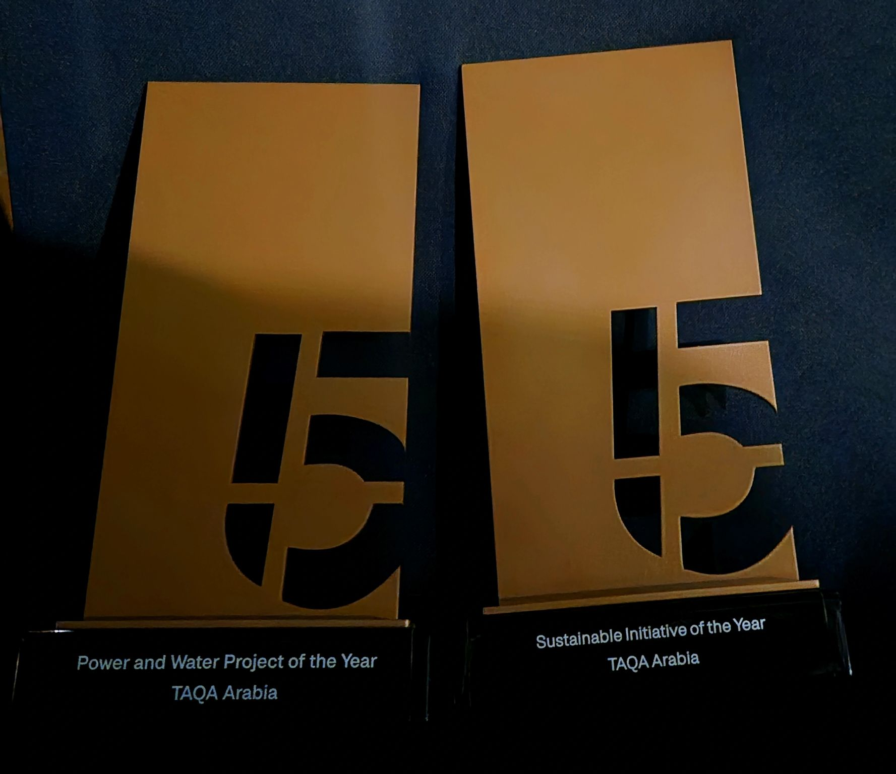
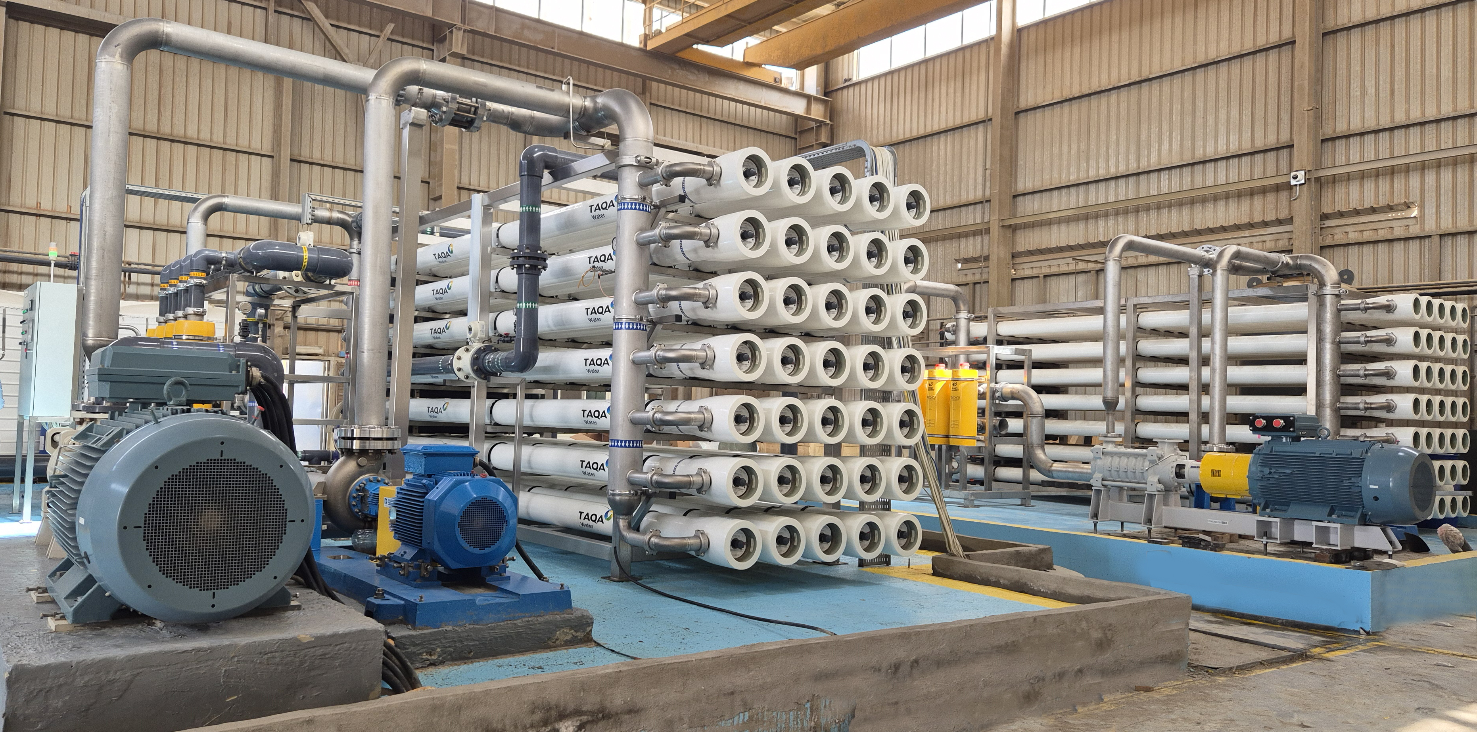
3
Water Desalination: Case Study – Soma Bay
Self operating Water Desalination transition to BOO
The Challenge
Reliable water security needed
Capital tied up in core hospitality business
Conventional RO meant high running costs
The Initiative
~USD 9 million invested by TAQA Water
Build-Own-Operate (BOO) model
Soma Bay's capital preserved for core operations
The Transformation
Energy-efficient RO paired with solar PV
50% less energy consumption
~EGP 33.6 million saved a year
~10,000 tonnes CO₂ cut annually
The Impact
Power & Water Project of the Year
Sustainable Initiative of the Year
Big 5 Construct Egypt Impact Awards
Notes:
Network gas and electricity as one solution

Slide 19
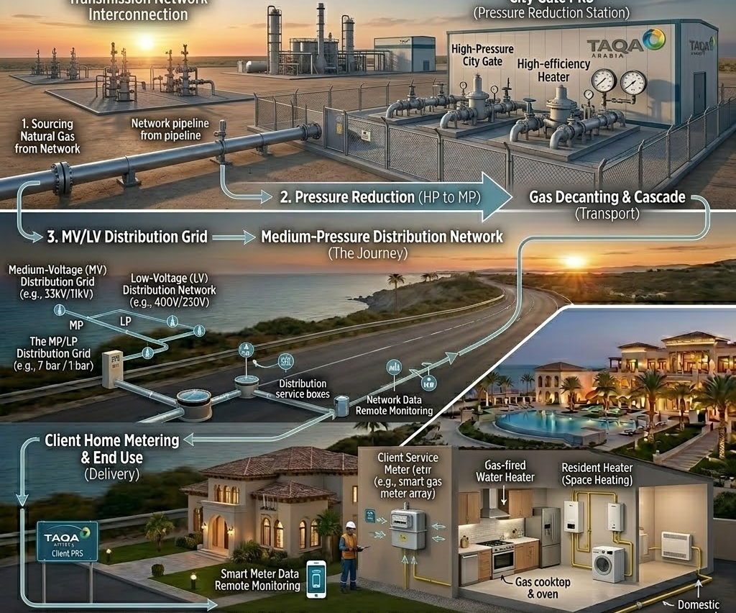
4
Gas Distribution: Scope & How It Works
SCOPE
1
TAQA INVESTS THE CAPEX
City-gate & pressure-reduction stations · Steel & PE distribution mains · Service lines to each home · Domestic meters & regulators · BOO / BOOT network financing
2
THE PROCESS — STEP BY STEP
1
TAQA secures the concession and designs the gas network.
2
Mains and service lines are laid across the community.
3
Pressure is regulated down to safe domestic levels.
4
Each home is connected, metered and commissioned.
5
TAQA operates, inspects and bills for the gas delivered.
3
WHAT YOU RECEIVE
TAQA can provide an integrated solution, including funding, construction, ownership and operation of the asset subject to project requirements
A licensed piped-gas network
10,000+ km
network
Safe, metered gas to every home
Lifetime operation and emergency response

Slide 20
4
Gas Distribution: Value Proposition
VALUE PROPOSITION
WHAT YOU GAIN
THE TAQA ARABIA EDGE
Diesel & LPG Fuel-Switching
Flexible Commercial Models
Manage the full transition from diesel and LPG to cleaner, cheaper natural gas.
Delivered as EPC, long-term O&M or BOO — choose the structure that fits your balance sheet.
Flexible Gas Sourcing — M-CNG or SNG
External & Internal Networks
Where no fixed pipeline exists yet, gas is supplied via M-CNG (mobile CNG) or SNG — no community waits.
TAQA builds the external distribution backbone and the internal in-compound and in-building network.
Higher Asset Value
One Partner Across all Phases
Connection to the national gas grid is a core industrial utility that lifts Community Assets value and tenancy.
A single accountable party from feasibility to handover removes interface risk for the developer, In-house engineering arm EGUSCO builds the network to spec.
Lower Living Costs
Standards Compliance
Subsidized piped natural gas is far cheaper than LPG cylinders or electric heating for residents.
Aligned with IGEM, EGAS and international gas-safety standards, protect residents and de-risk approvals.

Slide 21
4
Gas Distribution: Implementation Timeline
IMPLEMENTATION TIMELINE — START TO FINISH
Day 0–25
Day 25–70
Day 70–120
Day 120–240
Day 240–280
Day 280+
1
2
3
4
5
6
Feasibility
Engineering
Procurement
Construction
Commissioning
Operation
Network feasibility & route planning.
Detailed engineering & design.
Pipes, valves, meters & SCADA sourcing.
Network installation across the community.
Testing, safety checks & handover.
Licensed distribution & metering O&M.
PLAN & DESIGN Day 0–70
PROCURE & BUILD Day 70–240
COMMISSION & OPERATE Day 240+
Feasibility study, network route planning across the development and full detailed engineering and design.
Procurement of pipes, valves, meters and SCADA, then construction and installation of the distribution network.
Testing, commissioning and handover followed by licensed long-term distribution and metering operation.

Slide 22

4
Natural Gas Distribution: Proven Track Record
Unmatched Market Leadership
Egypt's first private natural gas distributor, licensed by EGAS — built on state-of-the-art networks under stable, long-term concessions.
End-to-End Capabilities
Surveys through engineering, construction, O&M, billing and 24/7 emergency response — fully in-house.
Dominant Private Network
Egypt's largest private gas pipeline network, by a wide margin.
+25
1.9M
Exclusive governorate concessions ensuring absolute long-term stability.
powering complex residential, commercial, and heavy-industry sites.
10k+
66%
Egypt's Private Natural Gas Distribution Network
Over 10,000 kilometers of robust, high-pressure Pipelines.
Dominant market share of all private gas distribution concessions in Egypt.
SAFETY & OPERATIONAL EXCELLENCE
ISO 9001:2015 Quality Management · ISO 14001:2015 Environmental Management · ISO 45001:2018 Occupational Health & Safety

Slide 23
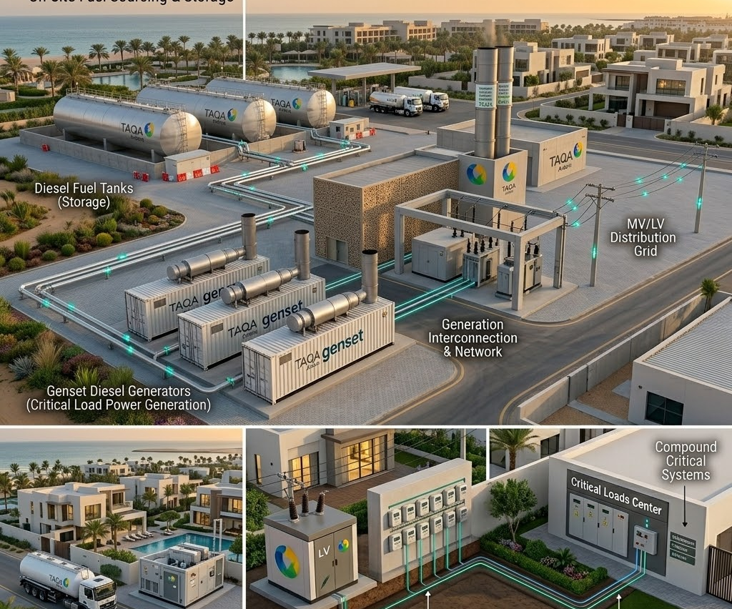
5
Diesel Rental: Scope & How It Works
SCOPE
1
TAQA INVESTS THE CAPEX
Rental diesel generator sets · Fuel tanks & automatic transfer switch · Synchronization & distribution panels · Remote telemetry & monitoring · Fuel-supply logistics
2
THE PROCESS — STEP BY STEP
1
TAQA sizes gensets to the site's standby or prime load.
2
Units are delivered, installed and synchronized on site.
3
Generators start automatically on grid loss or demand.
4
TAQA manages refuelling, service and remote monitoring.
5
Units scale up or down as the project's needs change.
3
WHAT YOU RECEIVE
TAQA can provide an integrated solution, including funding, construction, ownership and operation of the asset subject to project requirements
Immediate, reliable backup or prime power
Power on
day one
Fuel, service and monitoring included
Flexible capacity with no asset purchase

Slide 24
5
Diesel Rental: Value Proposition
VALUE PROPOSITION
WHAT YOU GAIN
THE TAQA ARABIA EDGE
Business / Community Continuity
Rental & OPEX Model
Instant back-up power keeps lifts, pumps, lighting and amenities running through any outage.
Rental and full-service options with guaranteed response SLAs — no capital outlay.
Uninterrupted Living
Rapid Deployment
Residents keep power to elevators, water pumps, security and common areas during grid failures.
Standardized gensets and skid solutions installed and commissioned fast.
Construction-Phase Power
Flexible Capacity
Temporary power for the build site converts seamlessly into back-up power at handover.
Modular sizing from 500 kVA to 20 MVA — scale up or relocate as the development grows.
Hands-Off Reliability
Bundled Transition
TAQA's 24/7 O&M, remote monitoring and rapid response remove the operating burden entirely.
Bridges to permanent gas or grid power within one partner.

Slide 25
5
Diesel Rental: Implementation Timeline
IMPLEMENTATION TIMELINE — START TO FINISH
Day 0–7
Day 7–14
Day 14–25
Day 25–35
Day 35–45
Day 45+
1
2
3
4
5
6
Load Assessment
Genset Sizing
Delivery
Integration
Commissioning
24/7 O&M
Back-up load survey & redundancy plan.
Capacity selection & rental structuring.
Gensets, enclosures & fuel tanks delivered.
Synchronization, ATS & switchgear tie-in.
Testing, safety checks & go-live.
Remote monitoring & rapid-response service.
ASSESS & SIZE Day 0–14
DEPLOY & INTEGRATE Day 14–45
OPERATE Day 45+
Back-up load survey, redundancy planning, genset capacity selection and rental / OPEX commercial structuring.
Delivery of gensets, enclosures and fuel storage, synchronization, ATS and switchgear integration, testing and go-live.
24/7 operation and maintenance with remote monitoring, predictive maintenance, spares and rapid-response SLAs.

Slide 26
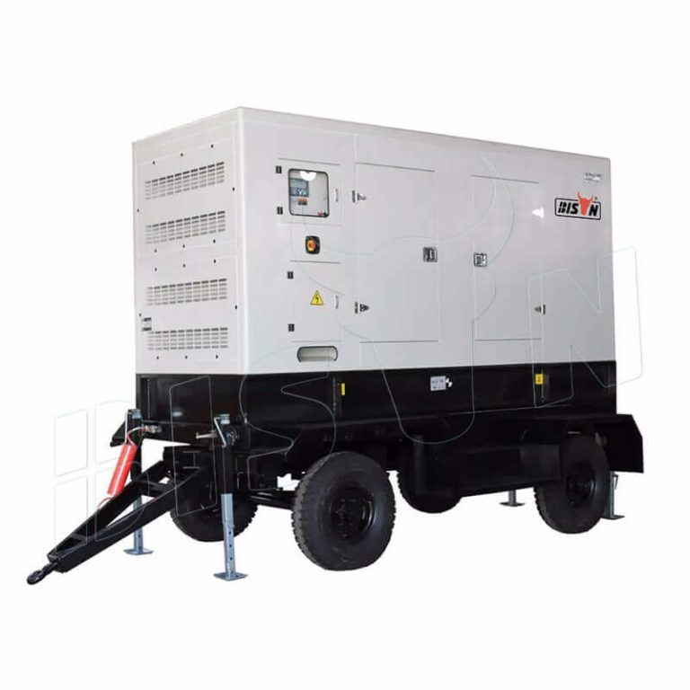

5
Diesel: Distributed Generation
Reliable Diesel Power Generation
TAQA Power: reliable diesel generator solutions for off-grid sites and business continuity during power shortages.
Flexible, Right-Sized Power
Gensets are rated 0.5–2 MW, right-sized to demand and scaled up simply by adding units.
Fast, Reliable Deployment
Fast-start units deliver dependable power for grid support, standby backup and off-grid sites.
Uninterrupted Supply
Designed for heavy-duty use, delivering guaranteed uptime with minimal maintenance.
38
0.5–2
Flexible, Reliable Backup Power
MW Installed Across Egypt
MW per Genset Tailored to the client current needs
TRUSTED BY TIER-1 DEVELOPERS —

Slide 27
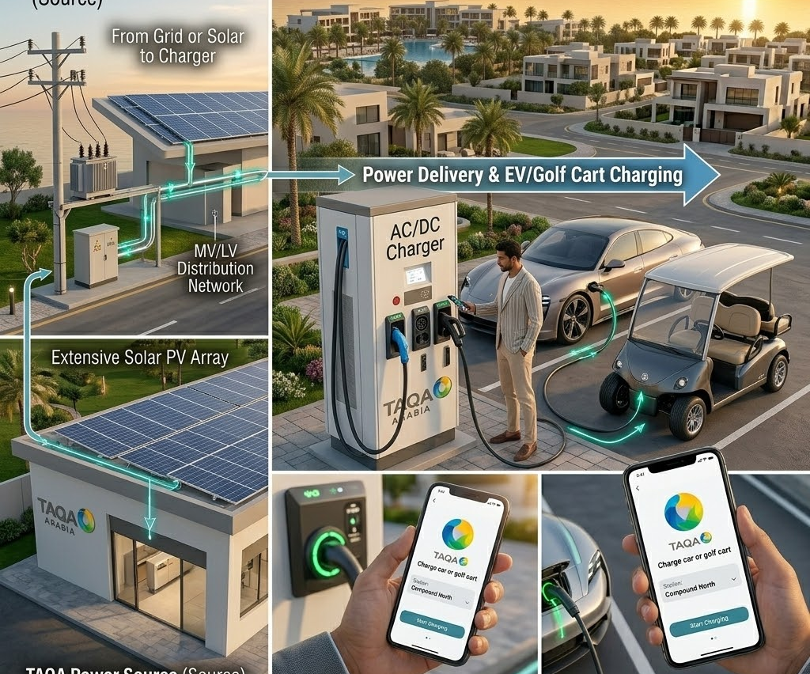
6
EV Chargers: Scope & How It Works
SCOPE
1
TAQA INVESTS THE CAPEX
AC & DC fast-charging units · Grid connection & upgrade works · Energy-management & load balancing · Payment, app & access platform · BOO / BOOT charger financing
2
THE PROCESS — STEP BY STEP
1
TAQA assesses parking, demand and available grid capacity.
2
Chargers and any needed grid upgrades are installed.
3
Smart load-management shares power across charging points.
4
Residents authenticate and charge via app or RFID.
5
TAQA operates, maintains and settles payments.
3
WHAT YOU RECEIVE
TAQA can provide an integrated solution, including funding, construction, ownership and operation of the asset subject to project requirements
A ready community charging network
Charge
at home
Seamless app-based charging & billing
Maintained, future-ready infrastructure

Slide 28
6
EV Chargers: Value Proposition
VALUE PROPOSITION
WHAT YOU GAIN
THE TAQA ARABIA EDGE
Full Charger Range
First EV License in Egypt
AC, DC fast and golf-car chargers cover every residential and resort mobility need.
TAQA holds the first private EV-charging license in the country — a genuine first-mover advantage.
Future-Proof Amenity
Lifecycle O&M & Uptime
EV-ready parking is now a deciding factor for buyers — it differentiates and future-proofs the community.
Ongoing operation and maintenance keep every charger available and revenue-generating.
Effortless Resident Experience
Flexible Financing options
App-based charging, transparent billing and a 24/7 hotline make adoption simple for residents.
TAQA Arabia invests in the Chargers or as Profit share Model turning charging into an income stream shared with the developer
Hotline & Mobile App
Turnkey Engineering
24/7 TAQA hotline plus a user and operator app for seamless charging and management.
Site assessment, design, supply and installation delivered end-to-end by one partner.

Slide 29
6
EV Chargers: Implementation Timeline
How TAQA delivers the solution from start to finish — phase by phase, with indicative timing
IMPLEMENTATION TIMELINE — START TO FINISH
Day 0–14
Day 14–30
Day 30–60
Day 60–90
Day 90–105
Day 105+
1
2
3
4
5
6
Site Assessment
Commercial Model
Supply
Installation
Activation
O&M & Support
Engineering survey & charger-mix design.
Full-investment / profit-share structuring.
AC / DC / golf-car charger procurement.
Turnkey installation & grid tie-in.
App onboarding, testing & go-live.
Lifecycle uptime, hotline & app support.
ASSESS & STRUCTURE Day 0–30
SUPPLY & INSTALL Day 30–105
OPERATE & SUPPORT Day 105+
Site engineering and charger-mix design (AC / DC / golf-car) plus commercial structuring under the full-investment profit-share model.
Procurement of chargers, turnkey installation and grid tie-in, mobile-app onboarding, testing and go-live.
Lifecycle O&M and uptime management backed by the 24/7 TAQA hotline and the user / operator mobile application.

Slide 30
6
EV Chargers: Proven Track Record
Pioneering Egypt's EV-charging rollout Across Egypt
TAQA Power secured the first private EV-charging license in Egypt and is rolling out AC and DC charging across residential, commercial and highway locations, supported by its own operator and user mobile app and 24/7 hotline. As Egypt's largest private power player, TAQA pairs charging with on-site solar and distribution — a complete green-mobility package for any community.
1st
3
Private EV-charging license in Egypt
Charger lines: AC, DC & golf-car
6
24/7
First EV License — Green Mobility
End-to-end services offered
Hotline & app support
Notes:
Case Study

Slide 31
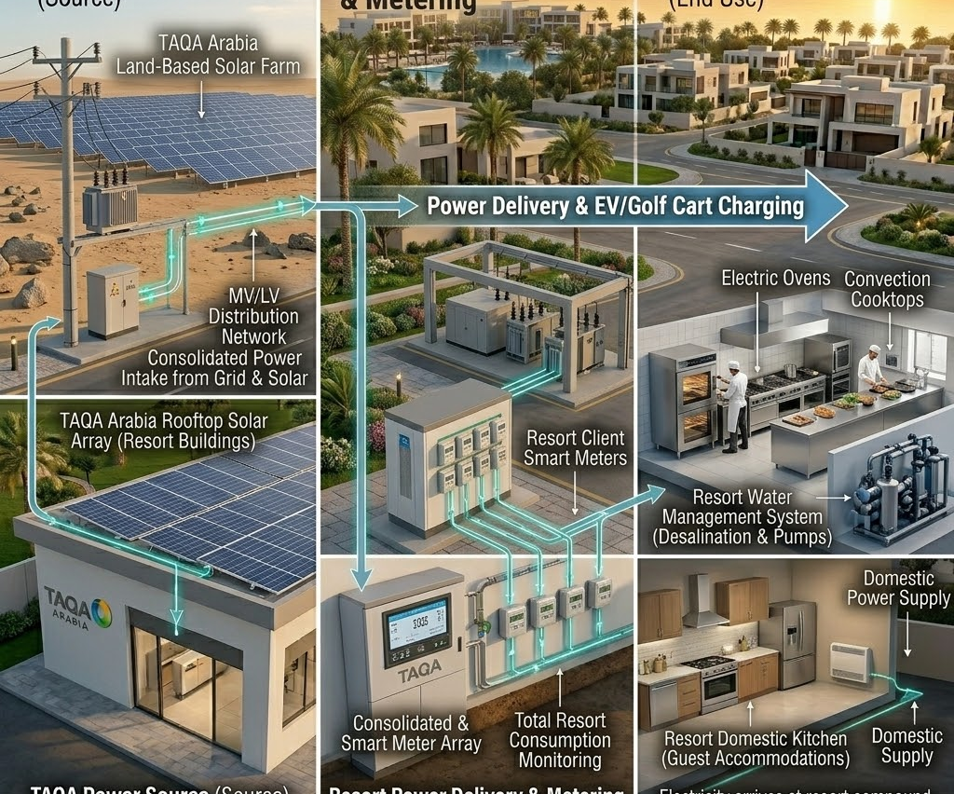
7
Solar PV: Scope & How It Works
SCOPE
1
TAQA INVESTS THE CAPEX
Rooftop & carport PV arrays · Inverters & mounting structures · Net-metering & connection works · Monitoring & performance platform · BOO / BOOT solar financing
2
THE PROCESS — STEP BY STEP
1
TAQA studies roofs, shading and the community's load profile.
2
PV arrays and inverters are installed and grid-tied.
3
Panels generate clean power during daylight hours.
4
Solar offsets common-area and household consumption.
5
TAQA monitors yield and maintains the system.
3
WHAT YOU RECEIVE
TAQA can provide an integrated solution, including funding, construction, ownership and operation of the asset subject to project requirements
Clean on-site solar generation
Sun-powered
savings
Lower common-area energy bills
Monitored, maintained PV assets

Slide 32
7
Solar PV: Value Proposition
VALUE PROPOSITION
WHAT YOU GAIN
THE TAQA ARABIA EDGE
Lower Energy Bills
Egypt’s Solar Pioneer
Solar’s cost per kWh sits well below the grid tariff — residents and common areas save from day one.
TAQA was the first national company to commercially operate a plot at the Benban solar park.
Tariff-Hike Hedge
Flexible Models
Lock in clean-energy cost for decades and insulate the community from grid-price escalation.
CAPEX, BOOT/BOO or PPA — own it, transfer it over time, or buy cheaper solar under a zero-capex PPA.
Uses Idle Space
Turnkey Engineering
Rooftops, car parks and unused land become productive, revenue-saving assets.
Survey, design, supply, installation and grid tie-in delivered end-to-end by one partner.
Strong ESG Credentials
Lifecycle O&M & Guarantee
Each 1 MWp avoids ~1,000 tons of CO₂ a year — measurable proof for sustainability reporting.
Remote monitoring, maintenance and performance guarantees keep output high for 25+ years.

Slide 33
7
Solar PV: Implementation Timeline
IMPLEMENTATION TIMELINE — START TO FINISH
Day 0–14
Day 14–30
Day 30–60
Day 60–110
Day 110–125
Day 125+
1
2
3
4
5
6
Site & Yield Study
Commercial Model
Design & Procure
EPC Installation
Commissioning
O&M & Monitoring
Roof survey, shading & yield study.
CAPEX / BOOT / PPA structuring & licensing.
System design, permitting & equipment supply.
Mounting, wiring, inverters & grid tie-in.
Testing, metering setup & go-live.
Lifecycle maintenance & performance guarantee.
ASSESS & DESIGN Day 0–30
BUILD & CONNECT Day 30–110
OPERATE & GUARANTEE Day 110+
Site survey, shading and energy-yield study plus commercial structuring under CAPEX, BOOT/BOO or a zero-capex PPA, with self-consumption / net-metering licensing.
System design, permitting, equipment procurement, EPC installation and grid tie-in to international standards.
Commissioning, metering and go-live, then lifecycle O&M, remote monitoring and 25-year performance guarantees.

Slide 34
7
Solar PV: Case Study NABQ
Powering a green, smart city with clean and cheaper energy in Sharm El-Sheikh
TAQA Arabia built the largest solar plant in Sharm El-Sheikh — 20 MW generating over 42 GWh a year, providing clean electricity for all Nabq bay. We also provides Soma Bay with 6.5 Mw Solar PV that generates around 13 GW per year with a discount of 15% from the MV gov. tariff. Today the MV tariff is 2.55 EGP and our tariff after savings is 2.17 EGP offering the client a savings of at least 5M EGP per year.
20 MW
42 GWh
Sharm El-Sheikh solar plant
Clean energy generated per year
≈500k t
4-6 mo
Projected Savings 25 Years
CO₂ avoided over its lifetime
Record build time

Slide 35





Why One Partner: The TAQA One-Stop-Shop
From Fragmented Vendors to a Single Operator
One SLA
A single service-level agreement governs gas, power, water, back-up and EV — one uptime guarantee, one penalty regime, one renewal.
Mobile CNG
TAQA
Arabia
One Communication Point
A single account team and 24/7 hotline for every utility — no chasing five contractors when something needs attention.
EV Charging
Electricity
One Commercial Relationship
Consolidated billing, aligned contract terms and a single negotiation instead of six separate procurement cycles.
One Engineering Standard
Utilities designed to interoperate from day one — shared trenches, shared metering platform, shared monitoring.
Diesel Back-up
Water
One Accountable Owner
End-to-end responsibility removes interface risk and finger-pointing between specialised vendors.
Gas

Slide 36



The Power of the Bundle: Cross-Solution Benefits
Solar + Desalination
Solar + EV Charging
Distribution + Smart Metering
On-site solar PV powers the RO plant — Egypt's first eco green desalination model, cutting both energy cost and CO₂.
Community solar feeds EV chargers, lowering charging cost and maximising the green-mobility story for residents.
One metering platform bills electricity and water together — shared infrastructure, single resident app.
Gas + Mobile CNG
Diesel + Distribution
Shared O&M & Monitoring
Mobile CNG bridges supply until the permanent gas network goes live — seamless handover, no diesel gap.
Back-up gensets integrate directly into the TAQA-built distribution network with automatic transfer — true redundancy.
One control room and field team monitor every utility — pooled spares, pooled response, lower unit O&M cost.
Sold as one SLA: lower combined cost · shared infrastructure & trenches · one billing & monitoring platform · stronger ESG / green-rating story · single accountable operator for the entire community utility backbone.

Slide 37
Success Story: Soma Bay
Egypt's first & largest eco solar-powered desalination plant
At Soma Bay on the Red Sea, TAQA Arabia integrated solar generation, power distribution and reverse-osmosis desalination into a single, renewable-powered utility system — using technology that consumes 50% less power than its peers. It is the clearest proof of the bundled, one-SLA model serving a residential and touristic destination.
Solutions combined on one site:
Solar PV
Power Distribution
Water Desalination
Smart O&M
50,000+
8,560
People served (Red Sea Gov.)
Tonnes CO₂ avoided / year
50%
2
Less power than peer plants
Industry awards won
Recognised as Sustainable Project of the Year and Power & Water Project of the Year.

