Slide 1
Natural Language Processing (Almost) from Scratch
Authors: Ronan Collobert, Jason Weston, Leon Bottou, Michael Karlen, Koray Kavukcuoglu, Pavel Kuksa

Slide 2
What is the paper about?
The paper addresses the challenge of developing effective natural language processing (NLP) models without relying on manually engineered features for each task.
The challenge was that traditional methods needed a lot of task-specific engineering. The authors developed a multilayer neural network that can handle multiple NLP tasks (like part-of-speech tagging and named entity recognition) by learning from large amounts of mostly unlabeled data. Multilayer neural network has an ability to discover hidden representations using a stochastic learning algorithm that scales linearly with the number of examples.
This approach led to a flexible and efficient tagging system that doesn’t require much computational power.
In the paper, first the authors discussed benchmark tasks for natural language processing. Then, they described their unified model and reported results from supervised training. Next, they used large unlabeled datasets to improve the model's performance with unsupervised internal representations. After that, they explored multitask supervised training and evaluate how adding specific NLP engineering can enhance their system. Finally, they aimed to create an efficient and accurate tagging system.

Slide 3
How simplified text representation and benchmarks have improved NLP?
Since it is currently not possible for computers to fully understand natural language, researchers are trying to represent texts in simpler forms. These simpler representations focus on obtaining two different types of information: syntactic information (like word types) and semantic information (like meanings of words)
Researchers label texts by tagging words to show their roles, like whether they are nouns or verbs. This labeling helps compare different systems.
Also, the availability of standard benchmarks has encouraged research in NLP.
As a result, effective systems have been developed for various NLP tasks.

Slide 4
So what was the problem and the solution?
The problem is that most cutting-edge systems solve specific tasks by using statistical models and features created specifically for those tasks. These methods improve performance on particular tests but often lack insights into general language understanding.
The authors recommended a single learning system that identifies useful internal representations, which can, for example, define the grammatical roles of words, while treating benchmarks as indicators of how well these representations apply to different tasks.
By minimizing reliance on linguistic knowledge and utilizing intermediate representations from large unlabeled datasets, they achieve good results, referring to their method as almost from scratch.

Slide 5
NLP Tasks Addressed in the Paper
The paper addresses four main tasks:
Part-of-Speech Tagging: It identifies the grammatical role of each word in a sentence (noun, verb).
Example: In "The cat sleeps," "cat" is a noun, and "sleeps" is a verb.
Chunking: It groups words into meaningful phrases, like noun or verb groups.
Example: "The quick fox" forms a noun phrase.
Named Entity Recognition (NER): It detects entities like people, locations, or organizations.
Example: In "Alice lives in London," "Alice" and "London" are entities.
Semantic Role Labeling (SRL): It assigns roles to sentence parts to understand who does what.
Example: In "John gave Mary a book," "John" is the giver, "Mary" is the receiver.

Slide 6
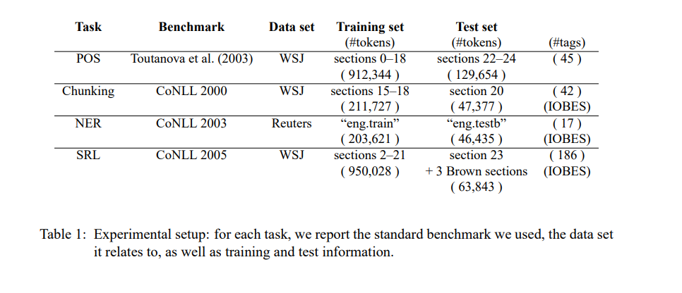
The benchmark tasks
The table shows benchmarks and which sections of the dataset are used for training and testing.

Slide 7
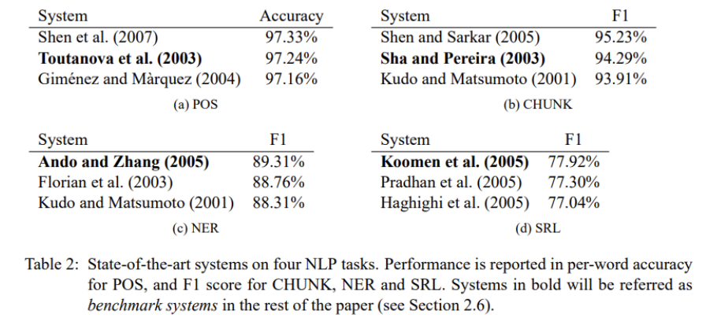
This table shows the accuracies of the 4 tasks performed by different people.
We will now look these 4 tasks.
The best Part of Speech classifiers are based on classifiers trained on windows of text which means segments of text that provide context and apply a bidirectional decoding algorithm, which processes the text from both directions (left-to-right and right-to-left).
Features include context from surrounding tags, and bigrams (two consecutive words)
Researchers like Toutanova. achieved the best accuracy using maximum entropy classifiers, while Gimenez and Márquez achieved also high accuracy with SVM and Viterbi decoders. Shen improved accuracy using guided learning.
Viterbi decoders use probabilities to make the best prediction by considering the previous word's tag. Guided learning allows the model to improve its predictions by using examples it has previously categorized correctly.

Slide 8
The second task is : Chunking, or shallow parsing. It labels sentence segments like noun or verb phrases.
Each word gets a tag, marked as either a begin-chunk (e.g. B-NP) or inside-chunk tag (e.g. I-NP).
The best accuracy came from, Shen and Sarkar, they improved accuracy using a voting classifier scheme with different tag representations. They also used POS features from an external tagger and created additional features.
The authors took those in black color as a benchmark for their models. These benchmark systems will serve as baseline references in their experiments, providing a standard for comparison.

Slide 9
The third task is Named Entity Recognition, it assigns categories like "PERSON" or "LOCATION" to elements in a sentence, using tags similar to chunking, indicating whether an entity is at the beginning or inside.
Florian used a combination of various machine-learning classifiers and they used different features included words, POS tags, CHUNK tags, prefixes and suffixes.
Ando and Zhang used semi-supervised approach.

Slide 10
The last task is Semantic Role Labeling. SRL aims to assign roles to words in a sentence based on their meaning.
It uses the PropBank format, where the verb is considered the central element in the sentence. Words connected to this verb are tagged with labels such as ARG0, ARG1, ARG2, etc. Additionally, there are supplementary tags like ARGM-LOC for locational expressions and ARGM-TMP for temporal expressions.
SRL systems consist of three main stages: producing a parse tree that represents the grammatical structure of a sentence, identifying which nodes in the tree correspond to the arguments of a specific verb, and classifying these nodes with tags. These systems use various feature categories to analyze sentences for example the positions of nodes in relation to the verb. These features are essential for the analysis and accurate labeling of sentences.

Slide 11
What is the general approach?
The NLP tasks in this paper can be seen as tasks assigning labels to words.
The traditional NLP approach involves extracting complex features from sentences that are designed by humans to enhance a model's performance.
These features are then fed into a standard classification algorithm, such as a Support Vector Machine (SVM).
The selection of features is a process based on linguistic instinct and trial and error, making it task-dependent and requiring further research for each new NLP task.

Slide 12
What did the authors do?
Instead, they aimed to do less pre-processing of features and used a multilayer neural network (NN) architecture that learns directly from the raw input data to produce the final output.
Their architecture processes input sentences through multiple layers to extract features.
The first layer focuses on individual words considering their grammatical properties (like nouns or verbs) and their positions in context , while the second looks at a group of words to understand context better.
The deeper layers are trained to ensure they fit the task using backpropagation. This flexible design works well for various NLP tasks and can adapt to new ones.

Slide 13
Window Approach and Sentence Approach
Window approach assumes the tag of a word depends mainly on its neighboring words.This means that to understand the meaning of a word, the model looks at the words around it.
When tagging a target word, the model uses a fixed window size, which specifies the number of neighboring words considered on either side.
But the window approach struggles with Semantic Role Labeling (SRL) because it requires tagging words based on a verb that may be outside the window. When using neural networks, the natural choice to tackle this problem becomes a convolutional approach. That is why we should use sentence approach.
In the sentence approach, the model captures the overall meaning.

Slide 14
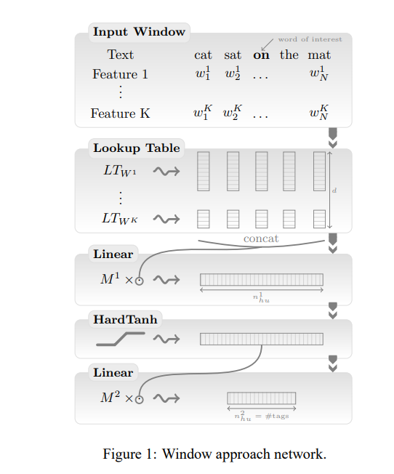
Figure 1 corresponds to the first part of the architecture, where they focus on extracting features from words in a localized context. It emphasizes how the network looks at a specific window of words, capturing both the target word and its neighbors.
By doing so, it effectively captures the local structure of sentences, which is crucial for tasks like part-of-speech tagging or named entity recognition.
Also, the architecture is flexible, allowing it to use either Figure 1 or Figure 2 for feature extraction, depending on the task.
For instance:
For tasks requiring focus on local word patterns, the window approach (Figure 1) is appropriate.
For tasks needing sentence-level understanding and context, the sentence approach (Figure 2) is more suitable.

Slide 15
The architecture processes the input by 5 steps:
Input Window: It starts with a window of words surrounding the target word, including additional features if available.
Lookup Table: It is essentially a matrix where each word in the vocabulary is assigned a vector, which the model uses for various NLP tasks. (also called a word embedding). The word embeddings are usually learned during training and capture syntactic and semantic properties of words. These vectors are concatenated to form a single vector.
Linear Layer: The concatenated vector is passed through a linear layer to transform it into a new feature space.The model learns to extract relevant features from the input data through backpropagation, adjusting the weights in these layers to improve performance. These layers apply transformations to change the representation of the input data using the weight matrix and bias vector.
HardTanh Activation: A non-linear transformation (HardTanh) is applied, to add non-linearity to the network.This allows the model to learn more complex patterns in the data.
Final Linear Layer: The processed feature vector is passed through another linear layer to produce output values representing predictions or class scores. Each output is a score for its tag, based on the input given to the network. This scoring uses a specific cost function to measure how well the model predicts the correct tags.

Slide 16
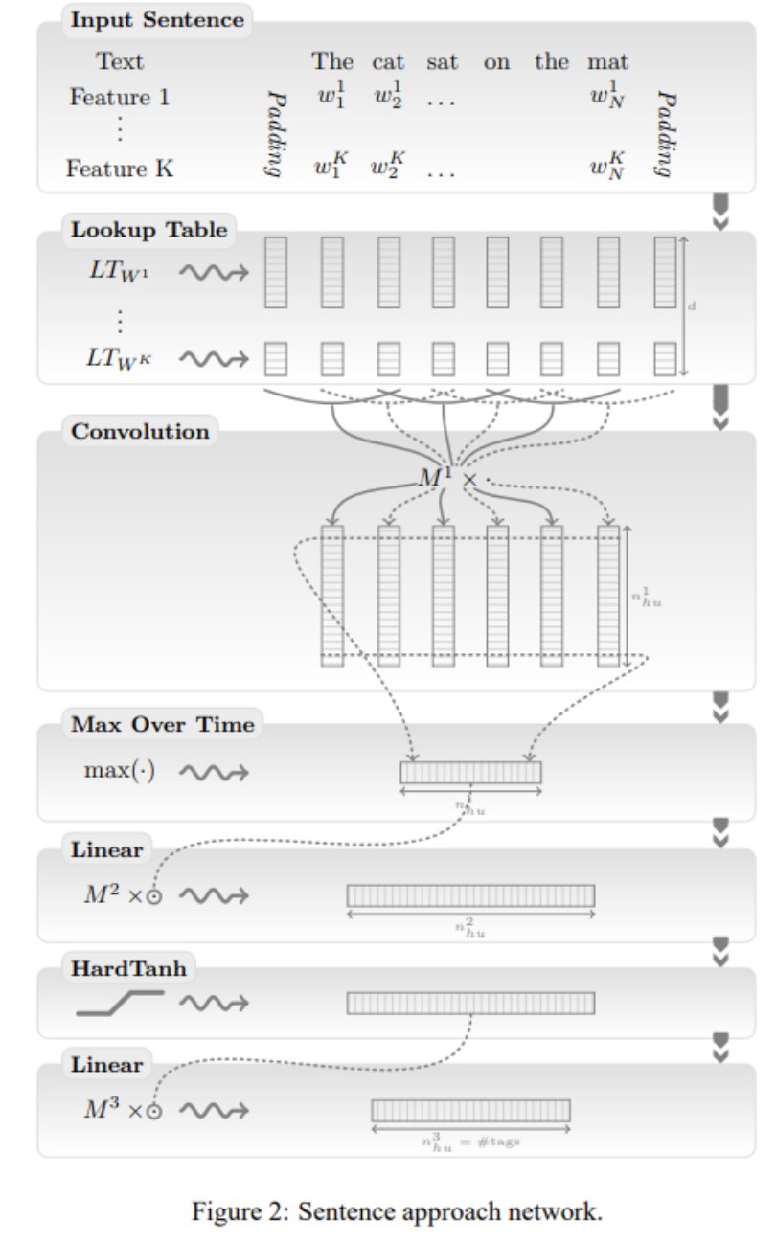
The second approach processes the entire sentence as a sequence, applying convolutional layers to capture both local and global dependencies throughout the whole sentence. Here's how the architecture works:
Input Sentence: The model takes the entire sentence as input.
Lookup Table: Each word in the sentence is mapped to a vector using embeddings. If multiple features (like part-of-speech tags) are used, they are also embedded and combined.
Convolutional Layer: The embedded vectors are passed through a convolutional layer to extract local features. The convolution applies a filter that slides over the sentence, detecting important patterns and dependencies between words.
Max Over Time Pooling: This operation selects the most significant feature detected by each filter, summarizing the sentence's most relevant information in a fixed-size vector. For example, given a set of word vectors representing a sentence, it takes the maximum value for each feature.
Fully Connected Layers: The resulting vector is passed through multiple linear layers, transforming it further while applying activation functions like HardTanh to introduce non-linearity.
Final Linear Layer: The output is computed in the final linear layer, producing a fixed-dimensional output suitable for various NLP tasks.

Slide 17
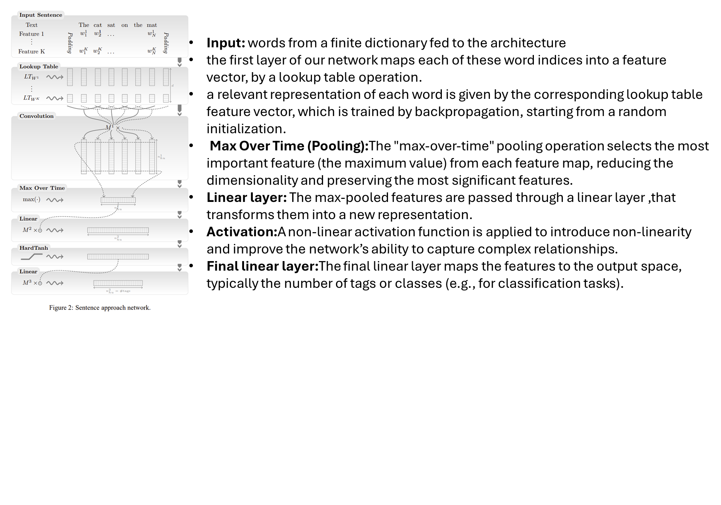
The second approach processes the entire sentence as a sequence, applying convolutional layers to capture both local and global dependencies throughout the whole sentence. Here's how the architecture works:

Slide 18

Transforming Words into Feature Vectors:
One of the key points of our architecture is its ability to perform well with the use of (almost ) raw words.
•words from a finite dictionary fed to the architecture
•the first layer of our network maps each of these word indices into a feature vector, by a lookup table operation.
•a relevant representation of each word is given by the corresponding lookup table feature vector, which is trained by backpropagation, starting from a random initialization.

Slide 19
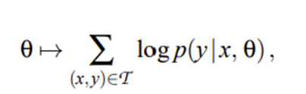
Extracting Higher Level Features from Word Feature Vectors
Using window approach
Using sentence approach
Tagging schemes
Training:
neural networks are trained by maximizing a likelihood over the training data, using stochastic gradient ascent

Slide 20

WORD-LEVEL LOG-LIKELIHOOD
In this approach, each word in a sentence is considered independently.
SENTENCE-LEVEL LOG-LIKELIHOOD
In tasks like chunking, NER or SRL we know that there are dependencies between word tags in a sentence: not only are tags organized in chunks, but some tags cannot follow other tags. Training using a word-level approach discards this kind of labeling information.

Slide 21
Training Language Models
The language model network was trained by stochastic gradient minimization of the ranking criterion, sampling a sentence-word pair (s, w) at each iteration.
Model selection:
Using the process of breeding: Within each line, child networks are initialized with the embeddings of their parents and trained on increasingly rich data sets with sometimes different parameters.

Slide 22
Progress in NLP over the years
Just to put things in perspective in order to understand impact of this paper
1: Traditional Feature Engineering in NLP (Pre-2011)
2: NLP from Scratch – Collobert et al. (2011) ← THIS PAPER
3: Word2Vec & GloVe (2013-2014)
4: Sequence-to-Sequence Models & Attention (2014-2017)
5: Attention Is All You Need – The Transformer (2017)
6: Pretrained Language Models – BERT & GPT (2018-2019)
7: Large Language Models & GPT-3 (2020)

Slide 23
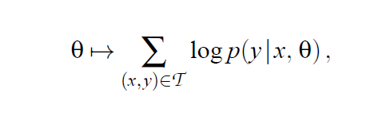
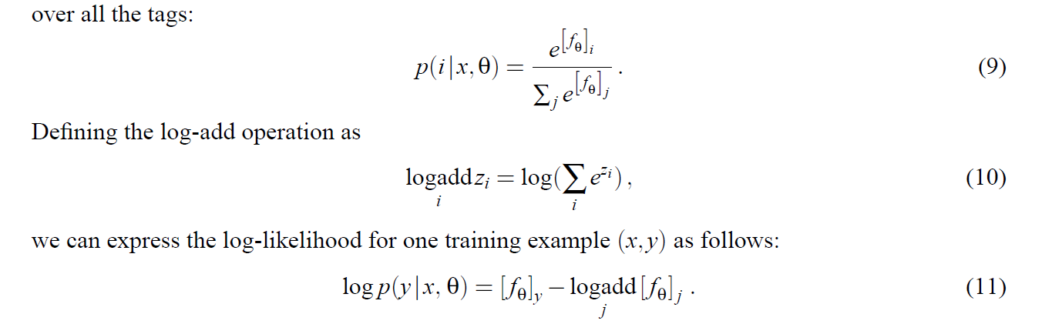
Key Mathematical Ideas (1)
neural networks are trained by maximizing a likelihood over the training data, using stochastic gradient ascent.where x corresponds to either a training word window or a sentence and its associated features, and y represents the corresponding tag.
Word Level Likelihood (WLL)

Slide 24
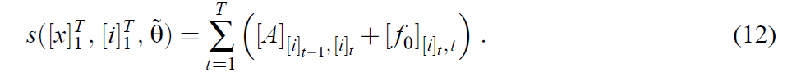
Key Mathematical Ideas (2)
neural networks are trained by maximizing a likelihood over the training data, using stochastic gradient ascent.where x corresponds to either a training word window or a sentence and its associated features, and y represents the corresponding tag.
Sentence Level Log Likelihood (Better for task like SRL )

Slide 25
Traditional Approach
All NLP tasks can be seen as tasks assigning labels to words.
From sentences extract a rich set of handcrafted features and use a standard classification algorithm (SVM) to classify words. Feature engineering requires specific domain knowledge.

Slide 26
Proposed Approach
Non preprocessed sentences are taken into multi layer NN and several layers of features learned automatically by NN by performing back propagation.
First layer creates features for each word
Second layer creates more global features by using window of words
Rest of the network is standard NN layers
We are training two parts, LUT (Vector Embeddings) and NN.
HardTanH is used to approximate tanh in more performant way.
Windows vs Convolution
Windows approach fails for SLR tasks because, windows might miss the verb. Better is to use convolution to summarize features into more global features.

Slide 27

Laçin Boz
Parisa Ahmadlu
David

