Slide 1


Car Sales
Prepared by team 3

Slide 2
👥 Team Members
Ahmed Bahy
Ahmed Abouelfadl
Mohamed Emad
Sarah Abdelazim
Esraa Magdy

Slide 3
Project Overview
This project focuses on analyzing the automotive market in the USA to support stakeholders in making informed decisions. By leveraging multiple data analysis tools, the team will extract insights regarding sales trends, customer preferences, and market dynamics. Each member contributes their independent analysis, and findings are collaboratively discussed to produce the most accurate and valuable final results.

Slide 4
Project Objectives
Provide deep insights into car sales trends and patterns in the USA.
Identify factors influencing sales performance across different segments.
Support stakeholders in making data-driven decisions for strategy and investment.
Utilize multiple analytical tools to ensure comprehensive and validated findings.
Foster team collaboration to combine individual analyses into the best final version.

Slide 5
Tools & Techniques
Excel for quick analysis and visualization.
SQL for querying and managing datasets.
Python for advanced statistical analysis and modeling.
Power BI and Tableau for interactive dashboards and visual storytelling.

Slide 6
Excel
We did the following using Excel:
Data Modeling
Data Cleaning
Data Analysis and Extracting Insights

Slide 7
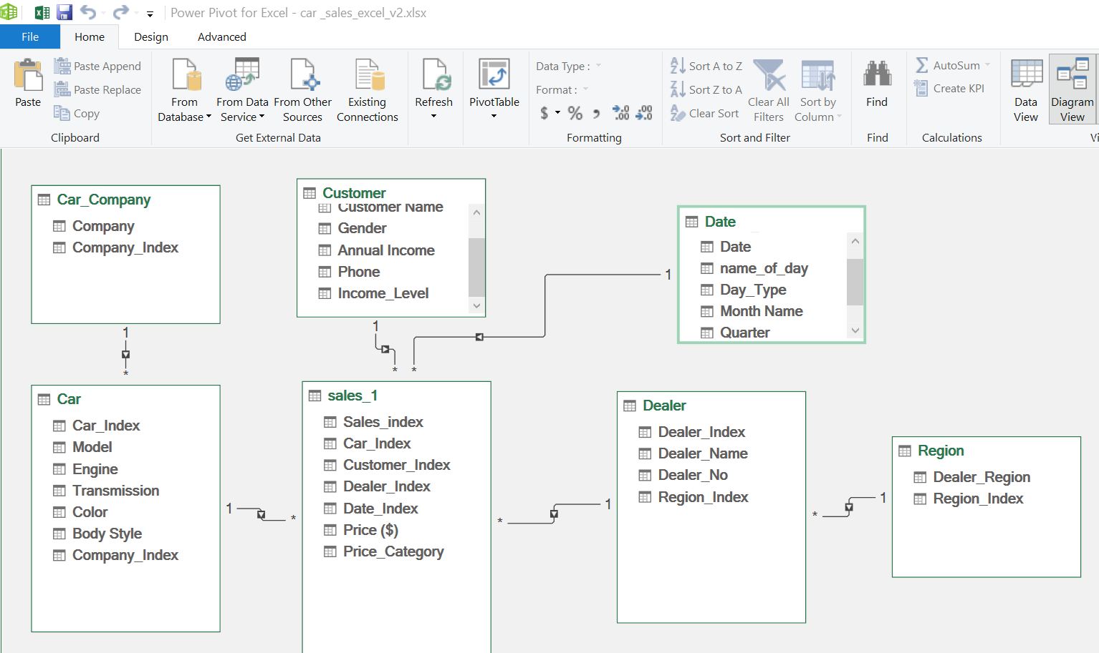
Data Modelling

Slide 8
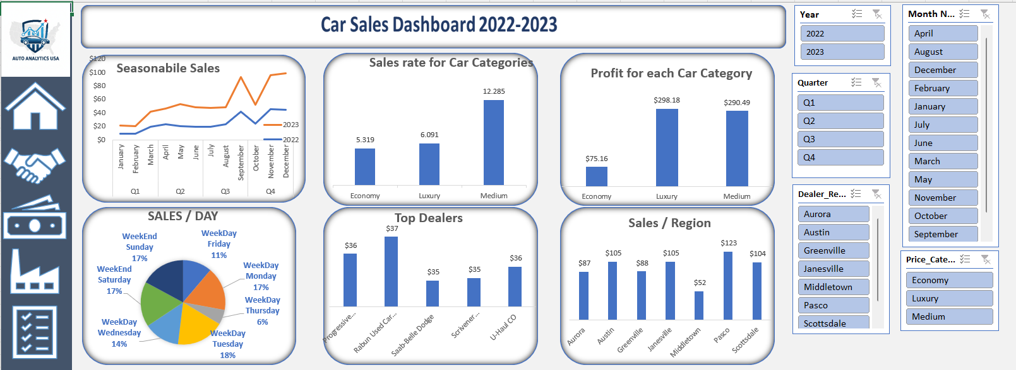
Dashboard

Slide 9
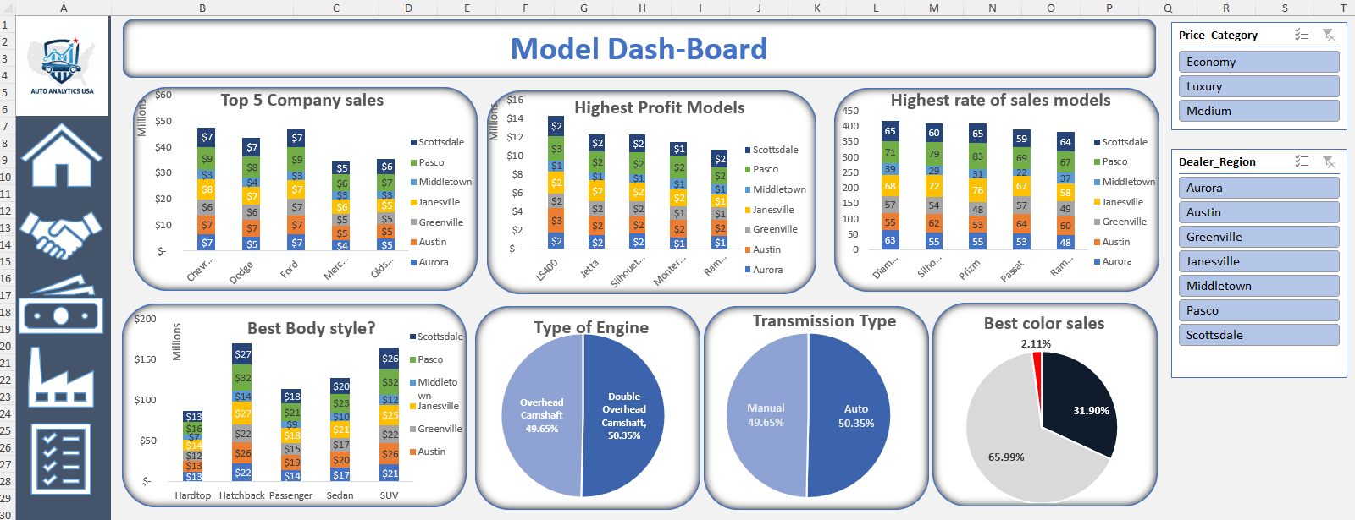
Dashboard

Slide 10
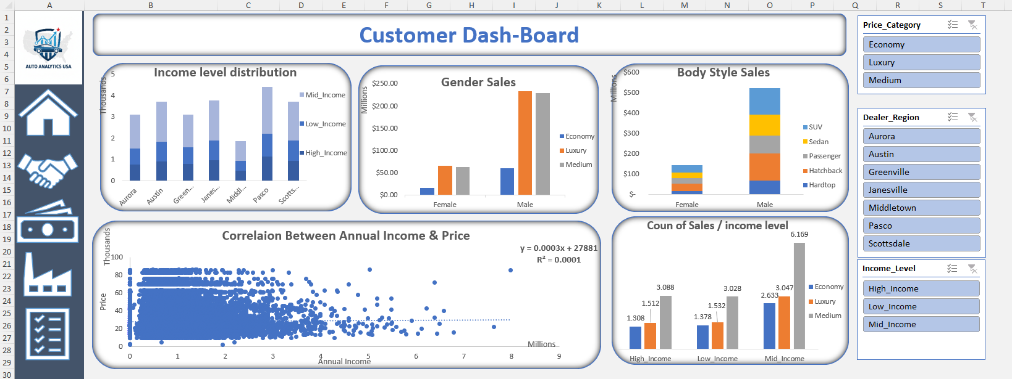
Dashboard

Slide 11
SQL:
We did the following using SQL:
Data Modeling
Data Cleaning
Data Analysis and Extracting Insights

Slide 12
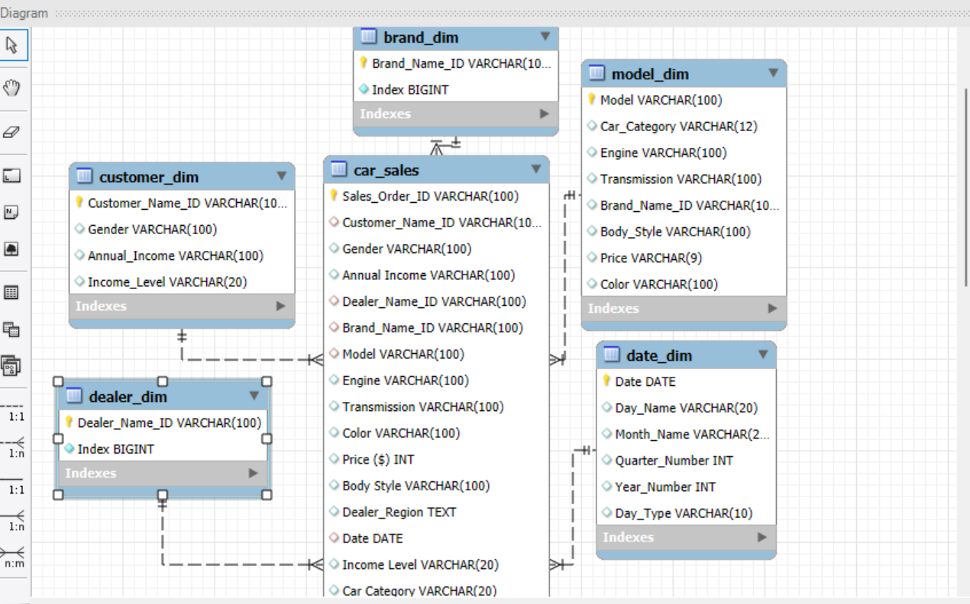
Data Modeling

Slide 13
Data Cleaning
We did the following:
Check duplicate data and remove them
Check missed data and replace them
Add some new columns to make some calculations.

Slide 14
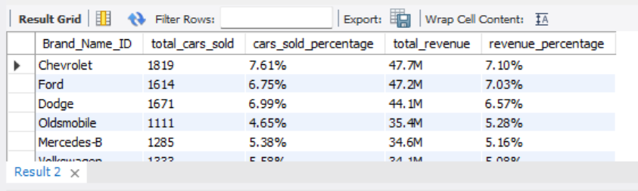
Data Analysis
Those are some of the insights created by us:
what is the brand that makes more sales?

Slide 15
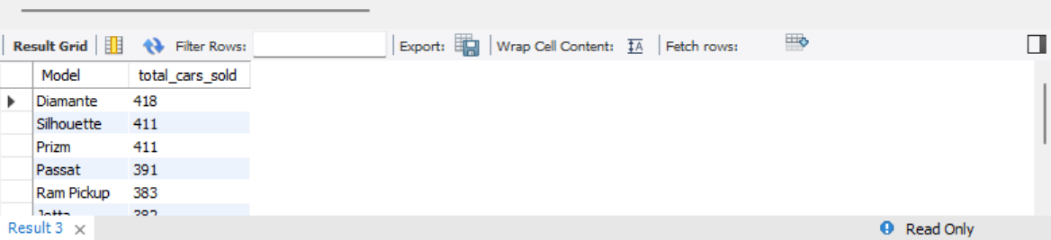
Data Analysis
what is models that makes most sales orders ?

Slide 16
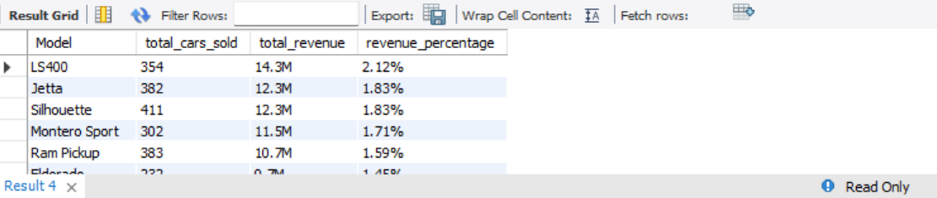
Data Analysis
what are the most profitable sold models?

Slide 17
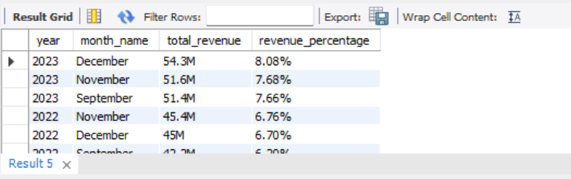
Data Analysis
what is the month that makes highest sales?

Slide 18
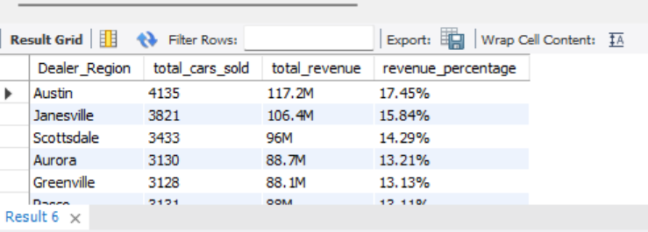
Data Analysis
What is region that makes the highest sales ?

Slide 19
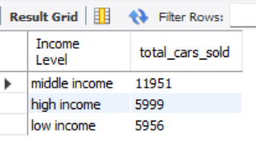
Data Analysis
What is the most income levels buy cars?

