Slide 1


Slide 2

Pointers and the Address Operator
Pointer Variables
Pointer Arithmetic
Initializing Pointers
Comparing Pointers
Pointers as Function Parameters
  Pass-by-Value
  Pass-by-Reference with Pointer Arguments
Constant Pointers
10-<number>

Slide 3

Each variable in a program is stored at a unique address in memory
Use the address operator & to get the address of a variable:
  int num = -23;
  cout << &num; // prints address
  // in hexadecimal
The address of a memory location is a pointer
10-<number>
Notes:
See pr10-01.cpp

Slide 4
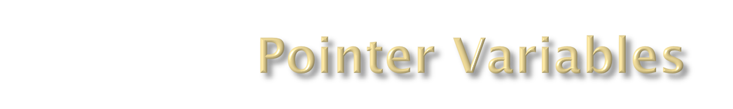
Pointer variable (pointer): variable that holds an address
Pointers provide an alternate way to access memory locations
10-<number>

Slide 5

Definition:
  int *intptr;
Read as:
“intptr can hold the address of an int” or “the variable that intptr points to has type int”
Spacing in definition does not matter:
  int * intptr;
  int* intptr;
10-<number>

Slide 6

Assignment:
int num = 25;
int *intptr;
intptr = &num;
Memory layout:
Can access num using intptr and indirection operator *:
cout << intptr; // prints 0x4a00
cout << *intptr; // prints 25
num
intptr
25
0x4a00
address of num: 0x4a00
10-<number>
Notes:
See pr10-02.cpp, pr10-03.cpp and pr10-04.cpp

Slide 7

Some arithmetic operators can be used with pointers:
  Increment and decrement operators ++, --
  Integers can be added to or subtracted from pointers using the operators +, -, +=, and -=
  One pointer can be subtracted from another by using the subtraction operator -
10-<number>

Slide 8

Assume the variable definitions
int vals[]={4,7,11};
int *valptr = &vals;
Examples of use of ++ and --
valptr++; // points at 7
valptr--; // now points at 4
10-<number>
Notes:
See pr10-09.cpp

Slide 9

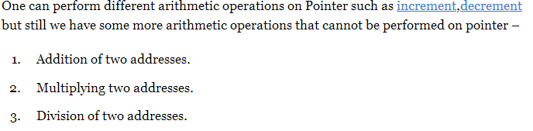
10-<number>

Slide 10
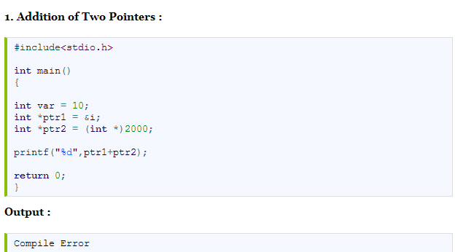

10-<number>

Slide 11
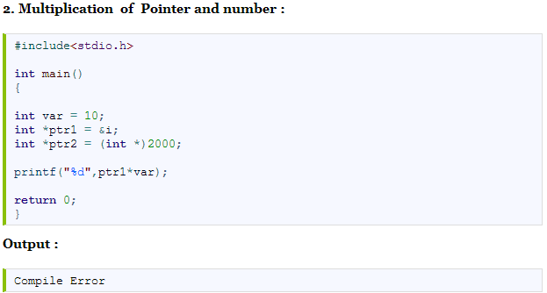
10-<number>

Slide 12

Can initialize to NULL or 0 (zero)
int *ptr = NULL;
Can initialize to addresses of other variables
  int num, *numPtr = &num;
Initial value must have correct type
  float cost;
  int *ptr = &cost; // won't work
10-<number>

Slide 13

Relational operators can be used to compare addresses in pointers
Comparing addresses in pointers is not the same as comparing contents pointed at by pointers:
  if (ptr1 == ptr2) // compares
  // addresses
  if (*ptr1 == *ptr2) // compares
  // contents
10-<number>
Notes:
See pr10-10.cpp

Slide 14

Pass-by-Value
In C/C++, by default, arguments are passed into functions by value.That is, a clone copy of the argument is made and passed into the function. Changes to the clone copy inside the function has no effect to the original argument in the caller. In other words, the called function has no access to the variables in the caller.
10-<number>

Slide 15

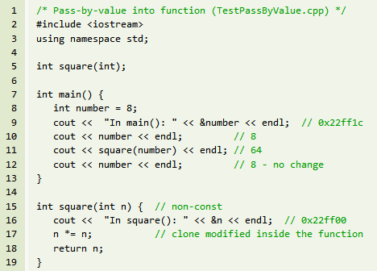
10-<number>

Slide 16

Pass-by-Reference with Pointer Arguments
In many situations, we may wish to modify the original copy directly (especially in passing huge object or array) to avoid the overhead of cloning. This can be done by passing a pointer of the object into the function, known as pass-by-reference.
10-<number>

Slide 17

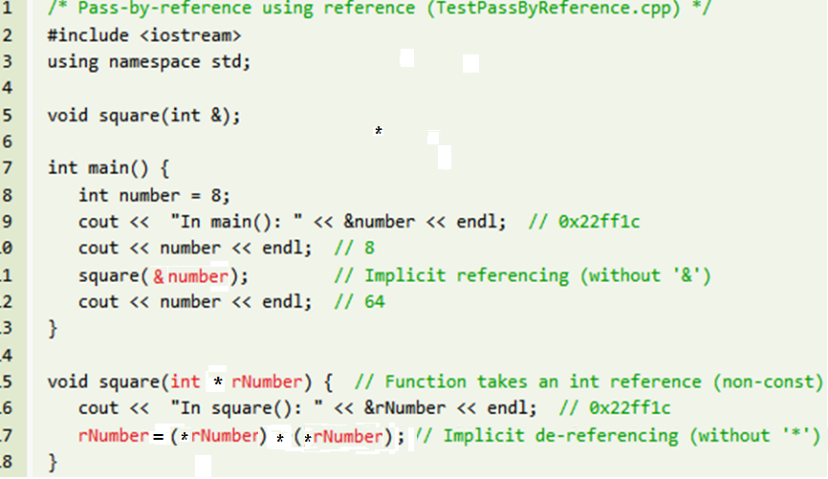
10-<number>

Slide 18

Defined with const keyword adjacent to variable name:
  int classSize = 24;
  int * const classPtr = &classSize;
Must be initialized when defined
Can be used without initialization as a function parameter
  Initialized by argument when function is called
  Function can receive different arguments on different calls
While the address in the pointer cannot change, the data at that address may be changed
10-<number>

Slide 19

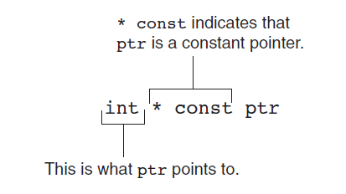
10-<number>

Slide 20

Each address location typically hold 8-bit (i.e., 1-byte) of data. A 4-byte int value occupies 4 memory locations. A 32-bit system typically uses 32-bit addresses. To store a 32-bit address, 4 memory locations are required.
10-<number>

Slide 21
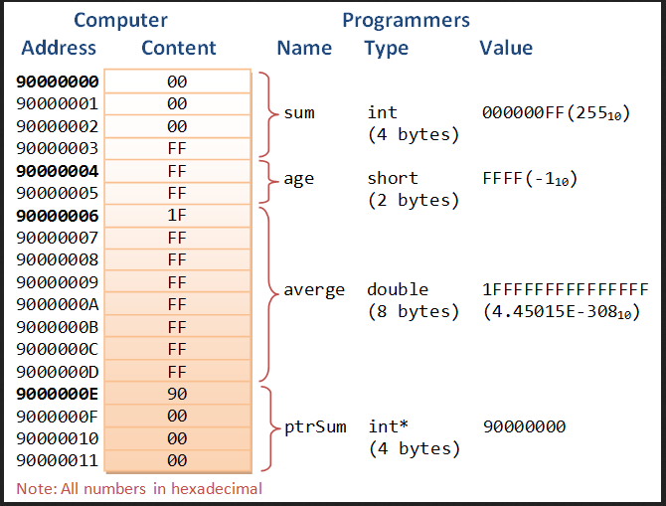
The following diagram illustrate the relationship between computers' memory address and content; and variable's name, type and value used by the programmers.
10-<number>

