Slide 1
Chapter 4
Selection Structures:
if and nested else if

Slide 2
Control Structures in C
Control structures control the flow of execution in a program or function.
There are two kinds of execution flow:
  Sequence:
    the execution of the program is sequential.
  Selection:
    A control structure which chooses alternative to execute.
We will focus on the selection control structure in this chapter.
2/4/2016

Slide 3
Operators Used in Conditions
Operator | Meaning | Type
< | Less than | Relational
> | Greater than | Relational
<= | Less than or equal to | Relational
>= | Greater than or equal to | Relational
== | Equal to | Equality
!= | Not equal to | Equality
4-<number>

Slide 4
Examples of Conditions
Operator | Condition | Meaning
<= | x <= 0 | x less than or equal to 0
< | Power < MAX_POW | Power less than MAX_POW
== | mom_or_dad == ‘M’ | mom_or_dad equal to ‘M’
!= | num != SETINEL | num not equal to SETINEL

Slide 5
Logical Operators
There are three kinds of logical operators.
  &&: and
  ||: or
  !: not
Logical expression is an expression which uses one or more logical operators, e.g.,
  (temperature > 90.0 && humidity > 0.90)
  !(n <= 0 || n >= 100).
2/4/2016
4-<number>

Slide 6
The Truth Table of Logical Operators
Op 1 | Op 2 | Op 1 && Op2 | Op 1 || Op2
nonzero | nonzero | 1 | 1
nonzero | 0 | 0 | 1
0 | nonzero | 0 | 1
0 | 0 | 0 | 0
Op 1 | ! Op 1
nonzero | 0
0 | 1

Slide 7
Operator Precedence
An operator’s precedence determines its order of evaluation.
Unary operator is an operator that has only one operand.
  !, +(plus sign), -(minus sign), and &(address of)
  They are evaluated second only after function calls.
Operator | Precedence
function calls | highest
! + - &
* / %
+ -
< <= >= >
== !=
&&
||
= | lowest
4-<number>

Slide 8
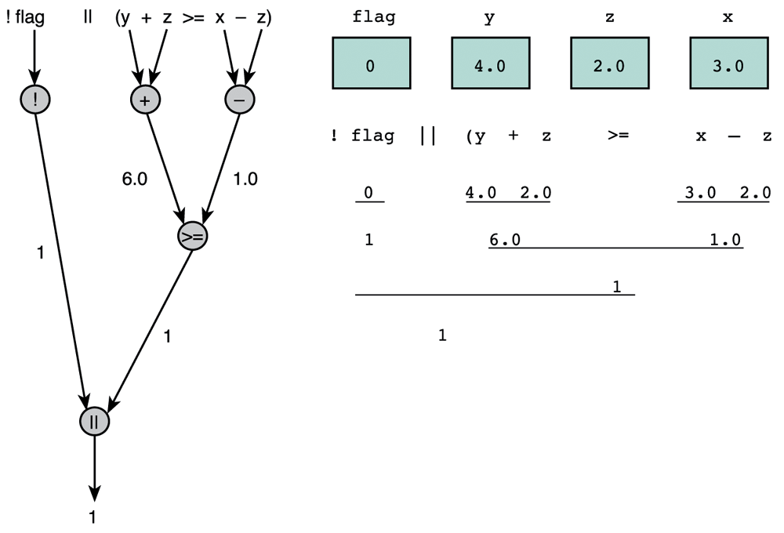
Evaluation for !flag || (y + z >= x - z)
The result of this expression is true
Evaluation tree

Slide 9
Comparing Characters
We can also compare characters in C using the relational and equality operators.
Expression | Value
‘9’ >= ‘0’ | 1 (true)
‘a’ < ‘e’ | 1 (true)
‘Z’ == ‘z’ | 0 (false)
‘a’ <= ‘A’ | system dependent

Slide 10
Flowchart
Flowchart is a diagram that shows the step-by-step execution of a control structure.
  A diamond-shaped box represents a decision.
  A rectangular box represents an assignment statement or a process.

Slide 11
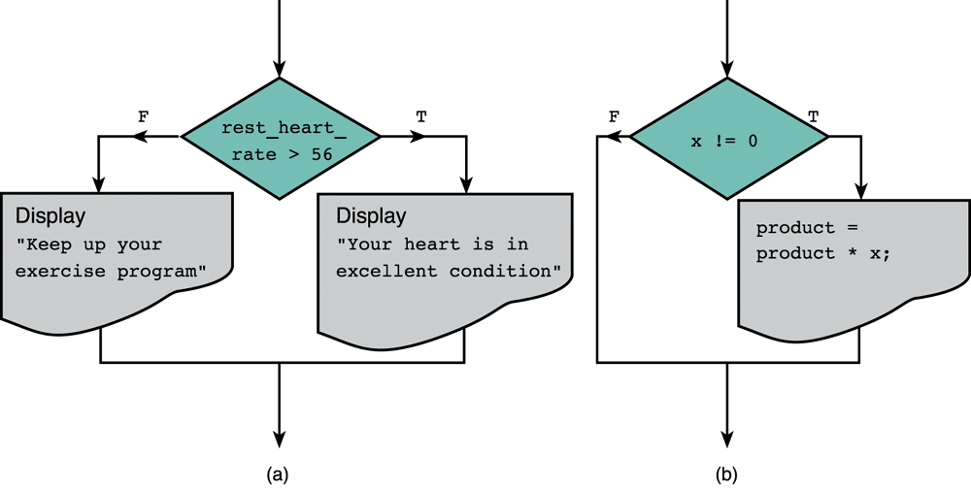
Flowcharts of if Statements with (a) Two Alternatives and (b) One Alternative
Decision
Decision

Slide 12
Conditions
A program may choose among alternative statements by testing the value of key variables.
  e.g., if( your_grade > 60 )
  printf(“you are passed!”);
Condition is an expression that is either false (represented by 0) or true (represented by 1).
  e.g., “your_grade > 60” is a condition.
Conditions may contain relational or equality operators, and have the following forms.
  variable relational-operator variable (or constant)
  variable equality-operator variable (or constant)

Slide 13
The if Statement
The if statement is the primary selection control structure.
Syntax: if (condition) statement;
else statement;
An example of two alternatives:
  if ( rest_heart_rate > 56 )
  printf(“Keep up your exercise program!\n”);
  else
  printf(“Your heart is in excellent health!\n”);
An example of one alternative:
  if ( x != 0.0 )
  product = product * x;

Slide 14
Nested if Statements
Nested if statement is an if statement with another if statement as its true task or false task.
e.g.,
if (road_status == ‘S’)
else
printf(“Drive carefully!\n”);
if (temp > 0) {
printf(“Wet roads ahead!\n”);
}else{
printf(“Icy roads ahead!\n”);
}
2/4/2016
4-<number>

Slide 15
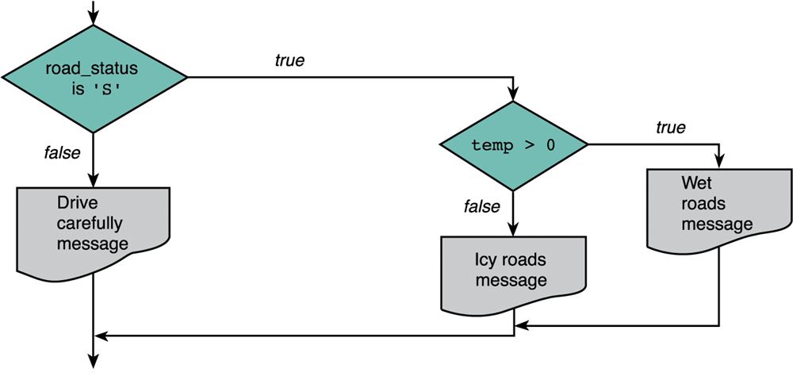
An Example for the Flowchart of Nested if Statements
Another if statement
Main if statement

Slide 16
Multiple-Alternative Decisions
If there are many alternatives, it is better to use the syntax of multiple-alternative decision.
Syntax:
if (condition₁)
statement₁
else if (condition₂)
statement₂
…
else if (condition_{n})
statement_{n}
else
statement_{e}

Slide 17
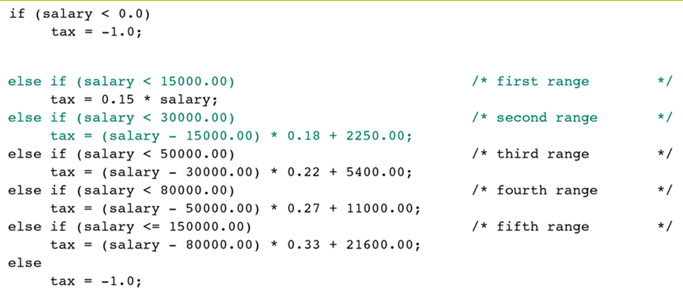
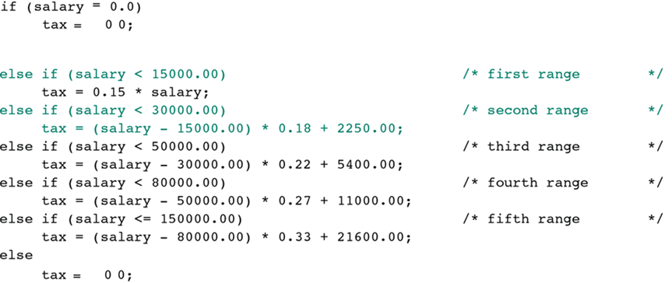
An Example of Multiple-Alternative Decisions

Slide 18
Homework
1. Write a program that takes a number as input from user and checks whether the number is even or odd.
Using if-else:

