Slide 1
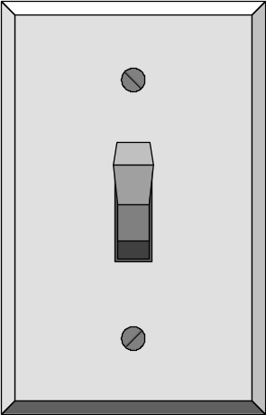
Programming
Switch command

Slide 2
Multiple Selection:
The switch Statement
multiway
expression
value1
action 1
value2
action 2
value3
action 3
value4
action 4

Slide 3
Multiple Selection:
The switch Statement
Syntax:
switch (<selector expression>) {
case <label1> : <sequence of statements>;
break;
case <label2> : <sequence of statements>;
break;
case <labeln> : <sequence of statements>;
break;
default : <sequence of statements>;
}

Slide 4
Multiple Selection:
The switch Statement
Meaning:
Evaluate selector expression.
The selector expression can only be: a bool, an integer, an enum constant, or a char.
Match case label.
Execute sequence of statements of matching label.
If break encountered,
go to end of the switch statement.
Otherwise continue execution.

Slide 5
Multiple Selection:
The switch Statement
case 1
action
case 2
action
case 3
action
default
action

Slide 6
switch Statement: Example 1
If you have a 95, what grade will you get?
switch(int(score)/10){
case 10:
case 9: cout << "Grade = A" << endl;
case 8: cout << "Grade = B" << endl;
case 7: cout << "Grade = C" << endl;
case 6: cout << "Grade = D" << endl;
default:cout << "Grade = F" << endl;
}

Slide 7

switch Statement: Example 2
switch(int(score)/10){
case 10:
case 9: cout << "Grade = A" << endl;
break;
case 8: cout << "Grade = B" << endl;
break;
case 7: cout << "Grade = C" << endl;
break;
case 6: cout << "Grade = D" << endl;
break;
default:cout << "Grade = F" << endl;
}

Slide 8


switch Statement: Example 2
is equivalent to:
if (score >= 90)
cout << "Grade = A" << endl;
else if (score >= 80)
cout << "Grade = B" << endl;
else if (score >= 70)
cout << "Grade = C" << endl;
else if (score >= 60)
cout << "Grade = D" << endl;
else // score < 59
cout << "Grade = F" << endl;

Slide 9
switch Statement: Example 2
#include <iostream>
int main()
{ char answer;
cout << "Is comp102 an easy course? (y/n): ";
cin >> answer;
switch (answer){
case 'Y':
case 'y': cout << "I think so too!" << endl;
break;
case 'N':
case 'n': cout << "Are you kidding?" << endl;
break;
default:
cout << "Is that a yes or no?" << endl;
}
return 0;
}

Slide 10

switch Statement with Multiple Labels: Example 3
switch (watts) {
case 25 : lifespan = 2500;
break;
case 40 :
case 60 : lifespan = 1000;
break;
case 75 : lifespan = 750;
break;
default :
lifespan = 0;
} // end switch

Slide 11
Points to Remember
The expression followed by each case label must be a constant expression.
No two case labels may have the same value.
Two case labels may be associated with the same statements.
The default label is not required.
There can be only one default label, and it is usually last.

