Slide 1
Iterations and Loops
The purpose of a loop is to repeat the same action a number of times
We refer to each time an action is repeated as an iteration.
We continue repeating the action until a terminating condition is satisfied.
This terminating condition is called a loop guard
The loop guard is represented by a boolean expression in the same way as the condition of an IF statement.
Before the loop starts we initialise variables involved in the loop
In C there are a number of ways to represent loops

Slide 2
For loops
For loops are a common form of loop particularly for repeating a task a fixed number of times( counting loops)
The syntax of a for loop is
For (loop initialization, loop guard, increment)
statement

Slide 3
Example of for loop
for (i = 0; i < 10; i = i + 1)
printf("i is %d\n", i);
i=0 is the initialization of the loop counter
i < 10 is the loop guard i.e. repeat until i is greater or equal to 10
i = i + 1; this is the counter increment ; it is more commonly written i ++
printf("i is %d\n", i); is the loop statement

Slide 4
While loops
The most basic loop in C is the while loop.
The general syntax of a while loop is
while( expression )
statement
The expression represents the loop guard.
While it is true repeat the statement.
Terminate when the expression evaluates to false

Slide 5
Example of a while loop
#include <stdio.h>
main()
{int x
x = 2;
while(x < 1000)
{ printf("%d\n", x);
x = x * 2; }
}
This program repeatedly prints out powers of two until we generate a number greater than or equal to 1000
The terminating condition is thus when the power of two equals or exceeds 1000

Slide 6
While Loops
Will execute only if condition is true.
Condition is tested before execution
Do while loops will execute once before testing the condition.

Slide 7
Do While Loop
do
{ }
while ( condition );
Notice that the condition is tested at the end of the block instead of the beginning, so the block will be executed at least once. If the condition is true, we jump back to the beginning of the block and execute it again.
A do..while loop is almost the same as a while loop except that the loop body is guaranteed to execute at least once.
A while loop says "Loop while the condition is true, and execute this block of code", a do..while loop says "Execute this block of code, and then continue to loop while the condition is true".

Slide 8
Example
#include <stdio.h>
main()
{ int x;
x = 0;
do
{ /* "Hello, world!" is printed at least one time even though the condition is false */
printf( "Hello, world!\n" );
} while ( x != 0 );
getchar(); }
Keep in mind that you must include a trailing semi-colon after the while in the above example. A common error is to forget that a do..while loop must be terminated with a semicolon (the other loops should not be terminated with a semicolon, adding to the confusion). Notice that this loop will execute once, because it automatically executes before checking the condition.

Slide 9
Sample loop questions
1: Write a program to calculate the integer square root of a number e.g. 7 integer square is 2 etc
2: Write a program which continually reads in integers until 45 is read in
3: Use a Do while loop to calculate the minimum of 100 integers being read in.

Slide 10
Read until 45
#include <stdio.h>
main()
{int x;
x =1;
while(x != 45)
{ printf(“enter no”);
scanf(“%d", &x);
}
}

Slide 11
Integer Square Root
#Include <stdio.h>
main()
{ int i,a;
printf(“enter number \n”);
scanf(“%d”,&a);
If (a < 0)
{printf(“No Square Root available”)}
else
{ i= 0;
while (i*i < a)
{i++};
printf(“The integer square root of %d is %d”,a,i);
}
}

Slide 12
Read until 45
#include <stdio.h>
main()
{int x;
do
{ printf(“enter no”);
scanf(“%d", &x);
}
while(x != 45) ;
}

Slide 13
Minimum
#include <stdio.h>
main()
{int x,min,counter;
counter = 0;
do
{ printf(“enter no”);
scanf(“%d", &x);
if (counter= = 0)
{min = x;}
else
{If (x < min) min = x; }
counter++;}
While (counter < 100) ;
printf(“minimum is %d”,min);
}

Slide 14
Minimum with while loop
#include <stdio.h>
main()
{int x,min,counter;
counter = 1;
printf(“enter no”);
scanf(“%d", &x);
min = x;
While (counter < 100)
{ printf(“enter no”);
scanf(“%d", &x);
If (x < min) min = x;
counter++;}
printf(“minimum is %d”,min);
}

Slide 15
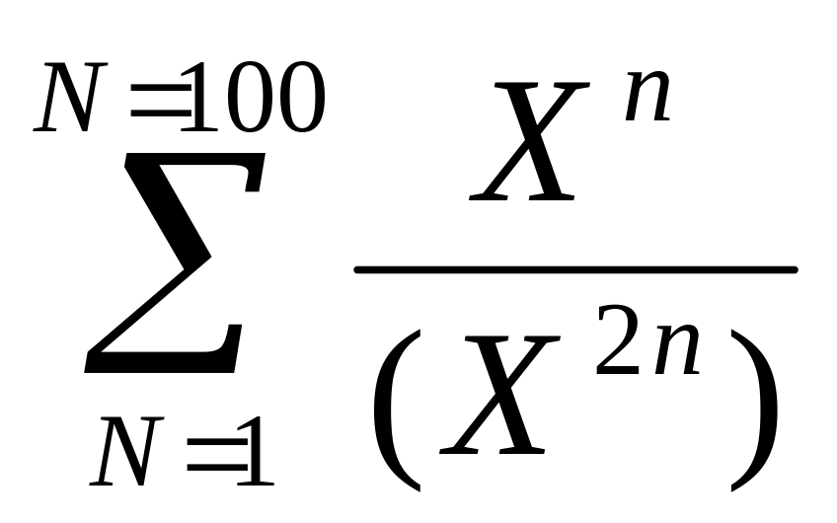
More questions
4: Read in 20 integers and count the even numbers
5: Write a program to calculate

Slide 16
Write a program to calculate
e = 1/1! + 1/2! + 1/3! Etc
Do it for 6 terms

Slide 17
No of even Integers
#Include <stdio.h>
main()
{ int i, a,sum;
sum = 0;
for (i=0;I < 20; i++)
{ printf(“enter number \n”);
scanf(“%d”,&a);
If ((a%2)==0)sum = sum + +;
};
printf(“total even nos is %d”,sum);
}

Slide 18
Sum of function
#Include <stdio.h>
#Include <math.h>
main()
{ int n, x;
float enum,denom,sum;
sum = 0.0;
printf(“enter number \n”);
scanf(“%d”,&X);
If (x == 0) printf(“sum not defined”)
else
{
for (n=1;n <= 100; n++)
{
enum = pow(x,n);
denom = pow(x,2*n);
sum = sum + (enum/denom);
};
printf(“total %f”,sum);
}
}

Slide 19
e
#Include <stdio.h>
#Include <math.h>
main()
{ int fac, n, x;
float enum,denom,sum;
sum = 0.0;
for (n=1;n <= 6; n++)
{
fac = 1;
For (x =1; x <= n; x++){
fac = fac*x;
}
enum = 1;
denom = 1.0/fac;
sum = sum + (enum/denom);
};
printf(“total %f”,sum);
}
}

Slide 20
Sum of function Example
#Include <stdio.h>
#Include <math.h>
main()
{ int n,i, fac;
float enum,denom,sum;
sum = 0.0;
for (n=1;n <= 100; n++)
{
fac = 1;
for (i=1, i <=n, i++)
{ fac = fac*i;
}
enum = n-1;
denom = fac*pow(n,2);
If (denom == 0) printf(“sum not defined”)
sum = sum + (enum/denom);
};
printf(“total %f”,sum);
}

Slide 21
Remember
Loops Consist of
1: Initialization
2: Terminating Condition (Guard)
3: Loop Body
4: Terminating Action

Slide 22
For Counted Loops Iterations use a For loop
Otherwise use a while or a do while loop

Slide 23
Some loop programs
1: Read in 10 integers and output their sum
2: Read in 10 integers and output the largest of them
3: Keep reading in integers until one is input which is larger than 100

Slide 24
Sum of 10 Integers
#Include <stdio.h>
main()
{ int i, a,sum;
sum = 0;
for (i=0;I < 10; i++)
{ printf(“enter number \n”);
scanf(“%d”,&a);
sum = sum + a;
};
printf(“total is %d”,sum);
}

Slide 25
Largest of 10 Integers
#Include <stdio.h>
main()
{ int i, a,max;
printf(“enter number \n”);
scanf(“%d”,&a);
max = a;
for (i=1;I < 10; i++)
{ printf(“enter number \n”);
scanf(“%d”,&a);
If (a > max) max = a;
};
printf(“largest is %d”,max);
}

Slide 26
Loop until
#Include <stdio.h>
main()
{ int a,
do
{ printf(“enter number \n”);
scanf(“%d”,&a);
};
while (a < 100)
printf(“The number which ended the loop is %d”,a);
}

Slide 27
While
#Include <stdio.h>
main()
{ int a,
a= 0;
while (a < 100)
{ printf(“enter number \n”);
scanf(“%d”,&a);
};
printf(“The number which ended the loop is %d”,a);
}

