Slide 1
Recursion

Slide 2
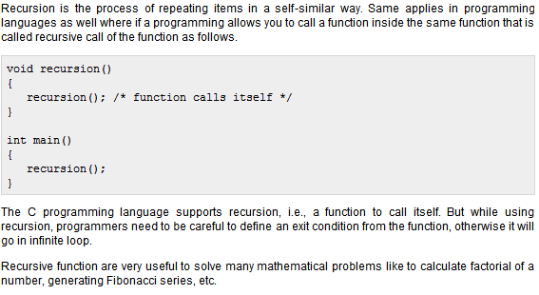
Recursion

Slide 3
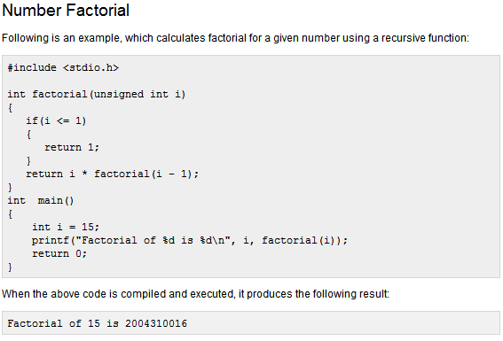

Slide 4
