Slide 1
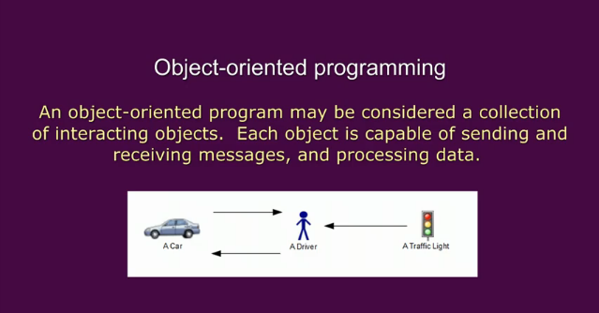

Slide 2
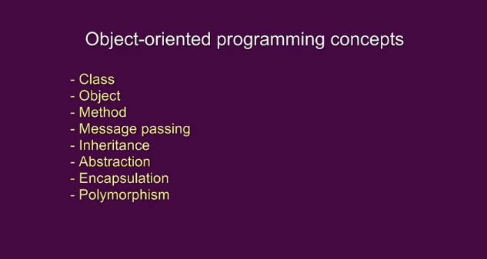

Slide 3
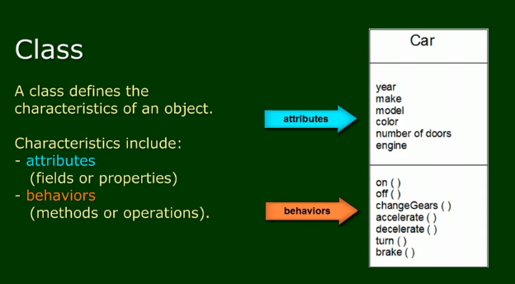

Slide 4
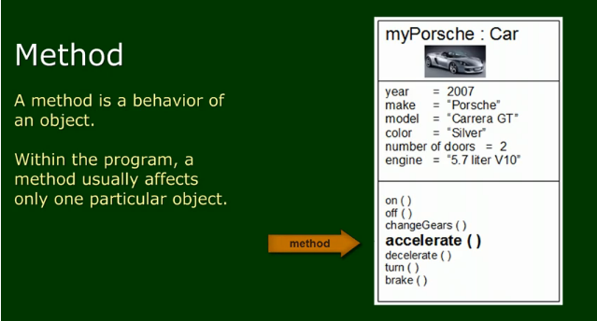

Slide 5
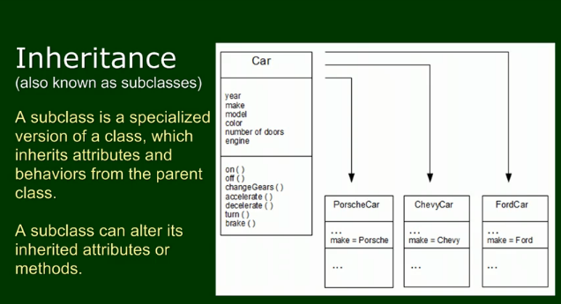

Slide 6
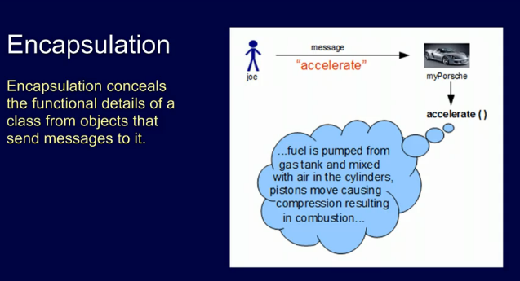

Slide 7
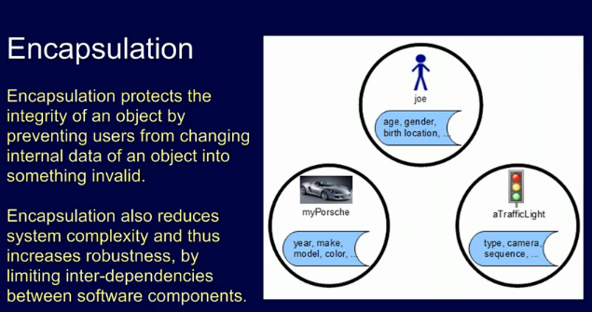

Slide 8
Abstraction
The next core principle of object-oriented programming we are about to examine is "abstraction".Abstraction means working with something we know how to use without knowing how it works internally. A good example is a television set. We don’t need to know the inner workings of a TV, in order to use it.

Slide 9
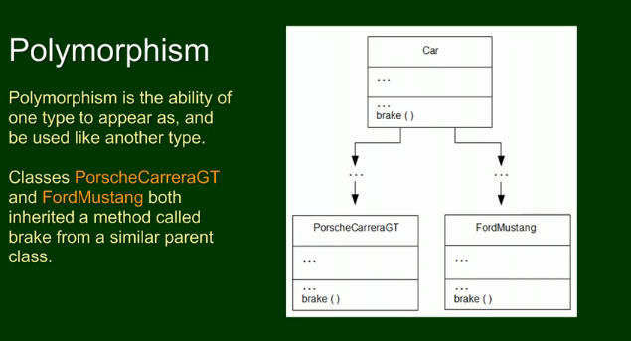

Slide 10
