Slide 1
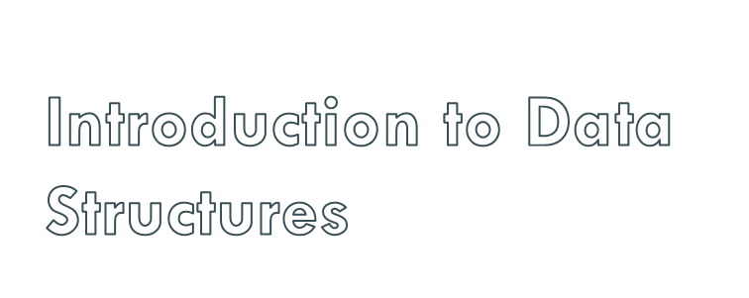
2nd Semester
Batch-2016
BS(Computer Science)

Slide 2
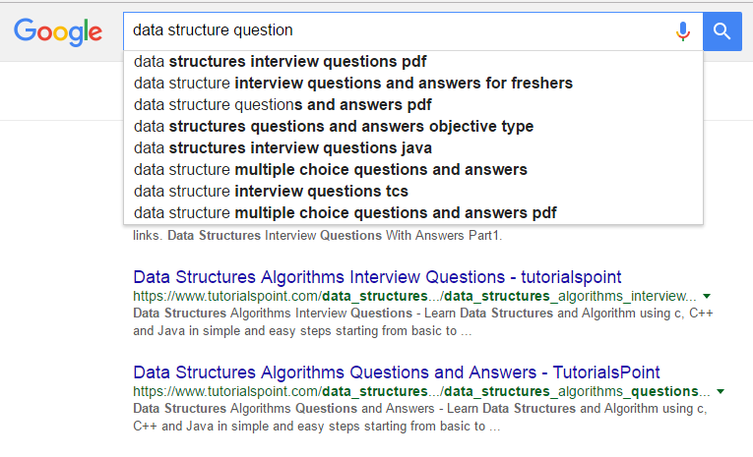

Slide 3
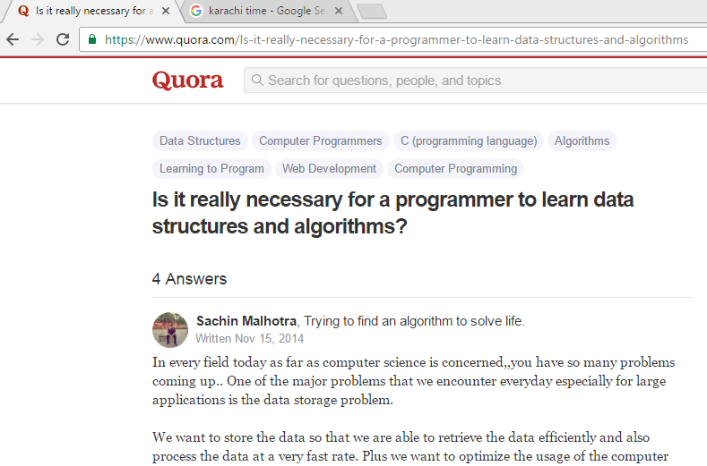

Slide 4

“I will, in fact, claim that the difference between a bad programmer and a good one is whether he considers his code or his data structures more important. Bad programmers worry about the code. Good programmers worry about data structures and their relationships.”
Linus Torvalds, 2006

Slide 5

A data structure is a specialized format for organizing and storing data. General data structure types include the array, the file, the record, the table, the tree, and so on. Any data structure is designed to organize data to suit a specific purpose so that it can be accessed and worked with in appropriate ways.

Slide 6

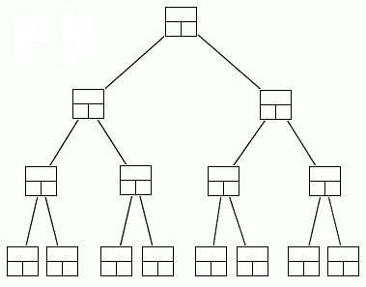
A data structure is a scheme for organizing data in the memory of a computer.
Some of the more commonly used data structures include lists, arrays, stacks, queues, heaps, trees, and graphs.
Binary Tree

Slide 7
The way in which the data is organized affects the performance of a program for different tasks.
Computer programmers decide which data structures to use based on the nature of the data and the processes that need to be performed on that data.
Binary Tree

Slide 8

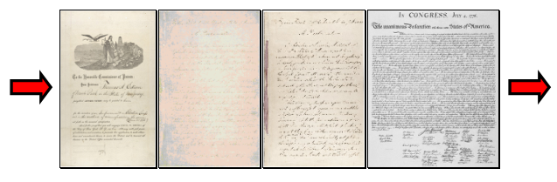
A queue is an example of commonly used simple data structure. A queue has beginning and end, called the front and back of the queue.
Data enters the queue at one end and leaves at the other. Because of this, data exits the queue in the same order in which it enters the queue, like people in a checkout line at a supermarket.

Slide 9

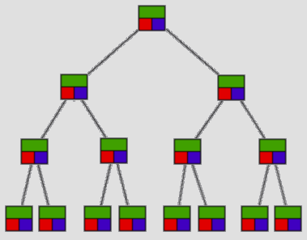
A binary tree is another commonly used data structure. It is organized like an upside down tree.
Each spot on the tree, called a node, holds an item of data along with a left pointer and a right pointer.
Binary Tree

Slide 10
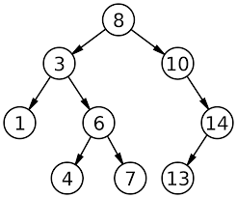

Slide 11
The pointers are lined up so that the structure forms the upside down tree, with a single node at the top, called the root node, and branches increasing on the left and right as you go down the tree.
Binary Tree

Slide 12

By comparing the queue with the binary tree, you can see how the structure of the data affects what can be done efficiently with the data.

Slide 13
A queue is a good data structure to use for storing things that need to be kept in order, such as a set of documents waiting to be printed on a network printer.
.

Slide 14
The jobs will be printed in the order in which they are received.
Most network print servers maintain such a print queue.
.

Slide 15
A binary tree is a good data structure to use for searching sorted data.
The middle item from the list is stored in the root node, with lesser items to the left and greater items to the right.

Slide 16
A search begins at the root. The computer either find the data, or moves left or right, depending on the value for which you are searching.
Each move down the tree cuts the remaining data in half.

Slide 17
Items can be located very quickly in a tree.
Telephone directory assistance information is stored in a tree, so that a name and phone number can be found quickly.

Slide 18
For some applications, a queue is the best data structure to use.
For others, a binary tree is better.
Programmers choose from among many data structures based on how the data will be used by the program.

Slide 19

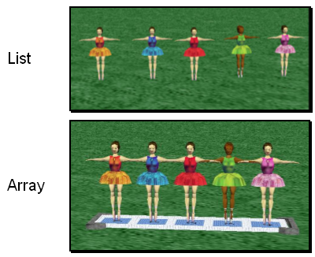
A list is an ordered set of data. It is often used to store objects that are to be processed sequentially.
A list can be used
to create a queue.
Notes:
The Redo button will reverse the last use of the Undo button, restoring the previous action.
The Ctrl-Y keyboard shortcut also can be used in place of the Redo button.

Slide 20
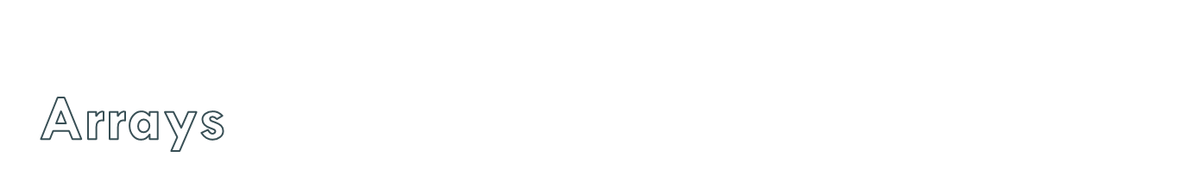
An array is an indexed set of variables, such as toy_{[1]}, toy_{[2]}, toy_{[3]},… It is like a set of boxes that hold things.
A list is a set of items.
An array is a set of
variables that each
store an item.
Notes:
The Redo button will reverse the last use of the Undo button, restoring the previous action.
The Ctrl-Y keyboard shortcut also can be used in place of the Redo button.

Slide 21
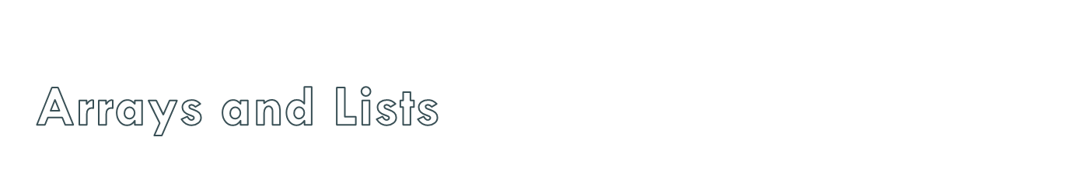
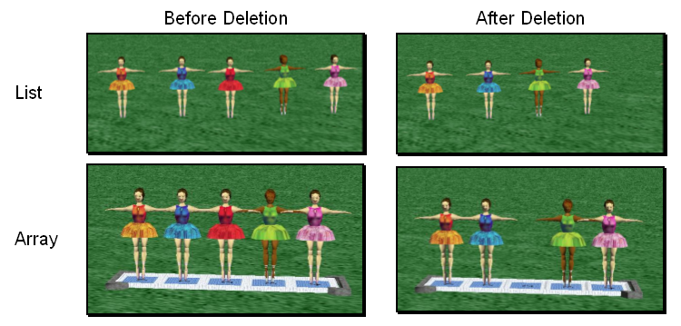
You can see the difference between arrays and lists when you delete items.
Notes:
The Redo button will reverse the last use of the Undo button, restoring the previous action.
The Ctrl-Y keyboard shortcut also can be used in place of the Redo button.

Slide 22
In a list, the missing spot is filled in when something is deleted.
Notes:
The Redo button will reverse the last use of the Undo button, restoring the previous action.
The Ctrl-Y keyboard shortcut also can be used in place of the Redo button.

Slide 23
In an array, an empty variable is left behind when something is deleted.
Notes:
The Redo button will reverse the last use of the Undo button, restoring the previous action.
The Ctrl-Y keyboard shortcut also can be used in place of the Redo button.

