Slide 1
Recursion C/C++

Slide 2
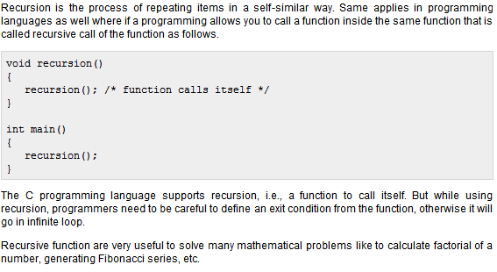
Recursion

Slide 3
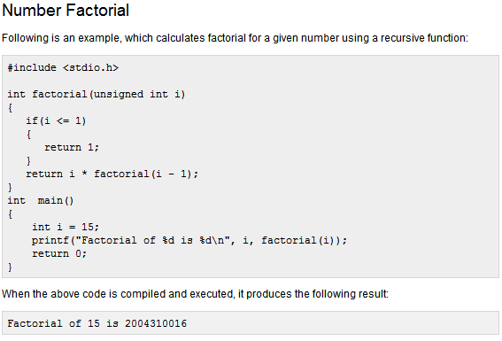

Slide 4
