Slide 1
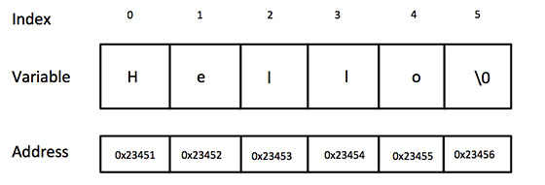
The C-Style Character String:
char greeting[6] = {'H', 'e', 'l', 'l', 'o', '\0'};
char greeting[] = "Hello";

Slide 2
S.N. | Function & Purpose
1 | strcpy(s1, s2); Copies string s2 into string s1.
2 | strcat(s1, s2); Concatenates string s2 onto the end of string s1.
3 | strlen(s1); Returns the length of string s1.
4 | strcmp(s1, s2); Returns 0 if s1 and s2 are the same; less than 0 if s1<s2; greater than 0 if s1>s2.
5 | strchr(s1, ch); Returns a pointer to the first occurrence of character ch in string s1.
6 | strstr(s1, s2); Returns a pointer to the first occurrence of string s2 in string s1.

Slide 3
#include <iostream>
#include <cstring>
using namespace std;
int main ()
{
char str1[10] = "Hello";
char str2[10] = "World";
char str3[10];
int len ;
// copy str1 into str3
strcpy( str3, str1);
cout << "strcpy( str3, str1) : " << str3 << endl;
// concatenates str1 and str2
strcat( str1, str2);
cout << "strcat( str1, str2): " << str1 << endl;
// total lenghth of str1 after concatenation
len = strlen(str1);
cout << "strlen(str1) : " << len << endl;
return 0;
}

Slide 4
The String Class in C++:
string str1 = "Hello";
string str2 = "World";
string str3;
int len ;
// copy str1 into str3
str3 = str1;
cout << "str3 : " << str3 << endl;
// concatenates str1 and str2
str3 = str1 + str2;
cout << "str1 + str2 : " << str3 << endl;
// total lenghth of str3 after concatenation
len = str3.size();
cout << "str3.size() : " << len << endl;

Slide 5
Implicit And Explicit Initialiation
string s1;
// Default constructor - creates an empty or null C++ string of length 0, equal to ""
string s2("hello");
// Explicit constructor call to initialize new object with C string
string s3 = "hello";
// Implicit constructor call to initialize new object with C string
string s4(s2);
// Explicit constructor call to initialize new object with C++ string
string s5 = s2;
// Implicit constructor call to initialize new object with C++ string

Slide 6
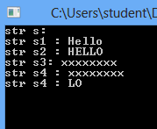
Creating String Objects
#include <string>
//string initialization
string s; //s contains 0 characters
string s1( "Hello" ); //s1 contains 5 characters
string s2 = “HELLO”; //s2 contains 5 characters
//implicitly calls the constructor
string s3( 8, 'x' ); //s3 contains 8 'x' characters
string s4 = s3; //s4 contains 8 'x' characters
string s5(s2, 3, 2); //s5 copies a substring of s2; it contains ”LO”

Slide 7
string s = “ABCDEFG”;
char c = s[2]; //assigns ‘C’ to c
s[4] = ‘*’; //changes s to “ABCD*FG”
string s = “ABCD*FG”;
string s2 = “Robot”;
string s5 = “Soccer”;
string s6 = s + “HIJK”; //changes s6 to “ABCD*FGHIJK s2 += s5; //changes s2 to “RobotSoccer”

Slide 8
Substring function: substr()
s6 = “ABCD*FGHIJK”;
s4 = s6.substr(5, 3); //Copy substring “FGH” to s4.
erase() and replace() functions:
s6 = “ABCD*FGHIJK”;
s6.erase(4, 2); //changes s6 to “ABCDGHIJK”;
s6.replace(5, 2, “xyz”); //changes s6 to “ABCDGxyzJK”;

Slide 9
s1.erase( start )
Erase from index start to end of string, including start
Replace
s1.replace( begin, N, s2)
begin: index in s1 to start replacing
N: number of characters to replace
s2: replacement string
s1.replace( begin, N, s2, index, num )
index: element in s2 where replacement comes from
num: number of elements to use when replacing
Replace can overwrite characters

Slide 10
find() function
returns the index of the first occurrence of a given substring:
string s7 = “Mississippi River basin”; //23 characters
cout << s7.find(“si”) << endl; //prints 3
If the find() function fails, it returns the length of the string it was searching.
cout << s7.find(“so”) << endl; //prints 23, the length of the string

Slide 11
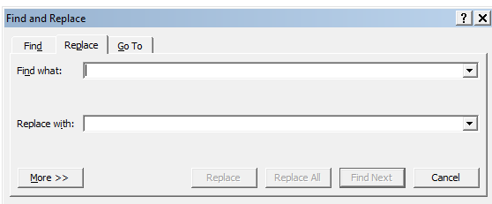
Replace Option in MSWORD

Slide 12
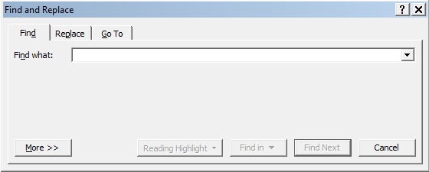
Find Option Option in MSWORD

Slide 13
Find functions
If found, index returned
If not found, string::npos returned
Public static constant in class string
s1.find( s2 )
s1.rfind( s2 )
Searches right-to-left
s1.find_first_of( s2 )
Returns first occurrence of any character in s2
Example: s1.find_first_of( "abcd" )
Returns index of first 'a', 'b', 'c' or 'd'

Slide 14
Assignment
S1=s2
s2 = s1;
Makes a separate copy
s2.assign(s1);
Same as s2 = s1;
myString.assign(s, start, N);
Copies N characters from s, beginning at index start
Individual character assignment
s2[0] = s3[2];
s1.swap(s2);
S2.swap(s1);
Switch contents of two strings

Slide 15
Member functions
s1.size() and s1.length()
Number of characters in a string
s1.capacity()
Number of elements that can be stored without reallocation
s1.max_size()
Maximum possible string size
s1.empty()
Returns true if empty
s1.resize(newlength)
Resizes string to newlength

Slide 16
s1.insert( index, s2 )
Inserts s2 before position index
s1.insert( index, s2, index2, N );
Inserts substring of s2 before position index
Substring is N characters, starting at index2

