Slide 1
Concepts of Object Oriented Programming
Lecture # 1

Slide 2
Why Do We Need Object-Oriented Programming?
Object-Oriented Programming was developed because limitations were discovered in earlier approaches to programming. To appreciate what OOP does, we need to understand what these limitations are and how they arose from traditional programming languages.

Slide 3
Procedural Languages
C, Pascal, FORTRAN, and similar languages are procedural languages. That is, each statement in the language tells the computer to do something: Get some input, add these numbers, divide by 6, display that output.
A program in a procedural language is a list of instructions.
For very small programs, no other organizing principle (often called a paradigm) is needed. The programmer creates the list of instructions, and the computer carries them out.

Slide 4
Problems with Structured Programming
As programs grow ever larger and more complex, even the structured programming approach begins to show signs of strain.
You may have heard about, or been involved in, horror stories of program development.
The project is too complex, the schedule slips, more programmers are added, complexity increases, costs skyrocket, the schedule slips further, and disaster ensues.

Slide 5
What does OOP mean?
Object-oriented programming (OOP) is a software programming model constructed around objects. This model compartmentalizes data into objects (data fields) and describes object contents and behavior through the declaration of classes (methods).

Slide 6
Features of OOP
OOP features include the following:
Encapsulation: This makes the program structure easier to manage because each object’s implementation and state are hidden behind well-defined boundaries.
Polymorphism: This means abstract entities are implemented in multiple ways.
Inheritance: This refers to the hierarchical arrangement of implementation fragments.

Slide 7
Features of OOP
Abstraction: "To represent the essential feature without representing the background details."Abstraction lets you focus on what the object does instead of how it does it.
OOP has been the programming model of choice for the last decade or more. OOP's modular design enables programmers to build software in manageable chunks rather than in large amounts of sequential code.

Slide 8
Lets Start With
Class
Object
Variable
Method
Access Modifiers

Slide 9
OOP Concepts
There are many explanations that we can find in internet about C# OOP, but here I will give a very simple example.
I will use a “House (like the houses we live in) “as a real-time example for easy understanding of OOP Concept in C#.

Slide 10
What is Class
Class is a like a Blueprint.
What is a blueprint?
Blueprint is outline drawing of our actual plan. For example if we plan to build our new home ,The Engineer will explain our new house plan with a blue print as shown in the image below. Once we finalized the plan the engineer will start building the house with same plan.

Slide 11
What is Class
Same like blueprint class is an outline of program. Using the class we can write our own method and declare the variables and using the objects we can access the class Method and Variables. The class will be complete with Variables, Methods and Objects.

Slide 12
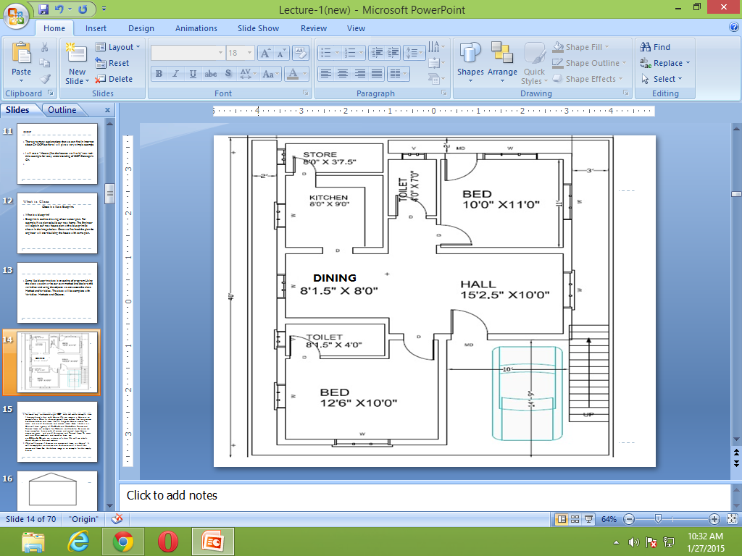

Slide 13
Contd..
For more easy understanding of OOP with real world example here I have explained a class with House.
We can imagine a House as an example for a Class. In a house, we will have rooms like living room, bedroom, kitchen and items like TV, fridge etc.
House owner can access and use all the rooms and rooms' items. Same like this in a Class will have a group of Methods and Variables.
Rooms and Rooms' Items are example for Methods and Variables. So now, we have a complete house with all rooms and rooms' items. House owner can access and use all the rooms and Rooms' Items.

Slide 14
Contd..
To access and use a Class, methods and variables here we use Objects. Objects are instance of a class. We will see details about objects in the next section.
What will happen if there are no rooms and items in a House? It will be empty and no one can use the house until it has all the rooms and Items. See the below image as an example for the empty house.

Slide 15
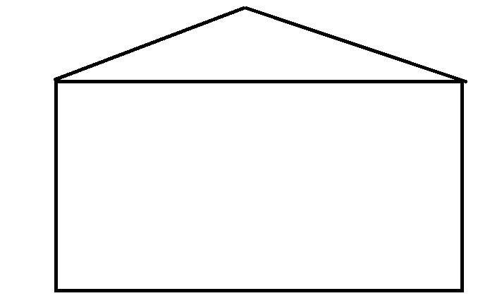
Now this empty house is a Class .So what is the use of a Class without Methods and variable.
Now let’s see an example for a Complete House with Rooms and items.

Slide 16
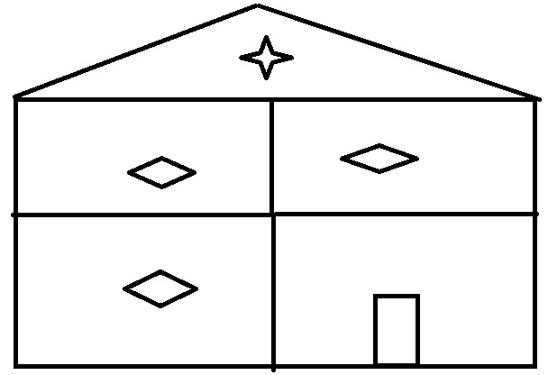
Contd..
So here, we have a complete house. Similarly, the Class will be complete with group of Variables, Methods and Objects. We can see details of all this later.
Class and objects are the base concept of OOP – Object Oriented Programming.
Example of Class : Class should be started with the Keyword class and next we give the name for our class we can give any meaning full name as Class Name, next we will have the Open and close brackets.
Class HouseClass1 { }

Slide 17
Object
As we have already seen that, House Owner will access and use all the Rooms of the House and its Items. Similarly, to access all Class Method and Variable we use Objects.
We can create one or many object for a same Class. Example we can say for a house there might be one or many owners.
Example of Object : Here “objHouseOwner” is the Object for a class which will be used to access all variable and Method of a class.
HouseClass1 objHouseOwner = new HouseClass1();

Slide 18
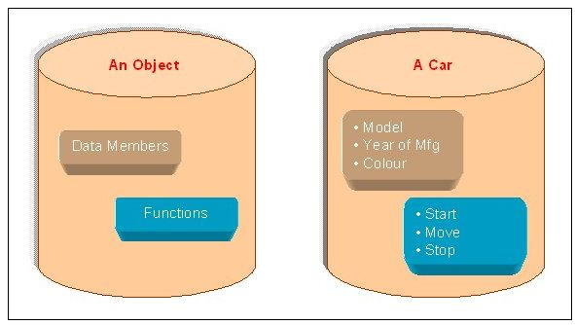
Another Example

Slide 19
Variable
Variables are used to store our value. Our value can be numeric or characters for example to store a Phone no we can use “int” type variable and to store our name we can use string type variable with name for each variable.
Variables can be local or Global. For Example, we can say if we buy a new TV , TV Service man will come and setup the TV in our home .He will give his contact number for future contacts .

Slide 20
Variable
Usually what we do is take a memo paper and write his contact number and keep it in a common place or in a wallet of ours. If we keep the memo in a Commonplace everyone who is visiting our house can see that contact number.
Global or public variables are similar to this. If we declared the variable as Global, All the Methods inside the class can access the variable. If we store the memo Only in our wallet, we can see the contact number. Local or private variables are similar to this.

Slide 21
Syntax for variable
Access-Modifiers Data-Type Variable-Name
By default the Access-Modifiers are by private, we can also use public to variable.
Example of Variable:
int noOfTV = 0;
public String yourTVName;
private Boolean doYouHaveTV = true;

Slide 22
Code
Class HouseClass1
{
int noOfTV = 2;
public String yourTVName = "SAMSUNG";
static void Main(string[] args)
{
HouseClassI objHouseOwner = new HouseClassI(); Console.WriteLine("You Have total " + objHouseOwner.noOfTV + " no of TV :"); Console.WriteLine("Your TV Name is : {0}" , objHouseOwner.yourTVName);
}
}

Slide 23
Explanation
In Above example program Two variables are declared. In main method I have created object for class.
Here we can see using the object we can access the variable of a class and display the output.
Main Method is the default Method of C#, where every console and windows application will start the program execution, In the Main Method, we can declare the Object for the class and use the object, and we can access all variables and Methods of a Class.

Slide 24
Contd..
For example, we can say there will be entrance gate for every house. Using the entrance gate we can enter inside our house. Similarly, to run our program there should be some default program execution starting Method.
Main method will be useful in this program execution starting point. Whenever we run our C# Console or windows application, first the Main method will be executed .From the main method we can create an object for our other classes and call their Methods.

Slide 25
End of Lecture 1

