Slide 1
Polymorphism
Lecture #10

Slide 2
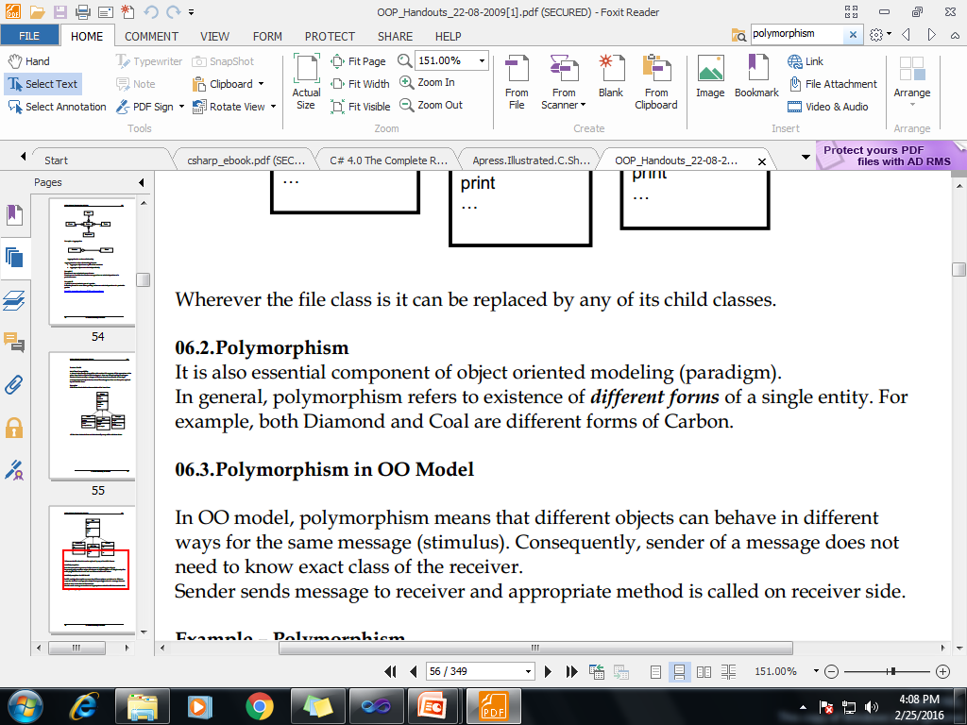
Polymorphism

Slide 3
Real World Example of Polymorphism
Example 1
A Teacher behaves with student.
A Teacher behaves with his/her seniors.
Here teacher is an object but the attitude is different in different situations.

Slide 4
Real World Example of Polymorphism
Your mobile phone, one name but many forms:
As phone
As camera
As mp3 player
As radio

Slide 5
…Polymorphism
There are two types of polymorphism:
Static or compile time polymorphism
Dynamic or runtime polymorphism

Slide 6
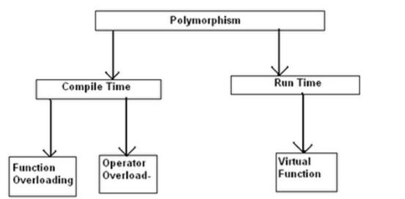

Slide 7
Static or Compile Time Polymorphism
In static polymorphism, the decision is made at compile time.
Which method is to be called is decided at compile-time only.
Method overloading is an example of this.
Compile time polymorphism is method overloading, where the compiler knows which overloaded method it is going to call.

Slide 8
Method Overloading
Method overloading is a concept where a class can have more than one method with the same name and different parameters.
Compiler checks the type and number of parameters passed on to the method and decides which method to call at compile time and it will give an error if there are no methods that match the method signature of the method that is called at compile time.

Slide 9
namespace MethodOverloading
{
class Program
{
public void Add(string a1, string a2)
{
Console.WriteLine("Adding Two String :" + a1 + a2);
}
public void Add(int a1, int a2)
{
Console.WriteLine("Adding Two Integer :" + a1 + a2);
}
static void Main(string[] args)
{
Program Obj = new Program();
Obj.Add(5, 6);
Obj.Add("String1", "String 2");
Console.Read();
}
}
}
Static Polymorphism-Method Overloading

Slide 10
Dynamic or Runtime Polymorphism
Run-time polymorphism is achieved by method overriding.
Method overriding allows us to have methods in the base and derived classes with the same name and the same parameters.
By runtime polymorphism, we can point to any derived class from the object of the base class at runtime that shows the ability of runtime binding.
Through the reference variable of a base class, the determination of the method to be called is based on the object being referred to by reference variable.
Compiler would not be aware whether the method is available for overriding the functionality or not. So compiler would not give any error at compile time. At runtime, it will be decided which method to call and if there is no method at runtime, it will give an error.

Slide 11
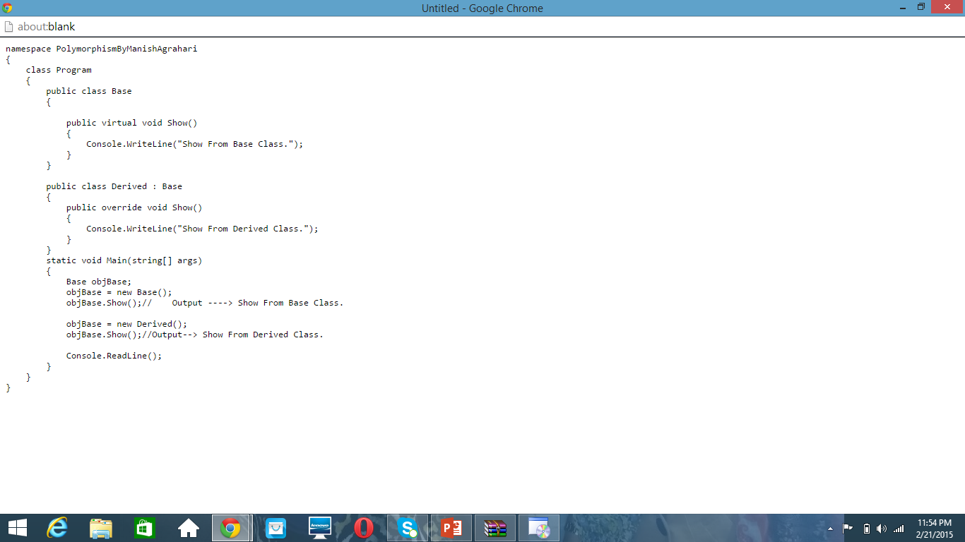

Slide 12
Virtual Method
Virtual method is a method whose behavior can be overridden in derived class. Virtual method allows declare a method in base class that can be redefined in each derived class.
When a virtual method is invoked, the run-time type of the object is checked for an overriding member. The overriding member in the most derived class is called, which might be the original member, if no derived class has overridden the member.

Slide 13
Code-Example
using System;
public class DrawingObject
{ public virtual void Draw() { Console.WriteLine(“ Draw any Object"); } }
public class Line : DrawingObject { public override void Draw() { Console.WriteLine("I'm a Line."); } }

Slide 14
public class Circle : DrawingObject { public override void Draw() { Console.WriteLine("I'm a Circle."); } } public class Square : DrawingObject { public override void Draw() { Console.WriteLine("I'm a Square."); } }

Slide 15
using System; public class DrawDemo { public static void Main( ) { DrawingObject[] dObj = new DrawingObject[4]; dObj[0] = new Line(); dObj[1] = new Circle(); dObj[2] = new Square(); dObj[3] = new DrawingObject(); foreach (DrawingObject drawObj in dObj) { drawObj.Draw(); } } }

Slide 16
Inheritance and Name Hiding
It is possible for a derived class to define a member that has the same name as a member in its base class. When this happens, the member in the base class is hidden
While this is not technically an error in C#, the compiler will issue a warning message. This warning alerts you to the fact that a name is being hidden. If your intent is to hide a base class member, then to prevent this warning, the derived class member must be preceded by the new key word within the derived class.

Slide 17
namespace Name_Hiding
{
class A
{
public int i=5;
}
class B : A
{
new public int i;
public B(int b,int a)
{
i = b;
base.i = a;
}
public void show()
{
Console.WriteLine("i in Derived Class : {0}", i);
Console.WriteLine("i in Base Class : {0}", base.i);
}
}
class Program
{
static void Main(string[] args)
{
B obj = new B(5,6);
obj.show();
Console.ReadKey();
}
}
}

Slide 18
using System;
class A
{
public int i = 0;
}
class B : A
{
new int i;
public B(int b)
{
i = b; // i in B
}
public void Show() {
Console.WriteLine("i in derived class: " + i);
}
}
class NameHiding
{
static void Main() {
B ob = new B(2);
ob.Show(); }}

Slide 19
End of Lecture 9

