Slide 1
Abstract Classes & Interfaces
Lecture #11

Slide 2
Abstract Class
We have created classes which could be both instantiated as objects and used as a base class from which to derive classes.
Often a base class is not intended to be instantiated and is provided solely for the purpose of providing an outline for subclasses.
Such a class is known as an abstract class. An abstract class cannot be instantiated as an object and is only provided for the purpose of deriving subclasses.

Slide 3
Abstract Class
Incomplete Classes
Contains one or more incomplete methods called abstract methods
Abstract class contains declaration or signature of abstract method and leaves the implementation of these methods to derived or sub class
Abstract methods & classes are marked with abstract keywords

Slide 4
Abstract Class & Method
The purpose of an abstract class is to be inherited by other classes. It cannot be instantiated. The abstract method is, by default, a virtual method.
It can exist only inside an abstract class.
Declare abstract classes or abstract methods using the abstract keyword as in this example:
abstract class MyBaseClass // abstract class
{
public abstract void MyMethod(); // abstract method
...
}

Slide 5
Abstract Class & Method
The abstract class might contain abstract methods and properties. When an abstract class is inherited, the derived class must implement all of its methods and properties.
As you can see in the code segment in previous slide, the abstract method doesn’t contain any implementation. The implementation goes inside the overriding methods of the derived classes.
The following keywords are not allowed in the abstract method declaration:
static
virtual

Slide 6
Abstract Class & Method
An abstract class does not mean that it should contain abstract members. Even we can have an abstract class only with non abstract members. For example:
abstract class absClass
{
public void NonAbstractMethod()
{
Console.WriteLine("NonAbstract Method");
}
}

Slide 7
namespace AbstractClasses_1
{
abstract class abcClass
{
public int Addnumbers(int a, int b)
{
return a + b;
}
public abstract int Multiplynumbers(int a,int b);
}
class Derived:abcClass
{
static void Main(string[] args)
{
Derived d = new Derived();
Console.WriteLine(d.Addnumbers(5, 4));
Console.WriteLine(d.Multiplynumbers(7, 8));
Console.Read();
}
public override int Multiplynumbers(int a, int b)
{
return a*b;
}
}
}
Abstract Class-Example Code 1

Slide 8
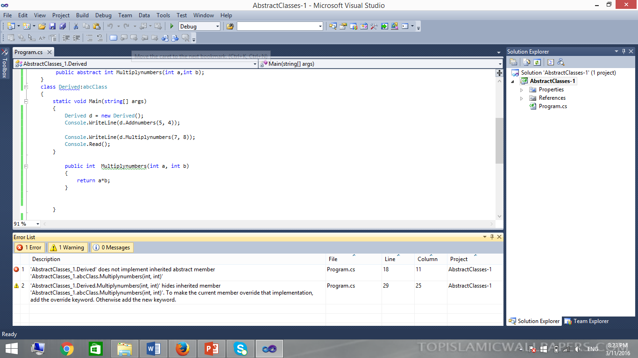

Slide 9
//Abstract Class1
abstract class absClass1
{
public abstract int AddTwoNumbers(int Num1, int Num2);
public abstract int MultiplyTwoNumbers(int Num1, int Num2);
}
//Abstract Class2
abstract class absClass2 : absClass1
{
//Implementing AddTwoNumbers
public override int AddTwoNumbers(int Num1, int Num2)
{
return Num1 + Num2;
}
}
//Derived class from absClass2
class absDerived : absClass2
{
//Implementing MultiplyTwoNumbers
public override int MultiplyTwoNumbers(int Num1, int Num2)
{
return Num1 * Num2;
}
}
Abstract Class-Example Code 2

Slide 10
Abstract Class-Example Code 3…
namespace AbstractClass
{
abstract class BaseEmp
{
public int ID { get; set; }
public string FirstName { get; set; }
public string LastName { get; set; }
public string getFullName()
{
return FirstName + "" + LastName;
}
public abstract int GetMonthlySalary();
}
}

Slide 11
…Abstract Class-Example Code 3…
namespace AbstractClass
{
class HourlyClass:BaseEmp
{
public int Totalhoursworked{ get; set; }
public int HourlyPay { get; set; }
public override int GetMonthlySalary()
{
return this.HourlyPay * this.Totalhoursworked;
}
}
}

Slide 12
…Abstract Class-Example Code 3…
namespace AbstractClass
{
class FullTimeEmp:BaseEmp
{
public int AnnualSalary { get; set; }
public override int GetMonthlySalary()
{
return this.AnnualSalary / 12;
}
}
}

Slide 13
namespace AbstractClass
{
class Program
{
static void Main(string[] args)
{
FullTimeEmp fte = new FullTimeEmp();
fte.FirstName = "Ali";
fte.LastName = "Hassan";
fte.ID = 1001;
fte.AnnualSalary = 10000;
Console.WriteLine("Details of FullTime Employee");
Console.WriteLine("ID is:" + fte.ID);
Console.WriteLine(fte.getFullName());
Console.WriteLine(fte.GetMonthlySalary());
Console.WriteLine("Details of Hourly Employee");
HourlyClass Hemp = new HourlyClass();
Hemp.FirstName = "Zain";
Hemp.LastName="Khan";
Hemp.ID = 1002;
Hemp.HourlyPay=600;
Hemp.Totalhoursworked=5;
Console.WriteLine("ID is:"+ Hemp.ID);
Console.WriteLine(Hemp.getFullName());
Console.WriteLine(Hemp.GetMonthlySalary());
Console.Read();
}
}
}
…Abstract Class-Example Code 3

Slide 14
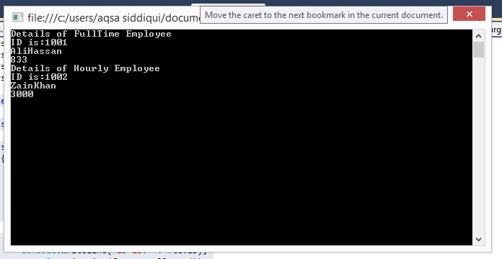
Output-Abstract Class-Example Code 3

Slide 15
Interface
In previous ,we had a look at abstract classes. Interfaces are much like abstract classes and they share the fact that no instances of them can be created.
However, interfaces are even more conceptual than abstract classes, since no method bodies are allowed at all.
So an interface is kind of like an abstract class with nothing but abstract methods, and since there are no methods with actual code, there is no need for any fields.

Slide 16
Interface
An interface is not a class. It is an entity that is defined by the word Interface. An interface has no implementation; it only has the signature or in other words, just the definition of the methods without the body.
As one of the similarities to Abstract class, it is a contract that is used to define hierarchies for all subclasses or it defines specific set of methods and their arguments.
The main difference between them is that a class can implement more than one interface but can only inherit from one abstract class.

Slide 17
Interface
So, what are interfaces good for if they don't implement functionality? They're great for putting together plug-n-play like architectures where components can be interchanged at will. Since all interchangeable components implement the same interface, they can be used without any extra programming. The interface forces each component to expose specific public members that will be used in a certain way.

Slide 18
Interface
Interfaces are declared by using the interfacekeyword. Here is a simplified form of an
interface declaration:
Interfacename
{
ret-type method-name1(param-list);
ret-type method-name2(param-list);
// ...
ret-type method-nameN(param-list);
}

Slide 19
Interface-Example Code-1…
namespace MultipleInheritApplication
{
interface calc1
{
int add(int a, int b);
}
interface calc2
{
int sub(int x, int y);
}
interface calc3
{
int mul(int r, int s);
}
interface calc4
{
int div(int c, int d);
}

Slide 20
class Calculation : calc1, calc2, calc3, calc4
{
public int result1;
public int add(int a, int b)
{
return result1 = a + b;
}
public int result2;
public int sub(int x, int y)
{
return result2 = x - y;
}
public int result3;
public int mul(int r, int s)
{
return result3 = r * s;
}
public int result4;
public int div(int c, int d)
{
return result4 = c / d;
}
..Interface-Example Code-1..

Slide 21
Class Program
{
static void Main(string[] args)
{
Calculation c = new Calculation();
c.add(8, 2);
c.sub(20, 10);
c.mul(5, 2);
c.div(20, 10);
Console.WriteLine("Multiple Inheritance concept Using Interfaces :\n ");
Console.WriteLine("Addition: " + c.result1);
Console.WriteLine("Substraction: " + c.result2);
Console.WriteLine("Multiplication :" + c.result3);
Console.WriteLine("Division: " + c.result4);
Console.ReadKey();
}
}
}
}
..Interface-Example Code-1

Slide 22
class Shape
{
public void setWidth(int w)
{
width = w;
}
public void setHeight(int h)
{
height = h;
}
protected int width;
protected int height;
}
public interface PaintCost
{
int getCost(int area);
}
class Rectangle : Shape, PaintCost
{
public int getArea()
{
return (width * height);
}
public int getCost(int area)
{
return area * 70;
}
}
Interface-Example Code-2…

Slide 23
class RectangleTester
{
static void Main(string[] args)
{
Rectangle Rect = new Rectangle();
int area;
Rect.setWidth(5);
Rect.setHeight(7);
area = Rect.getArea();
// Print the area of the object.
Console.WriteLine("Total area: {0}", Rect.getArea());
Console.WriteLine("Total paint cost: ${0}" , Rect.getCost(area));
Console.ReadKey();
}
}
..Interface-Example Code-2

Slide 24
namespace interfaces
{
interface IA
{
void display();
}
interface IB
{
void display();
}
class test:IA,IB
{
void IA.display()
{
Console.WriteLine("Display of IA");
}
void IB.display()
{
Console.WriteLine("Display of IB");
}
}
Interface-Example Code-3…

Slide 25
class InterfaceDemo
{
static void Main(string[] args)
{
test t = new test();
((IA)t).display();
((IB)t).display();
Console.ReadKey();
}
}
}
…Interface-Example Code-3

Slide 26
public interface IA
{
void Meth1();
void Meth2();
}
// B now includes Meth1() and Meth2() -- it adds Meth3().
public interface IB : IA
{
void Meth3();
}
// This class must implement all of IA and IB.
class MyClass : IB
{
public void Meth1()
{
Console.WriteLine("Implement Meth1().");
}
public void Meth2()
{
Console.WriteLine("Implement Meth2().");
}
public void Meth3()
{
Console.WriteLine("Implement Meth3().");
}
}
Interface-Example Code-4..
// One interface can inherit another.

Slide 27
…Interface-Example Code-4
class IFExtend
{
static void Main()
{
MyClass ob = new MyClass();
ob.Meth1();
ob.Meth2();
ob.Meth3();
}
}

Slide 28
End of Lecture 11

