Slide 1
Exception Handling
Lecture # 12

Slide 2
Exceptions
Exceptions are run-time errors that can stop the program execution unless they are handled properly.
Exceptions are generated when certain conditions occur in your program, such as dividing by zero, trying to open a file that was erased, incorrect casting, or running out of memory.
you deal with the exception by using the appropriate handler in order to prevent the program from stopping.
The handler is a block of code that catches the exception and tries to continue the program execution. If the appropriate handler is not available in your code, the default handler is used and the program is terminated.

Slide 3
Exceptions
In C#, an exception is an object of the class System.Exception or one of its subclasses, which represents an error that occurred during the program execution.
Exceptions provide a way to transfer control from one part of a program to another. C# exception handling is built upon four keywords: try, catch, throw and finally.

Slide 4
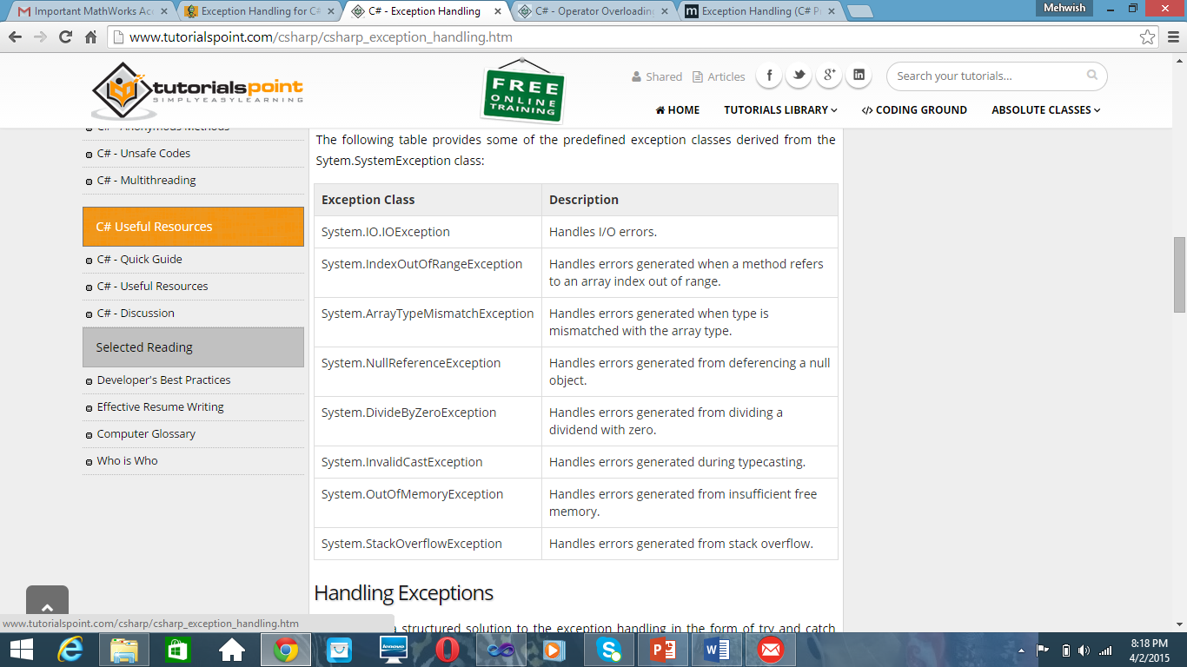

Slide 5
Exceptions
Handling exceptions requires using a special construct that uses one of the following statements:
throw: To throw or rethrow an exception.
try-catch: To catch and handle the exception
try-catch-finally: To catch and handle the exception and clean up resources

Slide 6
Throwing an exception
The throw statement takes the following form:
throw new expression();
where:
Expression is the exception object.
Notice that throw creates an object of any valid exception type using the new keyword.
Some of the exceptions that can be thrown by an application are:
InvalidCastException
OverFlowException
ArgumentNullException
ArithmeticException
DivideByZeroException

Slide 7
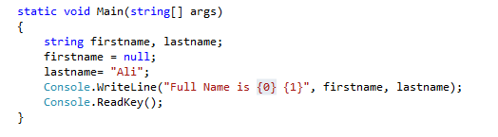
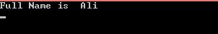
Without throw

Slide 8
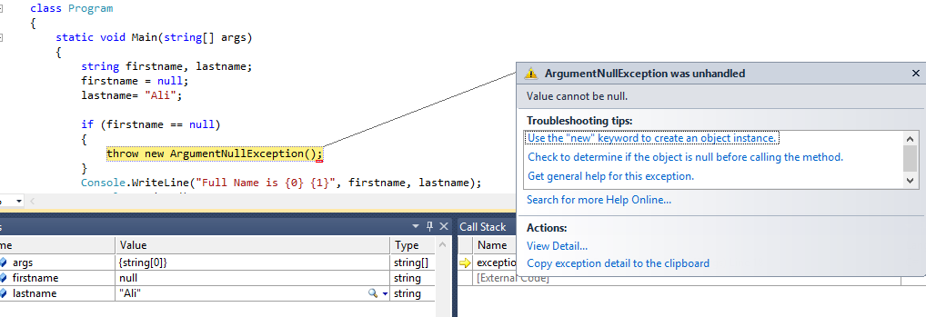
Throwing an Exception

Slide 9
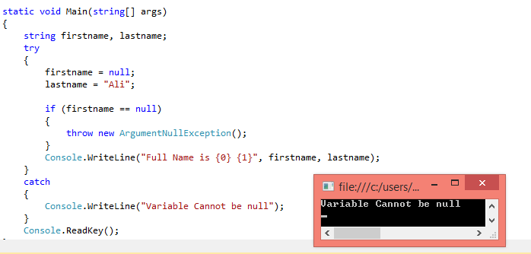
Throw and Handling Exception

Slide 10
namespace ConsoleApplication4
{
class Program
{
static void Main(string[] args)
{
double a, b;
Console.WriteLine("Enter first number");
a = Convert.ToInt32(Console.ReadLine());
Console.WriteLine("Enter second number");
b = Convert.ToInt32(Console.ReadLine());
if (b == 0)
{
throw new DivideByZeroException();
}
else
Console.WriteLine("Answer is:"+a / b);
Console.Read();
}
}
}

Slide 11
Catching an Exception
You can catch exceptions by using the try-catch statement, which contains two blocks. The first is the try block, inside which the suspicious code is inserted. It takes the form:
try
{// The code to be tried.
}
catch [(declaration)]
{
// The handler code.
}
where: declaration is the exception object declaration and is optional.

Slide 12
Catching an Exception
The two blocks are used together to build one statement. If you attempt to use the try block alone, you will get the compilation error:
error CS1524: Expected catch or finally.

Slide 13
Catching an Exception
It is also possible to use more than one catch block. In this case, the try-catch statement takes the form:
try {
// block of code to monitor for errors
}
catch (ExcepType1 exOb) {
// handler for ExcepType1
}
catch (ExcepType2 exOb) {
// handler for ExcepType2
}

Slide 14
Exception Class and Properties
The Exception class has several properties that make understanding an exception easier. These properties include:
The StackTrace property: This property contains a stack trace that can be used to determine where an error occurred. The stack trace includes the source file name and program line number if debugging information is available.
The Message property: This property provides details about the cause of an exception
TargetSite: obtains an object that specifies the method that generated the exception.

Slide 15
namespace ExceptionHandling_2
{
class Program
{
public void Method1(string str)
{
if (str == null)
throw new ArgumentNullException();
}
static void Main(string[] args)
{
Program p1 = new Program();
try
{
string str = null;
p1.Method1(str);
}
catch (Exception e)
{
Console.WriteLine("Exception is caught message is {0}",e.Message);
}
Console.WriteLine("Now program Continues");
Console.ReadLine();
}
}
}

Slide 16
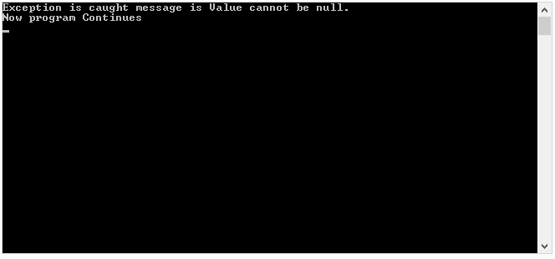

Slide 17
namespace ExceptionHandling_2
{
class Program
{
public void Method1(string str)
{
if (str == null)
throw new ArgumentNullException();
}
static void Main(string[] args)
{
Program p1 = new Program();
try
{
string str = null;
p1.Method1(str);
}
catch (Exception e)
{
Console.WriteLine("Exception stacktrace{0}",e.StackTrace);
}
Console.WriteLine("Now program Continues");
Console.ReadLine();
}
}
}

Slide 18


Slide 19
Catching an Exception
Using the Exception class as a parameter in a catch block is equivalent to not using a parameter at all. That means:
catch (Exception) {}
is equivalent to:
catch {}
You can use a parameter, such as Exception e, if you would like to display the exception text that is associated with the object e.

Slide 20
Organizing the Handlers
When you use more than one catch block, it is important to catch the most specific exceptions before the least specific ones. If, for example, the most specific exception is Arithmetic Exception, this exception should be the first one to catch. Then you organize the rest of the handlers in order, ending with the most general exception.

Slide 21
Organizing the Handlers
catch (ArithmeticException e) // first handler
{
//...
}
...
...
catch (Exception e) // last handler
{
// ...
}

Slide 22
Organizing the Handlers
Although the sequence of the exception handlers is totally up to your judgment, you cannot have the general handler before the specific ones. If you do that, you get the following compiler error:
error CS0160: A previous catch clause already catches all exceptions of this or of a super type ('System.Exception').

Slide 23
namespace ExceptionHandling_2
{
class Program
{
static void Main(string[] args)
{
int x, y;
x = 6;
y = 0;
try
{
Console.WriteLine("Division is :{0}", x / y);
}
catch (DivideByZeroException d)
{
Console.WriteLine("Exception caught {0}", d);
}
catch (Exception e)
{
Console.WriteLine("Exception caught {0}", e);
}
Console.ReadLine();
}
}
}

Slide 24
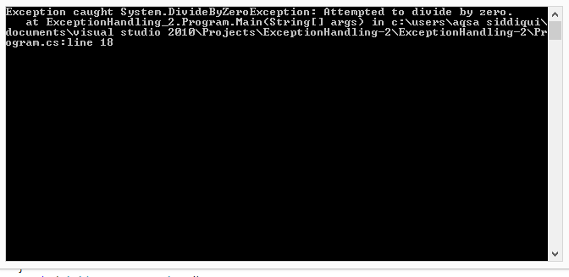

Slide 25
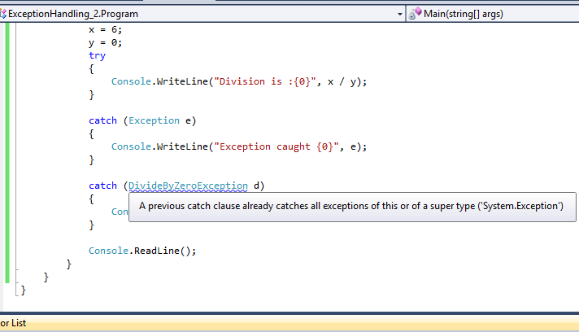

Slide 26
namespace ConsoleApplication4
{
class Program
{
static void Main(string[] args)
{
// Here, numer is longer than denom.
int[] numer = { 4, 8, 16, 32, 64, 128, 256, 512 };
int[] denom = { 2, 0, 4, 4, 0, 8 };
for (int i = 0; i < numer.Length; i++)
{
try
{
Console.WriteLine(numer[i] + " / " + denom[i] + " is " + numer[i] / denom[i]);
}
catch (DivideByZeroException)
{
Console.WriteLine("Can't divide by Zero!");
}
catch (IndexOutOfRangeException)
{
Console.WriteLine("No matching element found.");
}
}
Console.Read();
}
}
}

Slide 27
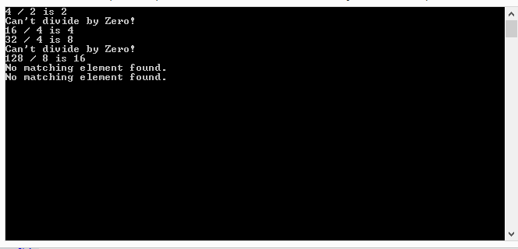

Slide 28
The try-catch-finally Statement
The try-catch-finally statement takes the form:
try
{//try-block}
catch
{//catch-block}
finally
{//finally-block}

Slide 29
The try-catch-finally Statement
where:
try-block contains the suspicious code to be tried.
catch-block contains the exception handler.
finally-block contains the cleanup statements to be executed regardless of the exception.

Slide 30
class UseFinally
{ public static void GenException(int what)
{
int t;
int[] nums = new int[2];
Console.WriteLine("Receiving " + what);
try
{
switch(what)
{
case 0:
t = 10 / what; // generate div-by-zero error
break;
case 1:
nums[4] = 4; // generate array index error
break;
case 2:
return; // return from try block
}
}

Slide 31
catch (DivideByZeroException)
{
Console.WriteLine("Can't divide by Zero!");
}
catch (IndexOutOfRangeException)
{
Console.WriteLine("No matching element found.");}
finally
{
Console.WriteLine("Leaving try.");
}
class program
{
static void Main(string[] args)
{
for (int i = 0; i < 3; i++)
{
UseFinally.GenException(i);
Console.WriteLine();
}
Console.Read();
}
}
}

Slide 32
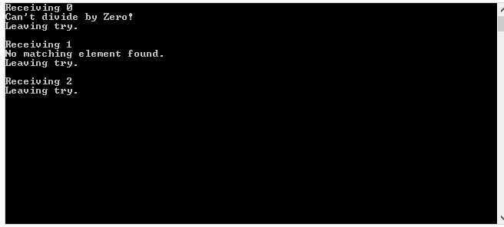

Slide 33
User-defined Exceptions
You can create an exception of your own by declaring it as a class derived from the ApplicationException class. The benefit to the programmer is the ability to add to the handlers whatever text is needed to explain in detail the error that took place.

Slide 34
User-defined Exceptions
You can inherit the ApplicationException as shown in this example:
class MyCustomException: ApplicationException
A constructor with a string parameter is used to send it as a message to the inherited class:
MyCustomException(string message): base(message)
{
}
The string parameter contains the message you would like to display when the exception is thrown

Slide 35
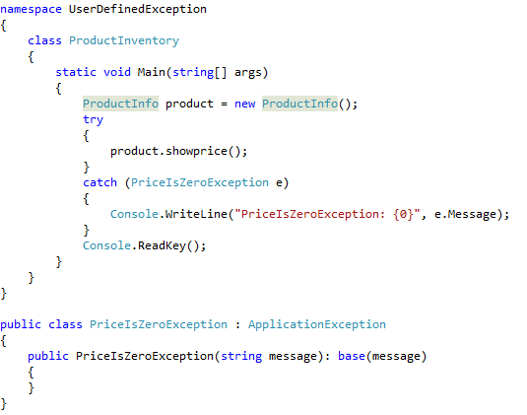
User-defined Exceptions (Example – 2)

Slide 36
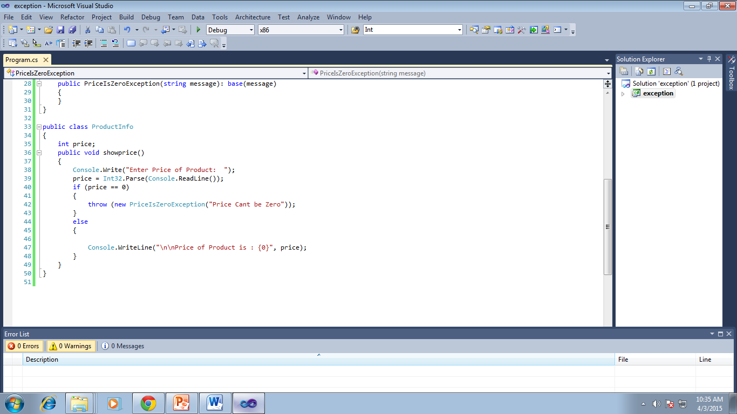

Slide 37
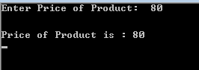
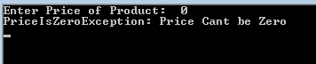

Slide 38
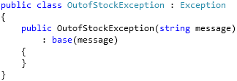
User-defined Exceptions (Example – 1)

Slide 39
static void Main(string[] args)
{
top:
int acceptorder;
Console.WriteLine("Welcome to Shopping Site:\nHow many headphone you want to buy (Total 10 in Stock):");
acceptorder = Convert.ToInt32(Console.ReadLine());
try
{ if (acceptorder == 10 || acceptorder < 10)
{ Console.WriteLine("Congratulations! You have bought {0} headphones", acceptorder);
Console.ReadLine(); }
else {
throw (new OutofStockException("OutofStockException Generated: The number of item you want to buy is out of stock. Please enter total item number within stock")); } }
catch (OutofStockException oex)
{ Console.WriteLine(oex.Message);
goto top; }}

Slide 40
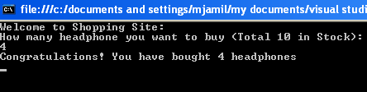
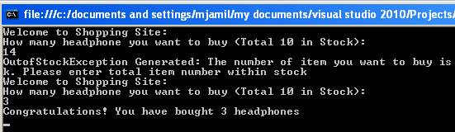

Slide 41
End of Lecture 12

