Slide 1
Delegates
Lecture #14

Slide 2
Delegate
A delegate is an object that can refer to a method, when you create a delegate, you are creating an object that can hold a reference to a method.
A delegate can be thought of as an object that contains an ordered list of methods with the same signature and return type.
• The list of methods is called the invocation list.
• When a delegate is invoked, it calls each method in its invocation list.

Slide 3
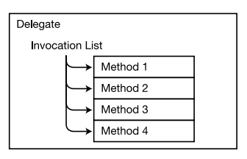
Figure- represents a delegate with four methods in its invocation list.

Slide 4
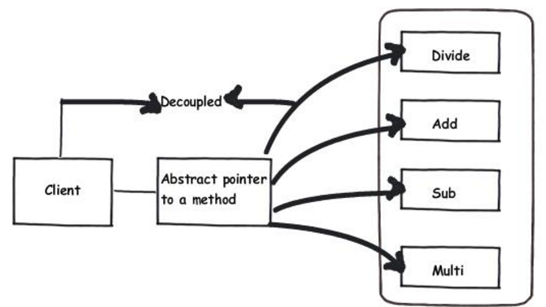
Delegates define a simple abstract pointer to the function / method.

Slide 5
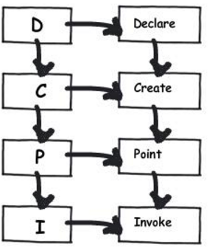
To implement a delegate is a four step process declare, create, point and invoke.

Slide 6
Method in invocation list
Methods held by a delegate can be from any class, as long as they match both the delegate’s
•Return type
• Signature (including ref and out modifiers)
Methods in the invocation list can be either instance methods or static methods.

Slide 7
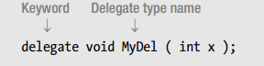
Declaring the Delegate Type
Delegates are types, just as classes are types. And as with classes, a delegate type must be declared before you can use it to create variables and objects of the type. The following example code declares a delegate type.
•The delegate type declaration, as with all type declarations, does not need to be declared inside a class

Slide 8
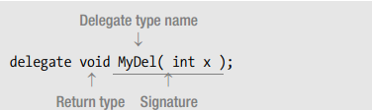
Declaring the Delegate Type
The following code declares delegate type MyDel. The declaration specifies that delegates of this type will accept only methods that return no value and have a single int parameter.
Figure shows a representation of the delegate

Slide 9
Declaring the Delegate Type
The delegate type declaration differs from a method declaration in two ways.
The delegate type declaration Is prefaced with the keyword delegate
Does not have a method body

Slide 10
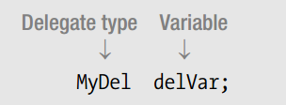
Creating the Delegate Object
A delegate is a reference type, and therefore has both a reference and an object. After a delegate type is declared, you can declare variables and create objects of the type. The following code shows the declaration of a variable of a delegate type:

Slide 11
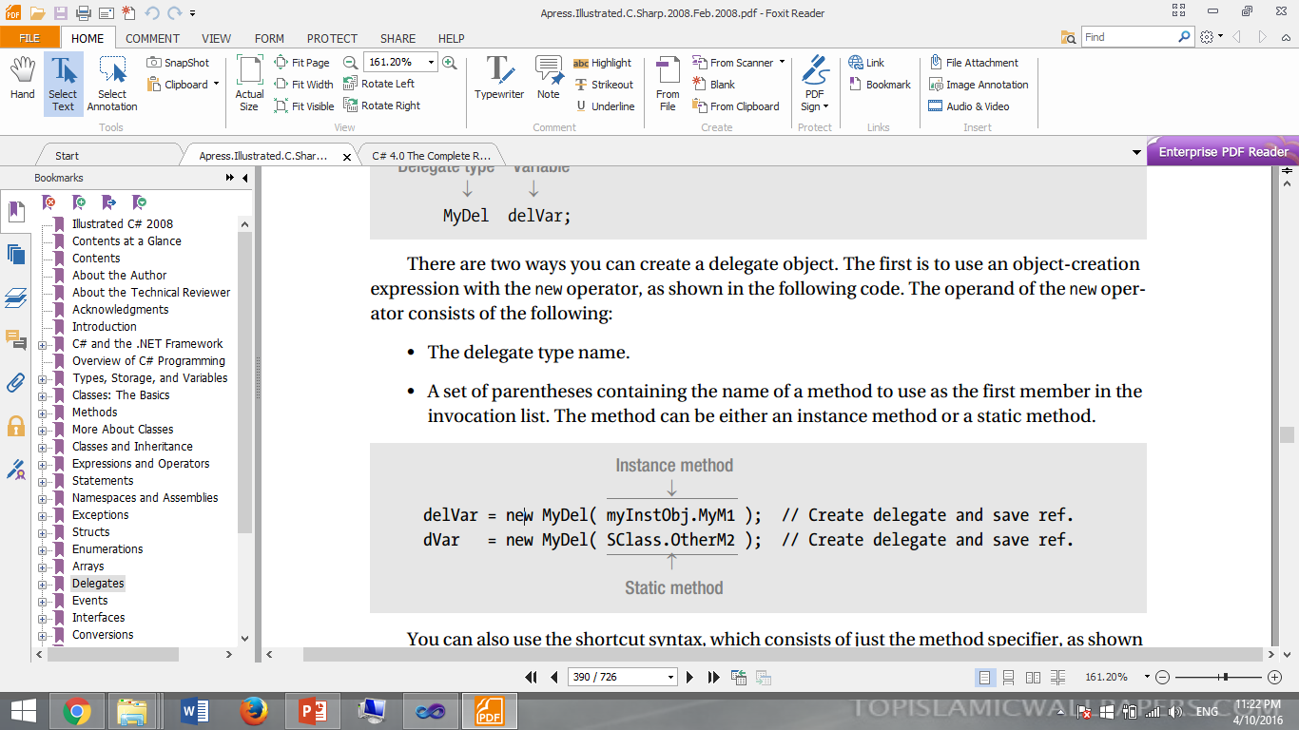
Creating the Delegate Object
There are two ways you can create a delegate object.
The first is to use an object-creation expression with the new operator, as shown in the following code. The operand of the new operator consists of the following:
• The delegate type name.
• A set of parentheses containing the name of a method to use as the first member in the invocation list. The method can be either an instance method or a static method

Slide 12
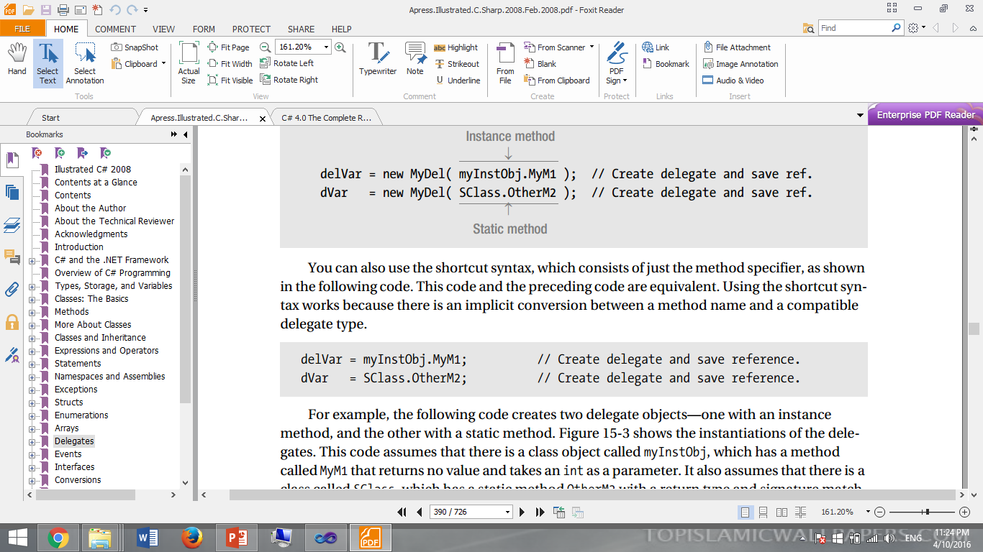
Creating the Delegate Object
You can also use the shortcut syntax, which consists of just the method specifier , as shown in the following code.
This code and the preceding code are equivalent. Using the shortcut syntax works because there is an implicit conversion between a method name and a compatible delegate type.

Slide 13
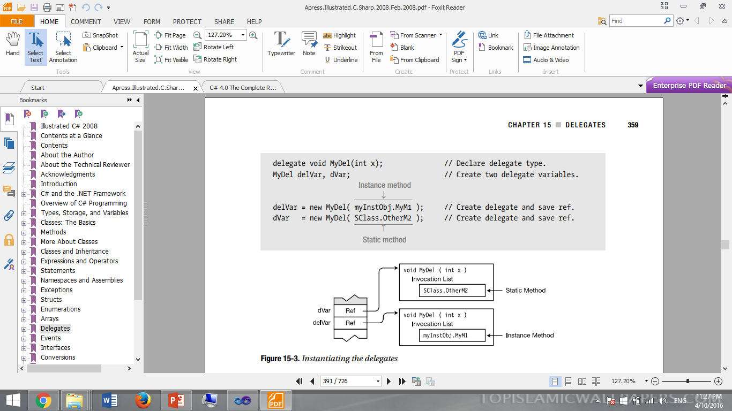
Instantiating the delegates

Slide 14
Assigning Delegates
Because delegates are reference types, you can change the reference contained in a delegate variable by assigning to it. The old delegate object will be disposed of by the Garbage Collector (GC) when it gets around to it.

Slide 15
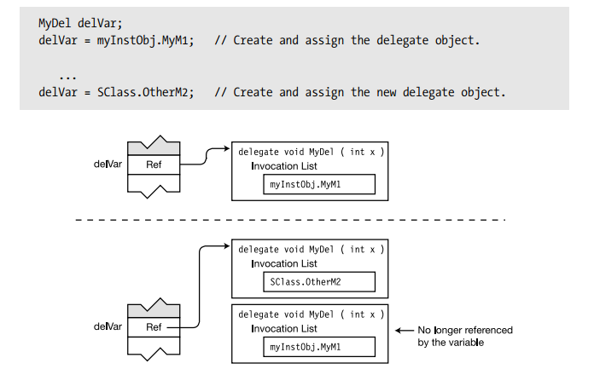
Assigning Delegates

Slide 16
namespace Delegates
{
delegate void MyDel(int x);
class MyClass1
{
public void Square(int s)
{
Console.WriteLine("Square is:" + s * s);
}
}
class MyClass2
{
public static void Cube(int s)
{
Console.WriteLine("Cube is:" + s * s* s);
}
}
class Program
{
static void Main(string[] args)
{
MyClass1 obj = new MyClass1();
MyDel MD1 = new MyDel(obj.Square);
MyDel MD2 = new MyDel(MyClass2.Cube);
MD1(5);
MD2(6);
}
}
}

Slide 17
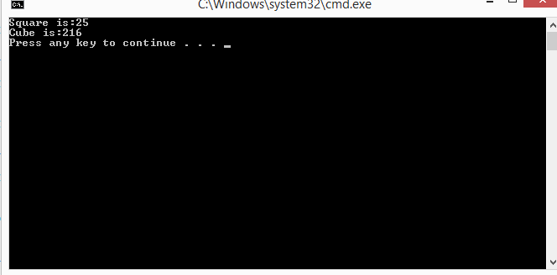

Slide 18
Multicasting
One of the most exciting features of a delegate is its support for multicasting.
In simple terms, multicasting is the ability to create an invocation list, or chain, of methods that will be automatically called when a delegate is invoked.
Such a chain is very easy to create. Simply instantiate a delegate, and then use the + or += operator to add methods to the chain. To remove a method, use – or – =.
If the delegate returns a value, then the value returned by the last method in the list becomes the return value of the entire delegate invocation. Thus, a delegate that makes use of multicasting will often have a void return type.

Slide 19
Adding Methods to Delegates
C# provides syntax for making it appear that you can add a method to a delegate—and it’s perfectly fine to think of it that way. You can add a method, or another delegate, to a delegate by using the += operator.

Slide 20
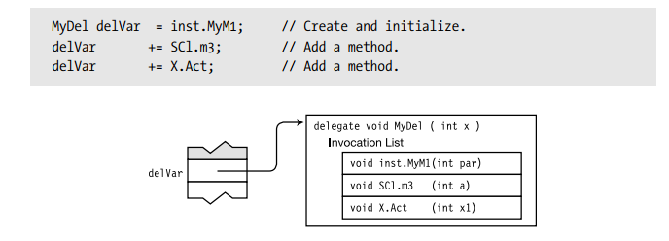

Slide 21
namespace Delegates
{
delegate void MyDel(int x);
class MyClass1
{
public void Square(int s)
{
Console.WriteLine("Square is:" + s * s);
}
}
class MyClass2
{
public static void Cube(int s)
{
Console.WriteLine("Cube is:" + s * s * s);
}
}
class Program
{
static void Main(string[] args)
{
MyClass1 obj = new MyClass1();
MyDel MD1 = obj.Square;
MD1 += MyClass2.Cube;
MD1(8);
}
}
}
Multicasting-Adding Delegates

Slide 22
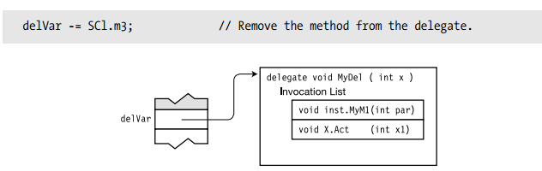
Removing Methods from a Delegate
You can also remove a method from a delegate, using the -=operator. The following code shows the use of the operator

Slide 23
Removing Methods from a Delegate
The following are some things to remember when removing methods:
• If there are multiple entries for a method in the invocation list, the -=operator starts searching at the end of the list and removes the first instance it finds of the matching method.
• Attempting to delete a method that is not in the delegate has no effect.
• Attempting to invoke an empty delegate throws an exception

Slide 24
Invoking Delegates with Return Values
If a delegate has a return value and more than one method in its invocation list, the following occurs:
• The value returned by the last method in the invocation list is the value returned from the delegate invocation.
• The return values from all the other methods in the invocation list are ignored.

Slide 25
namespace Delegates
{
delegate int MyDel();
class MyClass
{
int IntValue = 5;
public int Add2() { IntValue += 2; return IntValue; }
public int Add3() { IntValue += 3; return IntValue; }
}
class Program
{
static void Main(string[] args)
{
MyClass mc = new MyClass();
MyDel mDel = mc.Add2; // Create and initialize the delegate.
mDel += mc.Add3; // Add a method.
mDel += mc.Add2; // Add a method.
Console.WriteLine("Value: {0}", mDel());
}
}
}

Slide 26
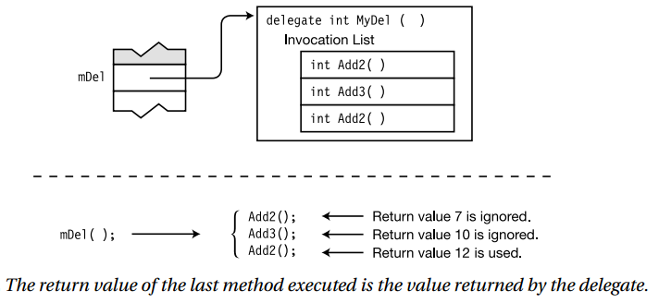
Output: Value: 12

Slide 27
End of Lecture 14

