Slide 1
Events
Lecture #15

Slide 2
Introduction
All of us have been exposed to event driven programming of some sort or the other.
Event-driven programming is a programming paradigm in which the flow of the program is determined by events such as user actions (mouse clicks, key presses) etc.
C# adds on value to the often mentioned world of event driven programming by adding support through events and delegates.

Slide 3
…contd
Using a delegate allows the programmer to encapsulate a reference to a method inside a delegate object.
The delegate object can then be passed to code which can call the referenced method, without having to know at compile time which method will be invoked.

Slide 4
Events
An event in a very simple language is an action or occurrence, such as clicks, key press, mouse movements, or system generated notifications.
Application can respond to events when they occur. Events are messages sent by the object to indicate the occurrence of the event. Events are an effective mean of inter-process communication.
Events are members of the class that raises them.

Slide 5
Events
The following are some important terms related to events:
Raising an event: The term for invoking or firing an event. When an event is raised, all the methods registered with it are invoked—in order.
Publisher: A class or struct that makes an event available to other classes or structs for their use.
Subscriber: A class or struct that registers methods with a publisher.
Event handler: A method that is registered with an event. It can be declared in the same class or struct as the event, or in a different class or struct.

Slide 6
Event
The Event model in C# finds its roots in the event programming model that is popular in asynchronous programming.
The basic foundation behind this programming model is the idea of "publisher and subscribers." In this model, you have publishers who will do some logic and publish an "event."
Publishers will then send out their event only to subscribers who have subscribed to receive the specific event.

Slide 7
Overview of Source Code Components
There are five components of code that need to be in place to use events.
Delegate type declaration: The event and the event handlers must have a common signature and return type, which is described by the delegate type declaration.
Event declaration: This is the declaration in the publisher class of the event that holds and invokes the event handlers.

Slide 8
Overview of Source Code Components
Code that raises the event: This is the code in the publisher that calls the event, causing it to invoke its event handlers.
Event handler declarations: These are the declarations in the subscriber classes of the methods (event handlers) to be executed when the event is raised.
Event registration: This is the code that connects the event handlers to the event.

Slide 9
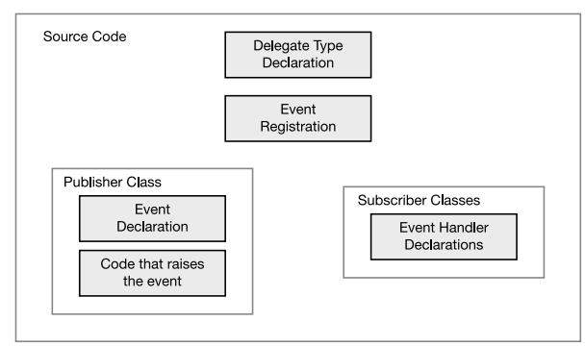
The five source code components of using an event

Slide 10
Events
When some thing happens a class can raise an event, which have a message that contain information about the event (event arguments) and send them out to the rest of the application, other parts of the application can respond to the event by executing methods called event handlers.
Event handler is a method that has the same signature as the event and this method is executed when the event occurs.
To define an event you need first to define a delegate that contains the methods that will be called when the event raised, and then you define the event based on that delegate.

Slide 11
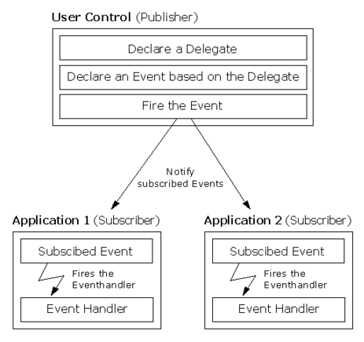

Slide 12
Events
Raising an events is a simple step.
First you check the event against a null value to ensure that the caller has registered with the event, and then you fire the event by specifying the event by name as well as any required parameters as defined by the associated delegate.

Slide 13
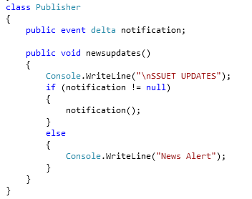
Publisher Class and Event

Slide 14
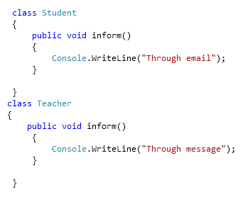
Subscriber Class and Event Handlers

Slide 15
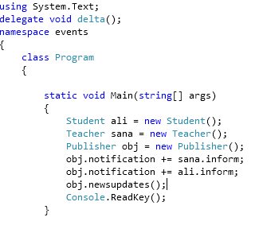
Subscribing to Event

Slide 16
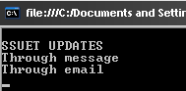

Slide 17
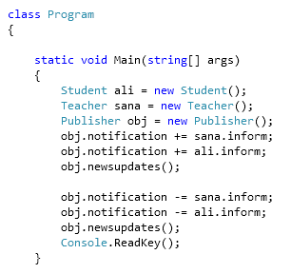
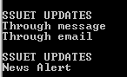
Unsubscribing from notification

Slide 18
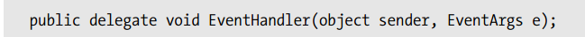
The Delegate Type and Event Handler
An event declaration requires the name of a delegate type. You can either declare one or use one that already exists. If you declare a delegate type, it must specify the signature and return type of the methods that will be stored by the event.

Slide 19
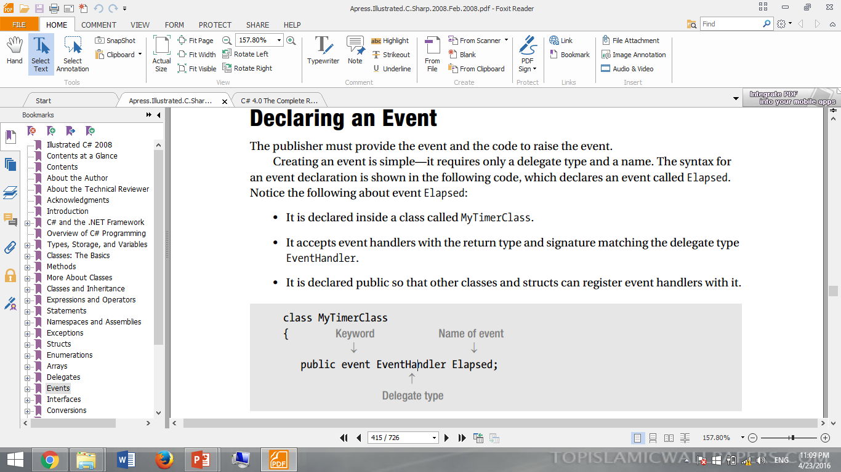
Declaring an Event
Creating an event is simple—it requires only a delegate type and a name. The syntax for an event declaration is shown in the following code, which declares an event called Elapsed.

Slide 20
Raising an Event
The event member itself just holds the event handlers that need to be invoked. Nothing happens with them unless the event is raised
For example, the code on next slide raises event Elapsed. Notice the following about the code:
Before raising the event ,it is compared to null, to see whether it contains any event handlers. If the event is null, it is empty.
Raising the event itself is like invoking a function.
Use the name of the event, followed by the parameter list enclosed in parentheses.
The parameter list must match the delegate type of the event.

Slide 21
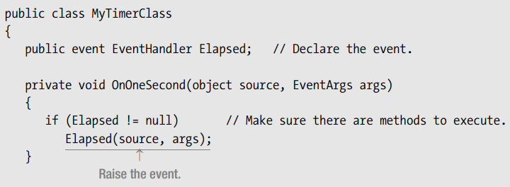
Putting together the event declaration and the code to raise the event gives the following class declaration for the publisher. The code contains two members: the event, and a method called OnOneSecond, which raises the event.

Slide 22
Subscribing to an Event
To add an event handler to an event, the handler must have the same return type and signature as the event’s delegate
Use the +=operator to add an event handler to an event
The method can be any of the following:
– An instance method
–A static method

Slide 23
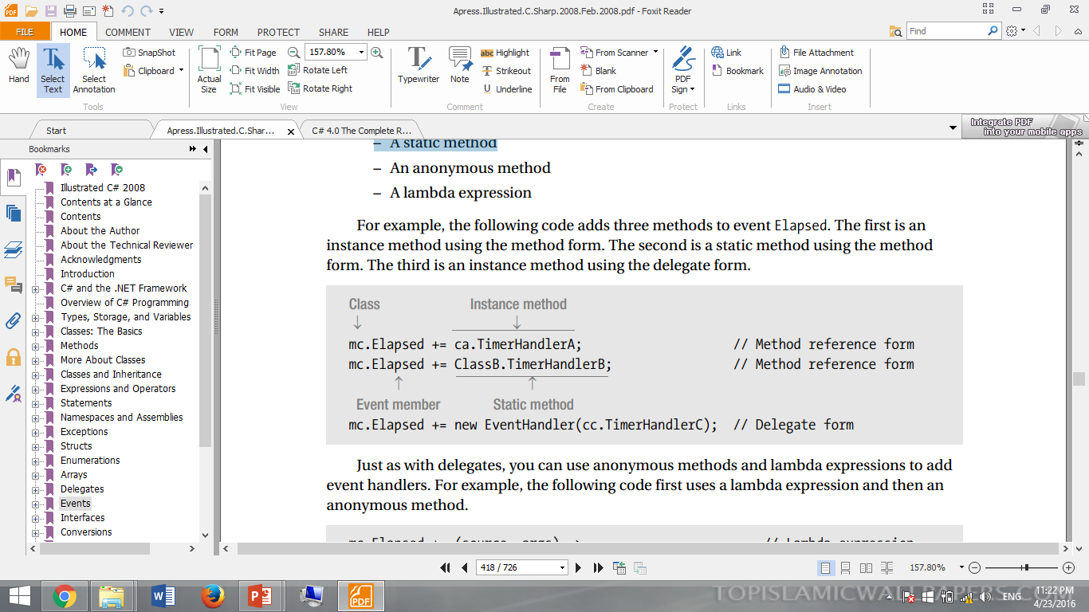
Subscribing to an Event

Slide 24
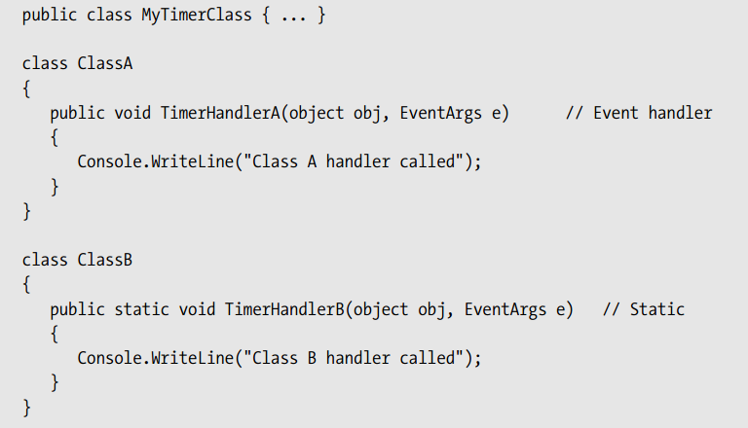
Event Handler

Slide 25
ExampleCode-1…
namespace EventHandling_1
{
public delegate void EventHandler();//Declare delegate type for event
class Test//----------Publisher Class-----------------
{
public event EventHandler SomeEvent;//event declaration
public void OnSomeEvent()// This is called to raise the event
{
if (SomeEvent != null)
{
SomeEvent();
}
}
}

Slide 26
…ExampleCode-1…
class Subscriber1
{
public static void Method1()//------------Handler
{
Console.WriteLine("Calling static Method1 of subscriber 1");
}
}
class Subscriber2
{
public void Method2()//------------Handler
{
Console.WriteLine("Calling Instance Method2 of subscriber 2");
}
}

Slide 27
…ExampleCode-1
class Program
{
static void Main(string[] args)
{
Test testObj = new Test();
Subscriber2 s2Obj = new Subscriber2();
testObj.SomeEvent += Subscriber1.Method1;// Add Handler() testObj.SomeEvent += s2Obj.Method2;// Add Handler() testObj.OnSomeEvent();// Raise the event.
}
}
}//namespace end

Slide 28
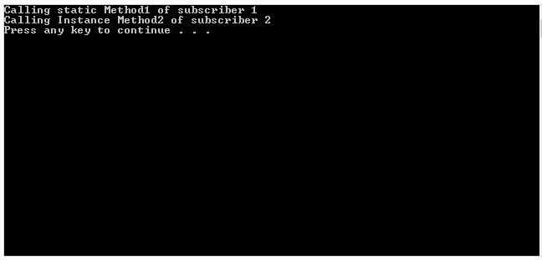
Output

Slide 29
class VideoEncoder
{
public delegate void videoEncodingEventHandler(object source, EventArgs args);
public event videoEncodingEventHandler VideoEncoded; // create event
public void EncodingVideo(Video vd)
{
Console.WriteLine("On video Encoding");
Thread.Sleep(6000);
OnvideoEncoded();//raise event
}
protected virtual void OnvideoEncoded()
{
if (VideoEncoded != null)
{
VideoEncoded(this, EventArgs.Empty);
}
}
}
}
ExampleCode-2…

Slide 30
…ExampleCode-2…
public class Mailservice()//------------Handler
{
public static void OnvideoEncoded(object source,EventArgs args)
{
Console.WriteLine("Sending Mail");
}
}
}
namespace events
{
class Video
{
public string title;
}
}

Slide 31
…ExampleCode-2
namespace events
{
class Program
{
static void Main(string[] args)
{
Video v1 = new Video { title = "Abc" };
VideoEncoder VC = new VideoEncoder();//publisher
Mailservice MS = new Mailservice();//subscriber
VC.VideoEncoded += Mailservice.OnvideoEncoded;
VC.EncodingVideo(v1);
}
}

Slide 32
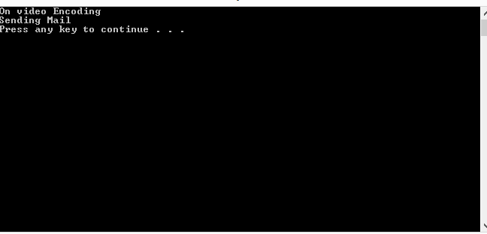
Output

Slide 33
End of Lecture 15

