Slide 1
Enumeration
Lect#16

Slide 2
Enumeration
An enumeration is a set of named integer constants. An enumerated type is declared using the enum keyword.
C# enumerations are value data type. In other words, enumeration contains its own values and cannot inherit or cannot pass inheritance.

Slide 3
Declaring enum Variable
The general syntax for declaring an enumeration is:
enum <enum_name> { enumeration list };
Where,
The enum_name specifies the enumeration type name.
The enumeration list is a comma-separated list of identifiers.

Slide 4
Declaring enum Variable
Each of the symbols in the enumeration list stands for an integer value, one greater than the symbol that precedes it. By default, the value of the first enumeration symbol is 0.
For example:
enum Days { Sun, Mon, tue, Wed, thu, Fri, Sat }

Slide 5
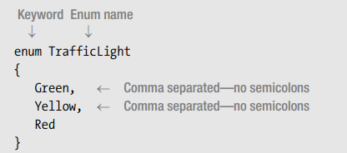
Declaring enum Variable
The following code shows an example of the declaration of a new enum type called TrafficLight, which contains three members.

Slide 6
Declaring Enum Variable
Every enum type has an underlying integral type, which by default is int.
Each enum member is assigned a constant value of the underlying type.
The compiler assigns 0 to the first member, and assigns each subsequent member the value one more than the previous member.
For example, in the TrafficLight type, the compiler assigns the int values 0, 1, and 2 to members Green, Yellow, and Red, respectively

Slide 7
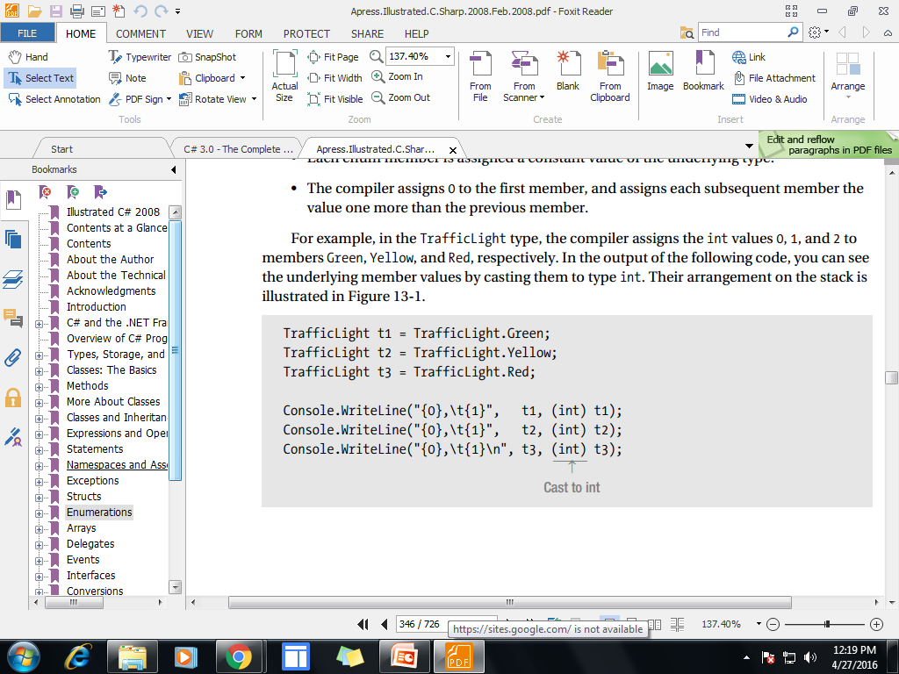
Declaring Enum Variable
In the output of the following code, you can see the underlying member values by casting them to type int
Output
Green, 0
Yellow, 1
Red, 2

Slide 8
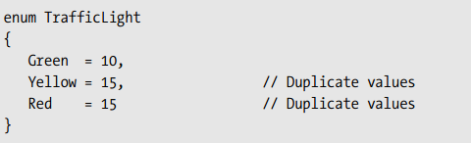
Initialize an Enumeration
You can specify the value of one or more of the symbols by using an initializer. Do this by following the symbol with an equal sign and an integer value. Symbols that appear after initializers are assigned values greater than the previous initialization value.

Slide 9
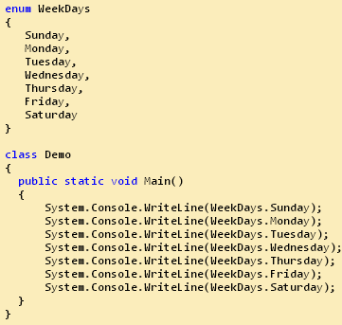
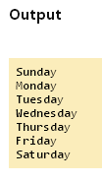
Example-1

Slide 10
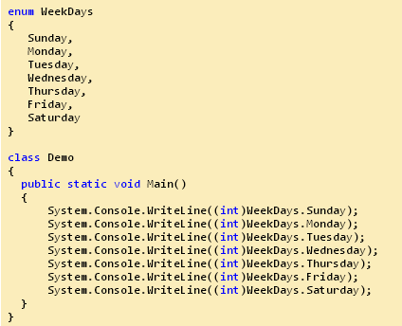
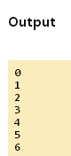
Example-2

Slide 11
Use Enumerations
Enumerations are very useful when your program requires one or more specialized symbols. For example, imagine that you are writing a program that controls a conveyor belt in a factory. You might create a method called Conveyor( )that accepts the following commands as parameters: start, stop, forward, and reverse.
Instead of passing Conveyor( )integers, such as 1 for start, 2 for stop, and so on, which is error-prone, you can create an enumeration that assigns words to these values.

Slide 12
using System;
class ConveyorControl
{
public enum Action { Start, Stop, Forward, Reverse };
public void Conveyor(Action com)
{ switch(com)
{ case Action.Start:
Console.WriteLine("Starting conveyor.");
break;
case Action.Stop:
Console.WriteLine("Stopping conveyor.");
break;
case Action.Forward:
Console.WriteLine("Moving forward.");
break;
case Action.Reverse:
Console.WriteLine("Moving backward.");
break;
}}}

Slide 13
class ConveyorDemo
{
static void Main()
{
ConveyorControl c = new ConveyorControl();
c.Conveyor(ConveyorControl.Action.Start);
c.Conveyor(ConveyorControl.Action.Forward);
c.Conveyor(ConveyorControl.Action.Reverse);
c.Conveyor(ConveyorControl.Action.Stop);
}
}
The output from the program is shown here:
Starting conveyor.
Moving forward.
Moving backward.
Stopping conveyor.

Slide 14
class Program
{ enum Volume { high=1,low, Medium }
public void GetEnum() {
Console.WriteLine("Select Volume:");
Console.WriteLine( "1.High");
Console.WriteLine("2.Low");
Console.WriteLine("3.Medium");
int i;
i=Convert.ToInt32(Console.ReadLine());
Volume myVolume= (Volume)i;
switch (myVolume)
{
case Volume.high:
Console.WriteLine("The volume has been turned up.");
break;
case Volume.Medium:
Console.WriteLine("The volume is in the middle.");
break;
case Volume.low:
Console.WriteLine("The volume has been turned down.");
break; }}

Slide 15
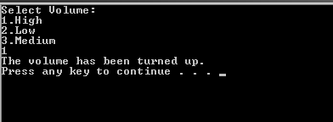
static void Main(string[] args)
{
Program p = new Program();
p.GetEnum();
}
}
}

Slide 16
End of Lecture 16

