Slide 1
Object-Oriented Analysis and Design
Lecture #17

Slide 2
What is UML?
UML = Unified Modeling Language
Intended to be used for
modeling business and similar processes,
analysis, design, and implementation of software-based systems
Standardized by Object Management Group (OMG)
Uses mostly graphical notations
Helps project teams communicate, explore potential designs, and validate the requirements and architectural design of the software system

Slide 3
Unified Modeling Language(UML)
UML is a standard modeling language, not a software development process. UML 1.4.2 Specification explained that process:
provides guidance as to the order of a team’s activities,
specifies what artifacts should be developed,
directs the tasks of individual developers and the team as a whole, and
offers criteria for monitoring and measuring a project’s products and activities.
UML is different from the other common programming languages like C++, Java, COBOL etc.
UML is a pictorial language used to make software blue prints.

Slide 4
Goals of UML
A picture is worth a thousand words, this absolutely fits while discussing about UML.
Object oriented concepts were introduced much earlier than UML. So at that time there were no standard methodologies to organize and consolidate the object oriented development. At that point of time UML came into picture.
At the conclusion the goal of UML can be defined as a simple modeling mechanism to model all possible practical systems in today’s complex environment.

Slide 5
Our Focus: the Language
Unified Modeling Language
Language = syntax + semantics
Syntax = rules by which language elements (e.g., words) are assembled into expressions (e.g., phrases, clauses)
Semantics = rules by which syntactic expressions are assigned meanings
The basic building blocks (syntax) of UML are:
Model elements (classes, interfaces, components, use cases)
Relationships (associations, generalization, dependencies)
Diagrams (class diagrams, use case diagrams, interaction diagrams)
Used to create large, complex structures
Each UML diagram is designed to let developers and customers view a software system from a different perspective and in varying degrees of abstraction

Slide 6
Types of UML Diagrams
The current UML standards calls for 13 different types of diagrams: class, activity, object, use case, sequence, package, state, component, communication, composite structure, interaction overview, timing, and deployment.
These diagrams are organized into two distinct groups: structural diagrams and behavioral or interaction diagrams.

Slide 7
Structural UML diagrams
Class diagram
Package diagram
Object diagram
Component diagram
Composite structure diagram
Deployment diagram

Slide 8
Behavioral UML diagrams
Activity diagram
Sequence diagram
Use case diagram
State diagram
Communication diagram
Interaction overview diagram
Timing diagram

Slide 9
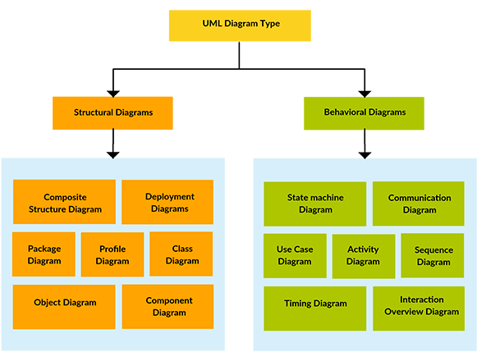

Slide 10
Use Case Modeling
A view of a system that emphasizes the behavior as it appears to outside users
Partitions system functionality into interactions (‘use cases’) that are meaningful to users or external systems (‘actors’)
The use case diagram displays the relationships among actors and use cases

Slide 11
Use Case Modeling
To show a use case on a use case diagram, draw an oval in the middle of the diagram and put the name of the use case in the center of, or below, the oval
To draw an actor (indicating a system user) on a use case diagram, you draw a stick person to the left or right of your diagram (some draw prettier stick people than others)
Use simple lines to depict relationships between actors and use cases

Slide 12
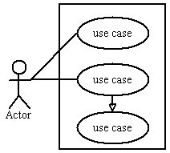
Basic Use Case Diagram Symbols and Notations
System
Draw your system's boundaries using a rectangle that contains use cases. Place actors outside the system's boundaries.

Slide 13

Basic Use Case Diagram Symbols and Notations
Use Case
Draw use cases using ovals. Label with ovals with verbs that represent the system's functions.

Slide 14
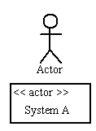
Basic Use Case Diagram Symbols and Notations
Actors
Actors are the users of a system. When one system is the actor of another system, label the actor system with the actor stereotype.

Slide 15
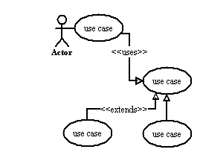
Basic Use Case Diagram Symbols and Notations
Relationships
Illustrate relationships between an actor and a use case with a simple line. For relationships among use cases, use arrows labeled either "uses" or "extends." A "uses" relationship indicates that one use case is needed by another in order to perform a task. An "extends" relationship indicates alternative options under a certain use case.

Slide 16
Use Case Diagram

Slide 17
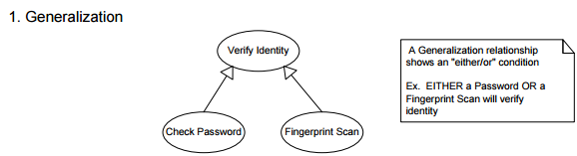
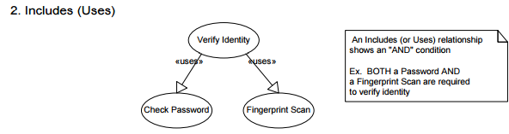
Use Case Relationships

Slide 18
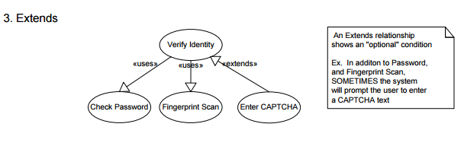
…Use Case Relationships

Slide 19
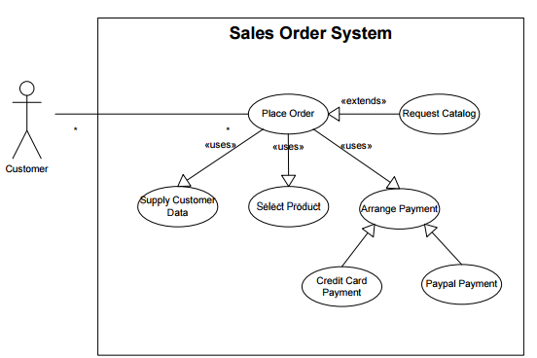
Use Case Relationships

Slide 20
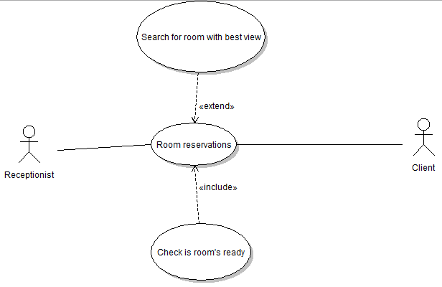

Slide 21
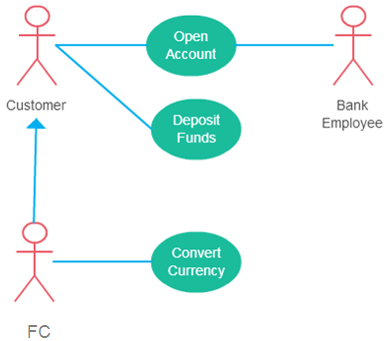
Generalization of an Actor
Generalization of an actor means that one actor can inherit the role of an other actor. The descendant inherits all the use cases of the ancestor. The descendant have one or more use cases that are specific to that role.

Slide 22
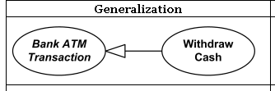

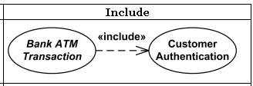

Slide 23
Structural Modeling
A view of a system that emphasizes the structure of the objects, including their classifiers, relationships, attributes and operations
Class diagrams model class structure and contents using design elements such as classes, packages and objects
A class diagram shows how the different entities (people, things, and data) relate to each other
It shows the static structures of the system (not dynamic or temporal)

Slide 24
Class Example
A class is depicted on the class diagram as a rectangle with three horizontal sections
The upper section shows the class's name
The middle section contains the class's attributes
The lower section contains the class's operations (or "methods")

Slide 25
Class Diagram
What is a Class Diagram? Class diagrams model the static structure of a system. They show relationships between classes, objects, attributes, and operations.
Class diagrams are the most common diagrams used in UML. Class diagram consists of classes, interfaces, associations and collaboration.
Class diagrams basically represent the object oriented view of a system which is static in nature.
Active class is used in a class diagram to represent the concurrency of the system.
Class diagram represents the object orientation of a system. So it is generally used for development purpose. This is the most widely used diagram at the time of system construction.

Slide 26
Classes
A class is a description of a set of objects that share the same attributes,
operations, relationships, and semantics.
Graphically, a class is rendered as a rectangle, usually including its name, attributes, and operations in separate, designated compartments.
ClassName
attributes
operations

Slide 27
Class Names
The name of the class is the only required tag in the graphical representation of a class. It always appears in the top-most compartment.
ClassName
attributes
operations

Slide 28
Class Attributes
An attribute is a named property of a class that describes the object being modeled.
In the class diagram, attributes appear in the second compartment just below the name-compartment.
Person
name : String
address : Address
birthdate : Date
ssn : Id

Slide 29
Class Attributes (Cont’d)
Attributes can be:
+ public
# protected
- private
/ derived
Person
+ name : String
# address : Address
# birthdate : Date
/ age : Date
- ssn : Id

Slide 30
Class Operations
Operations describe the class behavior and appear in the third compartment.
Person
name : String
address : Address
birthdate : Date
ssn : Id
eat
sleep
work
play

Slide 31
Depicting Classes
When drawing a class, you needn’t show attributes and operation in every diagram.
Person
Person
Person
name : String
birthdate : Date
ssn : Id
Person
Person
eat()
sleep()
work()
play()
name
address
birthdate
eat
play

Slide 32
Relationships
In UML, object interconnections (logical or physical), are modeled as relationships.
There are three kinds of relationships in UML:
dependencies
generalizations
associations

Slide 33
Dependency Relationships
A dependency indicates a semantic relationship between two or more elements. The dependency from CourseSchedule to Course exists because Course is used in both the add and remove operations of CourseSchedule.
CourseSchedule
Course
add(c : Course)
remove(c : Course)

Slide 34
Generalization Relationships
A generalization connects a subclass to its superclass. It denotes an inheritance of attributes and behavior from the superclass to the subclass and indicates a specialization in the subclass of the more general superclass.
Person
Student

Slide 35
Association Relationships
If two classes in a model need to communicate with each other, there must be link between them.
An association denotes that link.
Student
Instructor

Slide 36
Association Relationships (Cont’d)
We can indicate the multiplicity of an association by adding multiplicity adornments to the line denoting the association.
The example indicates that a Student has one or more Instructors:
Student
Instructor
1..*

Slide 37
Association Relationships (Cont’d)
We can also indicate the behavior of an object in an association (i.e., the role of an object) using role names.
teaches
learns from
Student
Instructor
1..*
1..*

Slide 38
Association Relationships (Cont’d)
We can also name the association.
membership
Student
Team
1..*
1..*

Slide 39
Association Relationships (Cont’d)
We can constrain the association relationship by defining the navigability of the association. Here, a Router object requests services from a DNS object by sending messages to (invoking the operations of) the server. The direction of the association indicates that the server has no knowledge of the Router.
Router
DomainNameServer

Slide 40
Association Relationships (Cont’d)
A class can have a self association.
next
LinkedListNode
previous

Slide 41
Association Relationships (Cont’d)
We can model objects that contain other objects by way of special associations called aggregations and compositions.
An aggregation specifies a whole-part relationship between an aggregate (a whole) and a constituent part, where the part can exist independently from the aggregate. Aggregations are denoted by a hollow-diamond adornment on the association.

Slide 42
Association Relationships (Cont’d)
Car
Engine
Transmission

Slide 43
Association Relationships (Cont’d)
A composition indicates a strong ownership and coincident lifetime of parts by the whole (i.e., they live and die as a whole). Compositions are denoted by a filled-diamond adornment on the association.
Window
Scrollbar
1
1
Titlebar
1
1
Menu
1
1 .. *

Slide 44
Interfaces
An interface is a named set of operations that specifies the behavior of objects without showing their inner structure. It can be rendered in the model by a one- or two-compartment rectangle, with the stereotype <<interface>> above the interface name.
<<interface>>
ControlPanel

Slide 45
Interface Services
Interfaces do not get instantiated. They have no attributes or state. Rather, they specify the services offered by a related class.
<<interface>>
ControlPanel
getChoices : Choice[]
makeChoice (c : Choice)
getSelection : Selection

Slide 46
Interface Realization Relationship
A realization relationship connects a class with an interface that supplies its behavioral specification. It is rendered by a dashed line with a hollow triangle towards the specifier.
<<interface>>
ControlPanel
specifier
implementation
VendingMachine

Slide 47
End of Lecture 17

