Slide 1
Sequence Diagram
Lecture # 19

Slide 2
Sequence Diagram
A sequence diagram is a form of interaction diagram which shows objects as lifelines running down the page, with their interactions over time represented as messages drawn as arrows from the source lifeline to the target lifeline. Sequence diagrams are good at showing which objects communicate with which other objects; and what messages trigger those communications. Sequence diagrams are not intended for showing complex procedural logic.

Slide 3
Sequence diagram components
Object
This box shape represents a class, or object, in UML. They demonstrate how an object will behave in the context of the system.
Activation boxes
Symbolized by a rectangle shape, an activation box represents the time needed for an object to complete a task. The longer the task will take, the longer the activation box becomes.

Slide 4
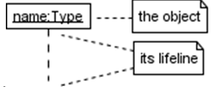
Sequence diagram components
Lifeline
A dashed vertical line that represents the passage of time as it extends downward. Along with time, they represent the sequential events that occur to an object during the charted process. Lifelines may begin with a labeled rectangle shape or an actor symbol

Slide 5
Sequence diagram components
Messages
Packet of information that are transmitted between objects. They may reflect the start and execution of an operation, or the sending and reception of a signal.
Synchronous messages
Represented by a solid line with a solid arrow head. This symbol is used when a sender must wait for a response to a message before it continues most method calls in object-oriented programming languages are synchronous. A closed and filled arrowhead signifies that the message is sent synchronously

Slide 6
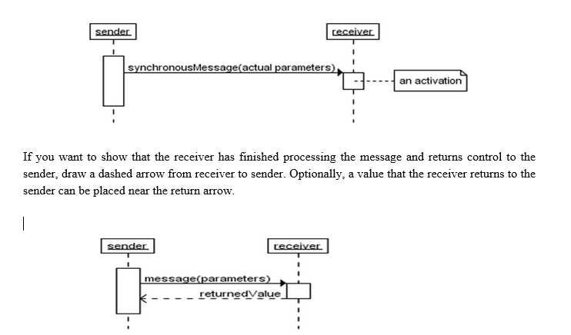
Sequence diagram components
Synchronous messages

Slide 7
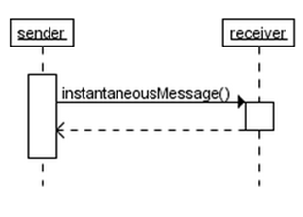
Sequence diagram components
Instantaneous message
Messages are often considered to be instantaneous, i.e. the time it takes to arrive at the receiver is negligible. For example, an in-process method calls. Such messages are drawn as a horizontal arrow.

Slide 8
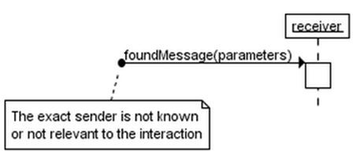
Sequence diagram components
Found message
A found message is a message of which the caller is not shown. Depending on the context, this could mean that either the sender is not known, or that it is not important who the sender was. The arrow of a found message originates from a filled circle.

Slide 9
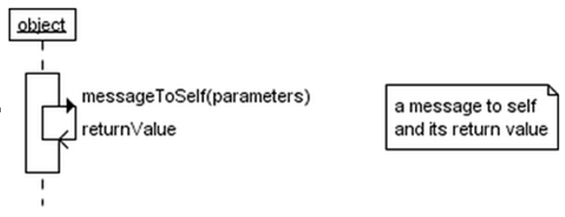
Sequence diagram components
Message to self
A message that an object sends itself can be shown as follows

Slide 10
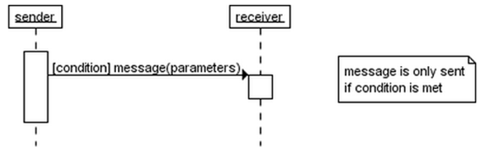
Sequence diagram components
Guard
A message can include a guard, which signifies that the message is only sent if a certain condition is met. The guard is simply that condition between brackets.

Slide 11
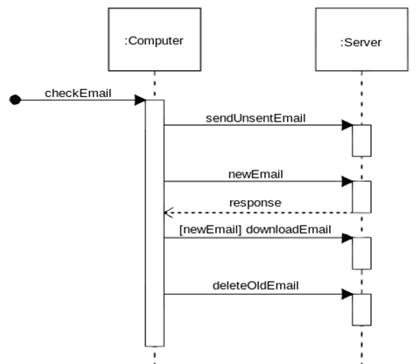
Sequence diagram of e-mail message sequence

Slide 12
End of Lecture 19

