Slide 1
Concepts of Object Oriented Programming(Data Types)
Lecture # 2

Slide 2
Declaring Variables
A data item is classified as either constant or variable
Constant data items cannot vary
Variable data items can hold different values at different points of time
All data items in a C# program have a data type
Data type describes the format and size of a piece of data

Slide 3
Variables in C#
The variables in C#, are categorized into the following types:
Reference type
Value types

Slide 4
Reference type
The reference types do not contain the actual data stored in a variable, but they contain a reference to the variables.
In other words, they refer to a memory location. Using multiple variables, the reference types can refer to a memory location.
If the data in the memory location is changed by one of the variables, the other variable automatically reflects this change in value.
Example-String data type

Slide 5
Value Type
Value Type Value type variables can be assigned a value directly. They are derived from the class System.ValueType.
The value types directly contain data. Some examples are int, char, and float, which stores numbers, alphabets, and floating point numbers, respectively.
When you declare an int type, the system allocates memory to store the value

Slide 6
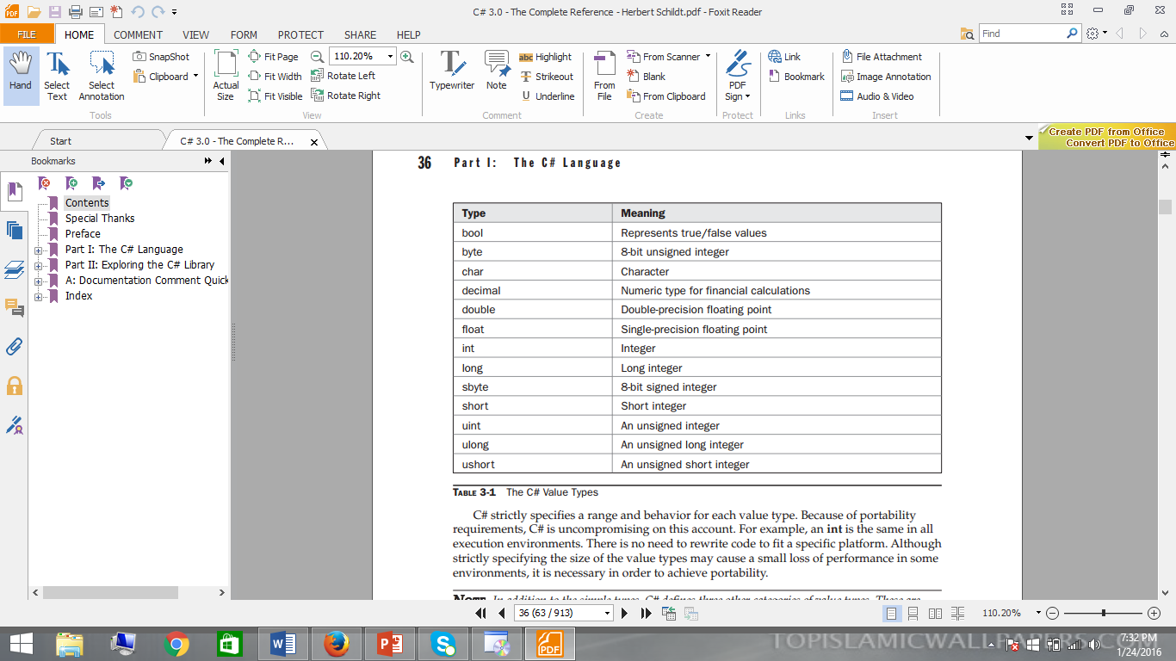

Slide 7
Integer Type
C# defines nine integer types: char,byte,sbyte,short,ushort,int,uint,long, and ulong.
However, the char type is primarily used for representing characters, and it is discussed later in slides.
The remaining eight integer types are used for numeric calculations.

Slide 8
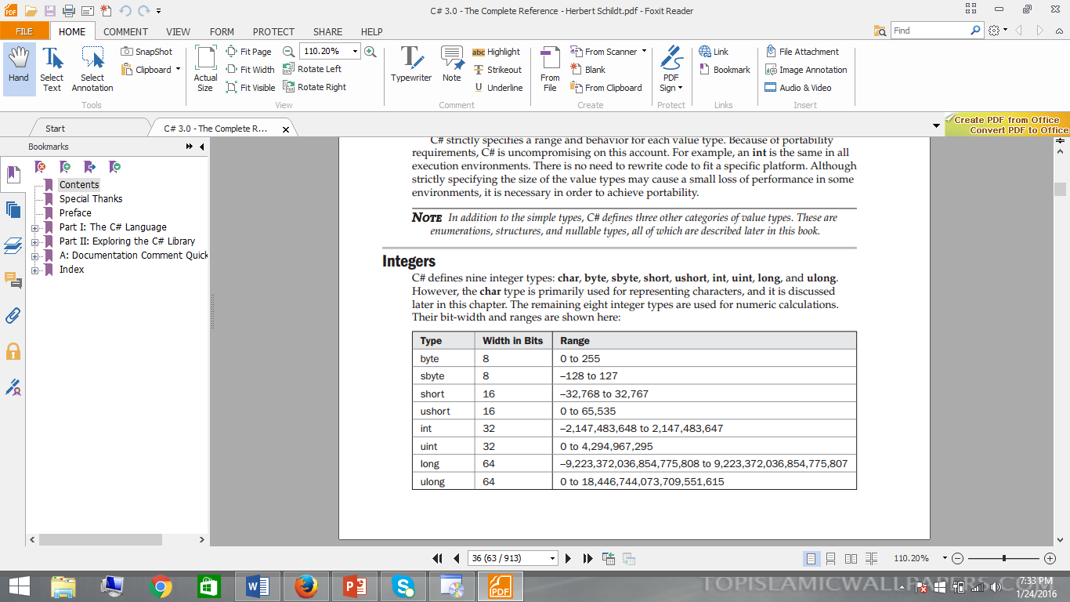
Integer Type

Slide 9
Floating Point
The floating-point types can represent numbers that have fractional components.
There are two kinds of floating-point types, float and double, which represent single and double precision numbers, respectively. The type float is 32 bits wide and has an approximate range of 1.5E–45 to 3.4E+38.
The double type is 64 bits wide and has an approximate range of 5E–324 to 1.7E+308
Syntax:
float val = 1.001f ( ‘f’ is suffix)
Console.WriteLine(val1)
double number = 1.5;
Console.WriteLine(number)

Slide 10
Decimal type
Perhaps the most interesting C# numeric type is decimal, which is intended for use in Monetary calculations.
The decimal type utilizes 128 bits to represent values within the range 1E–28 to 7.9E+28.
As you may know, normal floating-point arithmetic is subject to a variety of rounding errors when it is applied to decimal values.
The decimal type eliminates these errors and can accurately represent up to 28 decimal places (or 29 places in some cases).

Slide 11
Code-Decimal Data type
using System;
classUseDecimal
{
static void Main()
{
decimal price;
decimal discount;
decimal discounted_price;

Slide 12
Code-Decimal Data type
// Compute discounted price.
price = 19.95m;
discount = 0.15m; // discount rate is 15%
discounted_price = price - ( price * discount);
Console.WriteLine("Discounted price: $" + discounted_price);
}
}
The output from this program is shown here:
Discounted price: $16.9575

Slide 13
Additional Point--Place Holder
String.Format("{0,5}", 15); // " 15"
String.Format("{0,-5}", 15); // "15 “
String.Format("{0,5:000}", 15); // " 015“
String.Format("{0,-5:000}", 15); // "015 “
How you can write it ??
int a=7;
Console.WritleLine(“Number is {0,4}”,a);

Slide 14
Character type
In C#, characters are not 8-bit quantities like they are in many other computer languages, such as C++.
Instead, C# uses a 16-bit character type called Unicode. Unicode defines a character set that is large enough to represent all of the characters found in all human languages
A character variable can be assigned a value by enclosing the character inside single quotes. For example, this assigns X to the variable ch:
char ch;
ch = 'X';

Slide 15
Bool type
The bool type represents true/false values. C# defines the values true and false using the reserved words true and false. Thus, a variable or expression of type bool will be one of these two values.
Furthermore, there is no conversion defined between bool and integer values. For example, 1 does not convert to true, and 0 does not convert to false

Slide 16
End of Lecture 2

