Slide 1
Array & Strings ,Ref & Out Keywords with Methods
Lecture #4

Slide 2
Arrays
An array is a collection of variables of the same type that are referred to by a common name.
In C#, arrays can have one or more dimensions, although the one-dimensional array is the most common.
Although arrays in C# can be used just like arrays in many other programming languages, they have one special attribute: They are implemented as objects.

Slide 3
One-dimensional array
A one-dimensional array is a list of related variables. Such lists are common in programming.
For example, you might use a one-dimensional array to store the account numbers of the active users on a network. Another array might store the current batting averages for a baseball team.

Slide 4
Declaring an Array
Because arrays in C# are implemented as objects, two steps are needed to obtain an array for use in your program.
First, you must declare a variable that can refer to an array.
Second, you must create an instance of the array by use of new.
Therefore, to declare a one dimensional array, you will typically use this general form:
type[ ]array-name= new type[size];

Slide 5
// Demonstrate a one-dimensional array.
using System;
class ArrayDemo
{
static void Main()
{
int[] sample = new int[10];
int i;
for(i = 0; i < 10; i = i+1)
sample[i] = i;
for(i = 0; i < 10; i = i+1)
Console.WriteLine("sample[" + i + "]: " + sample[i]);
}
}

Slide 6
The output from the program is shown here:
sample[0]: 0
sample[1]: 1
sample[2]: 2
sample[3]: 3
sample[4]: 4
sample[5]: 5
sample[6]: 6
sample[7]: 7
sample[8]: 8
sample[9]: 9

Slide 7
Initializes an Array
The general form for initializing a one dimensional array is shown here:
type[ ] array-name= { val1,val2,val3, ..., valN};
Here, the initial values are specified by val1through valN.
They are assigned in sequence, left to right, in index order.
C# automatically allocates an array large enough to hold the initializers that you specify. There is no need to use the new operator explicitly.

Slide 8
// Compute the average of a set of values.
using System;
class Average
{
static void Main() {
int[] nums = { 99, 10, 100, 18, 78, 23,63, 9, 87, 49 };
int avg = 0;
for(int i=0; i < 10; i++)
avg = avg + nums[i];
avg = avg / 10;
Console.WriteLine("Average: " + avg);
}
}

Slide 9
Two-Dimensional Arrays
The simplest form of the multidimensional array is the two-dimensional array. In a two dimensional array, the location of any specific element is specified by two indices. If you think of a two-dimensional array as a table of information, one index indicates the row, the other indicates the column.
To declare a two-dimensional integer array table of size 10, 20, you would write
int[,] table = new int[10, 20];

Slide 10
// Demonstrate a two-dimensional array.
using System;
class TwoD {
static void Main() {
int t, i;
int[,] table = new int[3, 4];
for(t=0; t < 3; ++t) {
for(i=0; i < 4; ++i) {
table[t,i] = (t*4)+i+1;
Console.Write(table[t,i] + " ");
}
Console.WriteLine();
}
}
}

Slide 11
Foreach Loop
The foreach loop is used to cycle through the elements of a collection.
A collection is a group of objects. C# defines several types of collections, of which one is an array. The general form of foreach is shown here
foreach(type loopvar in collection)statement;

Slide 12
// Use the foreach loop.
using System;
class ForeachDemo {
static void Main() {
int sum = 0;
int[] nums = new int[10];
// Give nums some values.
for(int i = 0; i < 10; i++)
nums[i] = i;
// Use foreach to display and sum the values.
foreach(int x in nums)
{
Console.WriteLine("Value is: " + x);
sum += x;
}
Console.WriteLine("Summation: " + sum);
}
}

Slide 13
The output from previous program is shown here:
Value is: 1
Value is: 2
Value is: 3
Value is: 4
Value is: 5
Value is: 2
Value is: 4
Value is: 6
Value is: 8
Value is: 10
Summation: 90

Slide 14
Return an Array
Since in C# arrays are implemented as objects, a method can also return an array.
(This differs from C++ in which arrays are not valid as return types.)

Slide 15
using System;
namespace ArrayApplication
{
class MyArray
{
double getAverage(int[] arr, int size)
{
int i; double avg; int sum = 0;
for (i = 0; i < size; ++i)
{
sum += arr[i];
}
avg = (double)sum / size;
return avg;
}

Slide 16
static void Main(string[] args)
{
MyArray app = new MyArray();
int [] balance = new int[]{1000, 2, 3, 17, 50};
double avg;
avg = app.getAverage(balance, 5 ) ;
Console.WriteLine( "Average value is: {0} ", avg );
Console.ReadKey();
}
}
}

Slide 17
String
String defines and supports character strings. In many other programming languages,
A string is an array of characters.
In C#, strings are objects. Thus, string is a reference type. Although string is a built-in data type in C#

Slide 18
Operation on String
The string class contains several methods that operate on strings.
Table on next slide shows a few. The string type also includes the Length property, which contains the length of the string.
To obtain the value of an individual character of a string, you simply use an index.
For example:
string str = "test";
Console.WriteLine(str[0]);
This displays “t”, the first character of “test”

Slide 19
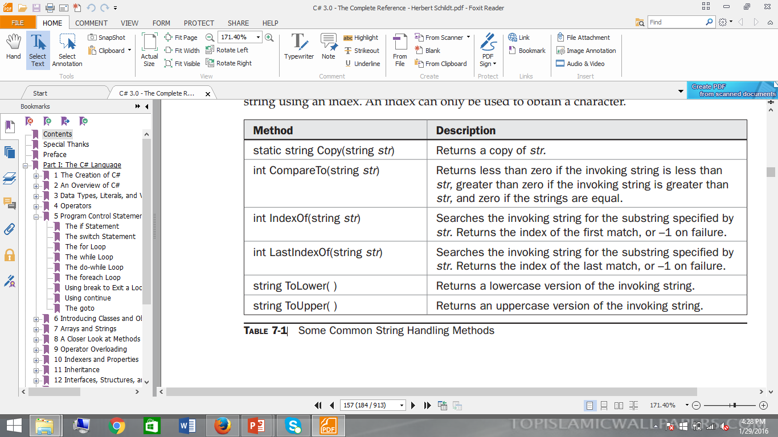

Slide 20
Value Vs. Reference
Value type directly contain the data and not the reference. And when assigned, the copy of that data is made to the assignment.
To elaborate, a new storage space is created for the variable in the function member declaration, and it starts off with the value that we specify in the member method calling. If we change that value, it doesn't affect any variable involved in that call.

Slide 21
Why Pass by Reference?
While writing a code, we often come across situations where we need to return multiple values from a single function/method.
But a method can only return a single value.
The question is how do we overcome such situation.
Answer is simple, use reference types, but how?

Slide 22
Using Ref
Reference parameters basically never pass the value of a variable used in the method calling, instead they use the variable themselves.
Rather than creating a new storage for that variable in the method declaration, the very same storage space is used, so the value of the variable in the member method and the value of the reference parameter will always be the same.
Reference parameters require ref modifier as part of both the declaration and the calling.

Slide 23
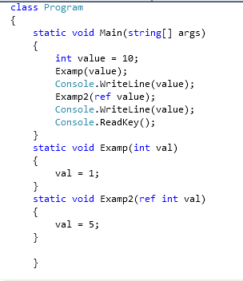
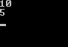
Example
Output

Slide 24
// Use ref to pass a value type by reference.
class RefTest
{
public void Sqr(ref int i)
{
i = i * i;
}}
class RefDemo
{
static void Main() {
RefTest ob = new RefTest();
int a = 10;
Console.WriteLine("a before call: " + a);
ob.Sqr(ref a); // notice the use of ref
Console.WriteLine("a after call: " + a);
}}

Slide 25
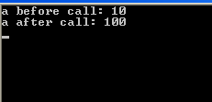
Output

Slide 26
Using Out
Output parameters are very much like reference parameters. The variable specified at the time of calling doesn't need to have been assigned a value before it is passed to the called method. When the method is invoked completely we can read that variable as it is assigned by now.
Like reference parameters, output parameters don't create a new storage location, but use the storage location of the variable specified on the invocation. Output parameters need the out modifier as part of both the declaration and the invocation - that means it's always clear when you're passing something as an output parameter.

Slide 27
using System;
class Decompose
{
public int GetParts(double n, out double frac)
{
int whole;
whole = (int) n;
frac = n - whole;
return whole;}
}
class UseOut {
static void Main() {
Decompose ob = new Decompose();
int i;
double f;
i = ob.GetParts(10.125, out f);
Console.WriteLine("Integer portion is " + i);
Console.WriteLine("Fractional part is " + f);
}}

Slide 28
The output from previous program is shown here:
Integer portion is 10
Fractional part is 0.125
Difference between out and Ref

Slide 29
End of Lecture 4

