Slide 1
Static Classes & Members in C#
Lecture #5

Slide 2
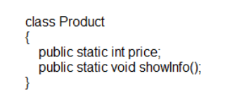
Static Keyword
Static Classes and class members are used to create data and methods that can be accessed without creating an instance of the Class.
The keyword Static can be applied to the Classes, field, method, properties, operator, event and constructors.

Slide 3
Static Class
A static class is basically the same as a non-static class, but there is one difference: a static class cannot be instantiated.
In other words, you cannot use the new keyword to create a variable of the class type. Because there is no instance variable, you access the members of a static class by using the class name itself.

Slide 4
…Static Class
A static class can be used as a convenient container for sets of methods that just operate on input parameters and do not have to get or set any internal instance fields.
For example, in the .NET Framework Class Library, the static System.Math class contains methods that perform mathematical operations, without any requirement to store or retrieve data that is unique to a particular instance of the Math class.
A static class cannot have non-static members. All methods, fields and properties in it must also be static.

Slide 5
…Static Class
That is, you apply the members of the class by specifying the class name and the method name, as shown in the following example.
double dub = -3.14;
Console.WriteLine(Math.Abs(dub));
Console.WriteLine(Math.Floor(dub));
Console.WriteLine(Math.Round(Math.Abs(dub)));

Slide 6
…Static Class
The following list provides the main features of a static class:
Contains only static members.
Cannot be instantiated.
Is sealed.
Cannot contain Instance Constructors.

Slide 7
Static Members
A C# class can contain both static and non-static members.
When we declare a member with the help of the keyword static, it becomes a static member.
A static member belongs to the class rather than to the objects of the class.
Hence static members are also known as class members and non-static members are known as instance members.

Slide 8
Static Members
They are slightly faster than instance methods because of this. Static methods can be public or private.
private static string companyName = "Microsoft";
private string name;
When you use a static field, you associate it with the class name rather than a particular object:
Console.WriteLine("Company Name: {0}", Employee.CompanyName);
This leads to classifying the class members into two categories:
Instance members
Static members

Slide 9
public class Automobile
{ public static int NumberOfWheels = 4;
public static void Drive()
{
//Some Statements
}
}
Main Method
{
Automobile.Drive();
int i = Automobile.NumberOfWheels;
}

Slide 10
class Program
{
static void MethodA()
{
Console.WriteLine("Static method");
}
void MethodB()
{
Console.WriteLine("Instance method");
}
static char MethodC()
{
Console.WriteLine("Static method");
return 'C';
}
char MethodD()
{
Console.WriteLine("Instance method");
return 'D';
}

Slide 11
static void Main()
{
// // Call the two static methods on the Program type. //
Program.MethodA();
Console.WriteLine(Program.MethodC());
// // Create a new Program instance and call the two instance methods. //
Program programInstance = new Program();
programInstance.MethodB();
Console.WriteLine(programInstance.MethodD());
}
}

Slide 12
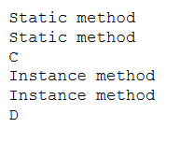
Output

Slide 13
Continue..
Static method can be call out without any reference to object, you cannot use INSTANCE members inside static methods, while you may call static members from non static context

Slide 14
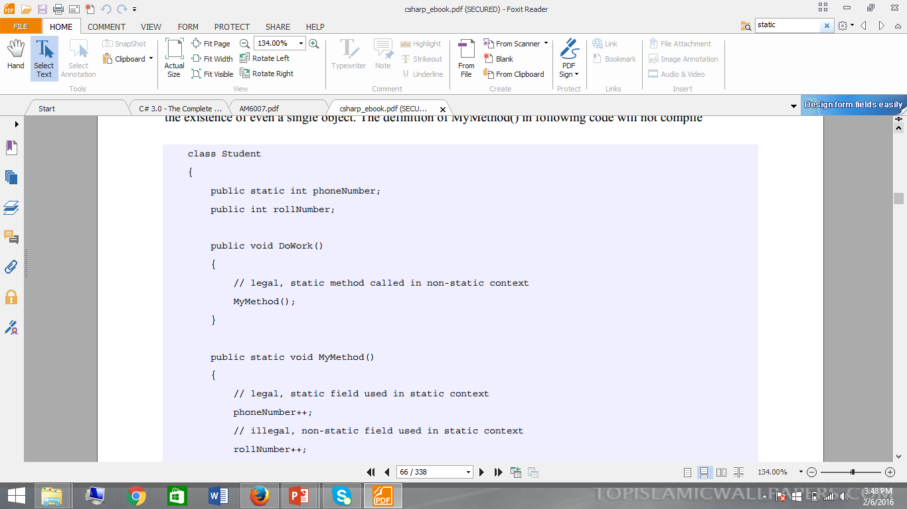

Slide 15
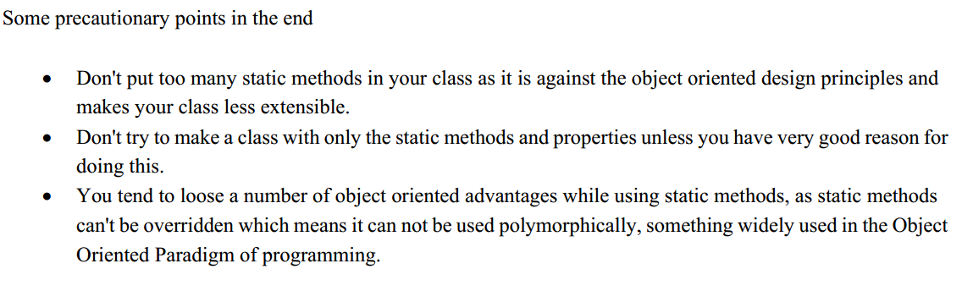

Slide 16
End of Lecture 5

