Slide 1
Encapsulation
Lecture # 6

Slide 2
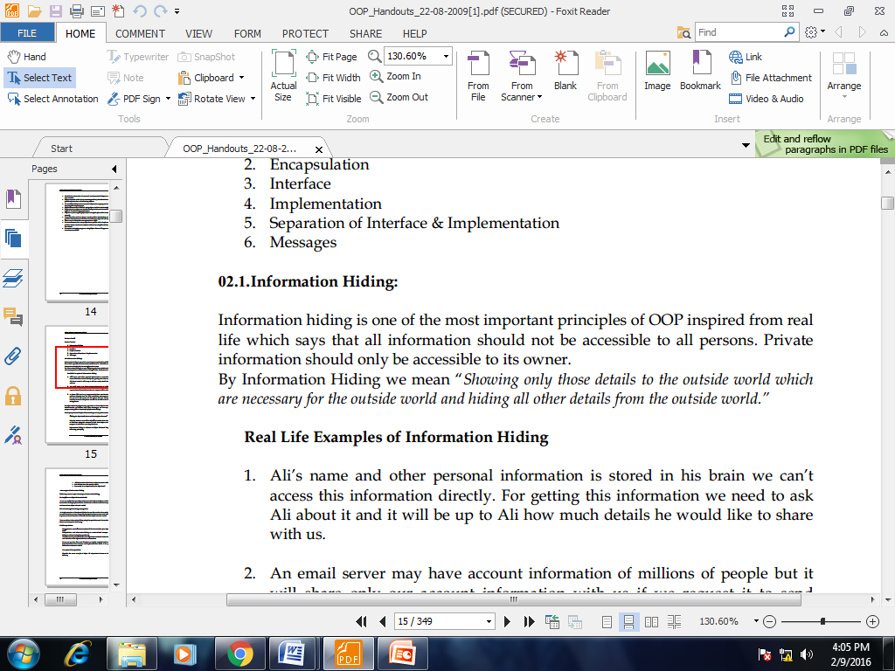
Information Hiding

Slide 3
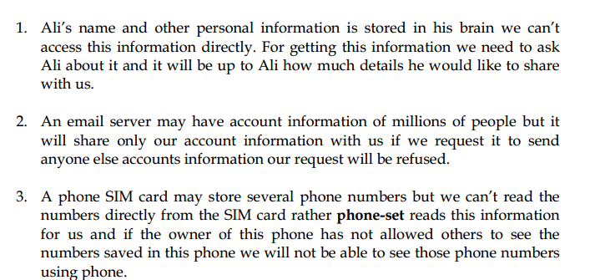
Real Life Example

Slide 4
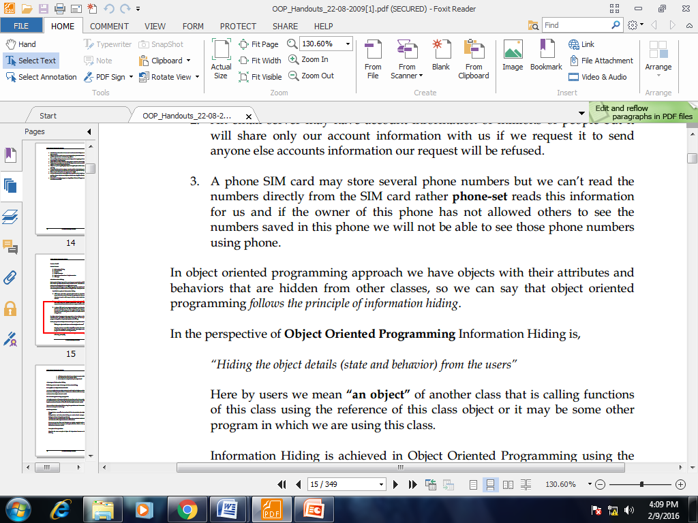
Information Hiding

Slide 5
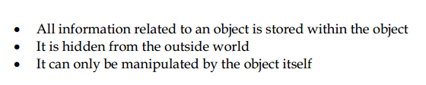
Information Hiding

Slide 6
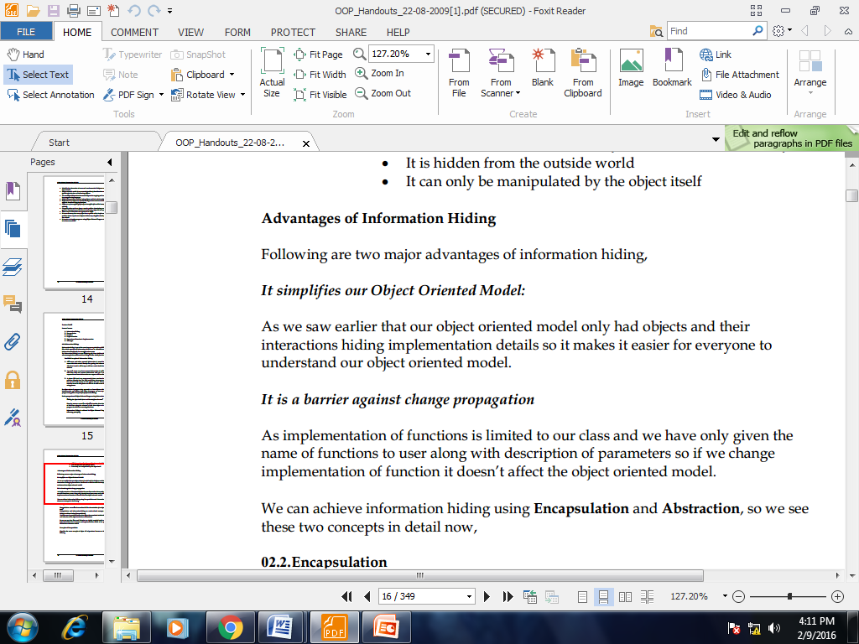
Advantages Of Information hiding

Slide 7
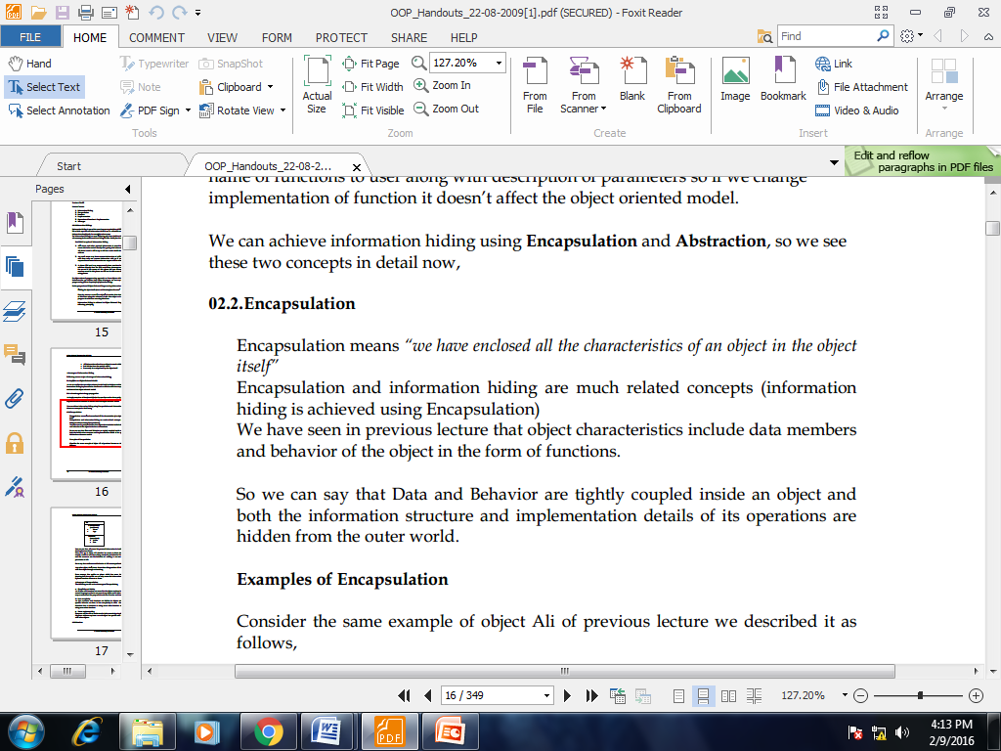
Encapsulation

Slide 8
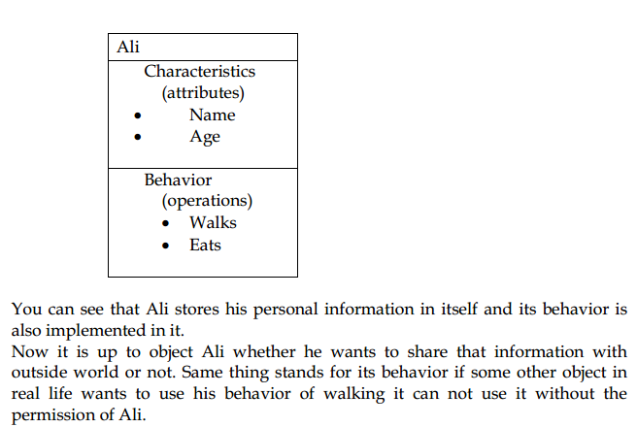

Slide 9
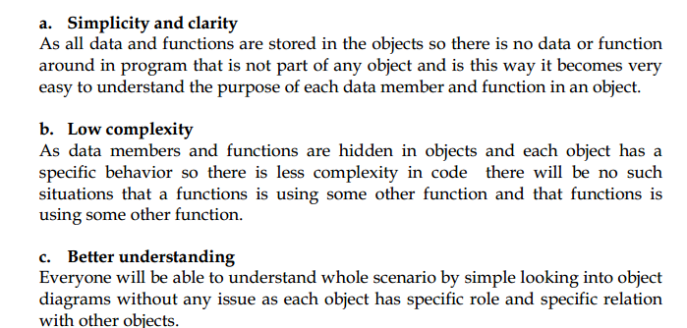
Advantages

Slide 10
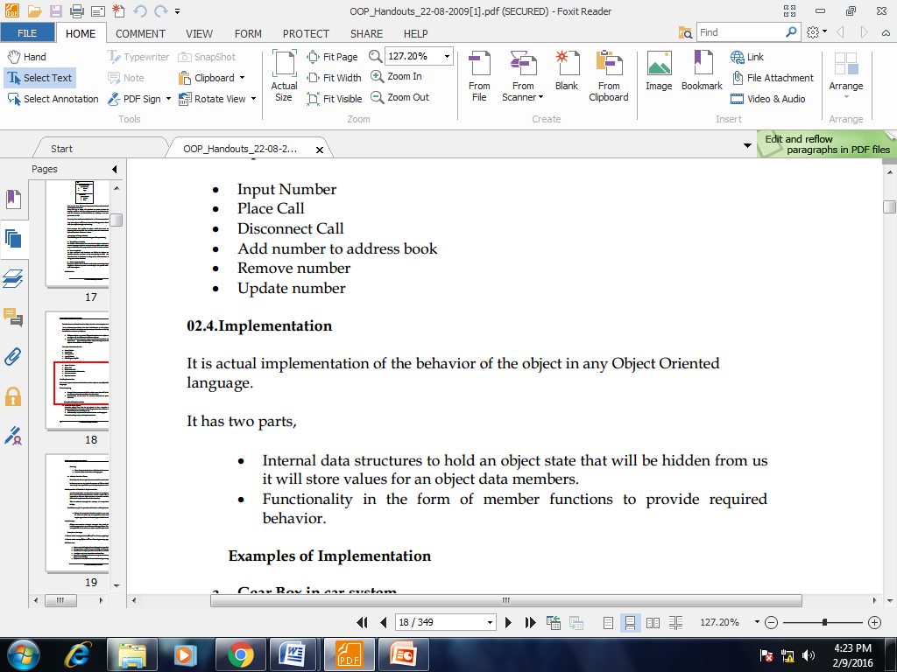
Implementation

Slide 11
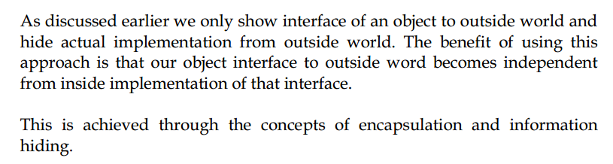
Separation of Interface & Implementation

Slide 12
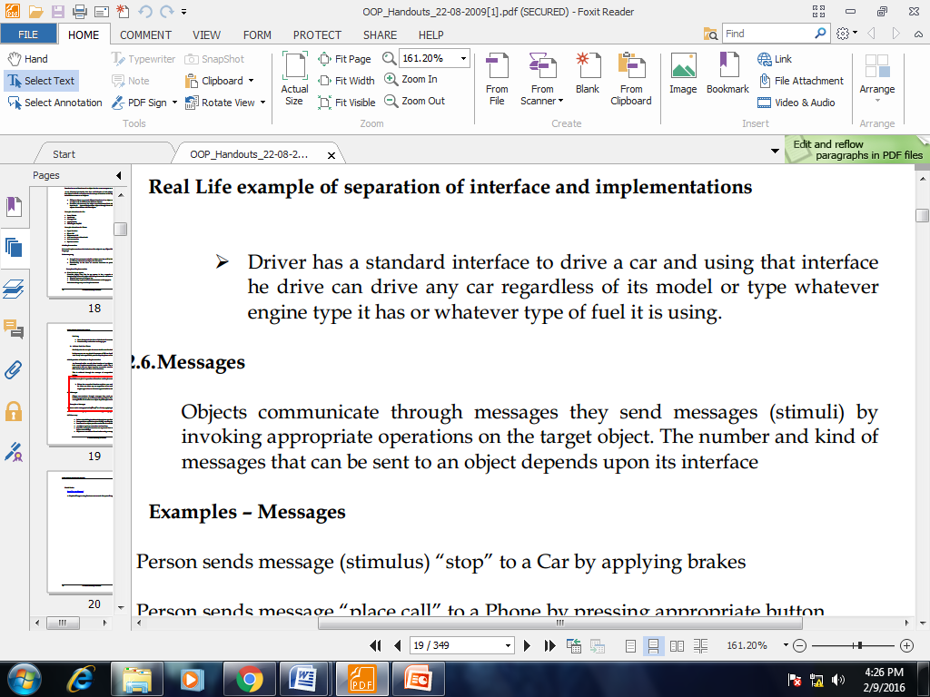
Example

Slide 13
Access Modifier
Encapsulation is implemented by using access specifiers. An access specifier defines the scope and visibility of a class member. C# supports the following access specifiers:
Public
Private
Protected
Internal
Protected internal

Slide 14
Access Modifier
Public: The type or member can be accessed by any other code in the same assembly or another assembly that references it.
Private: The type or member can be accessed only by code in the same class or struct.
Protected: The type or member can be accessed only by code in the same class or struct, or in a class that is derived from that class.
Internal: The type or member can be accessed by any code in the same assembly, but not from another assembly.
Protected internal: The type or member can be accessed by any code in the assembly in which it is declared, or from within a derived class in another assembly.

Slide 15
Access Modifier
Whenever we create a class, we always want to have the scope to decide who can access certain members of the class.
In other words, we would sometimes need to restrict access to the class members.
The one thumb rule is that members of a class can freely access each other. A method in one class can always access another method of the same class without any restrictions.
When we talk about the default behavior, the same class is allowed complete access but no else is provided access to the members of the class. The default access modifier is private for class members.
Point to remember: The default access modifier is internal for class members.

Slide 16
class Modifiers
{
static void AAA()
{
Console.WriteLine("Modifiers AAA");
}
public static void BBB()
{
Console.WriteLine("Modifiers BBB");
AAA();
}
}
class Program
{
static void Main(string[] args)
{
Modifiers.BBB();
}
}

Slide 17
Output
Modifiers BBB
Modifiers AAA
We added a class Modifiers and two static methods AAA and BBB.
Method BBB is marked as public. We call the method BBB from Main method.The method is called directly by the class name because it is marked static

Slide 18
Explanation
BBB is marked public and so anyone is allowed to call and run it.
Method AAA is not marked with any access modifier which automatically makes it private, that is the default.
The private modifier has no effect on members of the same class and so method BBB is allowed to call method AAA.

Slide 19
Now this concept is called member access. Modify the Program class and try to access AAA as:
Class Program
{
static void Main(string[] args)
{
Modifiers.AAA();
Console.ReadKey();
}
}
Output
'AccessModifiers.Modifiers.AAA()' is inaccessible due to its protection level
So , since method AAA is private, therefore no one else can have access to it except Modifiers class.

Slide 20
Now mark the AAA method as protected, our class looks like:
class Modifiers
{
protected static void AAA()
{
Console.WriteLine("Modifiers AAA");
}
public static void BBB()
{
Console.WriteLine("Modifiers BBB");
AAA();
}
}
class Program
{
static void Main(string[] args)
{
Modifiers.AAA();
}
}

Slide 21
'AccessModifiers.Modifiers.AAA()' is inaccessible due to its protection level.
Again the same output.
We cannot access the method AAA even after we introduced a new modifier named protected.
But BBB can access AAA method because it lies in the same class.

Slide 22
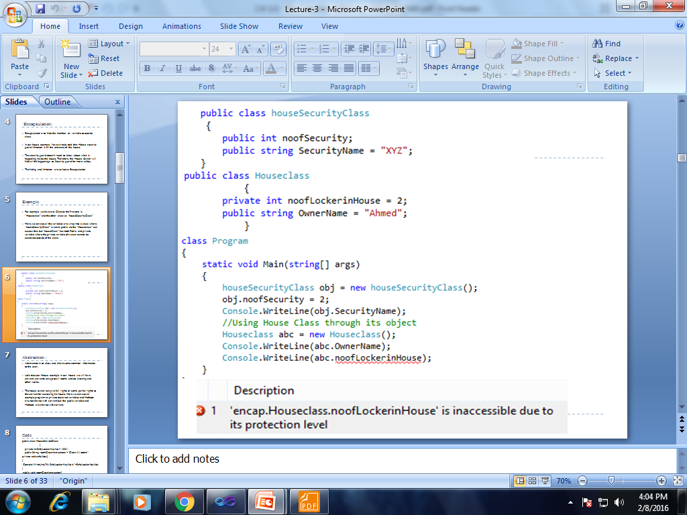

Slide 23
Encapsulation Implementation
Encapsulation provides a way to protect data from accidental corruption. Rather than defining the data in the form of public, we can declare those fields as private. The Private data are manipulated indirectly by two ways.
ENCAPSULATION USING ACCESSORS AND MUTATORS
ENCAPSULATION USING PROPERTIES

Slide 24
Accessor & Mutator
using system; public class Department { private string departname;
// Accessor. public string GetDepartname() { return departname; } // Mutator. public void SetDepartname( string a) { departname=a; } }

Slide 25
Accessor & Mutator
public static int Main(string[] args) { Department d = new Department(); d.SetDepartname(“COMPUTER SCIENCE"); Console.WriteLine("The Department is :" +d.GetDepartname()); return 0; }

Slide 26
Properties
using system; public class Department { private string departname; public string Departname { get { return departname; } set { departname=value; } } }

Slide 27
Properties
public class Departmentmain { public static int Main(string[] args) { Department d= new Department(); d.departname=“CS"; Console.WriteLine("The Department is :{0}",d.Departname); return 0; } }

Slide 28
End of Lecture 6

