Slide 1
Inheritance and its types
Lecture # 8

Slide 2
Inheritance
Inheritance is a mechanism of acquiring the features and behaviors of a class by another class. The class whose members are inherited is called the base class, and the class that inherits those members is called the derived class.

Slide 3
Types of Inheritance
Single
Multiple
Multilevel
Hierarchical
Hybrid

Slide 4
Advantages of Inheritance
Reduce code redundancy.
Provides code reusability.
Reduces source code size and improves code readability.
Code is easy to manage and divided into parent and child classes.
Supports code extensibility by overriding the base class functionality within child classes.

Slide 5
Single Inheritance
When a single derived class is created from a single base class then the inheritance is called as single inheritance.
Class A
Class B

Slide 6
Single Inheritance Code
//Base Class
class A
{
public void basemethod ()
{
//Code
} }
//Derived Class
class B : A
{ public void derivedmethod()
{ //Code
basemethod (); }}

Slide 7
Multi level Inheritance
When one class is derived from another derived class then this type of inheritance is called multilevel inheritance
Here we can see an example first Class A is derived in Class B and then the Class B is derived in Class C .
Now from Class C we can access both Class A and Class B variable and methods.

Slide 8
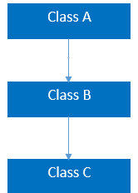
Multilevel Inheritance

Slide 9

Multilevel Inheritance Example Code

Slide 10
Multilevel Inheritance-Example#2
public class ClassA
{
private void privateMethod()
{
Console.WriteLine("private Method"); }
public void publicMethod()
{
Console.WriteLine("This Method Shared"); } }
public class ClassB : ClassA
{
public void ClassB()
{ Console.WriteLine(“Class B"); } }

Slide 11
Example#2 (contd..)
public class ClassC : ClassB
{
static void Main(string[] args)
{
ClassC obj = new ClassC();
obj.publicMethod();
objClassB();
//obj.privateMethod();
//This will be error as private method can not be accessed in Derived Class
}
}

Slide 12
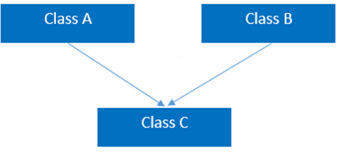
Multiple Inheritance

Slide 13
Multiple Inheritance
What is Multiple Inheritance? Multiple Inheritance is nothing but we can have more than one class and we can inherit both Classes in our derived class.
Will the .Net Support Multiple Inheritance?
The Answer to this Question is No. In C #, it’s not possible to write a Multiple Inheritance using Class.
Then how can we use the Multiple Inheritance
Interface will be used for Multiple Inheritance.

Slide 14
Multipath Inheritance
In this inheritance, a derived class is created from another derived classes and the same base class of another derived classes.
This inheritance is not supported by .NET Languages like C#, F# etc.

Slide 15
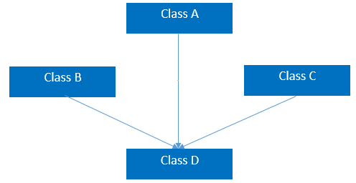
Multipath Inheritance

Slide 16
Hierarchal Inheritance
This is the type of inheritance in which there are multiple classes derived from one base class.
This type of inheritance is used when there is a requirement of one class feature that is needed in multiple classes.

Slide 17
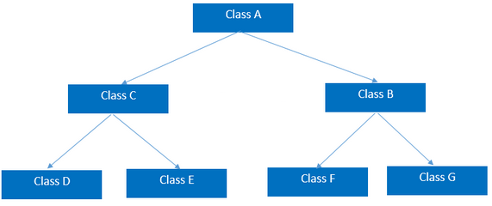
Hierarchal Inheritance

Slide 18

C

Slide 19
Hybrid Inheritance
This is combination of more than one inheritance. Hence, it may be a combination of Multilevel and Multiple inheritance or Hierarchical and Multilevel inheritance or Hierarchical and Multipath inheritance or Hierarchical, Multilevel and Multiple inheritance.
Since .NET Languages like C#, F# etc. does not support multiple and multipath inheritance. Hence hybrid inheritance with a combination of multiple or multipath inheritance is not supported by .NET Languages.
Any combination of single, hierarchical and multi level inheritances is called as hybrid inheritance.

Slide 20
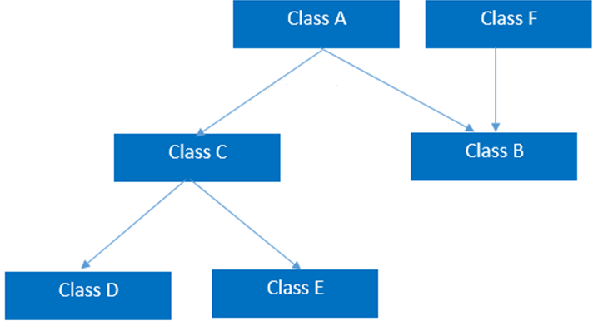
Hybrid Inheritance

