Slide 1
Base Keyword and Name Hiding
Lecture #9

Slide 2
Base and This Keywords
In a derived class, the base and this keywords can be used to reference members. These keywords disambiguate members. They eliminate confusion as to which member we want.
This, a keyword, eliminates naming conflicts. It indicates the current instance. Two variables sometimes have the same identifier. This keyword eliminates mistakes
Base is used in constructors. A derived class constructor is required to call the constructor from its base class.

Slide 3
Base Constructor
A derived class can call a constructor defined in its base class by using an expanded form of the derived class’ constructor declaration and the base keyword. The general form of this expanded declaration is shown here:
Derived-constructor (parameter-list) : base(arg-list)
{
// body of constructor
}

Slide 4
Base - (Example)
class TwoDShape
{
public double width;
public double height;
public void ShowDim()
{
Console.WriteLine("Width is :{0}", width);
Console.WriteLine("Height is :{0}", height);
}
public TwoDShape(double w,double h)
{
width = w;
height = h;
}
}

Slide 5
class Triangle:TwoDShape
{
public string style;
public Triangle(string s,double w,double h):base(w,h)
{
style = s;
} }
class Program
{
static void Main(string[] args)
{
Triangle t = new Triangle("Equilateral",45,69);
Console.WriteLine("Style is {0}", t.style);
t.ShowDim();
Console.ReadLine();
}}}

Slide 6
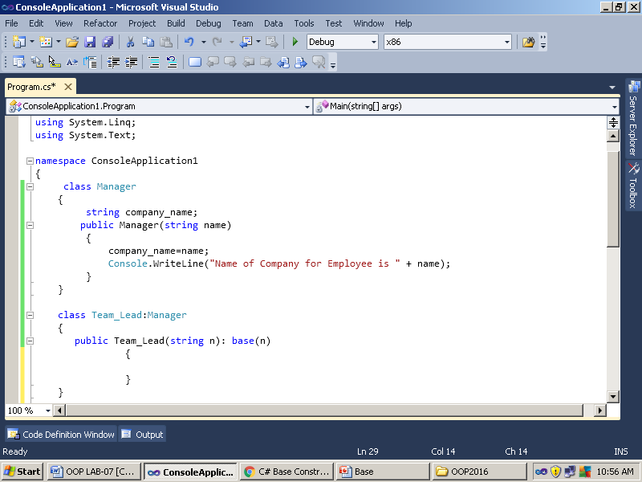
Example-2

Slide 7
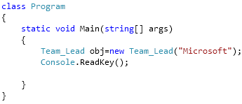
Example Contd..

Slide 8
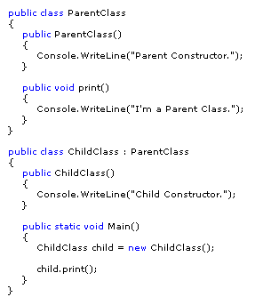
Output ?

Slide 9
Name hiding Example
class Base
{
public int value = 6;
}
class Derive : Base
{
public new int value = 7;
public void Write()
{
// Show difference between base and this. Console.WriteLine(base.value);
Console.WriteLine(this.value);
} }

Slide 10
Code
class Program
{
static void Main()
{
Derive d = new Derive();
d.Write();
} }
Output
6
7

Slide 11
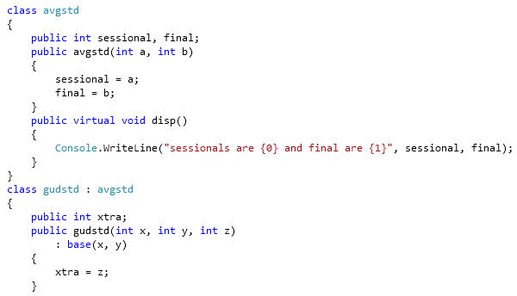
Example- Inheritance, Polymorphism and Constructor Chaining

Slide 12
