Slide 1



Donate ..
Save Lives!

Slide 2
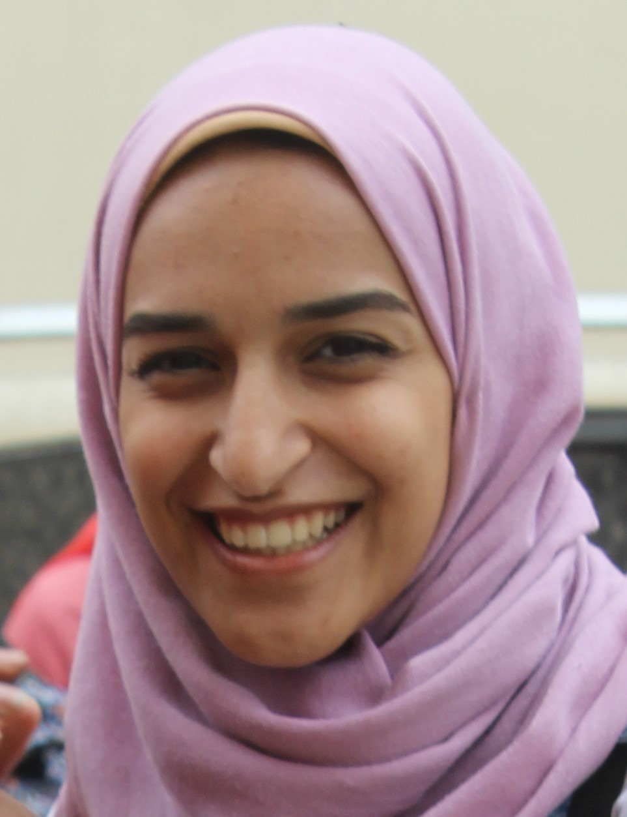
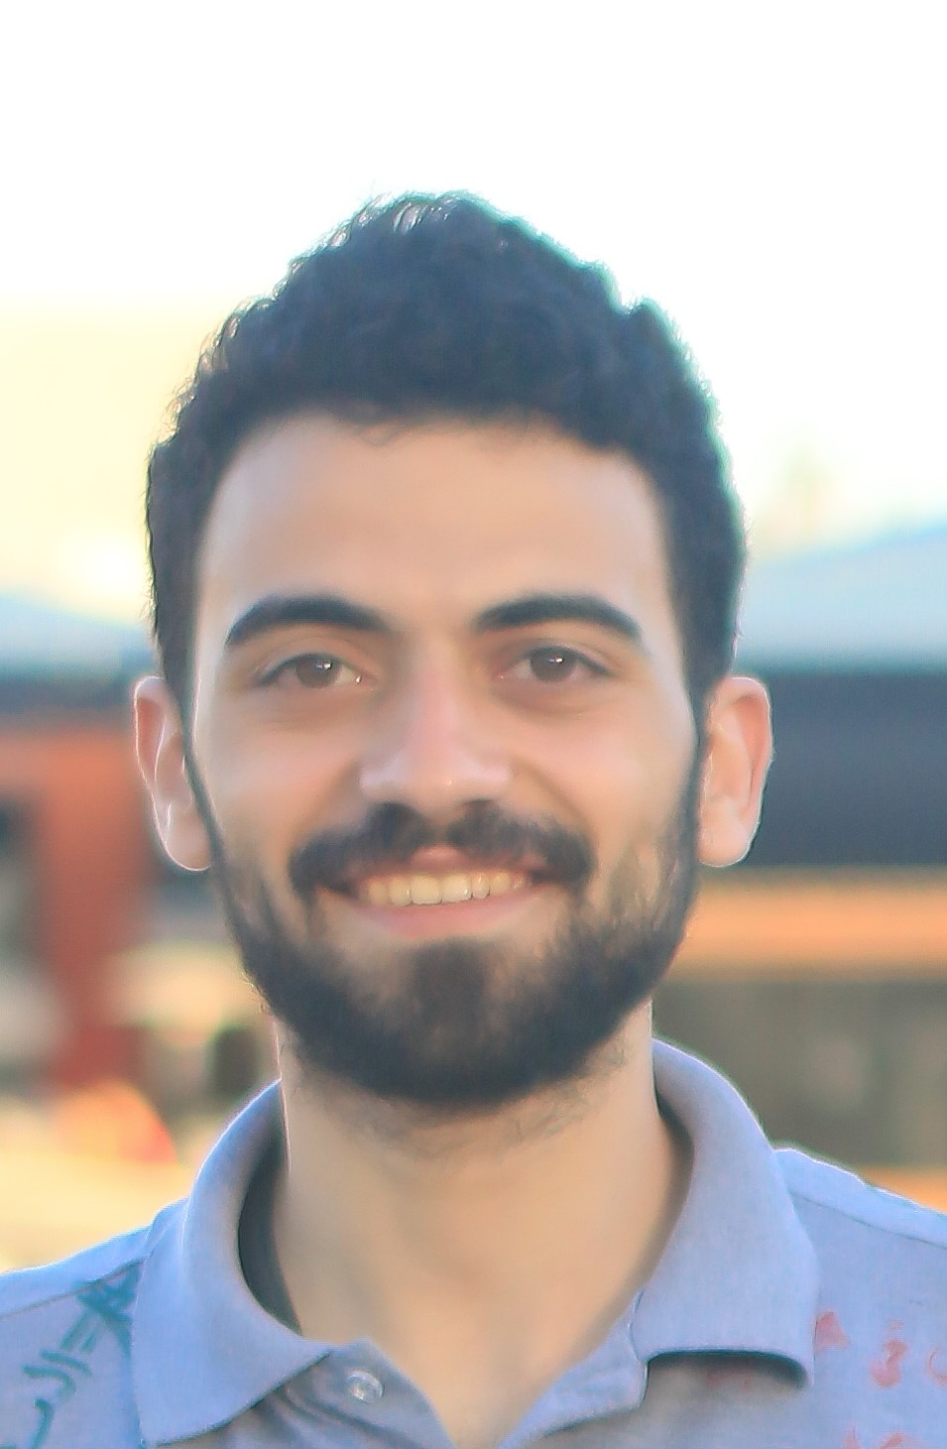
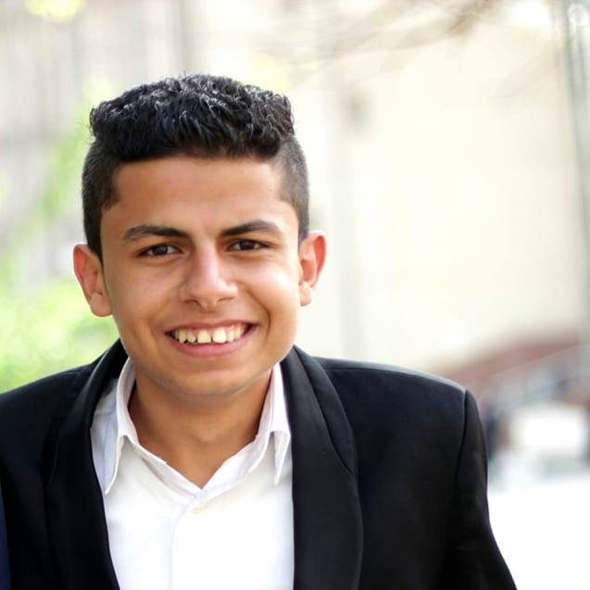
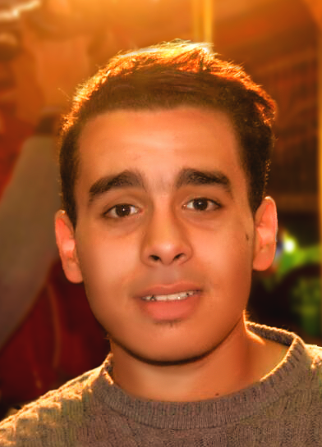
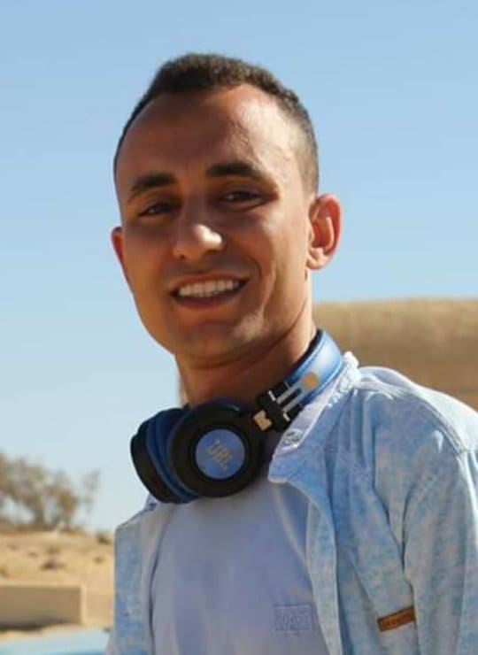
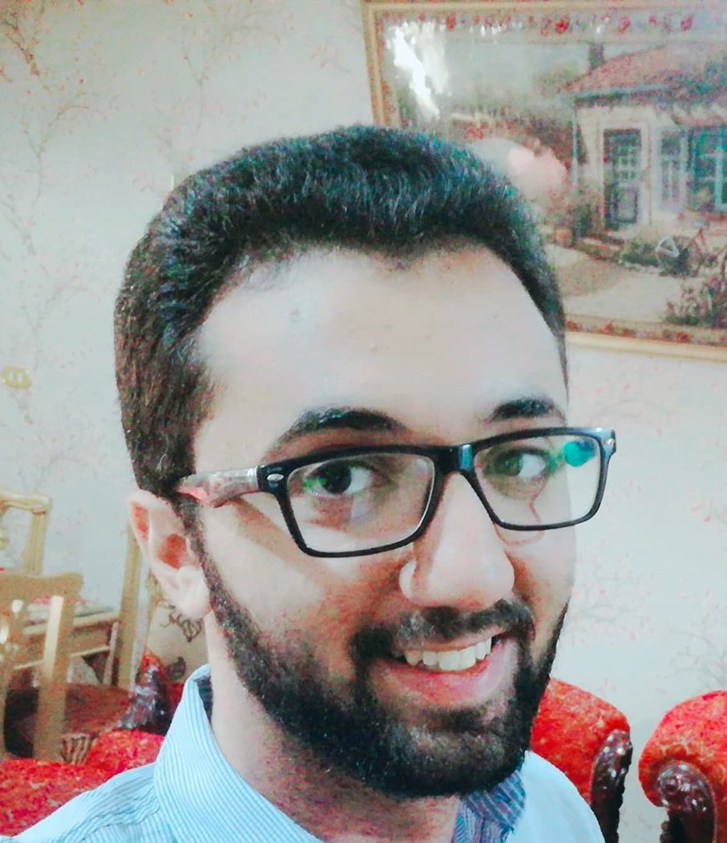
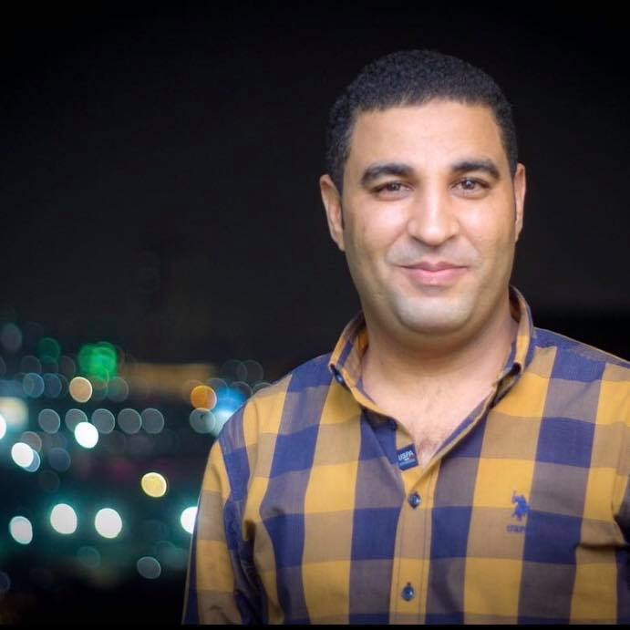
v
OUR
TEAM
Hader kamel
UI-UX
Moataz Al-Alazamy
Mobile App developer
Ahmed Beledy
System analyst
Mostafa Mohamed
Back End developer
Mohamed Ramadan
Supervisor
Database
Ahmed Anwar
Front End developer
Dr/Mostafa Thabet

Slide 3
Agenda
01
Problem Definition.
02
Previous Solutions.
03
Our Solution.
04
Used Technology.
05
Vision &mission .
06
Marketing strategy &Future work.

Slide 4
Problem definition
Health Sector Problems in Egypt .
Blood shortage problem
Culture of Egyptian society
Role of computer science in community service

Slide 5
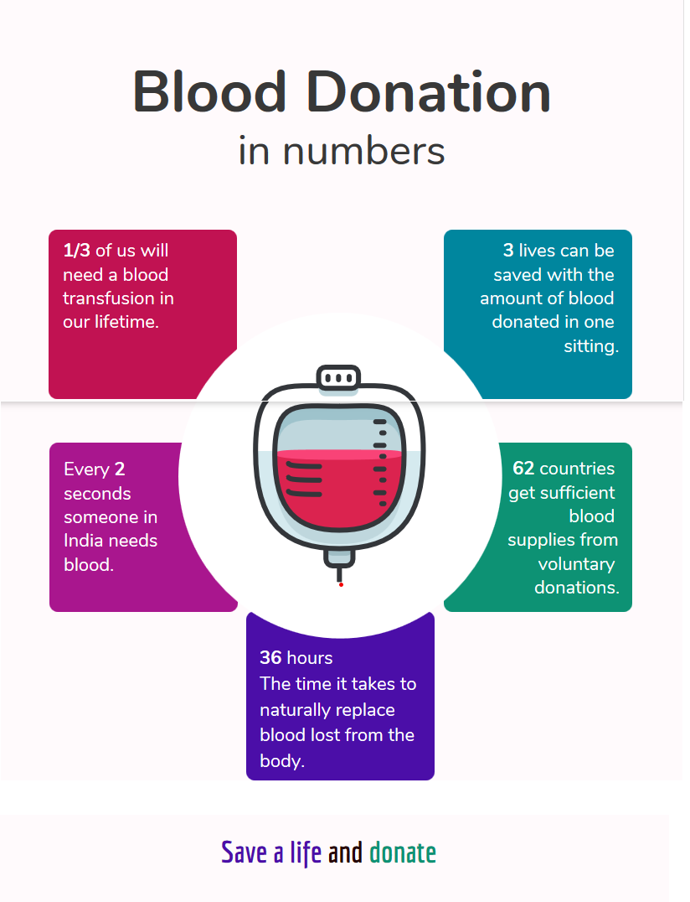
Info graphic illustrates the magnitude of the problem of blood shortage
The blood stock fills 1/3 of the actual requirement.
One out of 10 people entering the hospital needs blood vessels.
The donation rate is less than 30% of the patients need.

Slide 6
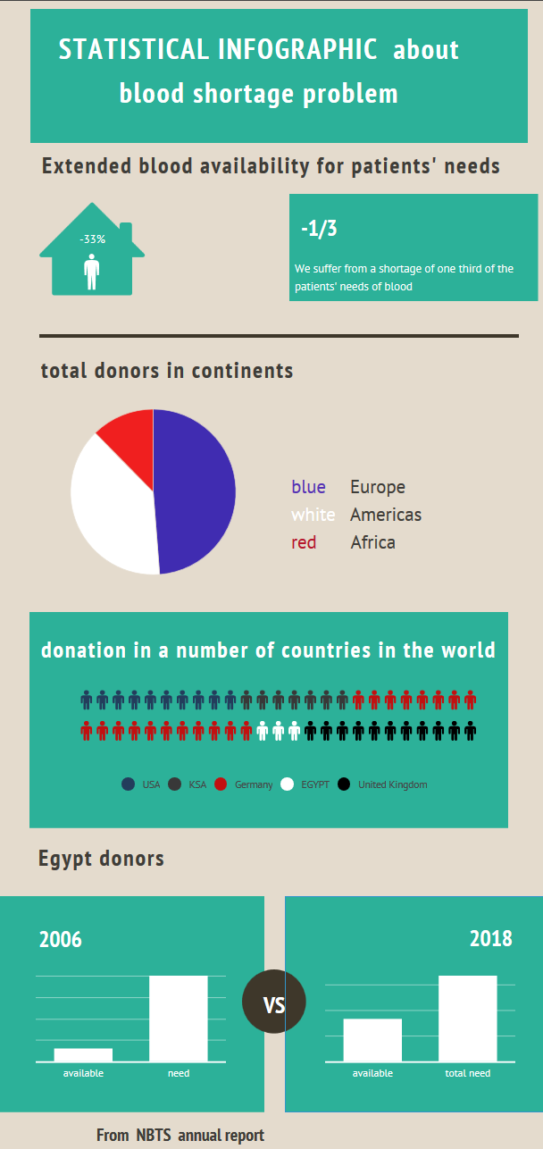
Info graphic illustrates the magnitude of the problem of blood shortage in Egypt
Total Egyptian donors does not exceed 1% from total population.
The rate of blood donation in Egypt is 1/6 the rate in developed countries.
World Health Organization put Egypt from 120 countries is unsafe in the blood.
Egyptians need 2.5 to 3 million blood bags There are no more than 800,000 bags.

Slide 7
Previous Solutions
Traditional way .
Facebook groups.
Application not meet user demand and security standards.

Slide 8
Our solution
User use mobile app and hospital has admin interface web application .
User can be a donor or requester .
User request blood by choose blood group and hospital .
User enter confirmation code from hospital.
The hospital analyze blood and prevent the patient donor from donating and reporting to application then application block user from donate
Application send notification to donors .
Donor confirm donation notification then application send his place to requester .
Hospital can edit blood group for a donor then report to application .

Slide 9
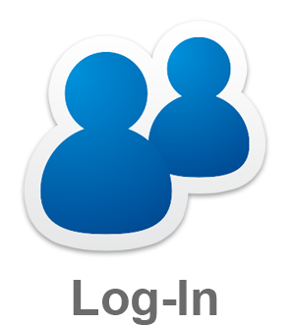

OUR PROCESS IS EASY
For requester
first
last
Go hospital
second

Slide 10


OUR PROCESS IS EASY
For donor
first
Third
Go hospital
second
last

Slide 11
Technologies
Firebase
Node JS
React JS
Swift
Apple mapkit

Slide 12

Firebase Firebase is Google’s mobile and web application development platform that helps you build, improve, and grow your app and it a Backend-as-a-Service
Firebase features .
Easy Setup & Integration
Conversion Funnels
Real-time In-App Analytics
Crash Recordings
Actionable Insights

Slide 13

Node.js Node is a cross platform runtime environment originally developed in2009
Why Node.js?
Node is non-blocking (callback)
Single-Threaded Model
Asynchronous Programming

Slide 14

React JS React is a popular open source front-end JavaScript library developed by Facebook.
Why React ?
Short and Easy Learning Curve
React is fast and agile
React Introduced JSX
Big Development Community

Slide 15
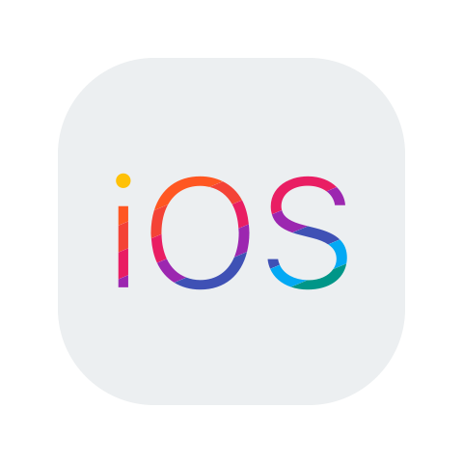
iOS is a mobile operating system created and developed by Apple Inc. exclusively for its hardware. It is the operating system that presently powers many of the company's mobile devices, including the iPhone, iPad, and iPod Touch
Why iOS ?
Better Developer Support & Tools.
Lesser Fragmentation.
High Quality Emulators.
Higher Revenue.
Apple map .

Slide 16

Swift Swift is a general-purpose, multi-paradigm, compiled programming language developed by Apple Inc.
Why Swift?
First of all it is open source, safe and fast language. Its mainly advantages are:
Rapid development process
Easier to scale the product and the team
Improved safety and performance
Automatic memory management

Slide 17
Vision &mission
we see , It is our duty to adapt the computer
science to serve the community
We choose health sector Given the deteriorating conditions in Egypt
Community service is our nominal goal

Slide 18
Achievements
Our project Achieved first place in the university competition for apps that serve the community
We still participate in some competitions for community service

Slide 19
Marketing strategy
01
Partnership between hospitals and app increases trust
02
The hospitals offers free blood donation to donors
03
Awareness of the benefits of blood donation.
04
Try to change Culture of Egyptian society.
05
Prize system for donors

Slide 20
The population of Egypt
105.000.000
1.5 % Expected number of donors
More than 1.000.000 user
100%
Total success! If campaign success

Slide 21
Future work
First stage
Develop android version from our project
Use machine learning to increase performance
Social media
Second stage
add features that enable user to donate and his Medicine to other users
Third stage
Transfer system from share blood and medicine system to more powerful share system allow user to donate and share anything related to health sector
This system allow you to donate Medical tools, medical equipment Money, Operations, donating organs and anything can improve medical sector in Egypt

Slide 22
THANKS!
Any questions?

