Slide 1
Simplifying Big Data in Apache Spark 2.0
Matei Zaharia
@matei_zaharia

Slide 2
A Great Year for Apache Spark
New Major
Version #
225K
1100
2.0
600
66K

Slide 3
About Spark 2.0
Remains highly compatible with 1.x
Builds on key lessons and simplifies API
2000 patches from 280 contributors

Slide 4
What’s Hard About Big Data?
Complex combination of processing tasks, storage systems & modes
ETL, aggregation, machine learning, streaming, etc
Hard to get both productivity and performance

Slide 5





Apache Spark’s Approach
Unified engine
Express entire workflow in one API
Connect existing libraries & storage
High-level APIs with space to optimize
RDDs, DataFrames, ML pipelines
Streaming
SQL
ML
Graph
…

Slide 6
New in 2.0
Structured API improvements (DataFrame, Dataset, SQL)
Whole-stage code generation
Structured Streaming
Simpler setup (SparkSession)
SQL 2003 support
MLlib model persistence
MLlib R bindings
SparkR user-defined functions
…

Slide 7
Original Spark API
Arbitrary Java functions on Java objects
+ Can organize your app using functions, classes and types
– Difficult for the engine to optimize
Inefficient in-memory format
Hard to do cross-operator optimizations
val lines = sc.textFile(“s3://...”)
val points = lines.map(line => new Point(line))

Slide 8
Structured APIs
New APIs for data with a fixed schema (table-like)
Efficient storage taking advantage of schema (e.g. columnar)
Operators take expressions in a special DSL that Spark can optimize
DataFrames (untyped), Datasets (typed), and SQL

Slide 9
Structured API Example
events = sc.read.json(“/logs”)
stats =
events.join(users)
.groupBy(“loc”,“status”)
.avg(“duration”)
errors = stats.where(
stats.status == “ERR”)
SCAN logs
SCAN users
while(logs.hasNext) {
e = logs.next
if(e.status == “ERR”) {
u = users.get(e.uid)
key = (u.loc, e.status)
sum(key) += e.duration
count(key) += 1
}
}
...
FILTER
JOIN
AGG
DataFrame API
Optimized Plan
Specialized Code

Slide 10

Structured API Example
events = sc.read.json(“/logs”)
stats =
events.join(users)
.groupBy(“loc”,“status”)
.avg(“duration”)
errors = stats.where(
stats.status == “ERR”)
FILTERED SCAN
SCAN users
while(logs.hasNext) {
e = logs.next
if(e.status == “ERR”) {
u = users.get(e.uid)
key = (u.loc, e.status)
sum(key) += e.duration
count(key) += 1
}
}
...
JOIN
AGG
DataFrame API
Optimized Plan
Specialized Code

Slide 11
New in 2.0
Merging DataFrame & Dataset
DataFrame = Dataset[Row]
Spark 1.6
14M
rows/s
Spark 2.0
125M
rows/s
Whole-stage code generation
Fuse across multiple operators
Optimized Parquet I/O
Parquet in 1.6
11M
rows/s
Parquet in 2.0
90M
rows/s

Slide 12
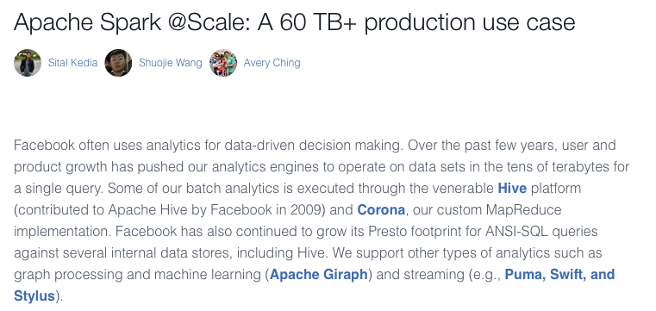
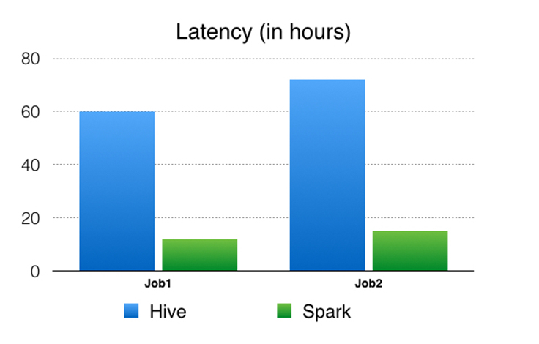


Slide 13
Beyond Batch & Interactive: Higher-Level API for Streaming

Slide 14
What’s Hard In Using Streaming?
Complex semantics
What possible results can the program give?
What happens if a node runs slowly? If one fails?
Integration into a complete application
Serve real-time queries on result of stream
Give consistent results with batch jobs

Slide 15
Structured Streaming
High-level streaming API based on DataFrames / Datasets
• Same semantics & results as batch APIs
• Event time, windowing, sessions, transactional I/O
Rich integration with complete Apache Spark apps
• Memory sink for ad-hoc queries
• Joins with static data
• Change queries at runtime
Not just streaming, but “continuous applications”

Slide 16
Structured Streaming API
Incrementalize an existing DataFrame/Dataset/SQL query
Example
batch job:
logs = ctx.read.format(“json”).open(“hdfs://logs”)
logs.groupBy(“userid”, “hour”).avg(“latency”)
.write.format(”parquet”)
.save(“s3://...”)

Slide 17
Structured Streaming API
Incrementalize an existing DataFrame/Dataset/SQL query
Example as
streaming:
logs = ctx.readStream.format(“json”).load(“hdfs://logs”)
logs.groupBy(“userid”, “hour”).avg(“latency”)
.writeStream.format(”parquet")
.start(“s3://...”)
Results always same as a batch job on a prefix of the data

Slide 18
Under the Hood
Batch Plan
Continuous Plan
Scan Files
Scan New Files
Automatically
transformed
Aggregate
Stateful Aggregate
Write to S3
Update S3

Slide 19
End Goal: Full Continuous Apps
Pure Streaming System
Continuous Application
>_
Ad-hoc
Queries
Streaming
Computation
Continuous Application
Output
Sink
Input
Stream
Output
Sink
Input
Stream
consistent with
Batch Job
Static Data

Slide 20
Development Status
2.0.1: supports ETL workloads from file systems and S3
2.0.2: Kafka input source, monitoring metrics
2.1.0: event time aggregation workloads & watermarks

Slide 21
Greg Owen
Demo

