Slide 1
Feature Hashing for Scalable Machine Learning
Nick Pentreath
IBM

Slide 2
About
About me
@MLnick
Principal Engineer at IBM working on machine learning & Apache Spark
Apache Spark PMC
Author of Machine Learning with Spark

Slide 3
Agenda
Intro to feature hashing
HashingTF in Spark ML
FeatureHasher in Spark ML
Experiments
Future Work

Slide 4
Intro to Feature Hashing

Slide 5

Encoding Features
Most ML algorithms operate on numeric feature vectors
Features are often categorical – even numerical features (e.g. binning continuous features)
$$\left[\begin{matrix}2.1 & 3.2 & −0.2 & 0.7\end{matrix}\right]$$
Notes:
ML models require numeric features
Most features are not neatly encoded as numbers
Need to encode categorical features; e.g. categories, tags
Many numerical features are not useful in “raw form” – e.g. geo-location, time-of-day are more useful as features if binned or transformed into “indicator” variables
Need to transform text features into numeric vector representations – e.g. search keywords

Slide 6


Encoding Features
“one-hot” encoding is popular for categorical features
“bag of words” is popular for text (or token counts more generally)
$$\left[\begin{matrix}0 & 0 & 1 & 0 & 0\end{matrix}\right]$$
$$\left[\begin{matrix}0 & 2 & 0 & 1 & 1\end{matrix}\right]$$
Notes:
One hot encoding
Bag of words

Slide 7
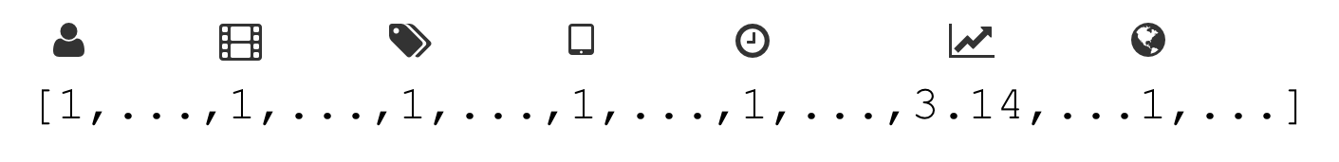
High Dimensional Features
Many domains have very high dense feature dimension (e.g. images, video)
Here we’re concerned with sparse feature domains, e.g. online ads, ecommerce, social networks, video sharing, text & NLP
Model sizes can be very large even for simple models
Notes:
Linear models in large sparse feature domains can have 10s-100s millions, even billions, of features
Features are often high cardinality – user and product ids, geo-locations, tags, search keywords
Feature interactions are commonly used – exploding feature dimension even further
More complex models such as Factorization Machines still multiply the model size significantly

Slide 8


The “Hashing Trick”
Use a hash function to map feature values to indices in the feature vector
Modulo hash value
to vector size to get
index of feature
Hash “city=boston”
$$\left[\begin{matrix}0 & 0 & 1 & 0 & 0\end{matrix}\right]$$
Boston
Modulo hash value
to vector size to get
index of feature
Hash “stock_price”
$$\left[\begin{matrix}0 & 2.60 & … & 0 & 0\end{matrix}\right]$$
Stock Price
Notes:
Hash function needs to spread feature indices evenly and minimise hash collisions
MurmurHash3 is commonly used
Similar to “kernel trick” – here the “trick” is fixed size feature vector (often << feature dimension) => dimensionality reduction

Slide 9
Feature Hashing: Pros
Fast & Simple
Preserves sparsity
Memory efficient
Limits feature vector size
No need to store mapping feature name -> index
Online learning
Easy handling of missing data
Feature engineering

Slide 10
Feature Hashing: Cons
No inverse mapping => cannot go from feature indices back to feature names
Interpretability & feature importances
But similar issues with other dim reduction techniques (e.g. random projections, PCA, SVD)
Hash collisions …
Impact on accuracy of feature collisions
Can use signed hash functions to alleviate part of it
Notes:
Signed hash functions => unbiased estimate (collisions will tend to cancel each other out in aggregate)

Slide 11
HashingTF in Spark ML

Slide 12
HashingTF Transformer
Transforms text (sentences) -> term frequency vectors (aka “bag of words”)
Uses the “hashing trick” to compute the feature indices
Feature value is term frequency (token count)
Optional parameter to only return binary token occurrence vector
Notes:
Transforms text (sentences) into term frequency vectors
Same as count vectorizer except that feature locations in the resulting vector use hashed indices

Slide 13
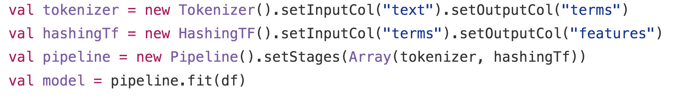
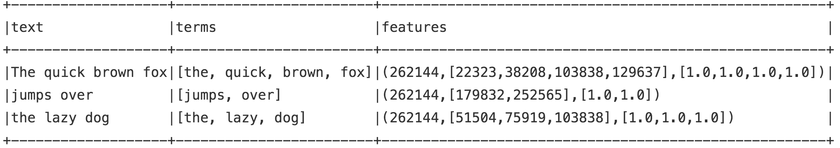
HashingTF Transformer
Notes:
Typical usage example

Slide 14
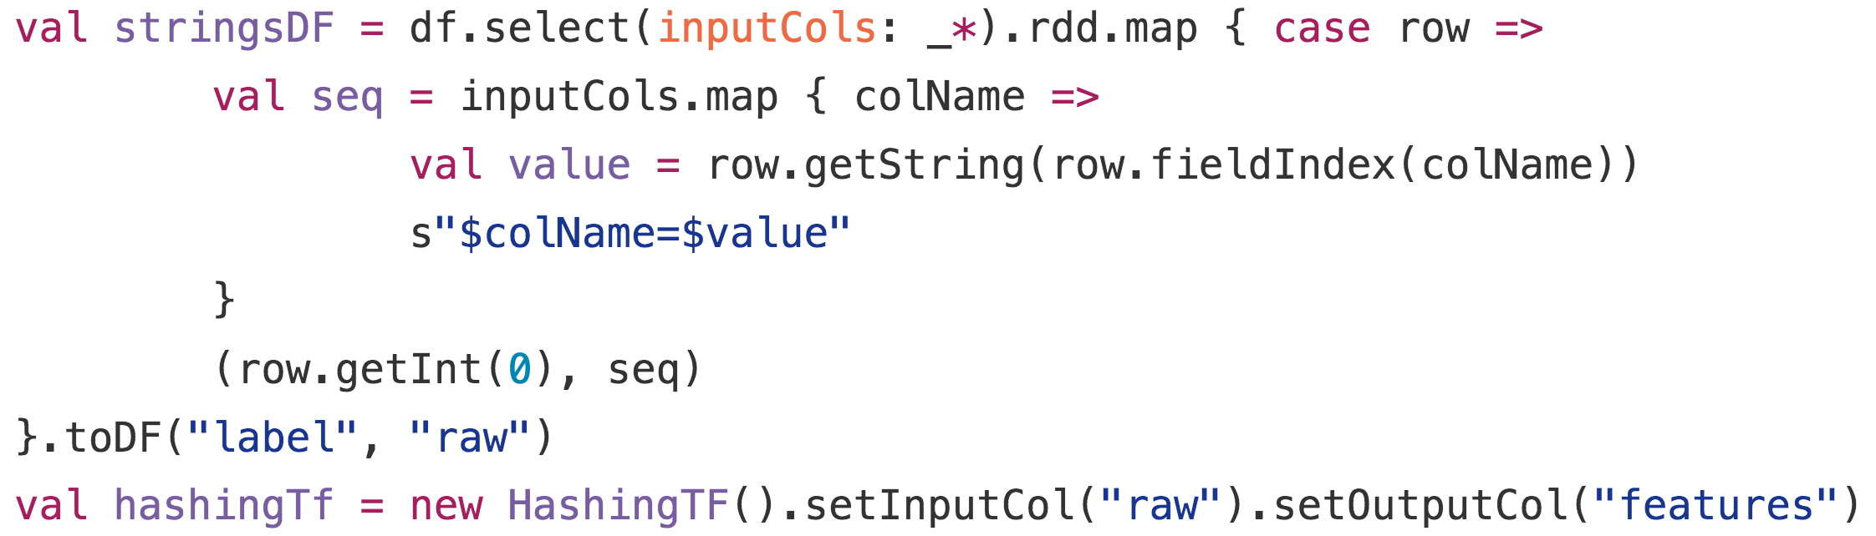
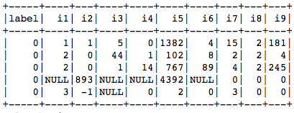
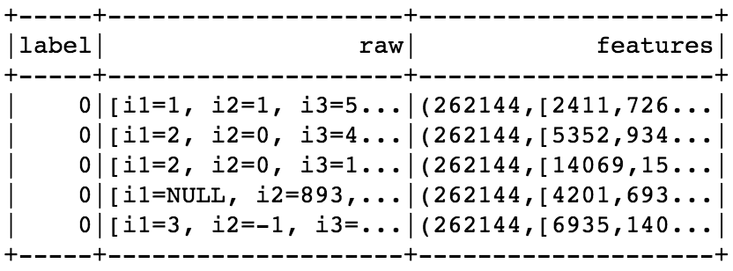
Hacking HashingTF
HashingTF can be used for categorical features…
… but doesn’t fit neatly into Pipelines
Notes:
”Stringify” workaround
Doesn’t fit into pipelines
Only works for categorical features

Slide 15
FeatureHasher in Spark ML

Slide 16
FeatureHasher
Flexible, scalable feature encoding using hashing trick
Support multiple input columns (numeric or string, i.e. categorical)
One-shot feature encoder
Core logic similar to HashingTF

Slide 17
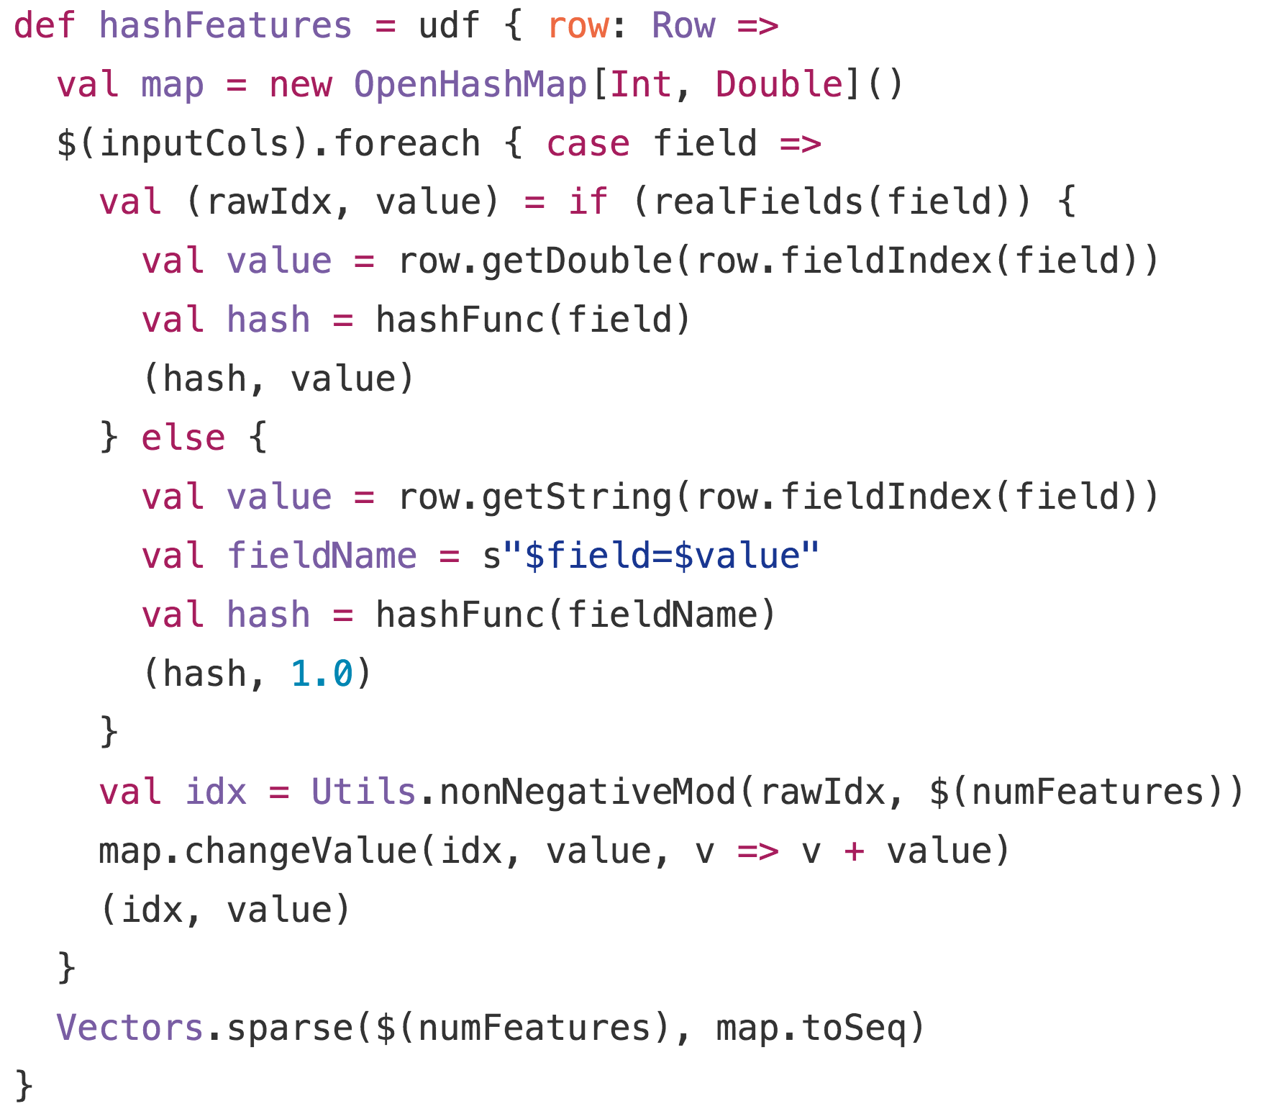
FeatureHasher
Operates on entire Row
Determining feature index
Numeric: feature name
String: “feature=value”
String encoding => effectively “one hot”

Slide 18
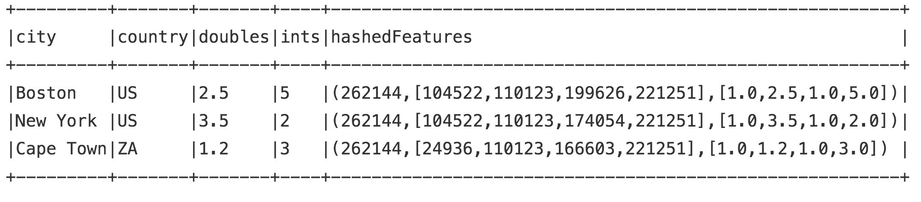
FeatureHasher

Slide 19
Experiments

Slide 20
Text Classification
Kaggle Email Spam Dataset
Notes:
Small dataset – 2500 examples
Email text content
After tokenization, feature dim = 56k
Compare CountVectorizer on full vocabulary with HashingTF with varying hash bits
At lower dimensions AUC Is actually higher!
In sparse domains feature hashing could be playing a regularization role?

Slide 21
Text Classification
Adding regularization (regParam=0.01)
Notes:
With regularization CountVectorizer performs better
Performance of HashingTF also better at highher bit rates

Slide 22
Ad Click Prediction
Criteo Display Advertising Challenge
45m examples, 34m features, 0.000003% sparsity
Outbrain Click Prediction
80m examples, 15m features, 0.000007% sparsity
Criteo Terabyte Log Data
7 day subset
1.5b examples, 300m feature, 0.0000003% sparsity

Slide 23
Data
Illustrative characteristics - Criteo DAC
Notes:
A few features dominate model size (e.g. probably user, ad, query ids etc)
A few “hot features” that occur in many examples.
Tails off quickly – power law data quite typical of interaction or user event data – search, recommendation, ads, social networks

Slide 24
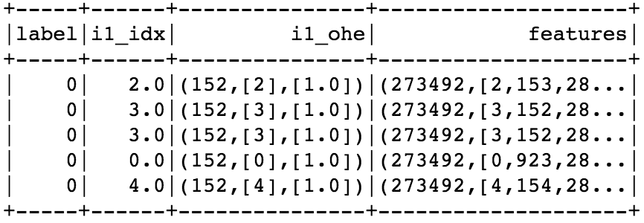
Challenges
Typical one-hot encoding pipeline failed consistently
Raw Data
OneHotEncoder
VectorAssembler
StringIndexer
OOM!
Notes:
OneHotEncoder OOM => ML Attribute metadata size?

Slide 25
Results
Compare AUC for different # hash bits

Slide 26
Results
Criteo 1T logs – 7 day subset
Can train model on 1.5b examples
300m original features for this subset
2²⁴ hashed features (16m)
Impossible with current Spark ML (OOM, 2Gb broadcast limit)

Slide 27
Summary & Future Work

Slide 28
Summary
Feature hashing is a fast, efficient, flexible tool for feature encoding
Can scale to high-dimensional sparse data, without giving up much accuracy
Supports multi-column “one-shot” encoding
Avoids common issues with Spark ML Pipelines using StringIndexer & OneHotEncoder at scale
Notes:
Spark ML issues with (a) high cardinality features; and (b) wide datasets

Slide 29
Future Directions
Include in Spark ML
Watch SPARK-13969 for details
Comments welcome!
Signed hash functions
Internal feature crossing & namespaces (ala Vowpal Wabbit)
DictVectorizer-like transformer => one-pass feature encoder for multiple numeric & categorical columns (with inverse mapping)

Slide 30
References
Hash Kernels
Feature Hashing for Large Scale Multitask Learning
Vowpal Wabbit
Scikit-learn

Slide 31
Thank You.
@Mlnick
spark.tc

