Slide 1
Automated Dasher
Developing the product
Product Owner: Ahmed Abdelnasser
© 2019 Udacity. All rights reserved.

Slide 2
Getting Started

Slide 3
Create Project Blueprint
A product launch is not just about deploying a beautifully designed,built and thoroughly tested feature. Your company needs to be equally prepared if not more to support every possible customer interaction associated with the product (e.g landing on your company website to learn more about the new feature)
© 2019 Udacity. All rights reserved.
Notes:
[ALL PARTICIPATION]

Slide 4
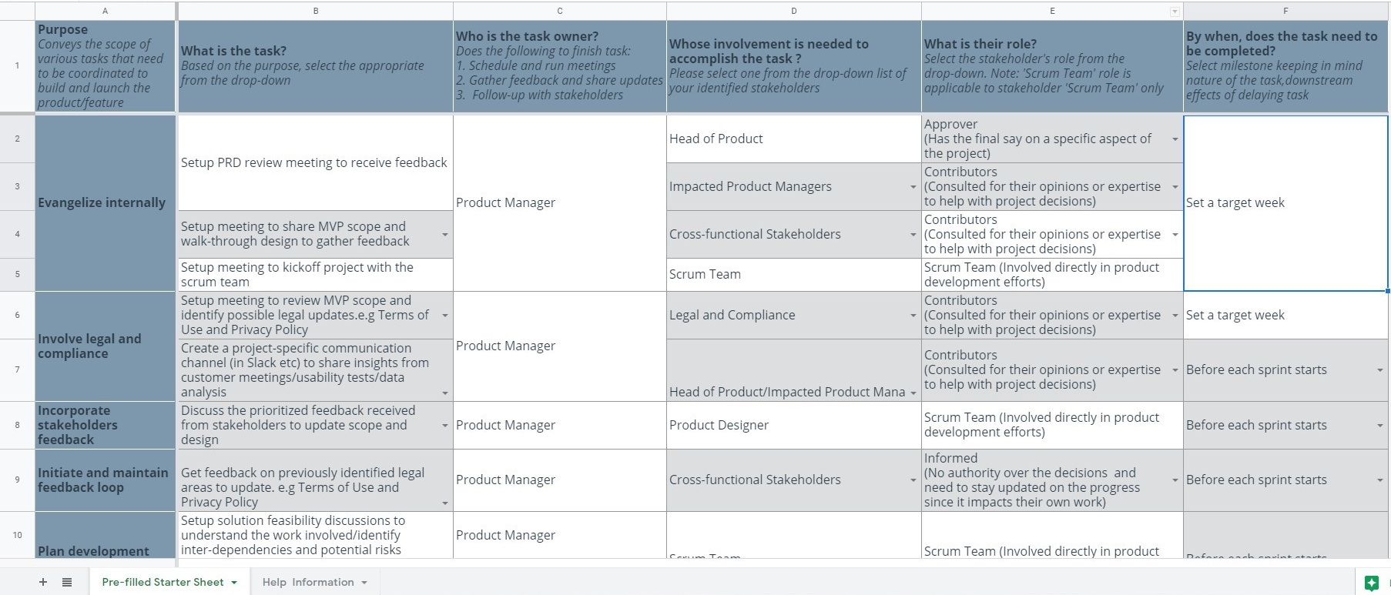
Create a coordination activities map
Share your project-specific coordination activities map here (Insert Link here). You can also share a screenshot below.
© 2019 Udacity. All rights reserved.

Slide 5
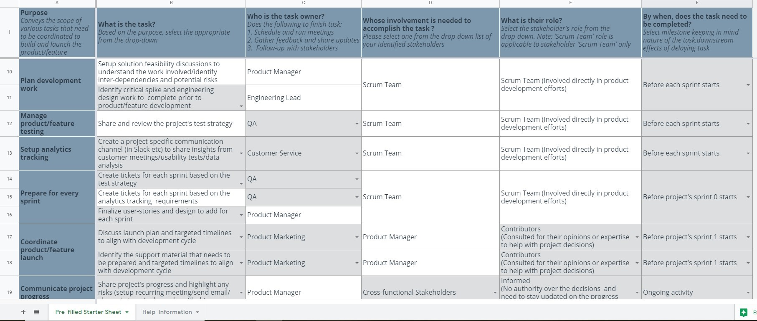
Create a coordination activities map
Share your project-specific coordination activities map here (Insert Link here). You can also share a screenshot below.
© 2019 Udacity. All rights reserved.

Slide 6
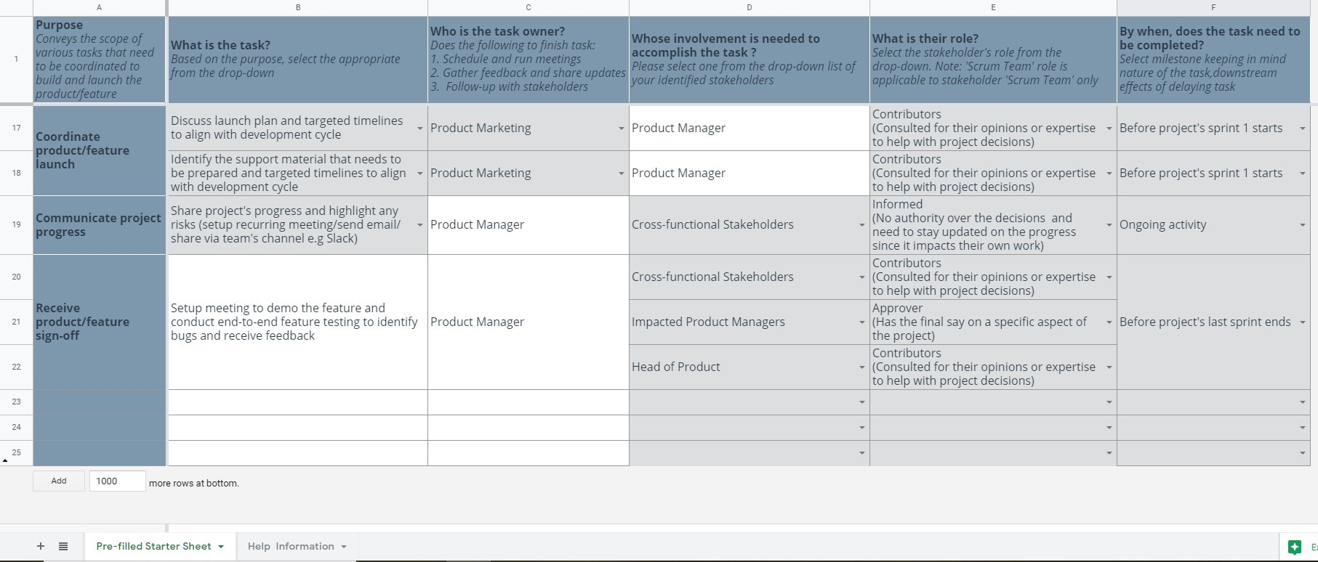
Create a coordination activities map
Share your project-specific coordination activities map here (Insert Link here). You can also share a screenshot below.
© 2019 Udacity. All rights reserved.

Slide 7
Plan for Sprint Meeting
As a PM, it is important to stay ahead of your scrum team and be prepared for every upcoming sprint by having a target goal defined with prioritized backlog for team to start costing and breaking down the tasks
© 2019 Udacity. All rights reserved.
Notes:
[ALL PARTICIPATION]

Slide 8
Sprint Planning Meeting Preparation
Sprint Goal
Give the operator access to Track and know status, Time estimated, Health of the robot
Sprint Backlog (list the prioritized user-stories from the product backlog)
1 | As an operator, I need to know the estimated time to help customer with details about their delivery
2 | As an operator, I need to know where’s the robot now(Track), To assign or schedule a new job for the robot
3 | As an operator, I need to know the status of the robot to help customer if he need to add something more
4 | As an operator, I need to know the health of the robot to control if there an issue
5 | As an operator, I need to know the order details and customer details so I can check it and give better assistant for the customer
Sprint Prioritization Logic
Focusing on the high priority, high critical feature at start would make sure that we have enough resources to build this feature set. Operator should be equipped with details that allow him to assist the customers well, like Tracking, Time estimated, Control the robot if there’s an issue and status all of this are essential features.
© 2019 Udacity. All rights reserved.

Slide 9
User Story 1
User Story | As an operator, I need to know the estimated time to help customer with details about their delivery
Design | Robot Estimated time
Acceptance Criteria | The operator can find the ‘Estimated Time’ when clicking ‘Robot Status’ and add the customer ID or Robot ID to find all details like: Estimated time, Order details, Order number, Customer ID, Robot ID. Time taken to populate this information after clicking the ‘Robot's status’ button from previous screen must be less than 500 MS. The information must be in a big/bold font and comfortable for the eyes.
Assumptions | The operator must login with his credintal ID and to connect customer number with the customer ID to be easily add for any information needed. Test the feature in a real work life
© 2019 Udacity. All rights reserved.

Slide 10
User Story 2
User Story | As an operator, I need to know the health of the robot to control if there an issue
Design | Robot’s Status
Acceptance Criteria | The operator can find ‘Status’ when click ‘Robot’s status’ they can find status and estimated time and many more details After Knowing the status there are 3 status (Available, On work, Error) if available they can assign or schedule a new job or if it is in a job also, if it has an error so he can control to know the issue and solve it
Assumptions | The operator must login with his credential ID and to connect customer number with the customer ID to be easily add for any information needed. Test the feature in a real work life
© 2019 Udacity. All rights reserved.

Slide 11
Decoding API Documentation
As a PM, you will collaborate with the engineering team and provide guidance that heavily influences their development approach. When a product requires an API integration, sometimes PM need to be “technical enough” to understand the following to refine the solution with designer and development team
what information is available via the API
how is it available
possible pricing impact
© 2019 Udacity. All rights reserved.
Notes:
[ALL PARTICIPATION]

Slide 12
Automated Dasher
Based on the API documentation how would you update your solution and design? | A discussion with engineering team is required to know how to calculate the average time for Automated dasher to reach any destination. We need to test it To crosscheck the time and distance covered by the robot and update the final time and distance formulae accordingly.
Based on your high-level understanding of the API documentation, are there any details that you want to discuss with engineering to refine solution and/or determine feasibility | Is the accuracy of the distance with the Google API 100% true? How to handle the error or warning statuses returned for any API query?

Slide 13
Re-prioritize Sprint Backlog
As a PM, unexpected issues and new feature requests will require you to triage them efficiently and re-prioritize the sprint backlog without impacting the roadmap deliverables significantly
© 2019 Udacity. All rights reserved.
Notes:
[ALL PARTICIPATION]

Slide 14
Issue 1: Landing Page loading too slow
Determine impact and criticality to prioritize issue | One of the biggest problems affair us ‘slow landing page’ that’s because of the customer is already in a bit of stress to know the time of delivery and location of their food that they have ordered. Making them wait for any longer time due to our technical issues is so poor quality so it’s a critical problem. Triggering the QA team to collect all traces and logs from the server for the engineering team to analyze Test all SW and report any errors appears, and ask the QA to test it also.
Next Steps You would carry out typically using JIRA (ticketing tool), communication channel (Slack) | Add the issue to the backlog sprint with a high priority (Priority 2) to solve it. add QA team and the engineering lead in the watchers list (JIRA). discuss this issue in the regular daily meeting, As a product manager, I must involve in their daily Meetings to know the status of this fix and I should add one from QA as well to participate.
Would you take additional steps ? | Create a discussion to know the root cause, And run an 8D analysis and share the reports to QA, engineering, head of product management. After solving the issue we will discuss it in a meeting and identify the steps to follow on how to mitigate the issue if this happens again in the future in spite of the solution that we have chosen
© 2019 Udacity. All rights reserved.

Slide 15
Issue 2: Misaligned fields in Profile Settings
Determine impact and criticality to prioritize issue | Checking out the screen added by the QA team personally, to understand the actual impact that the misaligned field can have on the customer, also try to test the app as an end user to check if it happens always. Discussion with UI/UX and Developers lead to get more technical insights into this issue from their perspectives and to collect their opinions As the data analysis team consider that only 2% of users get this issue so it’s not a high priority issue we can say it’s normal (Priority 3)
Next Steps use ticketing tool (JIRA), and communication channel (Slack) | Add the issue to the backlog sprint with a normal (Priority 3) to solve it. Discuss with the data analysis team if there’s any increasing in the percentage of customers using this issues. Discuss with developers team to estimate the issue points to fix this issue.
© 2019 Udacity. All rights reserved.

Slide 16

Email from Customer Service Manager
Use the information below to understand what is expected and use the next slide to share your answers
Sprint Progress
You are 3 days into the 2 week sprint and issue has been reported from production in the last 5 days
Email Thread
Our internal tool’s “send email with reset password link” is not working. We are able to trigger the email (containing the link to reset password), however users are complaining that they are not receiving the email from us. We noticed that the email is being received by users after 12 hours of being triggered from our internal tool. This is frustrating them and has increased the incoming call volume. Can you look into why the email (containing the link reset password) is being delivered so late ASAP?
Additional Details
20% of users that are unable to log due to incorrect password reach out to customer service team, where they trigger the email with the link to reset password using internal tool.
From previous engineering discussions, you believe the same email with link to reset password is triggered when a user requests a password reset email from the product directly.
On an average, 7% of daily total users that are unable to log into the product request this email,

Slide 17
Respond to Customer Service Manager’s Email
Determine impact and criticality to prioritize the issue (1 - Critical; 2 - High; 3 - Normal; 4 - Low) | Our internal tool’s “send code” is not working. We are able to trigger the code (containing the link to open the robot) this is a 1 so a critical issue and keep all stakeholders informed about this issue because it’s affecting the 30% of our customer. Since 7% of the total users would normally prefer to have their passwords reset due to forgotten passwords or so, it becomes all the way essential to fix this issue as soon as possible. Meeting with engineering team (backend) and IT to get more technical insights into this issue from their perspectives and to collect their opinion
Next Steps You would carry out typically using JIRA (ticketing tool), communication channel (Slack) | Add this issue in the current sprint backlog to work on that in the ongoing sprint. Set a short daily stand-up Meeting with QA, engineer lead and internal tool teams head to know the status of the fix. get a dedicated engineers team to work on this issue exclusively.
Sample Email Response | Hello, Thanks for informing us the technical issue well in time. Our engineering team has been informed about the issue and this issue raised to a critical priority due to the impact it has on our business and all stakeholders are informed and kept in the information loop for any updates, We are working hard to resolve this issue as soon as possible, Also we are thinking to Classify this issue so we won’t face this issue anymore. Regards,
© 2019 Udacity. All rights reserved.

Slide 18
Handle Potentially Difficult Situations
As a PM, you will be faced with many unexpected situations where you have to make a decision or push back while managing competing priorities from stakeholders and tackling issues that could potentially affect your product launch
© 2019 Udacity. All rights reserved.
Notes:
[ALL PARTICIPATION]

Slide 19
Respond to CEO or GM’s request via email
Assessment and result | The product feature is 65% functionality complete and not fully stable yet since, so we need a discussion with engineering to know what are the sub features that can be tested for demo purpose. Get hands-on the current product as a user to check once if the product is in a position to be demoed. Try to fill the gap if I find something or issue. Check the backlog sprint for any issue and make a list with the features finished.
Sample Email Response | Hello GM, Thanks a lot for the great interest that you show in the product and I surely understand the excitement that you have, to make a short demo to all the stakeholders. As you must be knowing that, we have 65% of the planned feature-set completed that can be definitely shown as a demo. However, they are not completely stable and not thoroughly tested. I’d further recommend to you that I give you a short demo before you show this to the customer, I'd be happy to assist you. Finally, I’d also like to check with you for a possibility if the date of demo can be postponed by another week. This would help us to show our tested product to the stakeholders with stable, tested features. Thanks for your understanding. Regards,
© 2019 Udacity. All rights reserved.

Slide 20
Step-in and guide the scrum team at stand up
Use the information below to understand what is expected and use the next slide to share your answers
Sprint Progress
You have 3 more days for the sprint to end
Assumption for exercise-sake
User stories being referred here are related to the product feature (project you are working on). The tickets are costed and targeted to be completed by the end of this sprint to go live with the product feature
Situation Details
You are stepping in as Scrum master for the stand up today. Your back-end engineer just finished sharing their update (pick up the analytics ticket, and there are no blockers). Your QA team member is next in line to share their update. In JIRA (ticket tracking tool) you notice the following:
A user story that needs to be marked as completed(‘done’) has two back-end tickets in “Code Review” status,which is assigned to the back-end engineer that just shared their update. You know from attending previous standups that these two tickets have been in ‘Code Review’ status for 2 days now
The back-end tickets are blocking two front-end tickets (which are in ‘Ready to Test’ status’) from being verified by QA
Also, there is one another ticket covering analytics requirements (story points =3), for which development has not yet started. This is currently ‘must-have’ for the launch and is expected to be completed in this sprint. The ticket cannot be completed (marked as done) by end of this sprint if it is not picked up for development by the end of today, The ticket has 5 tracking requirements as of now and you believe it is ok to have 2 out of these 5 be downgraded to ‘nice-to-have’ if needed to de-risk for the launch
© 2019 Udacity. All rights reserved.

Slide 21
Step-in and guide the scrum team at stand up
Video Response | Share the link to your video here <insert link> [Remove help text before you submit] Focus on recording the list of all questions and discussion details you plan to share with the the back-end engineer if you were present in the standup meeting 💡 Pay attention to your tone and focus on the purpose of intervention .Keep it focused and succinct( < 2minutes)
© 2019 Udacity. All rights reserved.

Slide 22
Handling Resource Constraints
List 2- 3 activities that you would carry out as a PM to unblock the scrum team immediately ? | Analyze the tasks that are immediately waiting for the QA testing. To handle the crisis I would request engineering to focus on the other planned tasks that can be started without QA. I will coordinate the Scrum master to unblock the engineering team so they can start immediately to focus on other important tasks at hand for launch. focus on alternatives to test features that were developed and waiting for QA.
Since the QA team member is shared across multiple projects, how would you coordinate with other PMs to de-risk your project and raise appropriate visibility ? | plan for a discussion with the head of PM and impacted PMs about the crisis situation and share our measures taken to address the issue. Confirm that they can still be shared across multiple projects as the assumption is, engineering would have chance to try to test their features during QA’s absence and QA would not be stressed once they back. organize the sprint and the next releases.
Since there is a potential risk, it is important to raise visibility amongst appropriate stakeholders | Head of Products, Impacted PMs, Engineering and Marketing (to keep all of them informed to escalate any Issue/Bug on time in launching a feature).
 | I will show them the Data and KPI’s that I taken to measure the success and how I handle any crisis situation or issue. show the launch date and show the impact those untested features have on the launch and the consequences if this feature is not delivered on time
© 2019 Udacity. All rights reserved.

Slide 23
How would you handle stakeholder feedback?
Feedback Assessment | [Remove help text before you submit] Limit to 3 bullets to list the questions you would ask the stakeholder to understand their feedback better
Video Response | Share the link to your video here (insert link) [Remove below help text before you submit] Record your final response to the stakeholder ( whether you agree or disagree with their suggestion that notification feature is a launch blocker) 💡Keep your response focused and succinct( < 2minutes)
© 2019 Udacity. All rights reserved.

