Slide 1
Legal AI Platform
AI-Powered Legal Workspace for Modern Law Firms
Case management · Document Intelligence · Multi-Agent Copilot · Client Portal · Voice Intake
Presented by: Ben Ahmed Mohamed
Company Supervisor : University Supervisor :
Graduation Year : 2025-2026

Slide 2
Table of Contents
01
Host Company Presentation
06
Project Analysis
02
Introduction & Context
07
Design & Technological Choices
03
Study of Existing Solutions
08
Realization
04
Proposed Solution
09
Conclusion & Perspectives
05
Adopted Methodology

Slide 3
HOST COMPANY PRESENTATION
01

Slide 4
Host Company
Where the project lives
⚖ Tunisian Law Firm — Modern Legal Practice
The firm handles civil, commercial, and corporate legal matters across Tunisia and cross-border jurisdictions including Germany.
Case Management
Client Relations
Multi-client case files
Intake workflows
Document tracking
Status updates
Deadline monitoring
Portal access
Legal Research
Compliance
Code retrieval
Multi-jurisdiction
Jurisprudence lookup
Audit trails
Drafting support
Role isolation

Slide 5
INTRODUCTION & CONTEXT
02

Slide 6
Problem Statement
What lawyers face today
BEFORE
AFTER
✗ Documents scattered across tools
✓ Unified case workspace with search
✗ Manual case summaries (hours)
✓ AI copilot: instant grounded summaries
✗ No jurisdiction-aware reasoning
✓ Tunisia + Germany legal code retrieval
✗ Generic AI with no case context
➜
✓ Case-scoped multi-agent reasoning
✗ No client self-service portal
✓ Separate secure client portal
✗ Voice intake requires manual entry
✓ Voice → transcript → consultation
✗ No grounded citations or audit trail
✓ Source citations + confidence scores

Slide 7
STUDY OF EXISTING SOLUTIONS
03

Slide 8
Competitive Analysis
Where existing tools fall short
Solution
Strengths ✓
Limitations ✗
Harvey AI
LLM for lawyers · Citation focus · Trusted by large firms
US-centric · No Tunisia/MENA · Proprietary · No custom corpus
Westlaw / LexisNexis
Huge corpus · Reliable precedents
Search-only · No generative AI copilot · Very expensive
CaseText / Clio
Practice management · Some AI features
Generic AI, not grounded · No multi-agent pipeline
ChatGPT / Gemini
Fast generation · Good language
No case scoping · Hallucinations · No legal citations
Our Platform
Case-grounded RAG · Multi-agent · Voice · Client portal · Tunisia legal codes
— Purpose-built for this firm

Slide 9
PROPOSED SOLUTION
04

Slide 10
Proposed Solution
A complete legal intelligence platform
⚖
Case Workspace
🤖
AI Copilot
📄
Document Intel
Cases · Clients · Documents Deadlines · RBAC · Multi-tenant
Multi-agent orchestration Intent routing · Grounded answers
OCR · NER · PII redaction Chunking · FAISS vector index
🔍
Legal Search
🎤
Voice Intake
🌐
Client Portal
Tunisia & Germany legal codes Citation verification · Fallback taxonomy
Transcription pipeline Audio → Consultation → Case
Public intake form Case status tracking · Secure login

Slide 11
ADOPTED METHODOLOGY
05

Slide 12
Methodology
Scrum + iterative AI development
Sprint Planning
Daily Standup
Sprint Execution
Sprint Review
Retrospective
→
→
→
→
Sprint
Period
Deliverables
Sprint 1–2
Feb 2026
Backend core: auth, cases, clients, documents, RBAC, multi-tenant
Sprint 3–4
Mar 2026
Document AI pipeline: OCR, NER, PII, chunking, FAISS indexing, RAG service
Sprint 5–6
Mar 2026
Copilot orchestration, intent routing, specialized agents, voice intake
Sprint 7–8
Apr 2026
Internal React workspace: case view, document panel, copilot chat, calendar
Sprint 9–10
Apr 2026
Client portal: intake form, status tracking, portal auth, MinIO uploads
Sprint 11–12
May 2026
Trust hardening: grounding, citation verification, AI Insight panel, eval suite

Slide 13
PROJECT ANALYSIS
06

Slide 14
Project Actors
Who uses the platform and how
🧑‍⚖️
🛡️
🤝
👤
Lawyer
Admin
Legal Assistant
Client
▸ Primary user
▸ Manages user accounts
▸ Uploads documents
▸ Submits intake form
▸ Manages cases & clients
▸ Tenant configuration
▸ Tracks deadlines
▸ Tracks case status
▸ Uses copilot & legal search
▸ Monitors system usage
▸ Runs document summaries
▸ Uploads supporting docs
▸ Reviews AI-grounded answers
▸ Access control & RBAC
▸ Prepares drafts
▸ Receives status updates
▸ Signs off on documents

Slide 15
Functional Requirements
Case & Client Management
AI Copilot & Agents
▸ Create/update/close legal cases
▸ Intent-routed copilot pipeline
▸ Manage clients and contacts
▸ Ask, summarize, draft, analyze intents
▸ Track deadlines and obligations
▸ Specialized agents per legal task
▸ Multi-tenant data isolation
▸ Grounded answers with source citations
Document Intelligence
Legal Search
▸ Upload PDF, DOCX, scanned images
▸ Tunisia + Germany legal codes corpus
▸ OCR, NER, PII redaction pipeline
▸ Article-level citation retrieval
▸ Chunking, embedding, FAISS indexing
▸ Claim verification agent
▸ Hybrid retrieval with reranking
▸ Fallback with explicit reason taxonomy
Voice & Intake
Client Portal
▸ Voice recording upload / live capture
▸ Public intake form submission
▸ Transcription to structured text
▸ Case status self-service tracking
▸ Auto-extract consultation fields
▸ Secure portal login (OTP)
▸ Consultation linked to case
▸ Document upload by client

Slide 16
Non-Functional Requirements
🔒 Security
⚡ Performance
▸ JWT + refresh token auth
▸ Background workers for heavy AI tasks
▸ BCrypt password hashing
▸ Redis caching for frequent lookups
▸ RBAC with role isolation
▸ FAISS in-memory vector search
▸ Multi-tenant data boundaries
▸ Paginated API endpoints
▸ CORS + rate limiting
▸ Lazy-loaded frontend bundles
🛡️ Reliability
🏗️ Maintainability
▸ LLM provider fallback chain
▸ Modular service architecture
▸ Structured fallback reason taxonomy
▸ Typed API contracts (Pydantic)
▸ Graceful degradation on 429 errors
▸ Clear agent-per-intent separation
▸ Smoke tests + E2E regression suite
▸ Centralized prompt contracts
▸ Eval gates before release
▸ Documented sprint history

Slide 17
Use Case Diagram
Actor–feature mapping
Legal AI Platform System
Manage Cases & Clients
Manage Users & Tenants
Lawyer
Ask AI Copilot (case-scoped)
Upload & Search Documents
View System Audit Logs
Legal Code Search
Admin
Submit Intake Form
Voice Intake → Consultation
Track Case Status
Client

Slide 18
Sequence Diagram — Copilot Pipeline
From user prompt to grounded answer
Lawyer UI
API Gateway
Orchestrator
RAG Service
Verifier Agent
LLM Gateway
Assembly
POST /copilot {prompt, case_id, scope}
dispatch(intent, context)
hybrid_retrieve(query, case_id)
verify_sources(chunks)
verified_chunks + confidence
grounded_context
generate(prompt + context)
raw_answer
assemble(answer, grounding, ai_insight)
structured_response
200 OK {answer, confidence, sources, ai_insight}

Slide 19
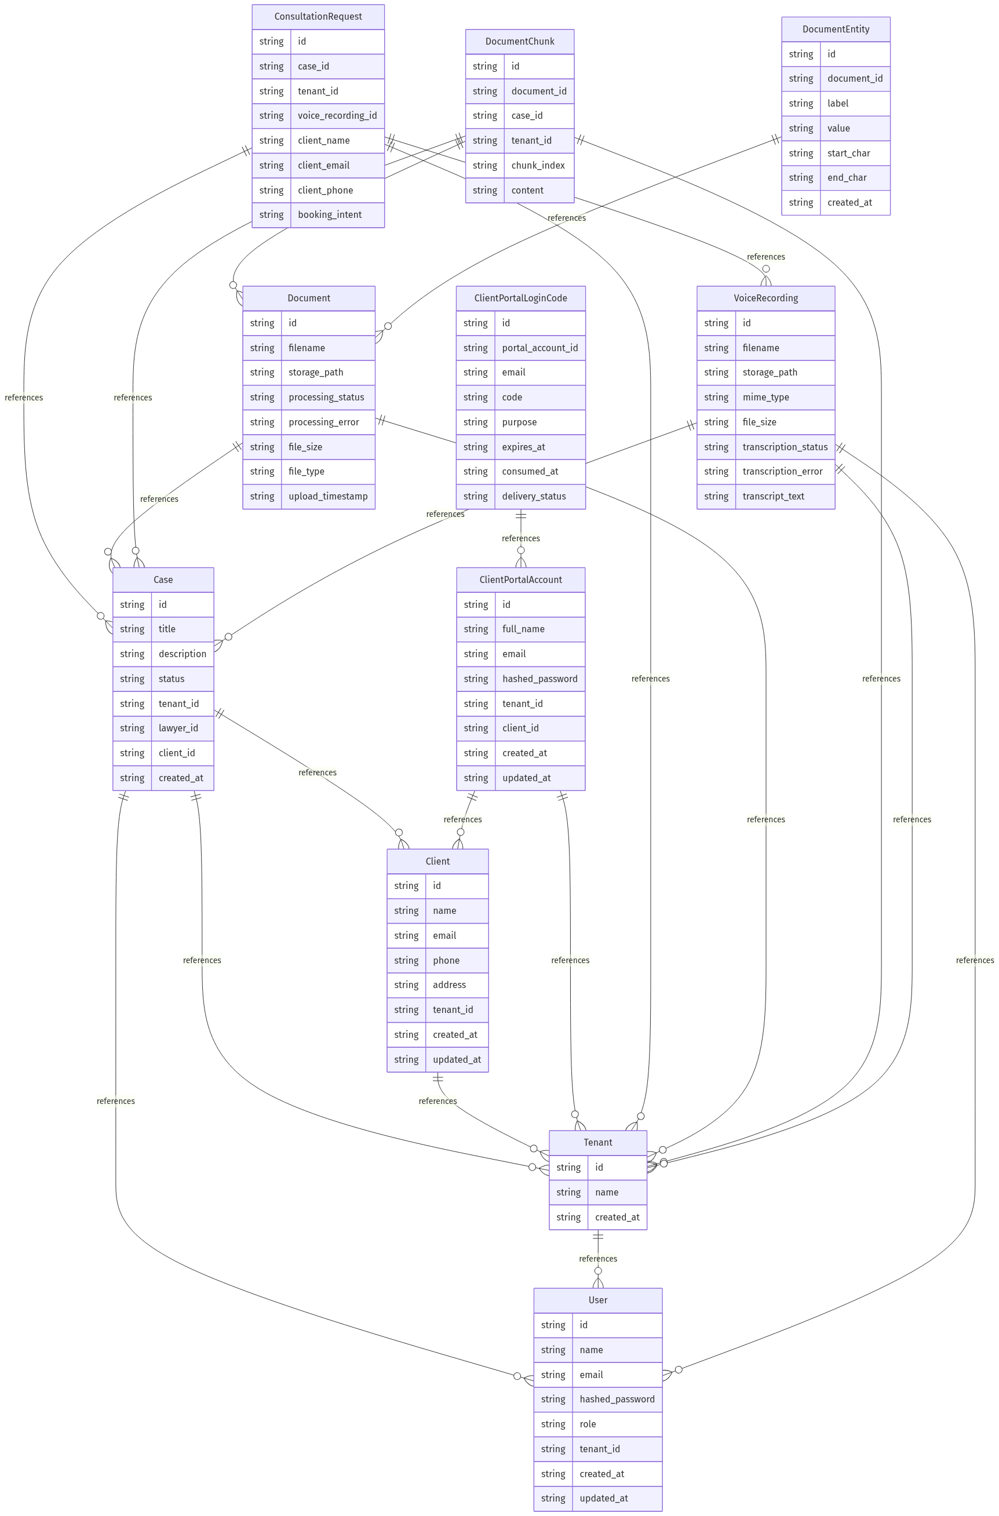
Entity-Relationship Diagram
Core data model

Slide 20
DESIGN & TECHNOLOGICAL CHOICES
07

Slide 21
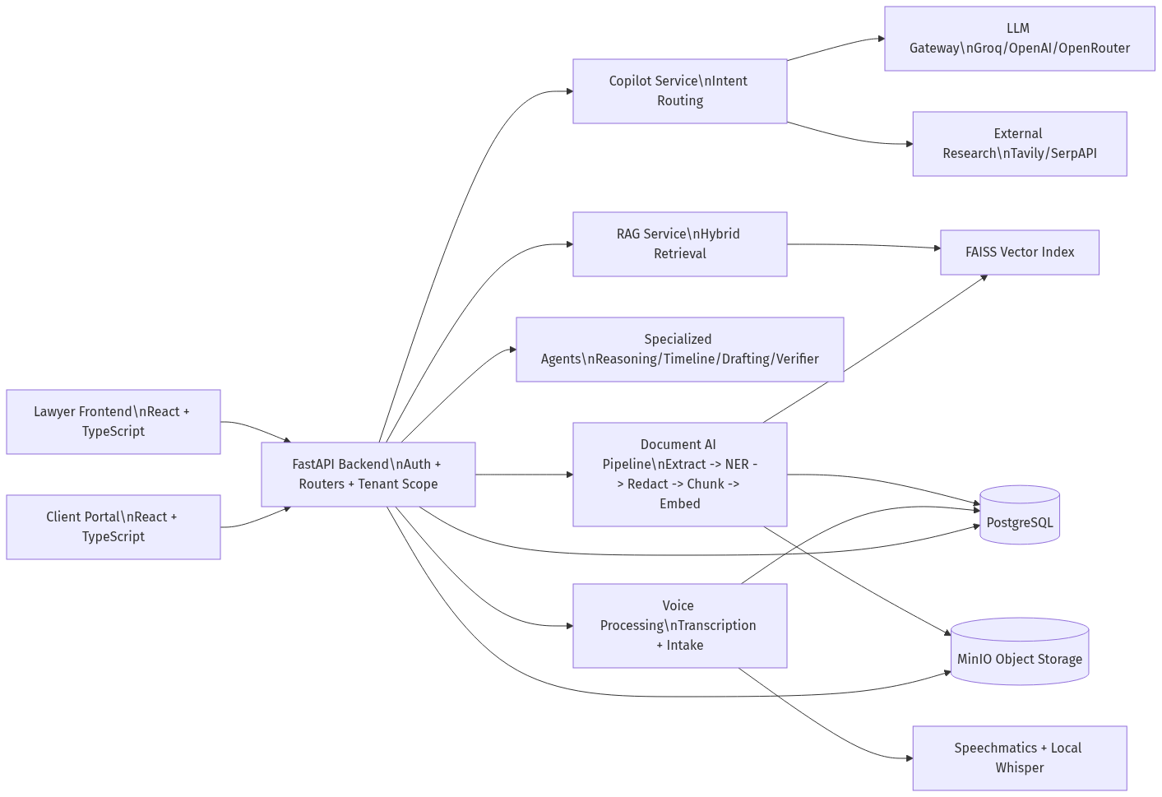
Logical Architecture
Layers and responsibilities

Slide 22
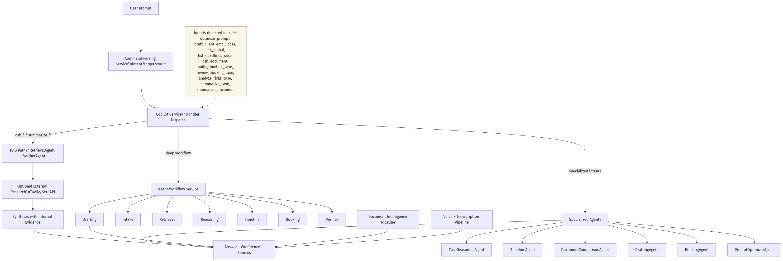
AI Orchestration Flow
Multi-agent pipeline internals

Slide 23
Physical Architecture
Docker deployment topology
Docker Host
React Frontend (Internal Workspace)
React Client Portal (Public Intake)
FastAPI Backend (Uvicorn --reload)
LLM Providers (Groq / OpenAI / OpenRouter)
Port 5173
Port 5174
Port 8000
External API
↓
↓
PostgreSQL 15 Port 5433
Redis 7 Port 6379
MinIO Object Storage Port 9000
FAISS Vector Index (In-memory)
AI Services Layer
▸ Document AI Pipeline
▸ RAG Service
▸ Legal Search
▸ Copilot Orchestrator
▸ Voice / Whisper
▸ Specialized Agents x10

Slide 24
Software Stack
Technologies chosen and why
Layer
Technology
Design Rationale
Frontend
React 18 + TypeScript + Vite + TailwindCSS
Two separate SPAs: internal workspace and public portal
Backend
FastAPI + Python 3 + Pydantic + Uvicorn
Async-first, auto-documented REST API with typed contracts
Database
PostgreSQL 15 + SQLAlchemy ORM
Relational model with multi-tenant isolation per schema
AI / ML
sentence-transformers + FAISS + Groq / OpenAI
Hybrid retrieval: dense embeddings + BM25 rerank + LLM generation
Storage
MinIO object storage
Document binary storage (PDFs, audio) with presigned URLs
Infra
Docker Compose + Redis 7 + GitHub Actions
Containerized local dev; CI trust-release-gate workflow

Slide 25
Security Design
Defence-in-depth across all layers
Authentication
Authorization
▸ JWT bearer tokens (stateless)
▸ RBAC: Admin / Lawyer / Assistant / Client
▸ BCrypt password hashing (cost factor 12)
▸ Multi-tenant: requests filtered by tenant_id
▸ Refresh token rotation
▸ Entity-level ownership checks on all routes
▸ OTP login for client portal
▸ Client portal isolated from internal API
Transport & Network
Data Protection
▸ HTTPS enforced in production
▸ PII redaction before embedding
▸ CORS allowlist per origin
▸ MinIO presigned URLs (time-limited)
▸ CORS preflight cache headers
▸ No secrets in source code (.env pattern)
▸ Rate limiting middleware
▸ Docker secrets for credentials

Slide 26
REALIZATION
08

Slide 27
Realization — AI Copilot Pipeline
Sprint 5–6: Orchestration & agents
1 User Prompt
2 Intent Detection
3 Context Enrichment
4 RAG Retrieval
5 LLM Generation
6 Verifier Agent
7 Assembly & Insight
→
→
→
→
→
→
Lawyer types natural language
15+ intents: ask, draft, summarize timeline, risks...
Case history, active docs, prior answers
FAISS dense + BM25 rerank hybrid search
Groq / OpenAI with grounded prompt contracts
Citation check Fallback reason Confidence score
Structured answer AI Insight panel Lawyer note
Specialized Agent Layer
PromptOptimizerAgent
RetrievalAgent
CaseReasoningAgent
TimelineAgent
DraftingAgent
DocumentComparisonAgent
StrictVerifierAgent
ClaimValidationAgent
ContradictionDetectionAgent
MatterClassificationAgent
ArticleApplicabilityAgent
WorkflowOrchestrator

Slide 28
Realization — Document Intelligence Pipeline
Sprint 3–4: From raw file to searchable knowledge
📤 Upload
🔍 OCR
🏷️ NER
🔒 PII Redact
✂️ Chunk
🧮 Embed
📦 Index
PDF / DOCX / Image MinIO storage Metadata in DB
→
Tesseract / PyPDF Scanned image support Text cleaning
→
Named entity recognition Person, Org, Date
→
Remove sensitive personal data before embedding
→
Sliding window chunking Overlap strategy
→
sentence-transformers all-MiniLM-L6-v2 384-dim vectors
→
FAISS CPU index Persisted to disk Metadata JSON
Hybrid Retrieval at Query Time
Query Embedding
FAISS Dense Search
BM25 Keyword
Cross-Encoder Rerank
Top-N Chunks
Source Citations
Encode user query with same model
Top-K by cosine similarity
Exact term match over corpus
Score all candidates together
Best N chunks pass to LLM
Article + page metadata attached
→
→
→
→
→

Slide 29
Realization — AI Insight & Trust Layer
Grounding classification + confidence scoring
Every AI answer is accompanied by a structured AI Insight block:
AI Insight — Example Response
Grounding Classification Matrix
grounding_type:
Case-grounded (document-based)
Scenario
Grounding Type
Confidence
confidence_level:
high
3+ doc sources, no fallback
Case-grounded (document-based)
high
sources_count:
7 document chunks matched
1–2 doc sources
Case-grounded
medium
Case context, no legal codes
Case-context reasoning
low
legal_grounding:
None — no verified legal provisions
External search fallback
Fallback (context-based)
medium
grounding_desc:
Strongly grounded in case documents, not supported by legal corpus
No sources found
Not grounded
low
lawyer_note:
Case record supports this response. Counsel review advised before external use.
General chat (no case)
General
varies

Slide 30
Realization — Frontend Workspaces
Internal workspace + public client portal
Internal Legal Workspace
Client Portal (Public)
Cases Page
Case list, filters, status badges, quick open
Intake Form
Name, contact, matter type, free-text description
Documents Page
Upload, preview, processing status, search
Case Status
Track status: pending → in-progress → closed
Copilot Chat
Intent-aware chat, AI Insight panel, sources
Document Upload
Attach supporting documents to intake request
Calendar Page
Deadline view, sync, event management
Portal Login
OTP-based login, isolated from staff auth
Evidence Review
Side-by-side doc comparison, annotations
Admin Panel
User management, tenant config, audit logs
Status History
Timeline of case updates and lawyer actions
Voice Intake
Record/upload audio, transcript view, link to case

Slide 31
Realization — Tests & Quality Gates
Automated validation across all trust-critical paths
Automated Eval Results
Full agent eval suite
43 / 43
100.0%
advancement/evals/agent_eval_report_20260330.json
Summary eval subset
6 / 6
100.0%
advancement/evals/agent_eval_report_summary.json
E2E copilot smoke test
4 / 4
100.0%
scripts/test_copilot_e2e.py
Backend unit tests (pytest)
All pass
—
tests/
Frontend build
0 errors
—
npm run build --prefix frontend
Client portal build
0 errors
—
npm run build --prefix client-portal
Definition of Done — Release Gate Thresholds
▸ Citation fidelity target: ≥ 95%
▸ Unsupported claim rate: ≤ 2%
▸ Weak-intent alert rate: < 70%
▸ Tier 3 Legal AI Done: grounding metadata on all outputs

Slide 32
CONCLUSION & PERSPECTIVES
09

Slide 33
Conclusion
What was built and what was proven
Delivered a production-architecture legal AI platform covering the full lawyer workflow:
Backend Platform
FastAPI, multi-tenant RBAC, 15 API routers, full case/client/document lifecycle
Document Intelligence
OCR → NER → PII redaction → chunking → FAISS indexing → hybrid retrieval
AI Copilot
15+ intents, 12 specialized agents, grounded answers, citation verification
Legal Search
Tunisia + Germany legal codes corpus, article-level retrieval, fallback taxonomy
Voice Intake
Audio → transcription → consultation extraction → case linkage
Client Portal
Public intake, OTP auth, case status, document upload — fully isolated
Trust Layer
AI Insight: grounding type, confidence, legal_grounding, lawyer note
Quality Gates
43/43 evals, 4/4 E2E, pytest suite, GitHub Actions release gate

Slide 34
Perspectives & Future Work
Next steps toward production readiness
Short-Term (next 3 months)
Long-Term (6–18 months)
▸ Fine-tune embedding model on Tunisian legal corpus
▸ Multi-jurisdiction expansion: France, Morocco, EU directives
▸ Article-level claim sentence mapping in UI
▸ Custom fine-tuned legal LLM (instruction-tuned on case data)
▸ Parser confidence scoring + disambiguation pass
▸ Real-time collaboration: multi-lawyer on same case
▸ Alembic database migrations (replace schema_sync.py)
▸ Mobile app for lawyer field access
▸ LLM provider abstraction + exponential backoff
▸ SaaS multi-firm deployment with billing and SSO

Slide 35
Thank You
Questions & Discussion
Legal AI Platform · PFE 2025–2026
github.com/ahmedbm068/legal-ai-platform-

