Slide 1
Cashing Opportunities in SPARK Framework
Presented By
Ahmed Mohamed Abdelmoniem Sayed

Slide 2
Outline
Introduction to Spark
How Caching works in SPARK
Missed Caching opportunities
How to benefit from Caching
Implementation Aspects
Planned Approach
Future Work

Slide 3
Introduction to SPARK
It extends the MapReduce model of Hadoop Framework to better support two common classes of batch and analytics applications:
Iterative algorithms (machine learning, graph)
Interactive data mining
Enhance programmability:
Integrates into Scala programming language.
Allow interactive use from Scala interpreter

Slide 4
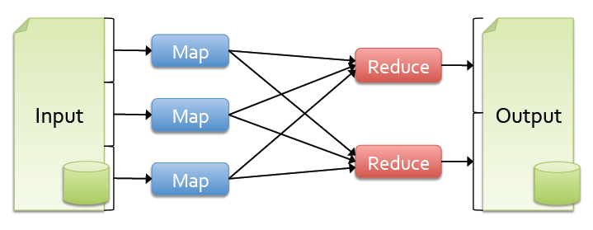
Introduction to SPARK
Problem and Motivation
Most current cluster programming models are based on directed acyclic data flow from stable storage to stable storage
Current frameworks and apps reload data from stable storage on each query execution.
Benefits of data flow: runtime can decide where to run tasks and can automatically recover from failures

Slide 5
Introduction to SPARK
Solution
Introduce Resilient Distributed Datasets (RDDs).
RDDs allow applications to keep working sets in memory for efficient reuse within a single lineage.
Retain the attractive properties of MapReduce
Fault tolerance, data locality, scalability
RDD is has the following characteristics:
Immutable collections of objects spread across a cluster
Built through parallel transformations (map, filter, etc)
Automatically rebuilt on failure
Controllable persistence (e.g. caching in RAM) for reuse

Slide 6
How Caching Works in SPARK
Most RDD operations are lazy (i.e, execution is delayed)
Think of an RDD as a description of a series of operations.
No data manipulation is carried out until an “ACTION” is called.
The following code is RDD that does ”NOTHING”:
IF an action is called, the file is read and action executes:

Slide 7
How Caching Works in SPARK
Actions: any RDD operation that require observing the contents of the data and hence cannot be lazy.
Count: the file needs to be read to count the number of lines in the file.
What if you call textFile.count again?
The file will be read and counted again.
An RDD is not data hence nothing is stored.

Slide 8

How Caching Works in SPARK
SPARK Framework has caching statement to cache an RDD in memory.
Now, the execution is same as before, “NOTHING” is executed.
textFile.cache is also a lazy operation
What happens when first call to textFile.count is called.
Now, the file will be loaded, cached, and counted.
All subsequent calls to textFile.count will use the cached version of the file.

Slide 9
How Caching Works in SPARK Important Notes about Caching
The cache behavior depends on the available memory.
If the file does not fit in the memory, then textFile.count will fall back to the usual behavior and re-read the file.
SPARK also assumes the file will never change.
It reads the file at an arbitrary point in time and may re-read parts of it as necessary later.
To handle changes/writes a new RDD (immutable) is created
Simply by creating a new file with a new name (textFile1) whenever you have new data, then load it as a new RDD

Slide 10
Missed Caching Opportunities When Caching is useful
cache is useful when the lineage of the RDD branches out.
If we want to filter the words of the previous example into a count for positive and negative words.
Without explicit call to Cache, each branch issues a reload of the data.
Adding an explicit cache statement will ensure that processing done previously in one branch is preserved and reused.

Slide 11

Missed Caching Opportunities Adding Explicit Call to Cache
In this case, Cache is said to “break the lineage” as it creates a checkpoint that can be reused for further processing.
RULE: Use cache when the lineage of your RDD branches out or when an RDD is used multiple times like in a loop.

Slide 12
How to Benefit from Caching Programmers

