Slide 1
Cashing Opportunities in SPARK Framework
Presented By
Ahmed Sayed and Byron Yi

Slide 2
Outline
Introduction to Spark
How Caching works in SPARK
Missed Caching opportunities
How to benefit from Caching
Implementation Aspects
Proposed Approach
Future Work

Slide 3
Introduction to SPARK
It extends the MapReduce model of Hadoop Framework to better support two common classes of batch and analytics applications:
Iterative algorithms (machine learning, graph)
Interactive data mining
Enhance programmability:
Integrates into Scala programming language.
Allow interactive use from Scala interpreter

Slide 4
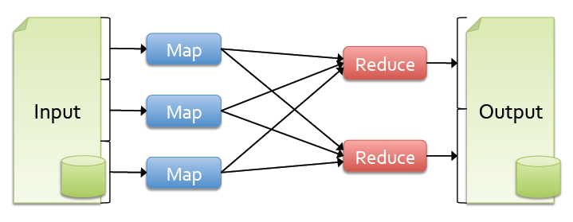
Introduction to SPARK
Problem and Motivation
Most current cluster programming models are based on directed acyclic data flow from stable storage to stable storage
Current frameworks and apps reload data from stable storage on each query execution.
Benefits of data flow: runtime can decide where to run tasks and can automatically recover from failures

Slide 5
Introduction to SPARK
Solution
Introduce Resilient Distributed Datasets (RDDs).
RDDs allow applications to keep working sets in memory for efficient reuse within a single lineage.
RDD is has the following characteristics:
Immutable collections of objects spread across a cluster
Built through parallel transformations (map, filter, etc)
Automatically rebuilt on failure
Controllable persistence (e.g. caching in RAM) for reuse
Retain the attractive properties of MapReduce
Fault tolerance, data locality, scalability

Slide 6
How Caching Works in SPARK Lazy Execution
Most RDD operations are lazy (i.e, execution is delayed)
RDD is a description of a series of operations.
No data manipulation is carried out until an “ACTION” is called.
The following code is RDD that does ”NOTHING”:
IF an action is called, the file is read and action executes:

Slide 7
How Caching Works in SPARK Actions
Actions: any RDD operation that require observing the contents of the data and hence cannot be lazy.
Count: the file needs to be read to count the number of lines in the file.
What if you call textFile.count again?
The file will be read and counted again.
RDD is not data hence nothing is stored.

Slide 8

How Caching Works in SPARK Cache statement
SPARK Framework has caching statement to cache an RDD in memory.
Now, the execution is same as before, “NOTHING” is executed.
textFile.cache is also a lazy operation
What happens when first call to textFile.count is called.
Now, the file will be loaded, cached, and counted.
All subsequent calls to textFile.count will use the cached version of the file.

Slide 9
How Caching Works in SPARK Important Notes about Caching
The cache behavior depends on the available memory.
If the file does not fit in the memory, then textFile.count will fall back to the usual behavior and re-read the file.
SPARK also assumes the file will never change.
It reads the file at an arbitrary point in time and may re-read parts of it as necessary later.
To handle changes/writes a new RDD (immutable) is created
Simply by creating a new file with a new name (textFile1) whenever you have new data, then load it as a new RDD

Slide 10
Missed Caching Opportunities When Caching is useful
cache is useful when the lineage of the RDD branches out.
If we want to filter the words of the previous example into a count for positive and negative words.
Without explicit call to Cache, each branch issues a reload of the data.
Adding an explicit cache statement will ensure that processing done previously in one branch is preserved and reused.

Slide 11

Missed Caching Opportunities Adding Explicit Call to Cache
In this case, Cache is said to “break the lineage” as it creates a checkpoint that can be reused for further processing.
RULE: Use cache when the lineage of your RDD branches out or when an RDD is used multiple times like in a loop.

Slide 12
How to Benefit from Caching Programmers
Programmers need to identify the dependency graphs for different RDDs that share a common substructure.
Programmers need to pin point the caching points in the whole program.
Programmers need to explicitly call function Cache on RDDs.
Non-Trivial task for programmers.
Programmers may not well trained/aware to benefit from Caching.
Projects have many contributors which makes even Caching harder.

Slide 13
How to Benefit from Caching The right way
Programmers need to focus on the functionality of different jobs.
Programmers need not worry about Caching enforcement.
Programmers need to collaborate smoothly.
Code Analysis to identify Job dependencies .
Automatic insertion of caching calls.
Efficient caching management framework.

Slide 14
Implementation Aspects Current state
Spark program instantiates an instance of Java class T that is a subclass of the base class org.apache.spark.rdd.RDD for each transformation.
The constructor of the base class consists of two arguments
a sequence of its dependencies deps into dependcies_ variable.
a Spark context singleton.
dependencies_ of the base class will be used in runtime to analyze the dependency graph.
the subclass could override this behavior by providing an alternative implementation of getDependencies().
Type of dependencies_ is Seq[Dependency[T]], a generic container type and its actual content is difficult to be revealed in the compile-time.

Slide 15
Implementation Aspects The right way
Analyze the dependencies by only inspecting the code instead of looking into the content of variable dependcies_ .
The def-use chain of RDD variables in transformation methods reveals data flow dependencies dfdeps.
While not as accurate as dependcies_ but gives useful insight on deps.
Actual deps is always a subset of dfdeps
Data-flow dependencies is not sound (i.e, if an RDD u in the data-flow dependencies of RDD v does not imply u is an actual DAG dependency of v)
However, if the value of u does not propagate to instantiation of v in the user program, u is certainly not an actual DAG dependency of v.

Slide 16
Proposed Approach Static Analysis
Static code analysis, which does not involve actually running of the program.
Static (Data-flow) analysis pose inaccurate possibilities given existence of a variety of control flow constructs (e.g. branching, switching, and loops).
The actual precision of the dependency analysis can be quantified
By Comparing against the benchmark caching policy (i.e. blindly taking all previous defined RDDs as dependencies without doing data-flow analysis).
Variables in the user program that represent the same RDD in terms of materalization
Reading the same input from disk multiple times
Apply semantically same mapper/aggregation functions more than once to the dataset.
This limitation is also impossible to avoid in Spark since there is no algorithm that is guaranteed to halt for equivalence relation detection.

Slide 17
Proposed Approach System Design
Spark RDD is represented as a immutable variable in the Scala progra
Explicitly declared using val keyword.
Implicitly declared in the return value of chaining method calls.
Data flow graph of RDD variables, which is available at compile-time when constructing the def-use chain for each of the program.
After merging the dependency graphs of all output into a single monolithic dependency graph.
prune to paths that do not lead to an output.
The out degrees of the intermediate nodes in the graph will be used to determine whether an alternative caching policy
Caching is prioritized in the descending order of intermediate nodes

Slide 18
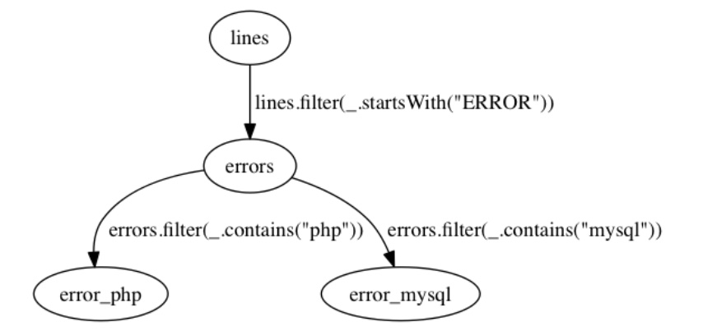
Proposed Approach Example

Slide 19
Proposed Approach Example
val lines = spark.textFile("hdfs://inputData")
val errors = lines.filter(_.startsWith("ERROR"))
Dependency detected between errors_php and errors_mysql
At this point the call to errors.cache is injected at the compilation time
errors.cache()
val num_error_php = errors.filter(_.contains("php")).count()
val num_error_mysql = errors.filter(_.contains("mysql")).count()
No need to read inputData again

Slide 20
Future Work
Fully understand the compilation engine of SPARK framework.
Build an algorithm to extract the data-flow dependencies among submitted jobs.
Build a tree to prioritize RDDs based on their order and out degree.
Implement and integrate as a module in SPARK.
Evaluate the performance gains and compare with naïve cache all RDD approach.

Slide 21
Thanks

