Slide 1
Reconciling Mice and Elephants in Data Center Networks
Conference Paper in Proceedings of CloudNet15 By
Ahmed M. Abdelmoniem and Brahim Bensaou
Presented By
Xiaoming Dai
Affiliated by
The Hong Kong University of Science and Technology

Slide 2
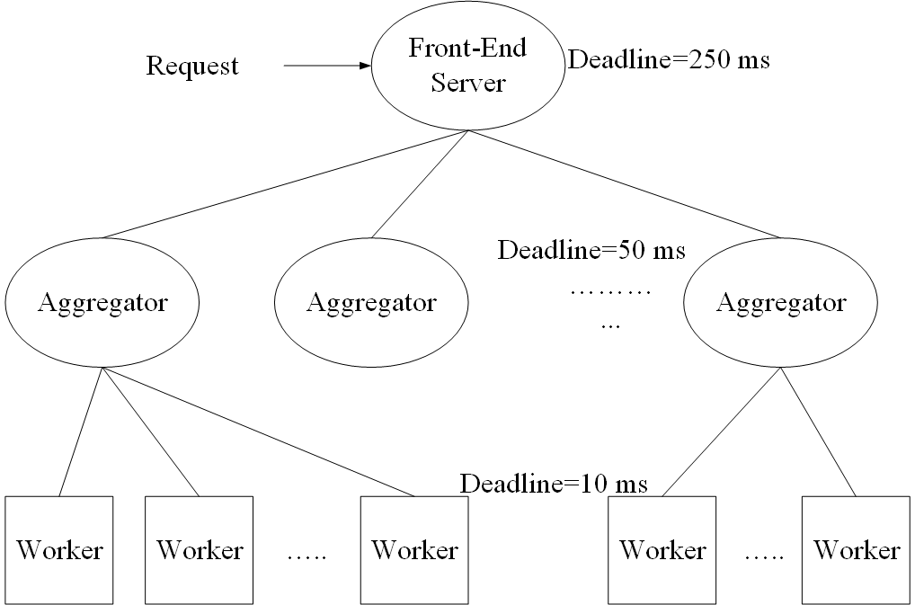
Partition/Aggregate Application Structure
Time is money
Strict deadlines (SLAs)
Missed deadline
Lower quality result
The foundation for many large-scale web applications.
Web search, Social network, Ad selection.
Examples : Google/Bing Search, Facebook Queries
Notes:
1- Talk about Partition Aggregate Type of traffic as explained by the figure, where a request comes in to Front-End Server with a specific Deadline (e.g 250 ms). The Application needs to return results within specified deadline otherwise the Service Level Agreement (SLA) is violated resulting into loss of revenue.
2- Each layer of the application has its own deadline, if missed, a partial result is returned to the user.
3- This type of application architecture is the foundation for many web-applications (e.g, web search, social networks, … etc) like Google search and Facebook Queries.
4- In most cases, Network is the bottleneck and the main contributor to missed deadlines -> hence the problem under research

Slide 3

Typical Workloads - Mice
Partition/Aggregate
(Query)
Short messages [50KB-1MB]
(Coordination, Control state)
Delay-sensitive
Delay-sensitive
Majority in data centers
(Contributes small number of bytes)
Mice
Notes:
1- Workloads in data centers are categorized into Mice and Elephants where most bytes comes from Elephants however the majority of the traffic are Mice
2- Mice flows includes Partition/Aggregate type of traffic as well as most short messages (i.e Control and Coordination).
3- They are the majority of traffic in DC but contribute small number of bytes to the total number of bytes in the network
4- Mice traffic is very sensitive to delays, large delays may prohibit their efficiency.

Slide 4

Typical Workloads - Elephant
Large flows [>1MB]
(Data update, VM migration)
Throughput-sensitive
Minority in data centers
(Contribute large number of bytes)
Elephant
Notes:
1- Elephant flows includes large volumes of Data updates and VM migration type of traffic.
2- They are the minority of traffic in DC but contribute large number of bytes to the total number of bytes in the network
3- Mice traffic is very sensitive to available throughput, small available bandwidth may interrupt their operation.

Slide 5

The Conflict
Partition/Aggregate
(Query)
Short messages [50KB-1MB]
(Coordination, Control state)
Large flows [>1MB]
(Data update, VM migration)
Delay-sensitive
Delay-sensitive
Throughput-sensitive
Notes:
1- There are a conflicting requirements from both types of flows ( The elephants with high throughput requirements and The mice with low latency requirements).
2- Hence, we need to reconcile between these conflicting parties and achieve their requirements simulatensouly.

Slide 6
TCP in the Data Center
TCP and its variants do not meet demands of applications in DC environment.
Suffers from bursty packet drops, Incast Problem
Elephants build up large queues:
Adds significant latency.
Wastes precious buffers, esp. bad with shallow-buffered switches.
Goal: Design an appropriate congestion control for data centers.
Window-based Solutions: DCTCP [1], ICTCP [2]
Loss Recovery Schemes: Reducing MinRTO [3], Cutting-Payload [4].
Notes:
1- TCP is the most widely used (nearly 99%) transport protocol by most applications in data centers.
2- TCP was designed with the internet architecture in mind and it is ill-suited to operate in data center environments.
3- similarly, its variants inherit the parent’s drawbacks and all were designed to achieve high speed in internet or wireless networks.
4- They suffer from bursty packet drops (incast), large queue build up from elephant traffic.
5- Recent proposals to design a suitable transport protocol for data centers
6- Window-based solutions (modification of current TCP) : DCTCP and ICTCP.
7- Loss Recovery Schemes (enhance loss recovery mechanism of TCP) : Reducing Minimum Retransmission Timeout (MinRTO) and Cutting-Payload in face of possible overflow.

Slide 7
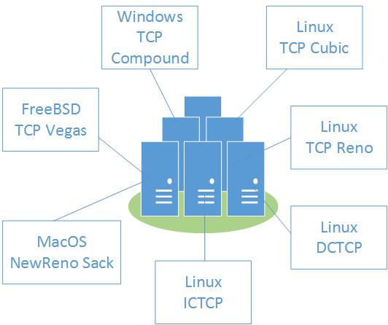
Drawbacks of proposed solutions
Data centers (esp. public ones) allows provisioning of VMs from different OS images each running a different TCP flavor → Fairness and stability issues.
Notes:
1- One of the major drawbacks of these proposals is that they depend on the implementation of transport protocol at sender/receiver in the VM image.
2- Cloud operators can not force specific OS image onto the tenants, they can selectively run customized images on the provisioned VMs.
3- Different TCP implementations may lead to fairness and stability issues.

Slide 8
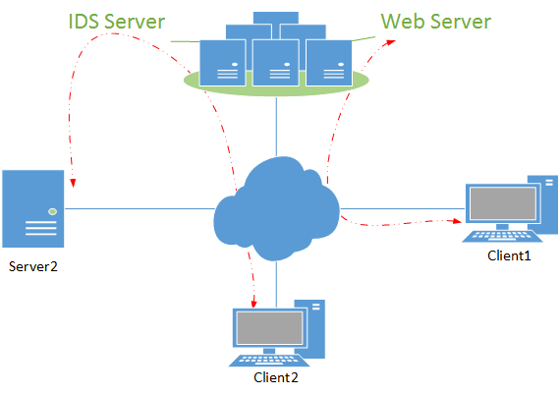
Drawbacks of proposed solutions (Cont.)
Requires modifications of TCP stack at the sender or the receiver or both → Not feasible if one of the peers are outside the data center.
Notes:
1- all proposals requires some modification either at the sender side, receiver side or both sides.
2- This is requirement may prohibit the actual deployment of such schemes.
3- For example if one or both communicating entities are outside the control of cloud operators.
4- In web server case, the client is outside the cloud network and in Intrusion Detection Server (middlebox) case, both the client and server are outside the cloud network

Slide 9
Data Center Transport Requirements
High Burst Tolerance.
Low Latency for mice and High Throughput for elephants.
fit with all TCP flavors.
No modifications to the TCP stack at all.
The challenge is to achieve these Conflicting Requirements.
Notes:
1- In summery, to design a practical mechanism, we need to achieve all the mentioned requirements where 3 and 4 which was missing from the previous proposals.
2- what is challenging is achieving all conflicting requirements at the same time.

Slide 10
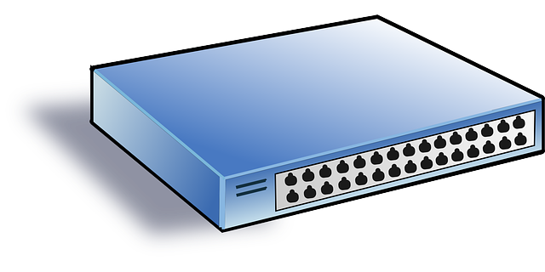

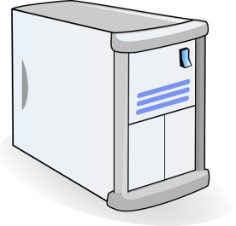
TCP Flow Control is the answer
Flow Control is part of all TCP flavors
Data
Data
Sender
Receiver
ACK
ACK
TCP header has a Receive Window Field to convey amount of buffer left at the receiver.
Send Window = Min (Congestion Win, Receive Win).
Notes:
1- Our answer leverages the functions of TCP flow control, which is an integral part of all types of TCP flavors
2- Hence, our solution will fit with all TCPs and will not require any more modifications to TCP stack.
3- In TCP flow control, the receiver uses TCP receive window field for conveying the amount of buffer left which will throttle the sender.
4- TCP flow control limits the sending rate of TCP senders using the equation above SendWnd=Min (congestion win, receive win).

Slide 11
Two Key Ideas
Switch’s egress port toward destination is a receiver of the data.
Buffer occupancy change over time
Buffer occupancy reflects level of congestion.
Locality of number of ongoing flow information.
Send explicit feedback by leveraging TCP receive window.
Similar to XCP and ATM-ABR techniques.
Receive window controls the sending rate.
Feedback is less than ½ RTT away.
Fast reaction to congestion events.
Low computation and rewriting overhead.
Notes:
Idea1 : In our scheme, we treat the egress port of the switch as the TCP receiver with limited buffering space.
1- Each port’s buffer space change over time and reflects level of congestion.
2- Number of active flows can be easily known by tracking per-port SYN and FIN flags.
Idea2: In our scheme, we send explicit feedback by rewriting the TCP receive window value in the backward direction.
1- The idea is quite similar to XCP and ATM-ABR techniques without their complexity.
2- Receive window will eventually limit TCP sender rate
3- the feedback is only ½ RTT away leading to fact reaction to congestion events.
4- our scheme requires O(1) computation and rewrite overhead.

Slide 12
RWNDQ Algorithm
Switch side (Local window proportional to queue occupancy):
Increase receive window when below the target.
Decrease when we are above the queue target.
Slow start to initially reach target fast.
Switch Port
Queue Target
Data
Data
ACK
ACK
Sender/Reciever side (No Change):
Send Window = Min(Congestion Win, Receive Win)
Notes:
RWNDQ Algorithm is implemented at the switch side only. No modifications to TCP sender/receiver.
At the switch:
1- Switch tracks a per-port local window value reflecting the current outgoing (forward path) queue occupancy with respect to the queue target.
2- The window is increased when the current queue level is less than the target and decreased if it is above queue target
3- We incorporate slow-start mechanism like TCP to achieve fast convergence towards the queue target level after which it will be disabled.

Slide 13
RWNDQ Convergence
Using fluid approach to model how RWNDQ reacts proportionally
Expectation: average queue converges to target as “t” goes to infinity
Experiment: run model in Matlab where target is set to 16.6 pkts
Notes:
To prove its convergence, we have set up a fluid model that mimics the operations of RWNDQ at the switch.
1- The model was implemented and several trials were run on matlab.
2- The expectation is that the average queue as the time reach infinity should converge to the target queue size.
3- Outcome from the matlab model is that average queue reaches the target, and the convergence is even faster with slow-start mechanism.

Slide 14
RWNDQ Fairness
Using implementation of RWNDQ in NS2.
Expectation: Better fairness and small variance due to equal buffer allocation among competing flows and shorter control loop.
Experiment: run 5 flows successively and compare with DCTCP
DCTCP
RWNDQ
Notes:
To prove its fairness among competing flows. We use implementation of RWNDQ in NS2 as the basis for our simulations.
1- We use a dumbbell topology (single routed topology), with 5 senders towards a single receiver starting and stopping at different times (in successive manner).
2- Expectation is that RWNDQ achieves good fairness due to its equal buffer allocation among competing flows and short control loop.
3- Compared with DCTCP, Figure shows that RWNDQ achieves better fairness with small variance.

Slide 15
Performance Analysis - MICE
NS2 simulation and compare with XCP, DCTCP.
Scenarios depicting Mice colliding with Elephants.
Mice Goal: Low Latency and low variability
*CDF: shows distribution over mice flows only
Notes:
Performance analysis of MICE flows – Goal is to achieve low latency.
1- We use a dumbbell topology with 50 senders (25 Mice and 25 Elephants) competing toward a single receiver.
2- we compare RWNDQ with DCTCP and XCP
3- Figure shows that RWNDQ flows achieves an smaller average response time with nearly zero variability among competing Mice flows.
4- This result is mainly attributed to low queue occupancies and the low loss rate and hence low retransmission timeouts leading to faster completion times.
4- This means that RWNDQ can guarantee a specific deadlines to flows and ensure that nearly all of them won't miss the deadline.

Slide 16
Performance Analysis - Elephants
NS2 simulation and compare with XCP, DCTCP.
Scenario depicting Mice colliding with Elephants.
Elephants Goal: High throughput
*CDF: shows distribution over elephant flows only
Notes:
Performance analysis of Elephants flows – Goal is to achieve high throughput with fair allocation among elephants.
1- We use a dumbbell topology with 50 senders (25 Mice and 25 Elephants) competing toward a single receiver.
2- we compare RWNDQ with DCTCP and XCP
3- Figure shows that RWNDQ flows achieves a high throughput close to what DCTCP and XCP achieves with a near zero variability among competing elephant flows.
4- This is attributed to the fact that RWNDQ fairly allocates the buffer space among competing flows and redistribute it proactively among active flows only.
5- This means that RWNDQ can guarantee a specific throughput to flows and ensure that nearly all of them achieve an equal effective throughput.

Slide 17
Performance Analysis - Queue
NS2 simulation and compare with XCP, DCTCP.
Scenario depicting Mice colliding with Elephants.
Queue Goal: Stable and small persistent queue
Notes:
Performance analysis of RWNDQ queue – Goal is to achieve small persistent queue with low variability.
1- We use a dumbbell topology with 50 senders (25 Mice and 25 Elephants) competing toward a single receiver.
2- we compare RWNDQ with DCTCP and XCP
3- Figure shows that RWNDQ achieves small persistent queue with nearly zero variability close to what is achieved by DCTCP.
4- This means that RWNDQ can ensure low queueing delay and burst tolerance.

Slide 18
Performance Analysis - Link
NS2 simulation and compare with XCP, DCTCP.
Scenario depicting Mice colliding with Elephants.
Link Goal: High Link Utilization over the time
*Drop in utilization for RWNDQ is only at the beginning of incast epoch due to its fast reaction and redistribution of bandwidth
Notes:
Performance analysis of Link– Goal is to achieve high link utilization over the time.
1- We use a dumbbell topology with 50 senders (25 Mice and 25 Elephants) competing toward a single receiver.
2- we compare RWNDQ with DCTCP and XCP
3- Figure shows that RWNDQ achieves high link utilization with small drops during the incast period only.
4- This means that RWNDQ can work in a work conserving manner while utilizing the available link bandwidth.

Slide 19
Why RWNDQ Works
High Burst Tolerance
Large buffer headroom → bursts fit.
Short control loop→ sources react before packets are dropped.
Low Latency
Small queue occupancies → low queuing delay.
3. High Throughput
Fair and fast bandwidth allocation→ mice finish fast and elephants retrieve back the bandwidth fast.
Notes:
The points in the slides is enough

Slide 20
Conclusions
RWNDQ satisfies all mentioned requirements for Data Center packet transport.
Handles bursts well.
Keeps queuing delays low.
Achieves high throughput.
Fits with any TCP flavor running on any OS.
No Modifications to TCP stack.
Features:
Very simple change to switch queue management logic.
Allows immediate and incremental deployment.
Notes:
The points in the slides is enough

Slide 21
References
[1] M. Alizadeh, A. Greenberg, D. A. Maltz, J. Padhye, P. Patel, B. Prabhakar, S. Sengupta, and M. Sridharan, “Data center TCP (DCTCP),” ACM SIGCOMM Computer Communication Review, vol. 40, p. 63, 2010.
[2] H. Wu, Z. Feng, C. Guo, and Y. Zhang, “ICTCP: Incast congestion control for TCP in data-center networks,” IEEE/ACM Transactions on Networking, vol. 21, pp. 345–358, 2013.
[3] V. Vasudevan, A. Phanishayee, H. Shah, E. Krevat, D. G. Andersen, G. R. Ganger, G. A. Gibson, and B. Mueller, “Safe and effective fine-grained TCP retransmissions for datacenter communication,” ACM SIGCOMM Computer Communication Review, vol. 39, p. 303, 2009.
[4] P. Cheng, F. Ren, R. Shu, and C. Lin, “Catch the Whole Lot in an Action: Rapid Precise Packet Loss Notification in Data Center,” in Proceedings of the 11th USENIX Symposium on Networked Systems Design and Implementation (NSDI 14), pp. 17–28, 2014.
Notes:
References to the proposed solutions DCTCP, ICTCP, MinRTO and Cutting-Payload

Slide 22
Thanks – Questions are welcomed

