Slide 1
Incast-Aware Switch-Assisted TCP Congestion Control for Data Centers
Conference Paper in Proceedings of GloebCom15 By
Ahmed M. Abdelmoniem and Brahim Bensaou
Presented By
Ahmed Mohamed Abdelmoniem Sayed
Affiliated by
The Hong Kong University of Science and Technology

Slide 2
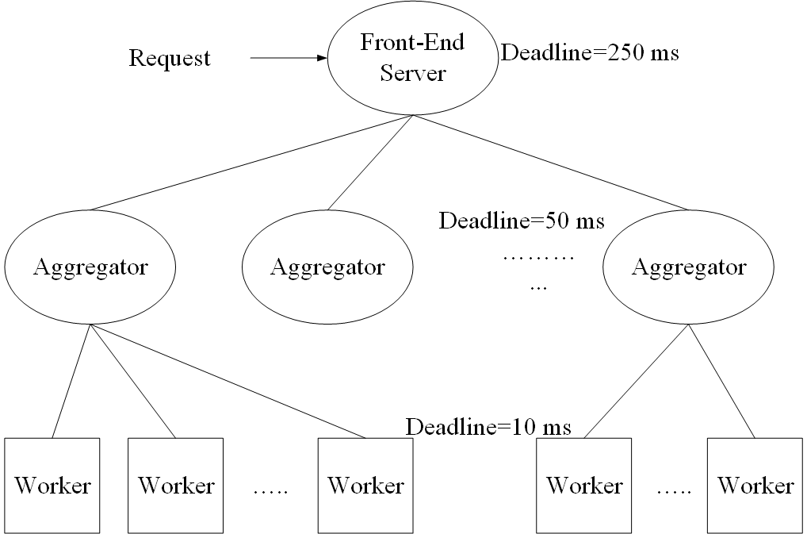
Partition/Aggregate Application Structure
Time is money
Strict deadlines (SLAs)
Missed deadline
Lower quality result
The foundation for many large-scale web applications[1].
Web search, Social network composition, Ad selection.
Examples : Google/Bing Search, Facebook Queries

Slide 3



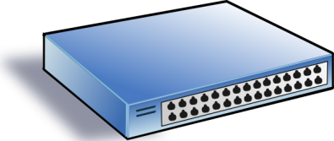

TCP Incast Problem
Worker 1
Synchronized mice collide.
Caused by Partition/Aggregate.
Aggregator
Deadline 50ms
Worker 2
Worker 3
RTO_{min} = 200 ms
Worker 4
Miss deadline due to TCP timeout detected by RTO

Slide 4
TCP in the Data Center
TCP and its variants does not meet demands of partition/aggregate applications in DC envirnoment.
Suffers from bursty packet drops → Incast Problem
Active research topic to design techniques that alleviate incast events in data centers.
Window-based Solutions: DCTCP [2], ICTCP [3]
Fast Loss Recovery Schemes: Reducing MinRTO [4]

Slide 5
Drawbacks of proposed solutions
Data centers (esp. public ones) allows provisioning of VMs from different OS images each running a different TCP flavor → Different congestion control logic.

Slide 6
Drawbacks of proposed solutions (Cont.)
Requires modifications of TCP stack at the sender or the receiver or both → Not feasible if the tenant upload his own image or one of the peers are outside the data center.

Slide 7
Incast-Aware Solution Requirements
Low Latency for incast traffic.
High Throughput for elephants.
Fit with all TCP flavors.
No modifications to the TCP stack at all.
Simple enough for ease of deployment.
The challenge is to achieve all of these Conflicting Requirements.

Slide 8
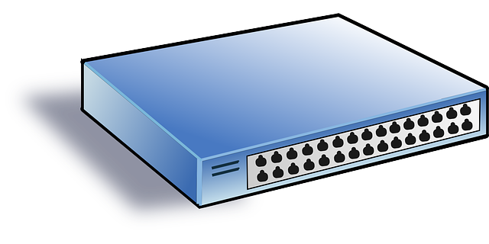
TCP Flow Control is the answer
Flow Control is part of all TCP flavors
Data
Data
Sender
Receiver
ACK
ACK
TCP header has a Receive Window Field which is a major part of TCP’s rate control (sending rate).
Send Window = Min (Congestion Win, Receive Win).

Slide 9
Two Key Ideas
Switch port toward destination monitors connection setup rate.
Count the number of SYN-ACKs and FINs.
The difference represents the expected new connections.
If expected number will overflow buffer → incast flag.
Set TCP receive window to 1 MSS during Incast.
Proactively react to possible incast congestion event.
Clear the buffer space occupied by elephants.
Make room for the incoming incast traffic.
Disable rewriting when incast event clears.
Low computation and rewriting overhead.

Slide 10
IQM Algorithm
Switch side (Continuously monitor incoming SYN/FIN):
If (extra traffic > “limit”) → raise incast flag.
Set TCP RWND=1 MSS during incast epoch.
Disable window rewriting when the queue drops back to “Save thr”.
Switch Port
Limit
Save Thr
Data
Data
ACK
ACK
Sender side (No Change):
Send Window = Min(Congestion Win, Receive Win)

Slide 11
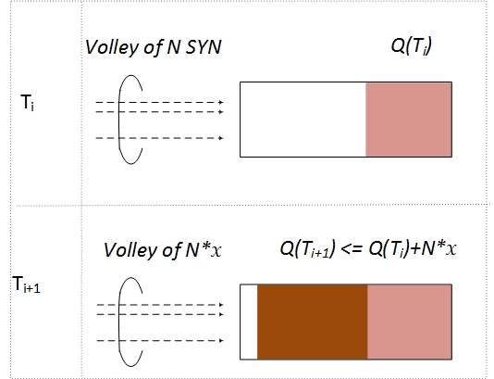
IQM example
At time T(i): the (persistent) queue was stable at Q(T(i)) while monitoring SYNs and FINs going through the queue.
At time T(i+1): the # of (new-close) connections observed within T(i+1)-T(i) is N, where x is the initial TCP congestion window in MSS.
If Q(T(i+1)) + N*x MSS > Q(limit) → raise INCAST flag.

Slide 12
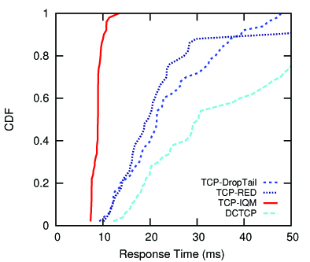
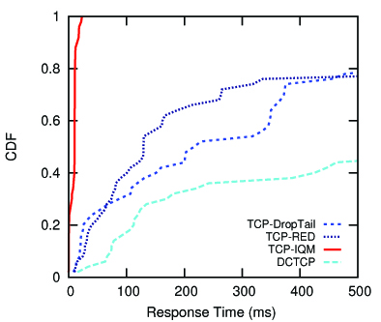
Simulation Analysis - Mice
NS2 simulation in a dumbbell topology and compare IQM with TCP-DropTail, TCP-RED and DCTCP.
Scenario depicting 100 flows (Mice and Elephants).
Mice Goal: Low Latency and low variance
Mean FCT
FCT Standard Deviation
*CDF: shows distribution over mice flows only (drops)

Slide 13
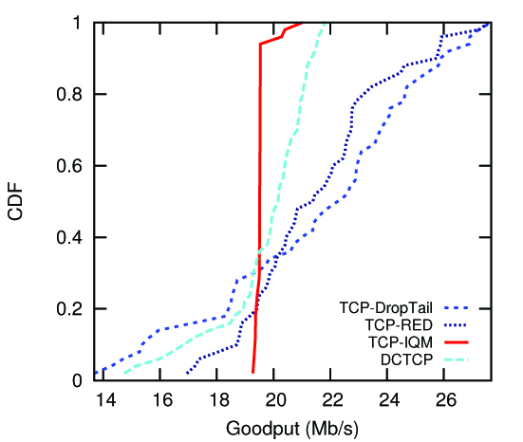
Simulation Analysis - Elephants
NS2 simulation in a single rooted setup (Many-to-1).
Scenario depicting 100 flows (Mice and Elephants).
Elephants Goal: High throughput

Slide 14
Testbed Setup
12 servers: 1 master, 1 OVS physical machine, 5 senders and 5 receivers with OVS for the vPorts.
Mice flows are Web page requests of 11.5 KB.
Elephants flows are iperf long lived connections.

Slide 15
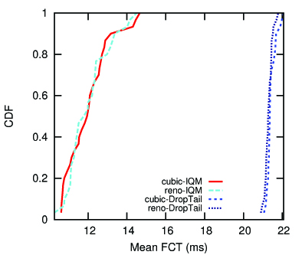
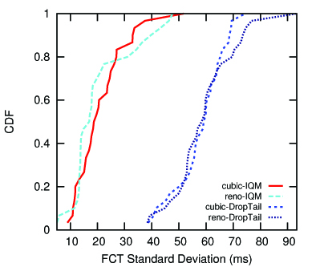
Experimental Analysis - Mice
Compare IQM against DropTail for Reno and Cubic.
Scenario depicting 150 elephants against 30 Mice.
Mice Goal: Low Latency and low variance
*CDF: shows distribution over mice flows only (drops)

Slide 16
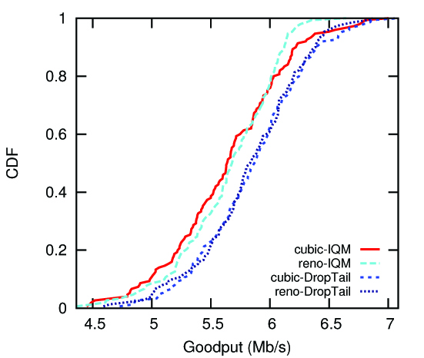
Experimental Analysis - Elephants
Compare IQM against DropTail for Reno and Cubic.
Scenario depicting 150 elephants against 30 Mice.
Elephants Goal: High throughput

Slide 17
Why IQM Works
High Burst Tolerance
Large buffer headroom before incast → bursts fit.
Short control loop→ sources react before packets are dropped.
Low Latency
Small queue occupancies → low queuing delay.
3. High Throughput
Fair and fast bandwidth allocation→ mice finish fast and elephants retrieve back the bandwidth fast.

Slide 18
Conclusions
IQM satisfies all mentioned requirements for Data Center packet transport.
Handles bursts well.
Keeps queuing delays low.
Achieves high throughput.
Fits with any TCP flavor running on any OS.
No Modifications to TCP stack.
Features:
Very simple change to switch queue management logic.
Allows incremental deployment.

Slide 19
References
[1] S. Kandula, S. Sengupta, A. Greenberg, P. Patel, and R. Chaiken, “The nature of data center traffic,” in Proceedings of the 9th ACM SIGCOMM conference on Internet measurement conference -IMC ’09. New York, New York, USA: ACM Press, Nov. 2009,p. 202.
[2] M. Alizadeh, A. Greenberg, D. A. Maltz, J. Padhye, P. Patel, B. Prabhakar, S. Sengupta, and M. Sridharan, “Data center TCP (DCTCP),” ACM SIGCOMM Computer Communication Review, vol. 40, p. 63, 2010.
[3] H. Wu, Z. Feng, C. Guo, and Y. Zhang, “ICTCP: Incast congestion control for TCP in data-center networks,” IEEE/ACM Transactions on Networking, vol. 21, pp. 345–358, 2013.
[4] V. Vasudevan, A. Phanishayee, H. Shah, E. Krevat, D. G. Andersen, G. R. Ganger, G. A. Gibson, and B. Mueller, “Safe and effective fine-grained TCP retransmissions for datacenter communication,” ACM SIGCOMM Computer Communication Review, vol. 39, p. 303, 2009.

Slide 20
Thanks – Questions are welcomed

Slide 21
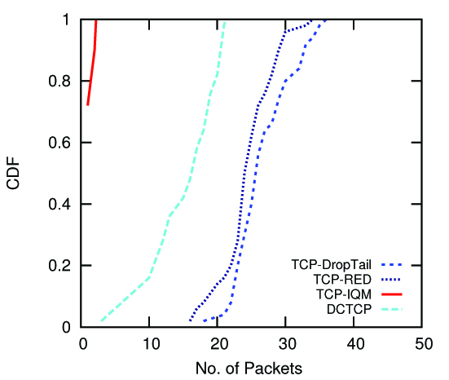
Simulation Analysis - Drops
Goal: Less drops → less timeouts → faster FCT
*CDF: shows distribution over mice flows only
Back
Notes:
Not ns2.

Slide 22
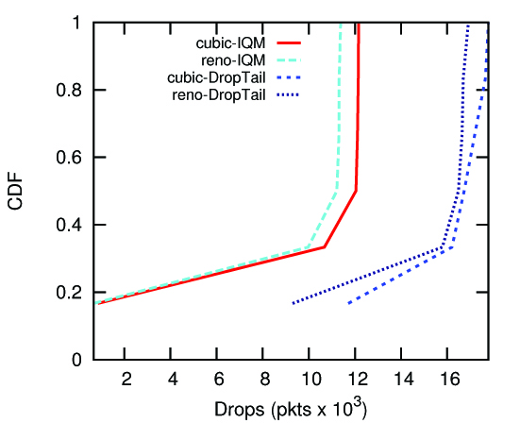
Experimental Analysis - Drops
Goal: Less drops → less timeouts → faster FCT
*CDF: shows distribution over mice flows only
Back

