Slide 1


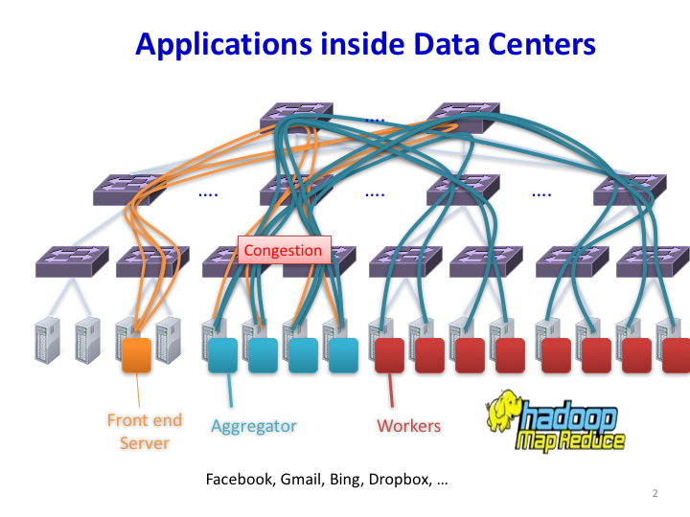
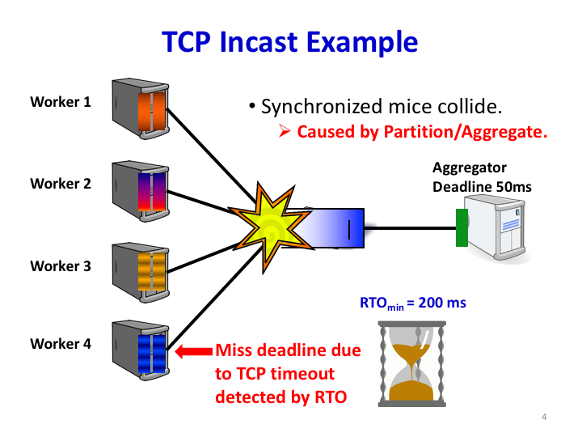
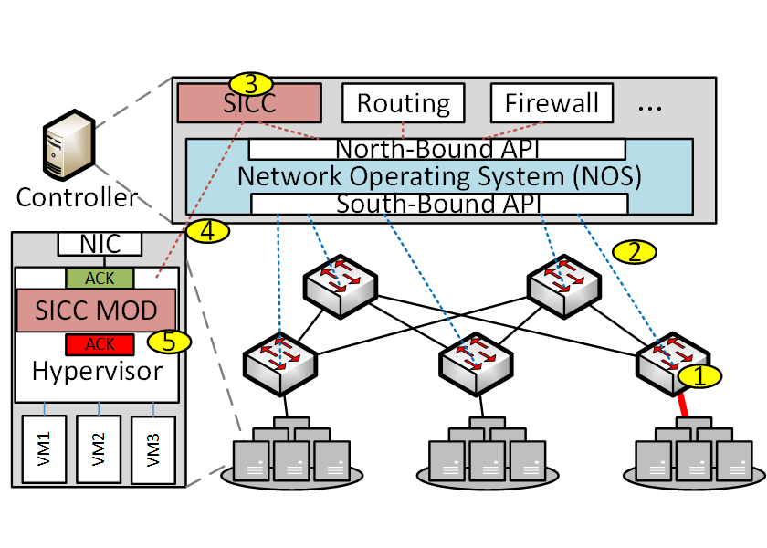
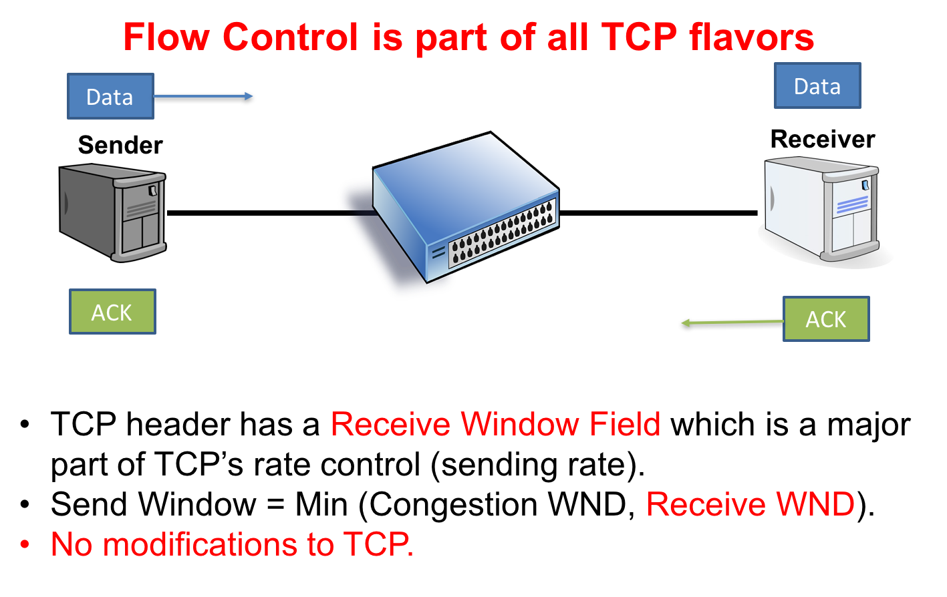
SICC: SDN-Based Incast Congestion Control For Data Centers Ahmed M. Abdelmoniem, Brahim Bensaou, James A. Abu CSE Dept, HKUST, Hong Kong. 📧:amas@cse.ust.hk
Datacenter Apps
Pros and Cons of Existing Solutions
Design Rationale
Elephant Goal: High Throughput
Achieved appealing performance gains.
Network stack modification (which may not be under operators authority).
Deployment and not supported features.
Desirable Solution
Sensitivity Analysis
Low Delay
Low Overhead
High Goodput
No VM update
large flows <-
Fits All TCP
Easy Deploy
-> small flows
At time t: the (persistent) queue was stable at Q(t), while collects Q occupancy and receives N SYNs.
If Q(t+1) + N*Init_CWND MSS > Buffer Size → INCAST.
At time t+1: The Controller notifies the hypervisor of involved sources → set ACK to 1MSS → Buffer drain.
At time t+x: The Controller sends outIncast OFF
10 times the RTT achieves a sweet spot
Incast Problem
Synchronized Arrival of flows as a result of partition/aggregate apps.
SICC operations
Experimental Results
Cluster Testbed using OpenvSwitch + Ryu Controller
Scenario depicting 126 mice against 21 Elephant.
Mice: lower latency
Elephant: High throughput
TCP Congestion Control
Simulation Analysis
Scenario depicting Mice colliding with Elephants.
100 senders: 1:3 mice to elephant ratio
Existing Solutions
Mice Goal: Low Latency and low variance
Conclusions & Future
Sender-Based :
DCTCP [1] and Reduce MinRTO [2]
Receiver-Based :
ICTCP [3] and PAC [4]
Switch-Assisted :
pFabric [5], Cut-Payload [6] and IQM[7]
~ 1 orders of magnitude
SICC satisfies all mentioned desirable solution properties.
Low latency for Incast and enough goodput for elephants.
Independent of transport protocol or VM sw stack.
Relies on readily available features in SDN switches.
Very simple change to end-host hypervisor logic.
Fits with any TCP flavor running on any OS.
Sensitive to SDN Controller-Switch-Hypervisor delays.

