Slide 1
E-COMMERCE
Orders, Returns & Profitability
Business Analytics Project
Revenue • Customer Lifecycle • Customer Value • Products • Returns
Hady Abohany • Rojeh Tamer • Ibrahim Desouky • Ahmed Shaban • Yousef Sayed • Ahmed Mohamed
E-Commerce Analytics • Project 2 1

Slide 2
Team & Responsibilities
Work distribution for the project
Hady Abohany
Revenue & Margins • Visualization
Rojeh Tamer
Interactive dashboard built in Power BI
Yousef Sayed
Customer Lifecycle
Ahmed Mohamed
Customer Value
Ibrahim Desouky
Customer Value + first three product / device queries
Ahmed Shaban
Worked with Ibrahim on the first three product / device queries
E-Commerce Analytics • Project 2 2

Slide 3
Project Overview
Turning marketplace data into operational insights
BUSINESS CONTEXT
USERS
E-commerce marketplace operating across multiple regions and devices.
Customers place orders, purchase items, and sometimes return them.
The analysis answers the COO's questions about revenue, customer behavior, products, and returns.
3,000
p2_users table
CORE TABLES
4
users • orders • order_items • returns
ANALYSIS AREAS
4
revenue • lifecycle • value • products/returns
E-Commerce Analytics • Project 2 3

Slide 4
Data Structure
Project 2 tables used in the analysis
p2_users
user_id • region • signup_date
p2_orders
order_id • user_id • order_date • device • region
p2_order_items
order_id • sku • category • qty • unit_price • discount • cogs
p2_returns
order_id • return_reason • return_date
CATEGORIES
ELEC • HOME • FASH • SPORT • BEAUTY • GROC
E-Commerce Analytics • Project 2 4

Slide 5
Analytical Workflow
SQL queries → results → visualizations → dashboard
01
02
03
04
Query
Measure
Visualize
Interpret
SQL aggregates and calculations
Revenue, margin, retention, spend, returns
Charts embedded from the notebook
Business takeaways for the COO
REVENUE AFTER DISCOUNT
MARGIN
Σ (GMV − Discount)
GMV − Discount − COGS − Shipping
Used for monthly revenue analysis
Used for regional margin analysis
E-Commerce Analytics • Project 2 5

Slide 6
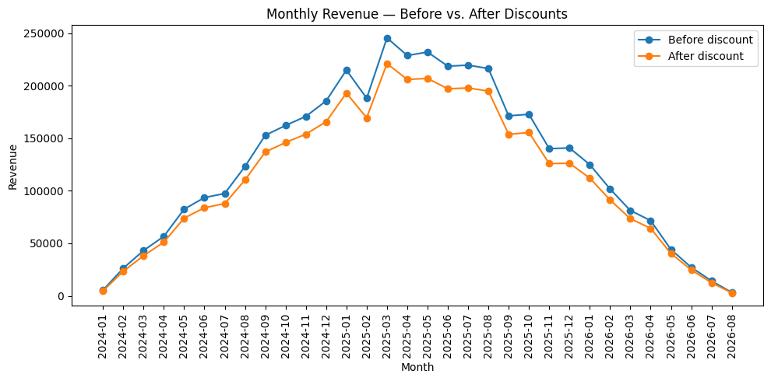
Revenue & Margins
Hady • Monthly revenue before vs. after discounts
PEAK MONTH
Mar 2025
Revenue before discount: 245,403.20
DISCOUNT EFFECT
Visible gap
After-discount revenue stays below gross GMV every month.
TREND
Growth → decline
Revenue rises into early 2025, then declines.
Monthly revenue before vs. after discounts
E-Commerce Analytics • Project 2 6

Slide 7
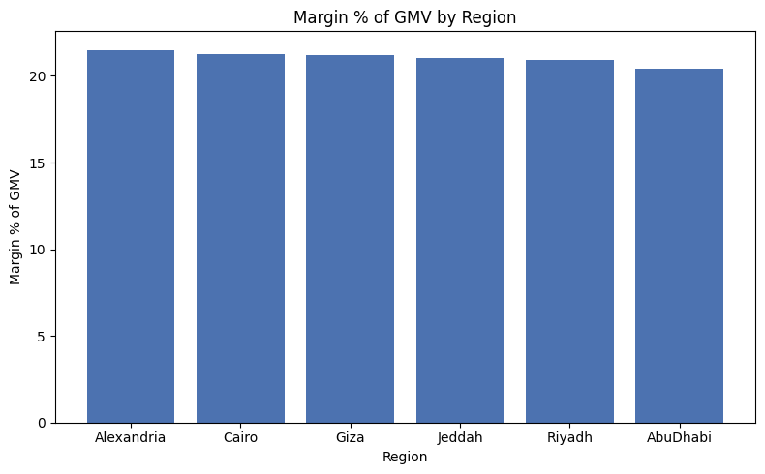
Regional Margins
Profitability after discounts, COGS and shipping
REGION
MARGIN %
Alexandria
21.50%
Cairo
21.28%
Giza
21.20%
Jeddah
21.05%
Riyadh
20.93%
AbuDhabi
20.40%
TOTAL MARGIN RANGE
20.40% – 21.50%
Margins are relatively close across regions.
Margin % of GMV by region
E-Commerce Analytics • Project 2 7

Slide 8
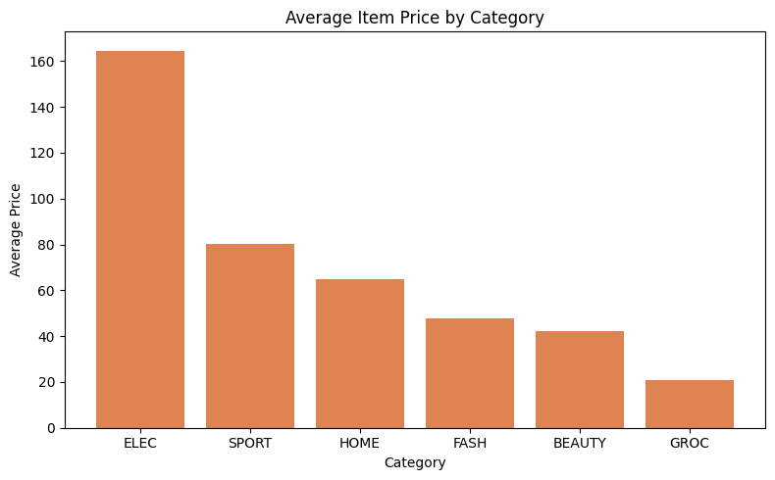
Average Item Price by Category
Hady • Supporting product economics
ELEC
164.57
Highest average price
SPORT
80.04
Second-highest average price
GROC
21.02
Lowest average price
Average item price by category
E-Commerce Analytics • Project 2 8

Slide 9
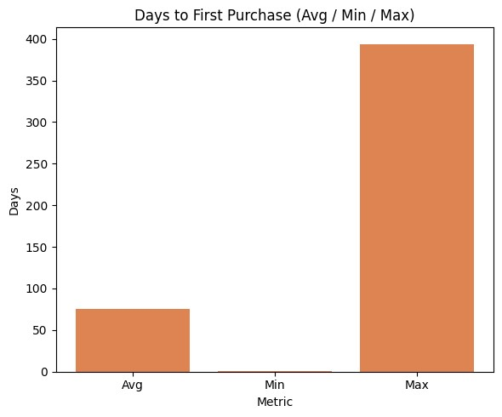
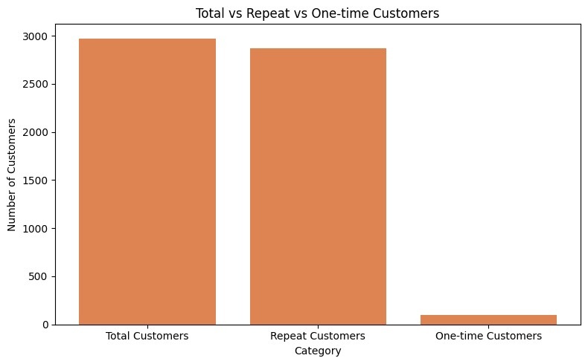
Customer Lifecycle
Yousef • From signup to repeat purchase
Days to first purchase
Total vs repeat vs one-time customers
AVG FIRST PURCHASE
REPEAT RATE
AVG 1ST → 2ND ORDER
75.3 days
96.64%
72.8 days
From signup
Of customers with orders
Gap between orders
E-Commerce Analytics • Project 2 9

Slide 10
Customer Lifecycle — Interpretation
Key retention timing signals
Average time from signup to first purchase: 75.3 days.
2,873 of 2,973 customers are classified as repeat customers.
Average gap between first and second order: 72.8 days.
The lifecycle analysis focuses on acquisition-to-purchase timing and repeat behavior.
FIRST PURCHASE
75.3 days
Average across customers with an order
REPEAT CUSTOMERS
2,873
Customers with more than one order
SECOND ORDER GAP
72.8 days
Average time between first and second order
E-Commerce Analytics • Project 2 10

Slide 11
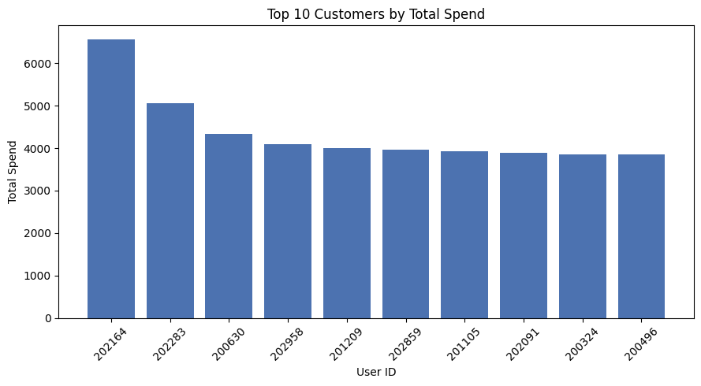
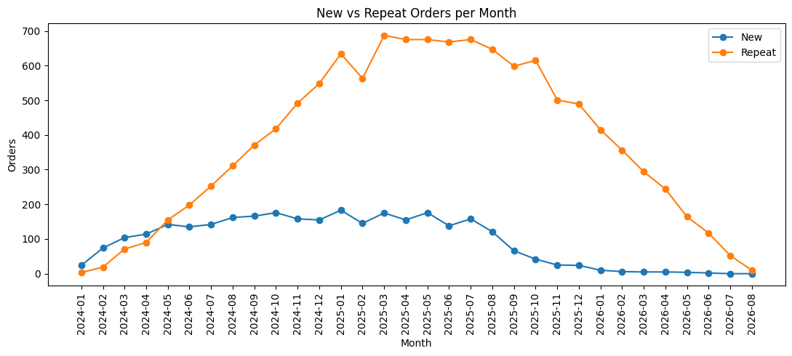
Customer Value
Ahmed Mohamed • Spend, order mix & recency
Top 10 customers by total spend
New vs repeat orders per month
TOP CUSTOMER
TOP CUSTOMER ORDERS
REPEAT ORDERS
202164 • 6,564.20
13
Overtake new orders
Highest total spend
Orders by the top-spend customer
Around mid-2024
E-Commerce Analytics • Project 2 11

Slide 12
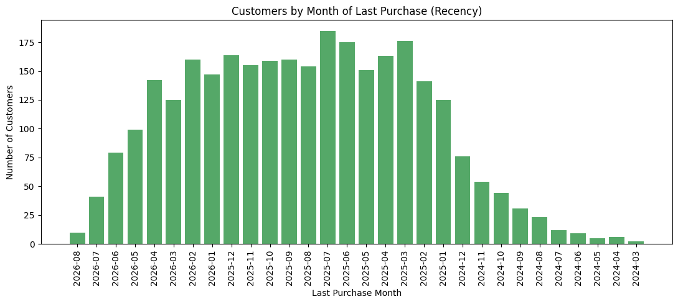
Customer Recency
Most recent purchase month across customers
The dataset ends in August 2026.
Many customers' last purchases occur in the more recent months.
A 60–90 day inactivity percentage would need a follow-up calculation using the dataset's maximum order date.
NEXT ANALYTICAL STEP
Days since last order
Useful for an explicit inactivity metric
Customers by month of last purchase
E-Commerce Analytics • Project 2 12

Slide 13
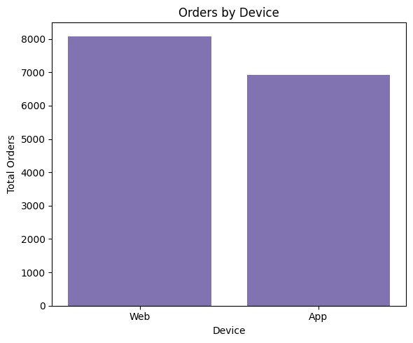
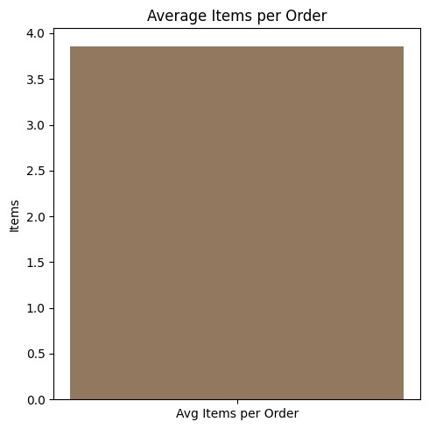
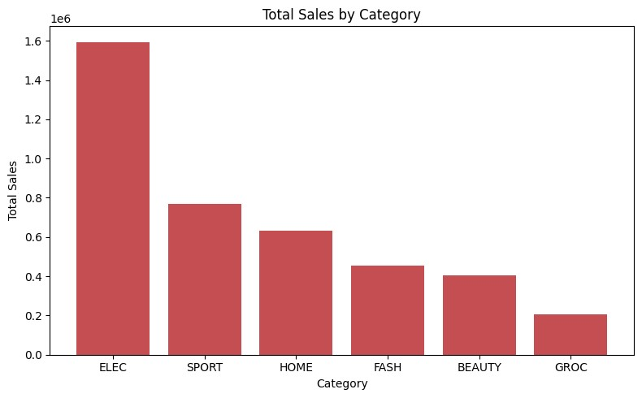
Products & Devices
Ibrahim Desouky + Ahmed Shaban • First three queries
Total sales by category
Orders by device
Average items per order
TOP SALES CATEGORY
DEVICE SPLIT
AVG ITEMS / ORDER
ELEC • 1,594,473.44
Web 8,086 • App 6,914
3.0
Total sales
About 54% / 46%
Based on the SQL query result
E-Commerce Analytics • Project 2 13

Slide 14
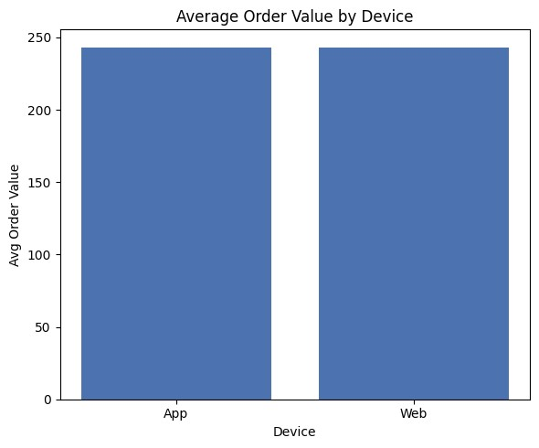
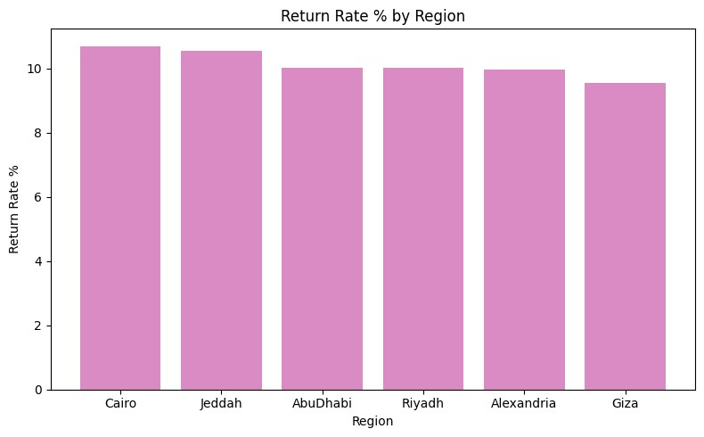
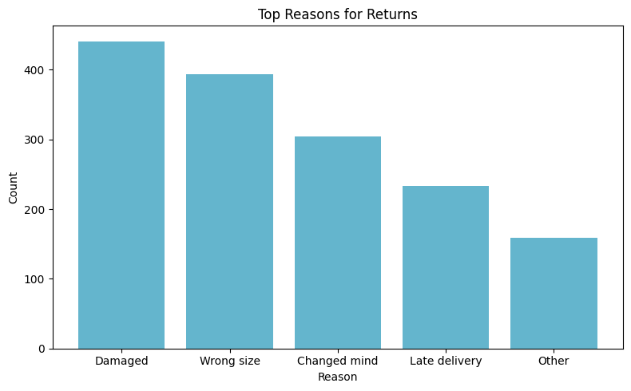
Device Spend & Returns
Additional product and customer-experience analysis
Average order value by device
Return rate by region
Top reasons for returns
AVG ORDER VALUE
RETURN RATE RANGE
TOP RETURN REASON
App 243.21 • Web 242.69
9.54% – 10.70%
Damaged • 441
Very close across devices
Regional rates are relatively close
Wrong size follows with 394
E-Commerce Analytics • Project 2 14

Slide 15
Executive Dashboard
A compact view of the main results
Users
Orders
Repeat customers
Avg items / order
Highest return rate
3,000
15,000
96.64%
3.0
10.70%
Revenue trend
New vs repeat orders
Category sales
Regional return rate
Return reasons
E-Commerce Analytics • Project 2 15

Slide 16
Key Findings
What the analysis shows
Revenue increased substantially through early 2025 before declining later in the observed period.
Regional margin percentages are tightly grouped around 20–21.5% of GMV.
Repeat customers represent 96.64% of customers with orders in the analysis.
ELEC is the largest sales category and also has the highest average item price.
Web generates more orders than App, while average order value is nearly identical.
Return rates are close across regions; damaged items and wrong size are the two most frequent reasons.
REVENUE
CUSTOMERS
RETURNS
Trend + peak + decline
Strong repeat behavior
Damage + sizing
Peak in Mar 2025
96.64% repeat rate
Top two return reasons
E-Commerce Analytics • Project 2 16

Slide 17
Query Results — KPI Summary
A compact table of the main outputs reported by the analysis
Metric | Result | What it tells us
Users | 3,000 | Customer base in p2_users
Orders | 15,000 | Orders analyzed
Customers with orders | 2,973 | Customers included in lifecycle analysis
Repeat customers | 2,873 | Customers with more than one order
Repeat-customer rate | 96.64% | Repeat customers / customers with orders
Average items / order | 3.0 | SQL query result
Peak revenue month | Mar 2025 | Highest monthly gross revenue
E-Commerce Analytics • Project 2 17

Slide 18
Query Results — Regional Margins
Margin = GMV − Discount − COGS − Shipping Cost
Region | Margin % | Position in result
Alexandria | 21.50% | Highest reported regional margin
Cairo | 21.28%
Giza | 21.20%
Jeddah | 21.05%
Riyadh | 20.93%
AbuDhabi | 20.40% | Lowest reported regional margin
Margin range: 20.40% – 21.50% — regional percentages are relatively close.
E-Commerce Analytics • Project 2 18

Slide 19
Query Results — Customer Lifecycle
Signup → first purchase → repeat purchase timing
Lifecycle measure | Result | Interpretation
Average signup → first purchase | 75.3 days | Average across customers with an order
Customers with orders | 2,973 | Lifecycle analysis population
Repeat customers | 2,873 | More than one order
Repeat-customer rate | 96.64% | Share of customers with orders
Average first → second order | 72.8 days | Average gap between first and second order
Most customers in the analysis are repeat customers; the timing metrics quantify the purchase cycle.
E-Commerce Analytics • Project 2 19

Slide 20
Query Results — Customer Value
Spend and order-frequency outputs
Measure | Result | Explanation
Top customer ID | 202164 | Highest total spend in the reported result
Top customer total spend | 6,564.20 | Total spend for customer 202164
Top customer orders | 13 | Number of orders by the top-spend customer
New vs repeat orders | Repeat overtakes new around mid-2024 | Monthly order-mix trend
E-Commerce Analytics • Project 2 20

Slide 21
Query Results — Products & Categories
Category sales and average item-price outputs
Category / KPI | Result | Interpretation
ELEC | 1,594,473.44 | Highest total sales
ELEC | 164.57 | Highest average item price
SPORT | 80.04 | Second-highest average item price
GROC | 21.02 | Lowest average item price
Average items / order | 3.0 | Order-level quantity indicator
ELEC leads reported sales and also has the highest reported average item price.
E-Commerce Analytics • Project 2 21

Slide 22
Query Results — Device Performance
Order volume and average order value by device
Device | Orders | Share | Average order value
Web | 8,086 orders | ≈ 54% of orders | 242.69 AOV
App | 6,914 orders | ≈ 46% of orders | 243.21 AOV
Web has the higher order count, while average order value is nearly identical across devices.
E-Commerce Analytics • Project 2 22

Slide 23
Query Results — Return Rate by Region
Regional return-rate outputs
Measure | Result | Meaning
Highest reported return rate | 10.70% | Regional maximum
Lowest reported return rate | 9.54% | Regional minimum
Range | 9.54% – 10.70% | Rates are relatively close
The query does not show a large regional spread in return rates.
E-Commerce Analytics • Project 2 23

Slide 24
Query Results — Return Reasons
Most frequent return reasons in the reported results
Return reason | Count | Position in result
Damaged | 441 | Most frequent reported reason
Wrong size | 394 | Second most frequent
Changed mind | ≈ 304 | Third (from the chart)
Late delivery | ≈ 235 | Fourth (from the chart)
Other | ≈ 160 | Remaining reasons
Damaged items and wrong size together dominate the reported return reasons.
E-Commerce Analytics • Project 2 24

Slide 25
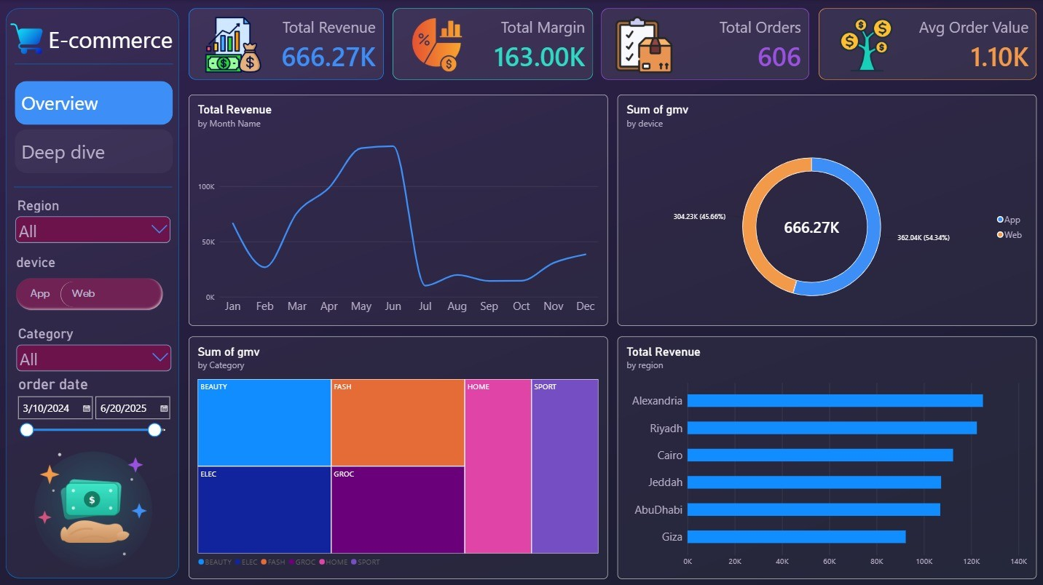
Interactive Dashboard — Power BI
Built by Rojeh Tamer in Microsoft Power BI
BUILT BY
Rojeh Tamer
Power BI
TOTAL REVENUE
666.27K
Dashboard KPI
TOTAL MARGIN
163.00K
Dashboard KPI
INTERACTIVITY
Region • Device • Category • Date
Note: dashboard KPIs and filters are shown exactly as in the Power BI report; they are kept separate from the notebook query-result tables.
E-Commerce Analytics • Project 2 25

