Slide 1
Hypothyroidism: An Unsupervised Approach to Anomaly Detection
Presenters: Ahmed ElAlfy, Hero Rfaat Mohammed, Mohammed Faidi
Affiliation: MSc AI4ST, University of Milan-Bicocca

Slide 2
Introduction
Anomalies in data can result from faults, glitches, or cyber-attacks, requiring effective detection techniques.
Applications span healthcare, manufacturing, and environmental fields.
Focus on unsupervised anomaly detection without prior data knowledge.

Slide 3
Dataset Description
Dataset details: 21 attributes, 15 binary, 6 continuous, 7200 objects.
No information on attribute significance, adding complexity.

Slide 4
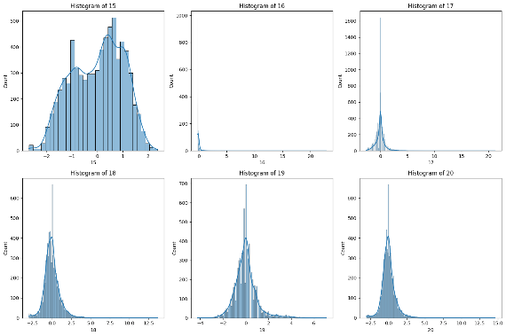
Figure 1. Grid of histograms for continuous attributes

Slide 5
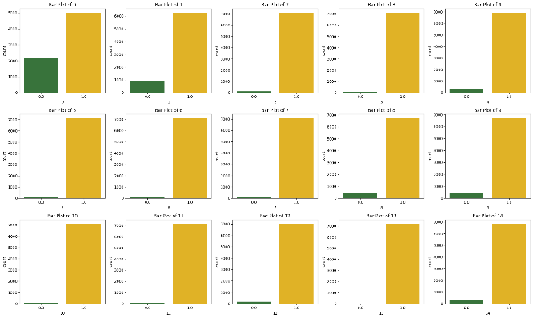
Figure 2. Grid of bar plots for binary attributes

Slide 6
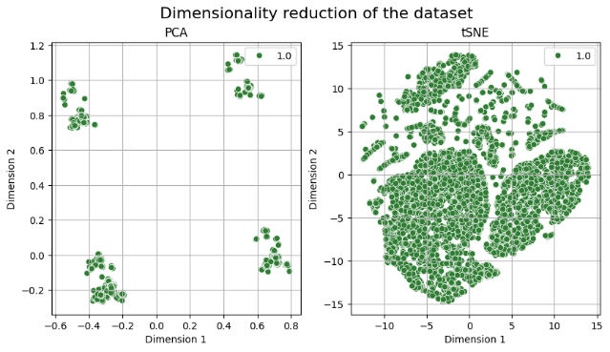
Figure 3. PCA and tSNE visualization for the whole dataset

Slide 7
Pre-Processing
Data cleaning: removing headers, correcting continuous values.
Normalization using Z-score standardization for consistent data ranges.
Z= (x-μ)/std
Notes:
it is very crucial in adjusting the values of columns in a dataset
without distorting differences in the ranges of values or losing information.

Slide 8
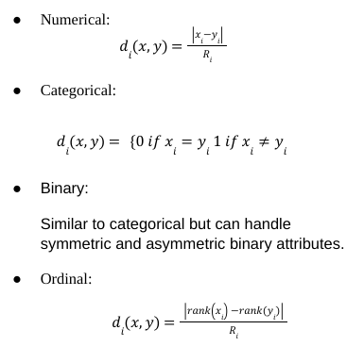
Proximity Measure
Gower Distance: Effective for mixed attributes, values between 0 (identical) and 1 (maximally dissimilar).
Mahalanobis Distance: Considers correlations within the dataset, suitable for binary data.

Slide 9
Anomaly Detection Methods
Binary Attributes: Mahalanobis Distance, Isolation Forest.
Continuous Attributes: PCA, Isolation Forest, LOF.
Mixed Attributes: Hierarchical Clustering, Isolation Forest, VAE.
Notes:
Given the nature of our data which is a mixed dataset of binary and continuous attributes, itwas crucial togo throughvariousalgorithmsand techniques thatdealwiththiskindofdataasmanyalgorithmsfailto do so.

Slide 10


Binary Attributes Analysis
Mahalanobis Distance: 90 outliers detected.
A measure of distance between a point and its distributribution by taking into account the correlations.
Isolation Forest: 36 outliers detected.
Build an ensemble of trees for a given dataset. Anomalies are instances with short average path lengths.
Common outliers between methods: 14.
Notes:
Mahalanobis distance is the measure of the distance between a point and its distribution [6]. It differs from Euclidean distance by taking into account the correlations of the dataset
it identifies points that are unusual considering the joint distribution, rather than just individual variables.
This algorithm uses a tree structure in which each of the tree nodes represents a decision based on randomly selected features and a value is split between the minimum and maximum values of these selected features
Scores close to 1 indicate anomalies, while scores close to 0 indicate normal points.

Slide 11
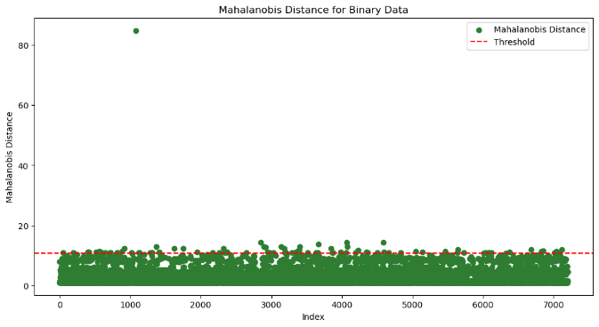
Figure 4. Scatterplot of Mahalanobis Distance for binary data

Slide 12
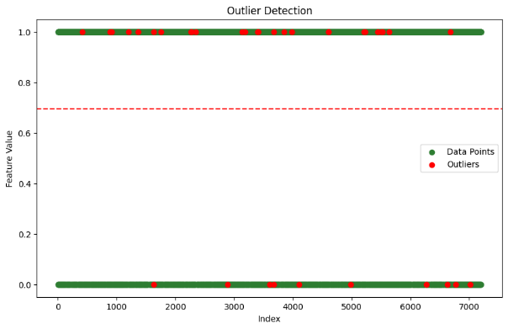
Figure 5. Scatterplot of Isolation Forest for binary data

Slide 13
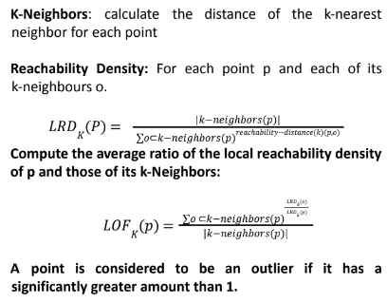
Continuous Attributes Analysis
PCA: 15 outliers detected.
A statistical technique for dimensionality reduction. . Computes a reconstruction error using MSE.
Isolation Forest: 36 outliers detected.
LOF: 36 outliers detected.
Density-based. Measures the density of a point and compare sto density of its neighbors.
Common outliers between methods: 13.
Notes:
Local Outlier Factor is one of the density-based outlier detections that overcomes some drawbacks of the other distance approaches. LOF measures the density of a point and compares this density to the densities of its neighbors which makes this algorithm able to detect the outliers in a density diverse dataset. LOF algorithm goes as follows:

Slide 14
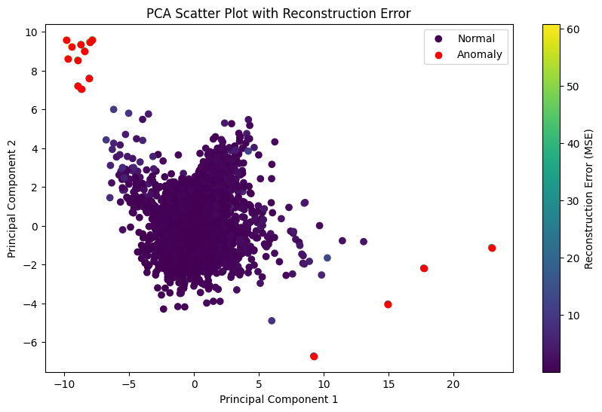
Figure 6. Outlier Detection using PCA

Slide 15
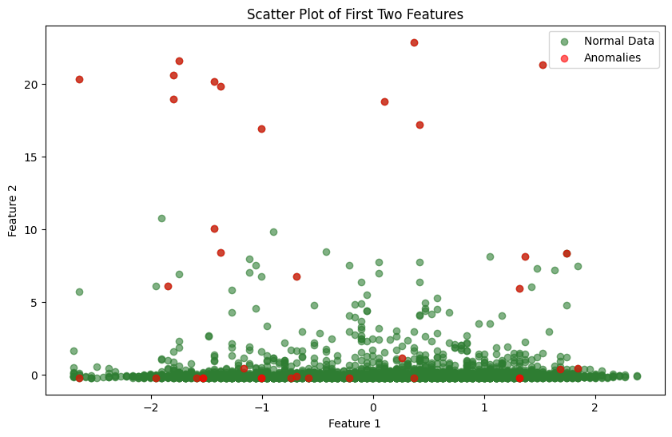
Figure 7. Scatterplot of outlier detection on continuous data using Isolation Forest

Slide 16

Figure 8. Scatterplot of outlier detection on continuous data using Isolation Forest

Slide 17
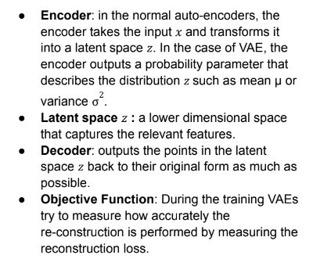
Mixed Attributes Analysis
Hierarchical Clustering: 11 clusters, limited outlier detection.
Based on nested clustering organized like a hierarchical clustering. We do not need to assume the number of clusters. Agglomerative clustering using Ward as the linkage method.
Ward measure the increase in the total within-cluster variance when two clusters are merged.
Isolation Forest: Limited success.
Variational AutoEncoder (VAE): Effective, 72 outliers detected.
Notes:
Two major types of clustering, partitioning clustering and hierarchical clustering. Partitioning is based on dividing the data into non-overlapping clusters like K-means and DBScan. In hierarchical clustering any number of cluster can be acheved by cutting the dendrigram tree at cettain distances. Two types: Hierarchical clustering itself is divided into two types: Agglomerative and Divisive clustering. In Divisive clustering, we keep splitting until each cluster contains a single point or we reach a certain number of clusters. Onthe other hand, Agglomerative clustering, which we have used in our paper, starts with each point as a cluster and keeps merging the closest pair of clusters until there is one single cluster or a certain number of clusters left. One of the most important things to consider while performing agglomerative clustering is the linkage method, as the results differ completely depending on the linkage method used whether it is single, complete, average, centroid, ward, or median. The differences between those linkage types are as follows:
Single or minimum: Measures the distance between the closest pair of points between two clusters.
Complete or maximum: Measures the greatest distance between a pair of points between two clusters.
Average: Measures the average distance between all pairs of points, one in each cluster.
Centroid: Measures the distance between the centroids of the clusters.
Ward: Measures the increase in the total within-cluster variance when two clusters are merged.
Median: Measures the distance between the median points of clusters.
After comparing different types of linkage, we chose the Ward as it has the best results in clustering such diverse data. We cut the forest at a distance = 39 so we could get a decent number of clusters after analyzing the dendrogram which was 11 clusters. However, this method fails to capture all the outliers accurately despite achieving a very good silhouette score which was 0.438.
A Variational Autoencoder (VAE) belongs to the family of autoencoders, which are neural networks designed to learn efficient representations of data, typically for dimensionality reduction and feature learning. The VAE works as follows:

Slide 18
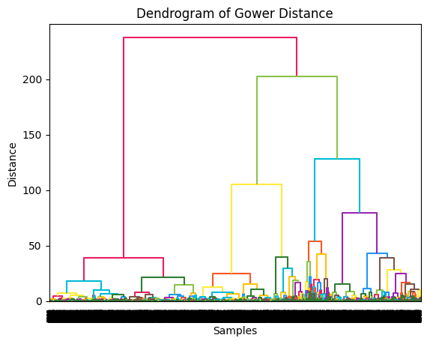
Figure 10. Dendrogram of Gower Distance - Hierarchical Clustering

Slide 19
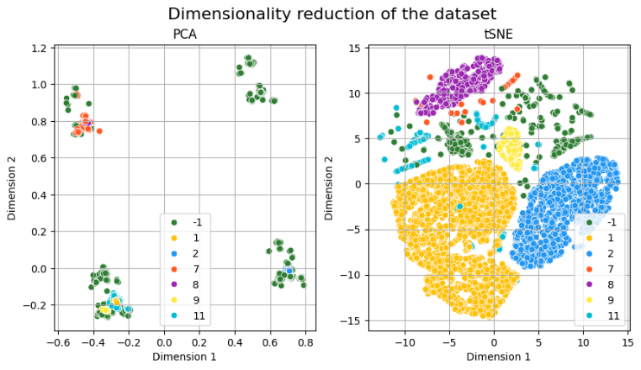
Figure 11. Outlier detection using Hierarchical Clustering

Slide 20
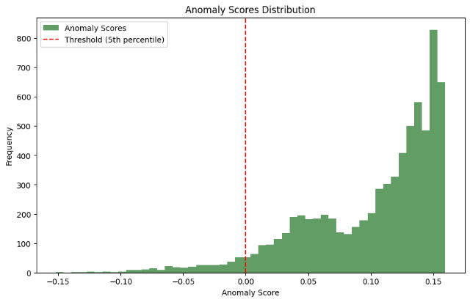
Figure 12. Anomalies score distribution

Slide 21
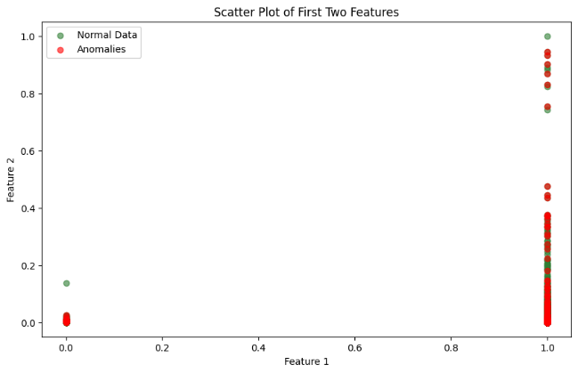
Figure 13. Scatter plot of anomalies detected by Isolation Forest

Slide 22
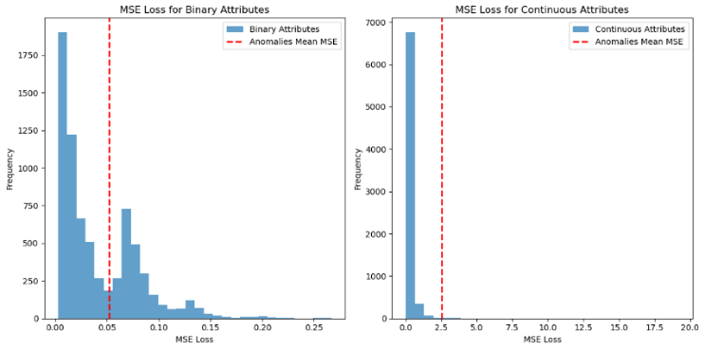
Figure 14. Histogram of MSE for binary and continuous attributes

Slide 23
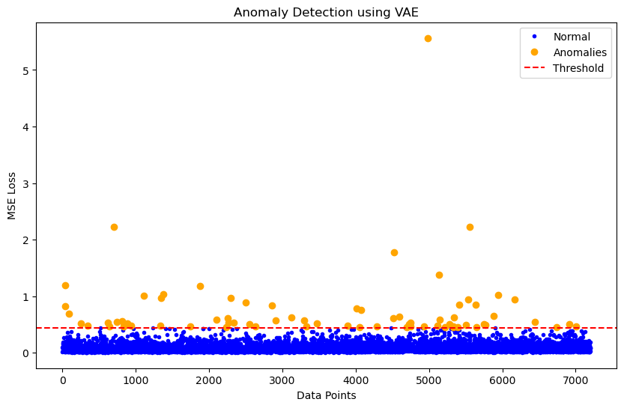
Figure 15. Scatterplot of outlier detection using VAE
Notes:
After training our model on 50 epochs with 100 batch size while using the MSE (Mean-Squared Error) as the reconstruction error and setting the threshold to be the 99th percentile of the MSE loss, we were able to achieve our most accurate outlier detection algorithm that succeeded in detecting 72 outliers.

Slide 24
Discussion
Challenges: mixed data types, dataset context, evaluation.
Impact on results: Difficulty in accurate outlier detection and evaluation.

Slide 25
Future Work
Advanced feature engineering techniques.
Specialized algorithms for mixed-type datasets.
Contextual information to enhance model performance.

Slide 26
Conclusion
Continuous data:
- PCA: 15
- Isolation Forest: Failed to detect many outliers with several outliers detected equal to 36.
- Local Outlier Factor (LOF): Also, failed to detect many of the outliers to 36.
- common outliers between
them which were 13.
Binary Data:
- Mahalanobis Distance: 90
- Isolation Forest: 36. however, it wasn’t that effective.
- common outliers: 14

Slide 27
Conclusion
Whole (Mixed) Data: - Hierarchical Clustering: after using the
Gower distance as a distance metric, it failed to detect many of the outliers. However, we achieved a silhouette score of 0.438
- Isolation Forest: as usual it failed to detect many outliers.
- Variational Autoencoder (VAE): final decision, 72
VAE's effectiveness in anomaly detection.

Slide 28
Questions?

