Slide 1

Diamond price analysis
Represented By
Ahmed Elbhbaty

Slide 2
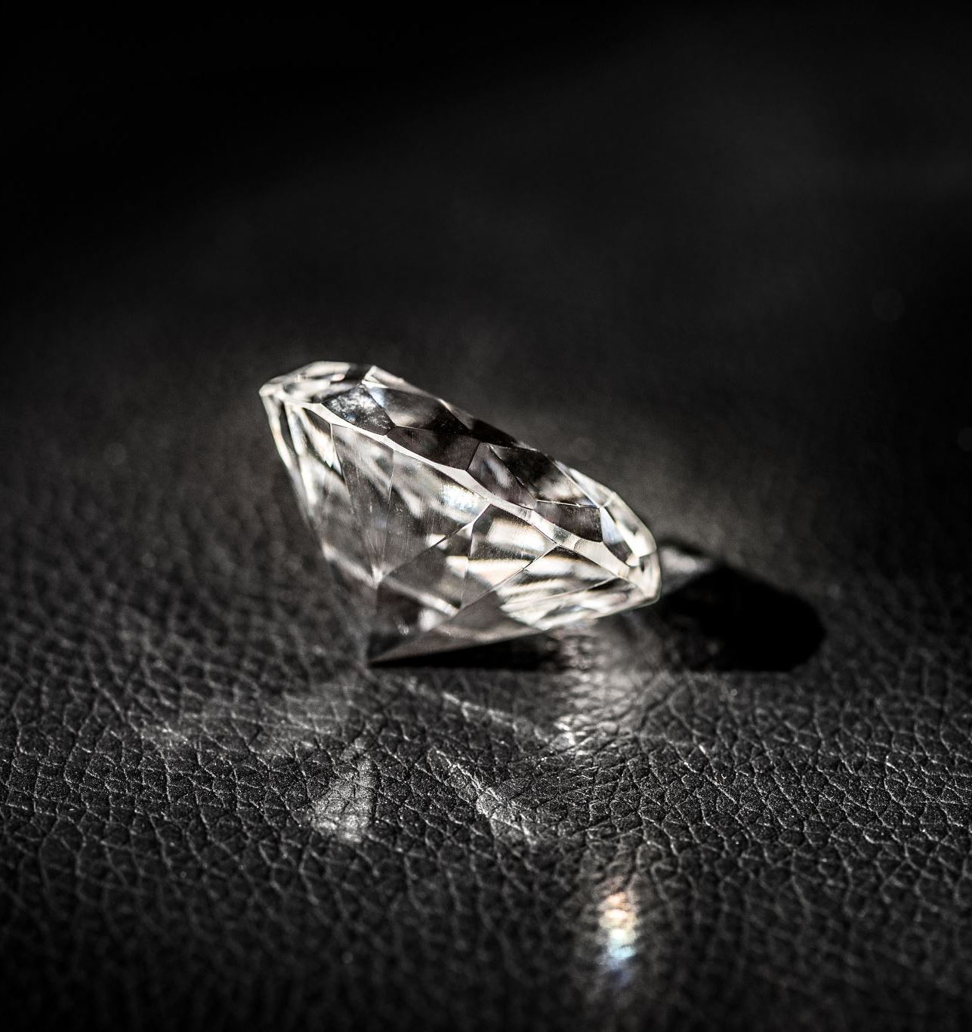
Metadata :
Carat: Weight of the diamond (1 carat = 200 mg)
Cut: Quality of diamond’s shape and facets
Color: Hue graded from colorless (D) to yellow (Z)Z
Clarity: Purity based on flaws or inclusions
Depth: Height of the diamond as a percentage of diameter
Table: Flat top surface, affects light reflection
Price: Cost based on quality and market demand
Size: Dimensions in millimeters, related to carat weight.

Slide 3
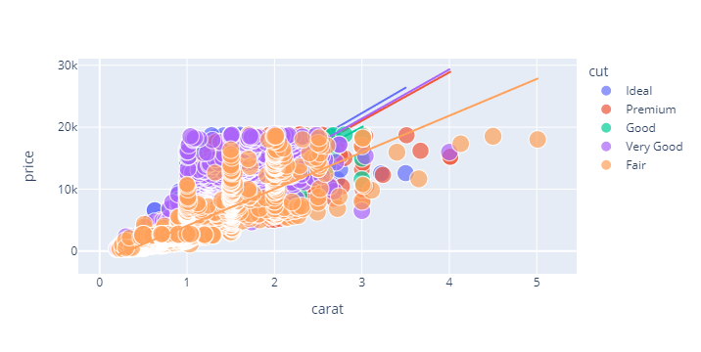
Relationship between the carat and the price of diamond

Slide 4
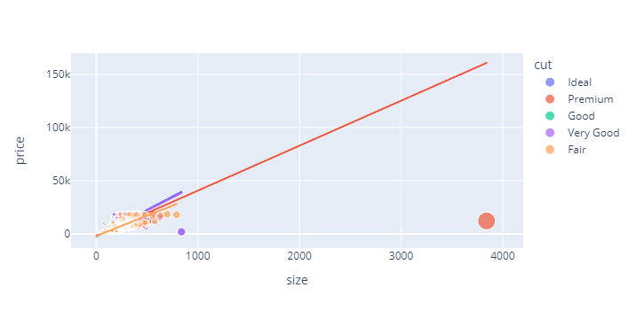
Relationship between size and price

Slide 5
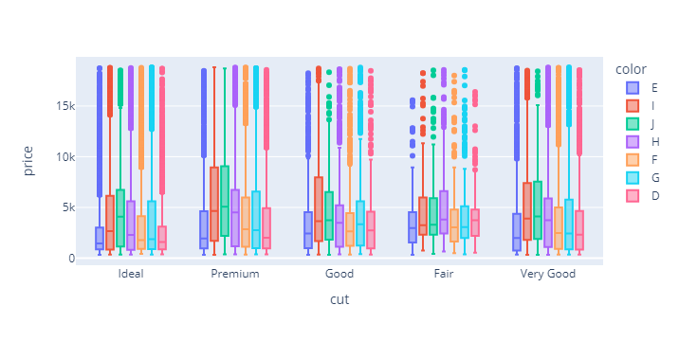
The well-look is relatively larger compared to other diamonds.
There is a linear relationship between the size of all diamond types and their prices.
Let us now take a look at the prices of all diamond types based on their colors

Slide 6
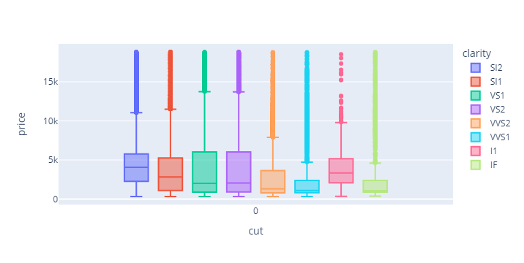
Prices of all types of diamonds based on their clarity

Slide 7
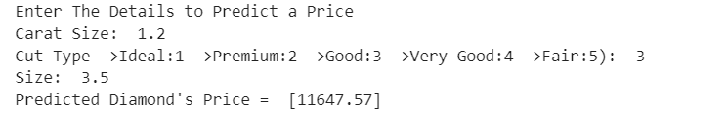
Train the data for prediction
Finally, I make a prediction model based on the features of the diamond

