Slide 1
DIGITAL EGYPT PIONEERS INITIATIVE (DEPI)
Transport Analysis
End-to-End Public Transport Analytics Pipeline
AI & Data Science Track · Graduation Project
Python · Pandas · PySpark · SQL · scikit-learn · Streamlit
Transport Analysis · DEPI AI & Data Science
1 / 33

Slide 2
Agenda
01
Problem & objectives
02
Solution architecture, UML diagrams & technology stack
03
Data design, ETL, and SQL analytics
04
Machine learning models & metrics
05
Reporting, dashboard & live demo
06
Insights, impact & next steps
Transport Analysis · DEPI AI & Data Science
2 / 33
Notes:
Walk through the agenda so the audience knows the structure of the talk.

Slide 3
Project Team
DEPI — AI & Data Science Track
Ahmed El-Gamal
Maryam Khaled
Youssef Mustafa
Pipeline / ETL
SQL Analytics
Machine Learning
Mariam Tarek
Mostafa Fouad
Nada Ahmed
Reporting
Dashboard / UI
Documentation
Transport Analysis · DEPI AI & Data Science
3 / 33
Notes:
Briefly introduce each team member and their focus area.

Slide 4
PART 1
The Problem
Why transport analytics matters
Transport Analysis · DEPI AI & Data Science
4 / 33

Slide 5
The Challenge
1
Public transport operators generate large volumes of trip data daily
2
Fares, delays, zones, weather, and traffic interact in complex ways
3
Manual reporting is slow and does not support predictive decisions
4
Need one pipeline: clean data → SQL insights → ML forecasts → interactive UI
Transport Analysis · DEPI AI & Data Science
5 / 33
Notes:
Frame the business problem: operators need faster, predictive insight from trip data.

Slide 6
Project Objectives
Ingest
Transform
Analyze
Load or generate realistic trip datasets
Bronze → Silver → Gold medallion ETL
SQL warehouse queries for ops KPIs
Predict
Report
Explore
Fare, delay, and trip segmentation models
Automated Markdown + PNG charts
Interactive Streamlit dashboard
Transport Analysis · DEPI AI & Data Science
6 / 33

Slide 7
PART 2
Architecture
How the system is designed
Transport Analysis · DEPI AI & Data Science
7 / 33

Slide 8
End-to-End Architecture
1. Ingestion
2. Batch ETL
3. SQL
4. ML
5. Report
6. UI
→
→
→
→
→
data_pipeline.py
spark_etl.py
sql_analytics.py
train_ai_model.py
analysis_report.py
dashboard.py
• Orchestrator: src/main.py runs stages 1–5 in order
• Dashboard is a separate entry point reusing the same dataset
• Outputs land in data/ and reports/ for demos and grading
Transport Analysis · DEPI AI & Data Science
8 / 33

Slide 9
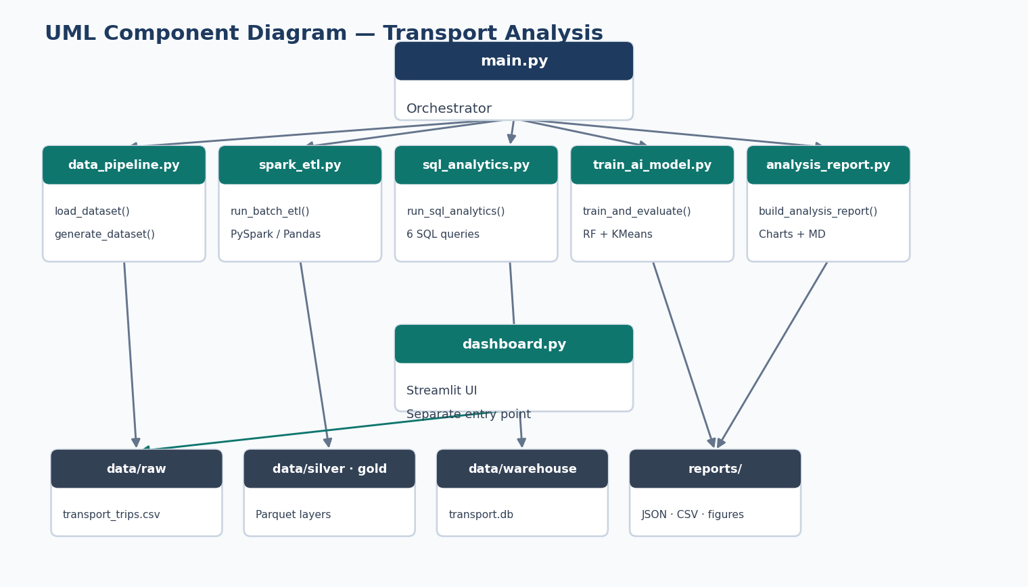
UML Component Diagram
Modules, data stores, and how main.py orchestrates the pipeline
Transport Analysis · DEPI AI & Data Science
9 / 33
Notes:
Explain each Python module as a component and how data flows between layers.

Slide 10
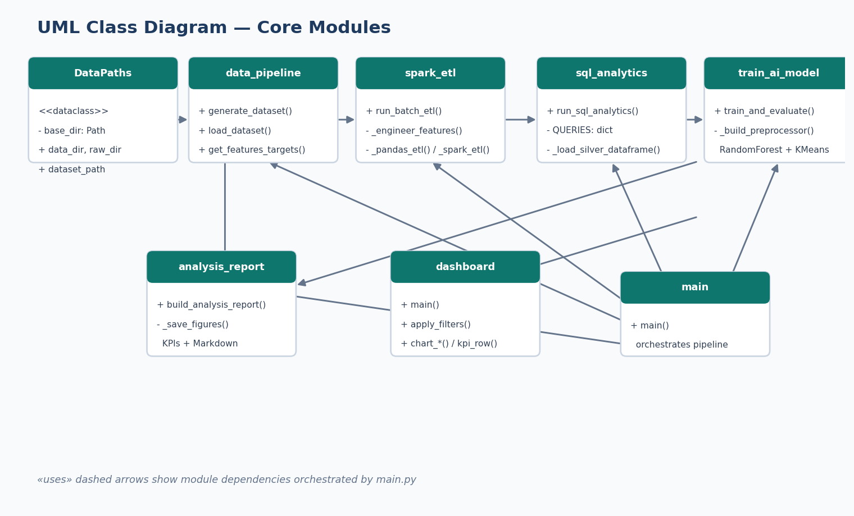
UML Class Diagram
Core classes and public functions in each source module
Transport Analysis · DEPI AI & Data Science
10 / 33
Notes:
Walk through DataPaths, pipeline functions, and how main.py uses each module.

Slide 11
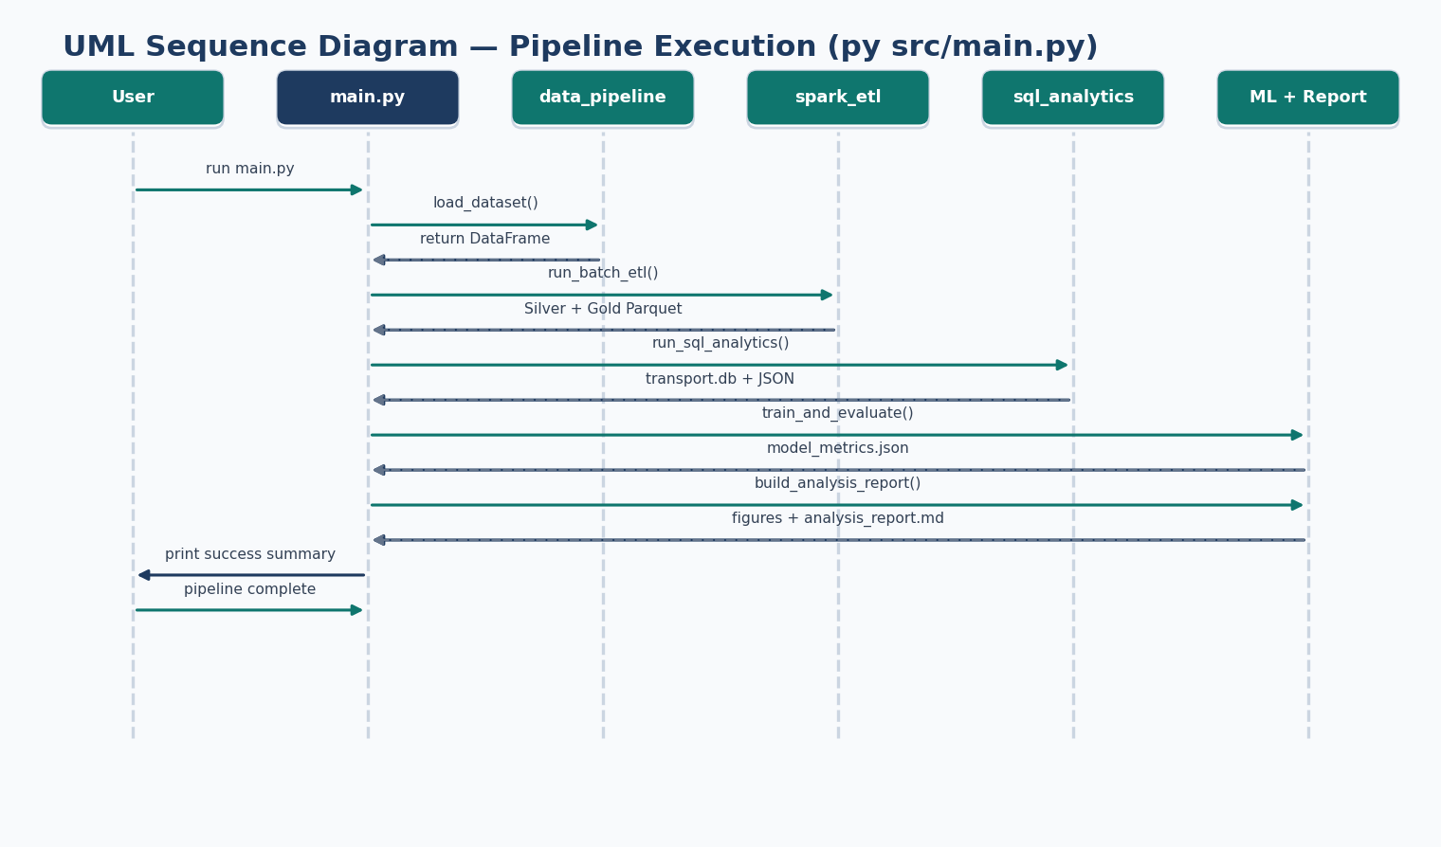
UML Sequence Diagram
Step-by-step execution when running py src/main.py
Transport Analysis · DEPI AI & Data Science
11 / 33
Notes:
Trace the call order: load data → ETL → SQL → ML → report → console summary.

Slide 12
Technology Stack
Data
ETL
Analytics
ML
Viz / UI
Python 3.10+
PySpark (optional)
SQLite warehouse
scikit-learn
Matplotlib / Seaborn
Pandas / NumPy
Pandas fallback
SQL aggregations
RandomForest
Streamlit
PyArrow (Parquet)
Medallion layers
JSON exports
KMeans clustering
Plotly charts
Transport Analysis · DEPI AI & Data Science
12 / 33

Slide 13
Repository Structure
src/ main, data_pipeline, spark_etl, sql_analytics, train_ai_model, analysis_report
data/raw transport_trips.csv (Bronze)
data/silver cleaned Parquet with engineered features
data/gold daily aggregated summaries
data/warehouse transport.db (SQLite analytics)
sql/ analytics_queries.sql
reports/ metrics JSON, clustered CSV, figures, Markdown report
dashboard.py Streamlit interactive website
Transport Analysis · DEPI AI & Data Science
13 / 33

Slide 14
PART 3
Data & ETL
From raw trips to gold summaries
Transport Analysis · DEPI AI & Data Science
14 / 33

Slide 15
Trip Data Schema
5,000 synthetic trips · seed = 42 for reproducibility
Core Fields
Fare, Context & Targets
• trip_id, trip_date, pickup_hour
• vehicle_type: Taxi / Bus / Metro / RideShare
• zone: Downtown, Airport, Suburb, Industrial, Coastal
• trip_distance_km, trip_duration_min
• passenger_count
• base_fare, tip_amount, total_fare (ML target)
• payment_type: Cash / Card / Mobile
• weather, traffic_level, delay_minutes
• is_delayed (1 if delay > 5 min) — ML target
Transport Analysis · DEPI AI & Data Science
15 / 33

Slide 16
Synthetic Data Design Logic
Distance
Gamma distribution per vehicle type, clipped to 0.5–45 km
Duration
distance × random factor × traffic × weather multipliers
Fare
distance × rate_per_km × zone multiplier + tip by payment type
Delay
traffic × Exp(2.5) + rain/fog bonus; delayed if > 5 minutes
Reproducibility
Fixed seed (42); load CSV if present, else generate
Transport Analysis · DEPI AI & Data Science
16 / 33

Slide 17
Medallion ETL: Bronze → Silver → Gold
BRONZE
SILVER
GOLD
Raw CSV ingest
Clean + features
Daily aggregates
• transport_trips.csv
• dropna + clean
• groupby date × vehicle × zone
• 5,000 rows
• speed_kmh
• trip_count, revenue
• As-recorded trips
• revenue_per_km
• avg_fare, delay_rate
• is_peak_hour
• 3,522 summary rows
• Parquet output
Transport Analysis · DEPI AI & Data Science
17 / 33

Slide 18
Feature Engineering & Engine Fallback
• speed_kmh = distance / (duration in hours)
• revenue_per_km = total_fare / distance
• is_peak_hour = 1 if pickup hour is 7–9 or 17–19
• run_batch_etl() probes Java → PySpark; otherwise identical Pandas path
• Writes reports/etl_report.json (engine, row counts, output paths)
• Latest run: engine = pandas · 5,000 silver · 3,522 gold rows
Transport Analysis · DEPI AI & Data Science
18 / 33

Slide 19
PART 4
SQL Analytics
Warehouse queries and business KPIs
Transport Analysis · DEPI AI & Data Science
19 / 33

Slide 20
SQLite Analytics Warehouse
01
Load Silver Parquet (or raw CSV fallback) into data/warehouse/transport.db
02
Replace table transport_trips on each pipeline run
03
Execute 6 analytical queries via pandas.read_sql_query
04
Export results → reports/sql_analytics.json
05
Regenerate sql/analytics_queries.sql for documentation and reuse
Transport Analysis · DEPI AI & Data Science
20 / 33

Slide 21
Six Analytical SQL Queries
daily_trip_volume
avg_fare_by_zone
Trips & revenue per day
Premium zones by avg fare
delay_rate_by_traffic
revenue_by_vehicle_type
Delay hotspot by traffic
Revenue ranking by mode
peak_hour_analysis
weather_impact
Demand & delay by hour
Weather vs delay risk
Transport Analysis · DEPI AI & Data Science
21 / 33

Slide 22
SQL Highlights (Latest Run)
38.4%
$65,182
$35.47
High traffic delay rate
Taxi total revenue (leader)
Airport avg fare (premium)
• Airport and Downtown command higher average fares
• High traffic is the clearest delay hotspot for operations
• Taxi leads revenue; Metro/Bus compete on volume and lower fares
Transport Analysis · DEPI AI & Data Science
22 / 33

Slide 23
PART 5
Machine Learning
Predict fares, delays, and segments
Transport Analysis · DEPI AI & Data Science
23 / 33

Slide 24
Three-Model ML Stack
Fare Regression
Delay Classification
Trip Clustering
RandomForestRegressor
RandomForestClassifier
KMeans (k=4)
200 trees, seed=42
200 trees, seed=42
Scaled features
Target: total_fare
Target: is_delayed
distance, duration,
R² = 0.981
Accuracy = 77.9%
fare, delay_minutes
MAE = $1.91
Base delay rate = 30.7%
Silhouette = 0.323
Transport Analysis · DEPI AI & Data Science
24 / 33

Slide 25
Preprocessing & Leakage Control
• ColumnTransformer: StandardScaler on numeric features
• OneHotEncoder(handle_unknown='ignore') on categoricals
• Features: hour, vehicle, zone, distance, duration, passengers, payment, weather, traffic
• Excluded from X: total_fare, is_delayed, tip_amount, delay_minutes, trip_id, trip_date
• Pipeline = preprocessor + model; train_test_split 80/20, random_state=42
• Same split seed for regression and classification → comparable evaluation
Transport Analysis · DEPI AI & Data Science
25 / 33

Slide 26
Interpreting Model Performance
R² 0.981
MAE $1.91
Distance, vehicle type, and zone dominate fare structure
Predictions are close enough for pricing analytics demos
Accuracy 77.9%
Silhouette 0.323
Useful ops signal despite stochastic traffic/weather
Moderate separation: short urban vs longer airport patterns
Transport Analysis · DEPI AI & Data Science
26 / 33

Slide 27
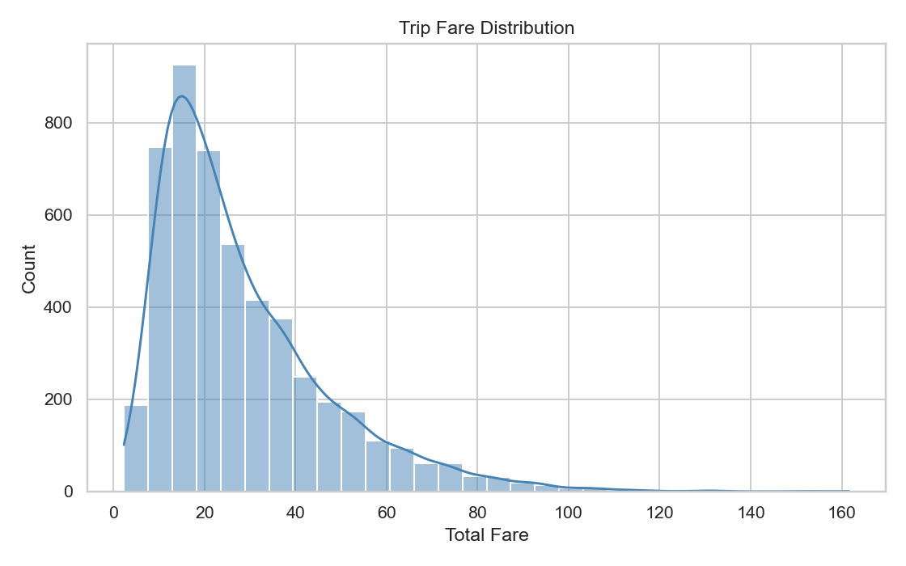
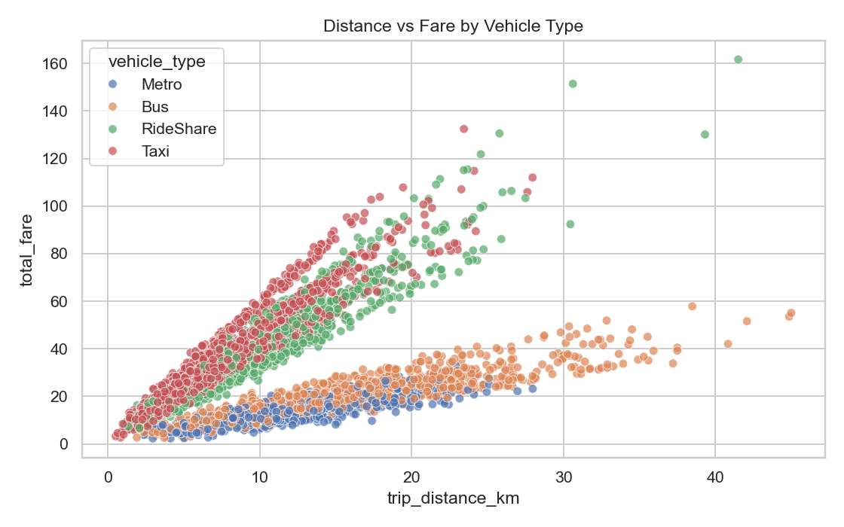
Visual Insights — Fare & Distance
Transport Analysis · DEPI AI & Data Science
27 / 33

Slide 28
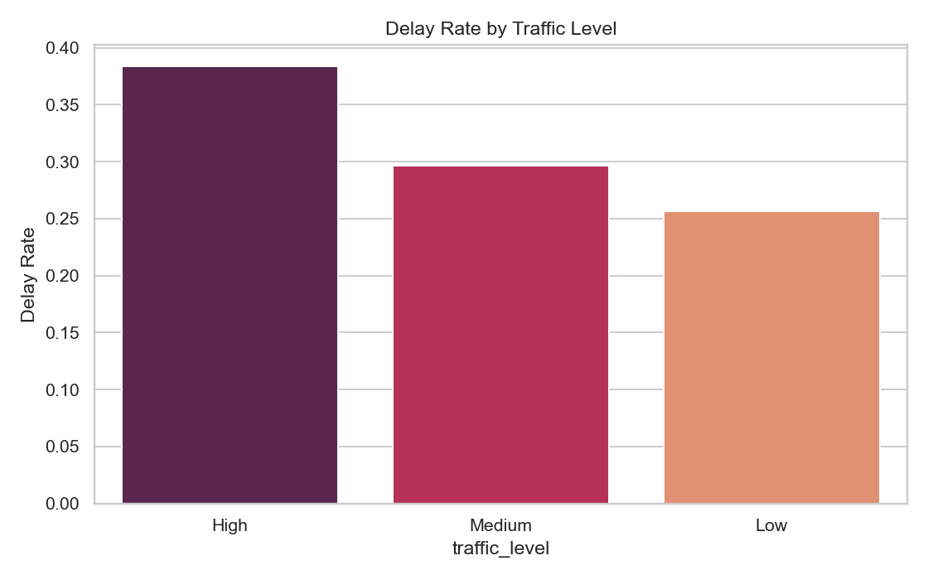
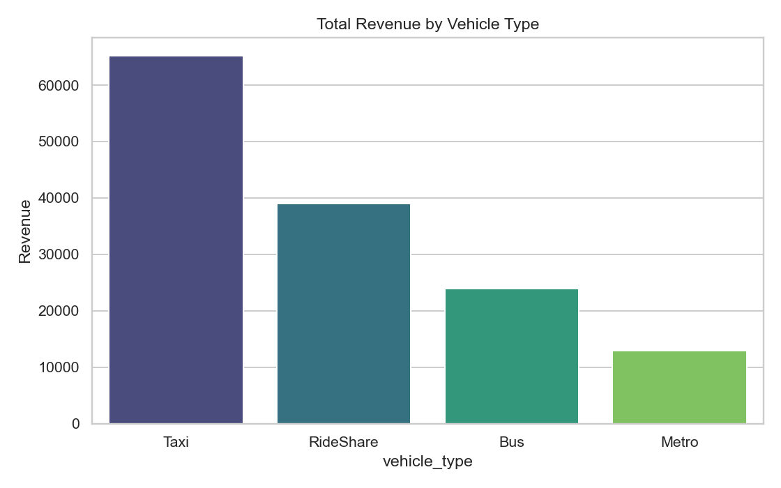
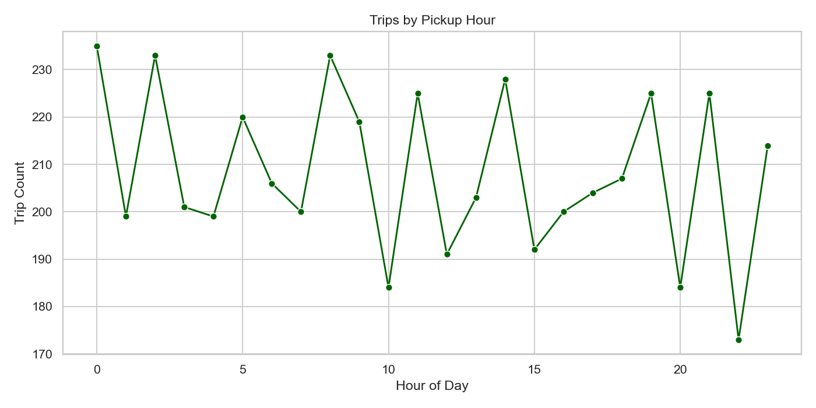
Visual Insights — Delays & Revenue
Transport Analysis · DEPI AI & Data Science
28 / 33

Slide 29
PART 6
Dashboard & Demo
Interactive exploration for stakeholders
Transport Analysis · DEPI AI & Data Science
29 / 33

Slide 30
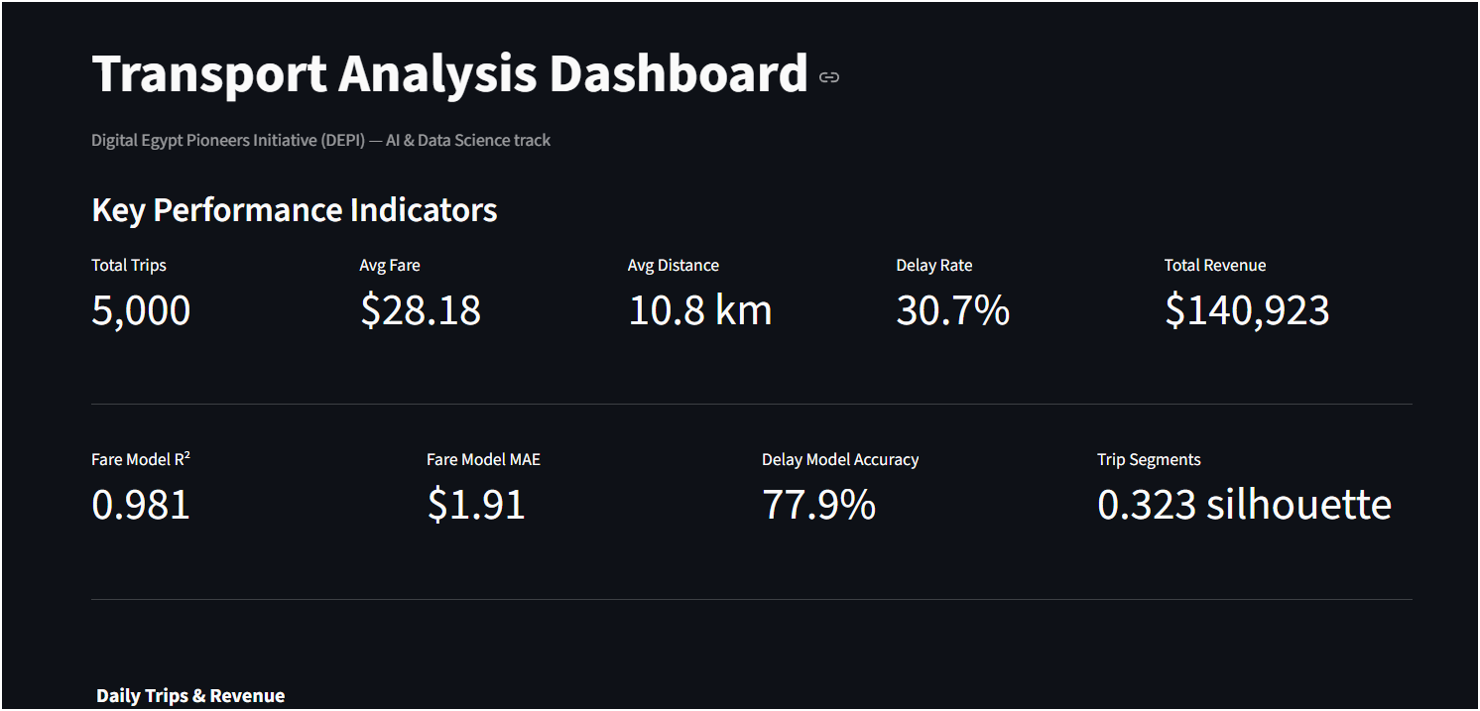
Streamlit Interactive Dashboard
• KPIs: trips, fare, distance, delay, revenue
• ML metric cards from model_metrics.json
• Sidebar filters update all charts live
• Plotly dual-axis & scatter charts
• Sortable trip records table
• Run: py -m streamlit run dashboard.py
• URL: http://localhost:8501
Transport Analysis · DEPI AI & Data Science
30 / 33

Slide 31
How to Run the Project
Offline Pipeline
Interactive Website
py -m pip install -r requirements.txt py src/main.py
py -m streamlit run dashboard.py or double-click run_website.bat
Produces Parquet, SQLite, metrics, figures, Markdown report
Opens localhost:8501 Filters · KPIs · Charts · Table
Transport Analysis · DEPI AI & Data Science
31 / 33

Slide 32
Key Insights & Impact
1. Distance and vehicle type strongly drive fare levels
2. Airport / Downtown are premium zones; Taxi leads revenue
3. High traffic and adverse weather raise delay risk — actionable for ops
4. Trip segments separate short urban hops from longer airport routes
5. One reproducible pipeline from raw CSV to dashboard-ready insights
6. Ready for demos, grading, and extension to real operator data
Transport Analysis · DEPI AI & Data Science
32 / 33

Slide 33
Thank You
Questions & Discussion
Ahmed El-Gamal · Youssef Mustafa · Maryam Khaled · Mariam Tarek · Mostafa Fouad · Nada Ahmed
DEPI — AI & Data Science · Transport Analysis Project
Transport Analysis · DEPI AI & Data Science
33 / 33
Notes:
Invite questions. Offer a short live demo of the dashboard if time allows.

